Slide 1

外研版高中英语 选择性必修第四册
Unit 6 Space and beyond
Period 3 Developing ideas and Presenting ideas

Slide 2
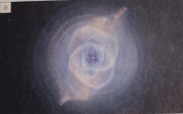
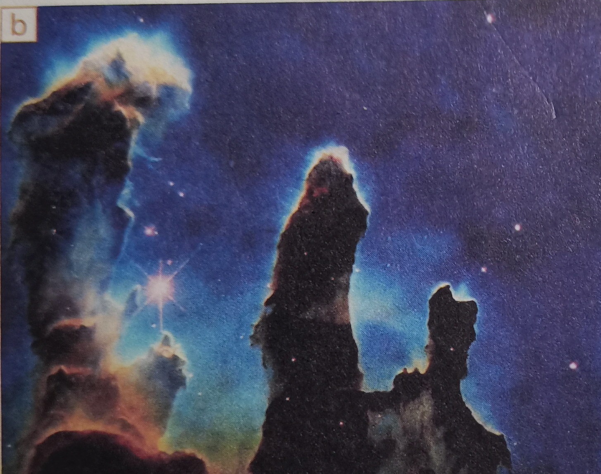
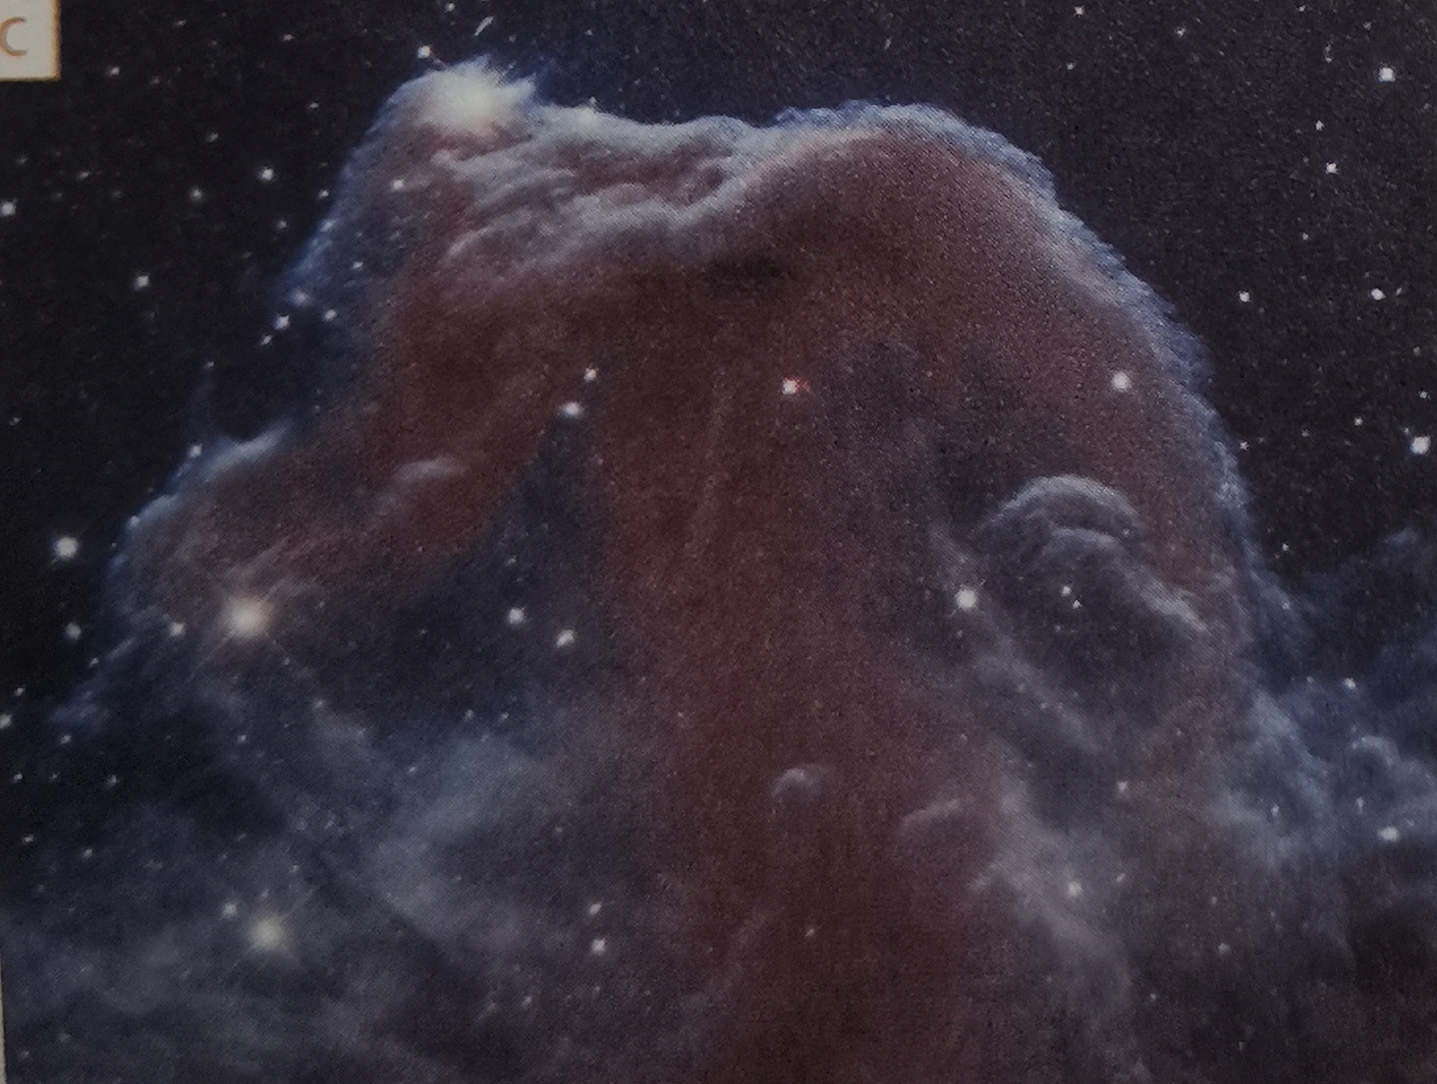


Part 1 Developing ideas: “Eyes Upon the Night”
A → | the Hubble and its nickname | 1 The Pillars of Creation
B → |  | 2 The Horse-head
C → |  | 3 The Cat’s Eye
3
1
2
Pre-reading: Know more about the Hubble Space Telescope

Slide 3
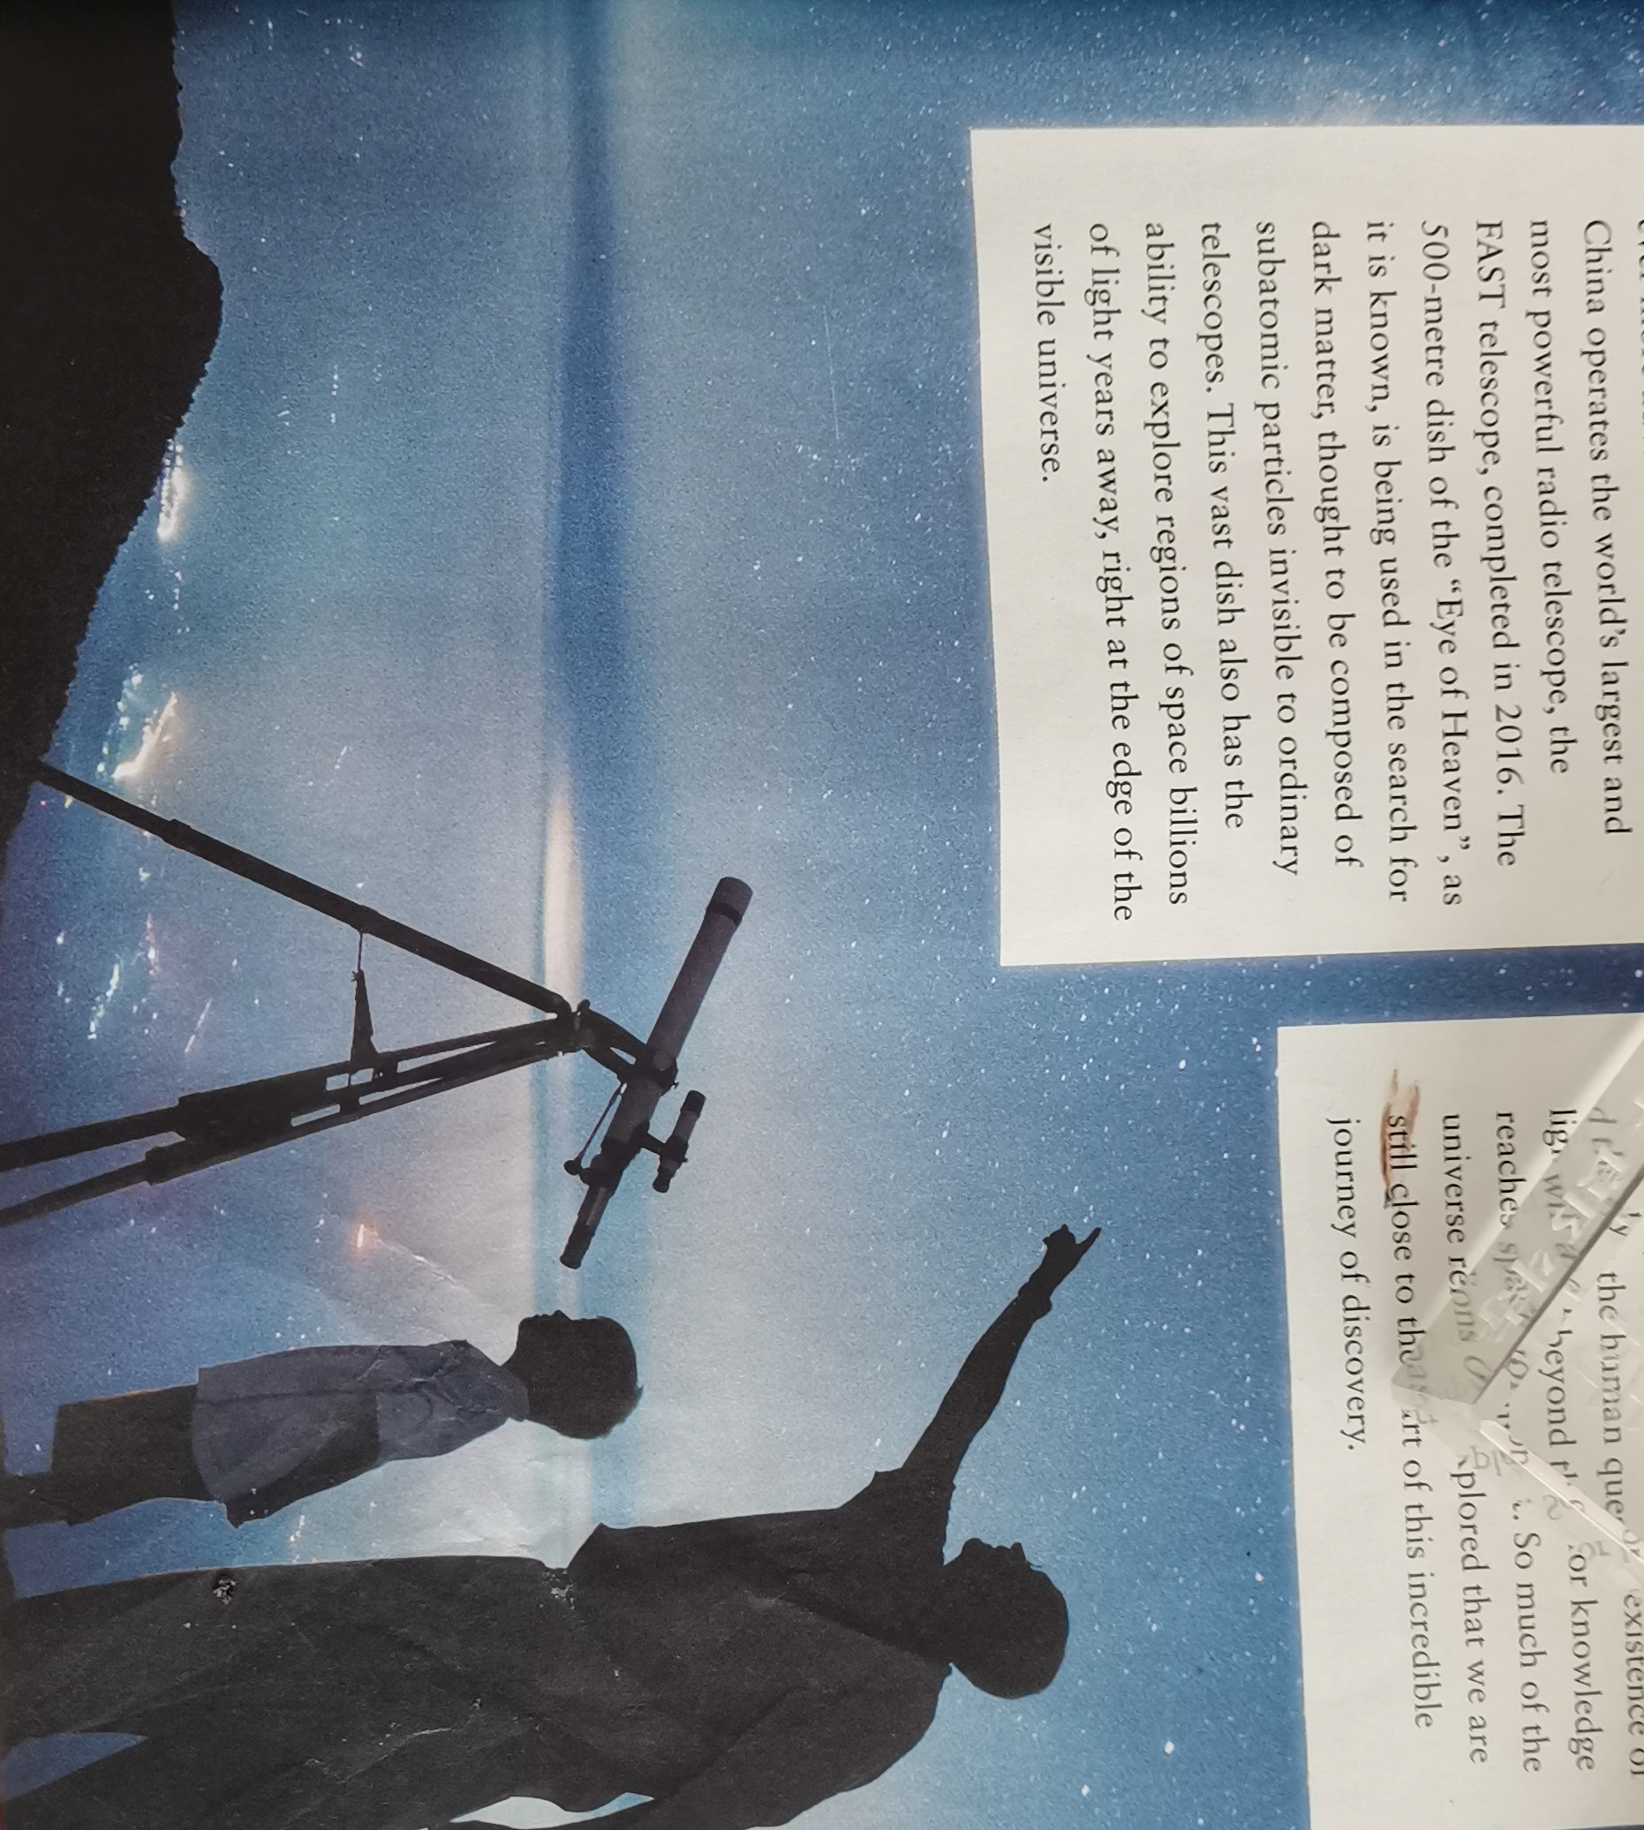
Reading: “Eyes Upon the Night”
Star gazing and curiosity about the space were from the very ancient times of human history.

Slide 4
Reading comprehension 1
1. In ancient China, how did people understand the night sky?
In fact, the people in ancient times were unable to understand what they could see. Not knowing what stars were, people used their imaginations to create a world in the night sky.
2. When did human’s power to see the sky start change dramatically?
When the first telescope was angled at the night sky, it changed dramatically.

Slide 5
3. What did the Hubble Space Telescope help people do when it was launched in 1990?
It allowed people to see much far from the earth and helped work out the age and nature of the universe as well as discover the incredible fact.
4. What do you think eyes in the passage refer to?
“Eyes” in the passage refer to not only the mysterious large-eyed bronze statue of the ancient Shu Kingdom in China, the Hubble Space Telescope and the 500-metre dish of the “Eye of Heaven” built in Guizhou of China, but also stand for the spirit of space exploration.

Slide 6
Reading comprehension 2
The structure and the theme
Parts | Paragraphs | The main idea
Part 1
Part 1
Part 1
Paragraph 1
The way of understanding the night sky in ancient times.
The development of the telescope and the development of the telescope.
Paragraphs 2/3/4
Paragraph 5
There will be a long and incredible journey of space exploration.

Slide 7
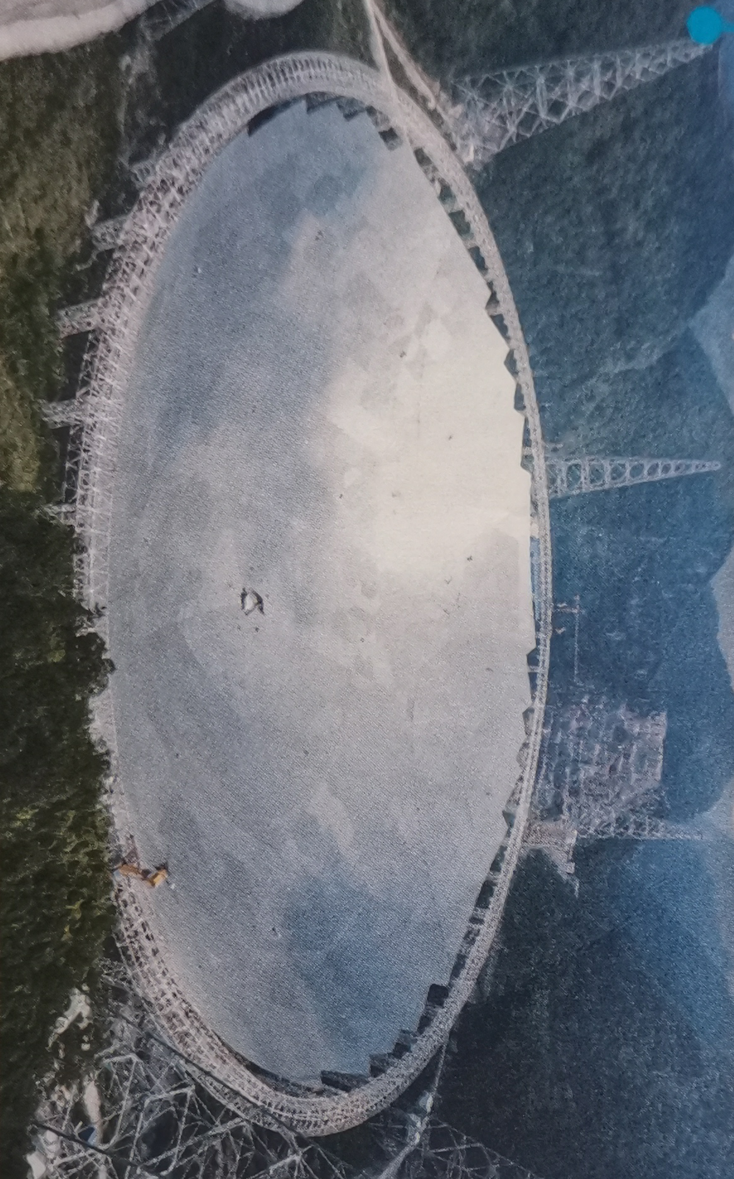
Reading comprehension 3
 | Thousands of years ago, people already regarded the night sky as an ¹ ________________________________. It was believed that the huge eyes of the large-eyed bronze statues from the Chinese archaeological site at Sanxindui were able to ² _______________________________________________.
 | Our power to see the sky changed dramatically when ³ ________________________________________________. It extended ⁴ _______________________________________ and caused us to realize that the universe is a far larger place than we ever imagined.
endless source of fascination
look across great distances into the stars
the first telescope was angled at the night sky
the power of the human eye

Slide 8
 | In 1900, the Hubble Space Telescope was launched into orbit. For the first time, people could 5. ________________________________________________________________. These ranged from 6 _______________________________________________and even to new planets.
 | In 2016, 7. _________________________ was built in China. It is used in the search for dark matter, which cannot be observed by ordinary telescopes. It____________________ has the ability to make discoveries beyond our imaginations.
see breathtakingly beautiful images of our universe taken from beyond Earth
enormous clouds of gas to huge block holes
the FAST telescope
vast dish

Slide 9
Think & Share
1. Why do you think people have always been interested in the stars?
The reasons vary from person to person. As for me, I wonder whether other life exists there.

Slide 10
Think & Share
2. Which development in astronomy mentioned in the passage has made the greatest impression on you?
The FAST telescope called “Eye of Heaven” leaves me the greatest impression.

Slide 11
Think & Share
3. In what different ways do the two reading passage in this unit reflect the spirit of exploration?
The first passage is mainly about the Challenger disaster. Although it was a tragedy, people did not stop exploring space. This shows that people will always seek to explore space, even if some lose their life in ding so.
.....
(Please refer to next page)

Slide 12
Think & Share
The second passage is about the development of the telescope, and how it reflects the desire to explore the unknown. Unlike the exploration conducted by astronauts of the Challenger such as those in the Challenger, the exploration in the second passage was conducted by people located on Earth, at no personal risk.
Nevertheless, the knowledge gained from telescope is immense. The two passages show that there are different ways of exploring universe and of gaining knowledge.

Slide 13
Give a talk about the quote
The more we know, the more we feel our ignorance; the more we feel how much remains unknown. (Humphry Davy)
Point of view
Argument
Supporting examples:
I can not agree with the saying more.
Take reading for example. The more you read good books, the more shallow you will feel, and the less when you realize that you know too little, you will actively do more reading. On the contrary, those who have read fewer books often think that they know a lot, but they do not realize that the ocean of knowledge is endless. As the saying goes, “My life is limited while knowledge is infinite.”

Slide 14
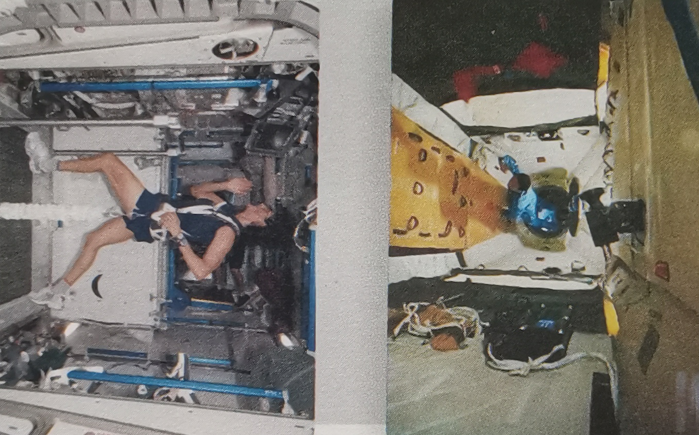
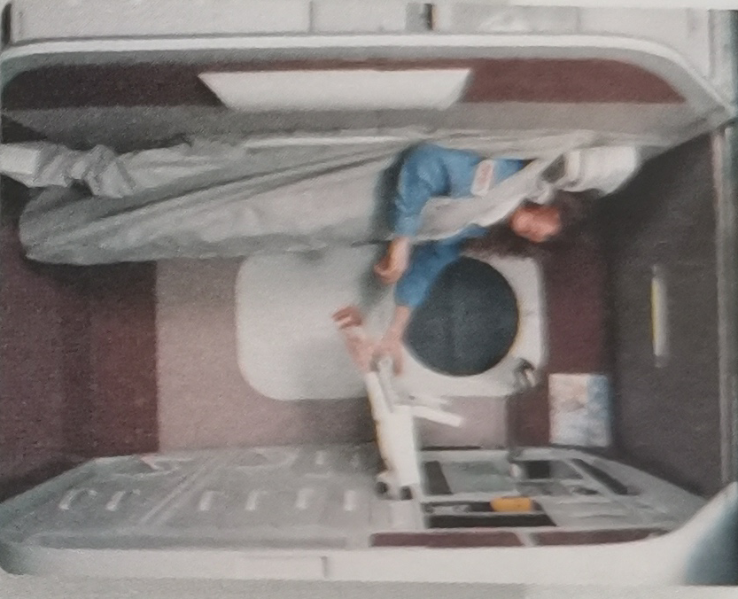
Part 2 Writing a journal entry about living in space

Slide 15
The outline of the writing
1 | What astronauts need to do in a spacecraft:
2 | What are provided for astronauts to help them keep fit:
being strapped to sleeping compartments; doing housework;
keeping themselves clean;
exercising on a regular basis;
providing proper food for astronauts

Slide 16
Read and answer
Read the passage on Page 71 and answer the questions.
① What is the main reason why everyday tasks are less simple in space?
Everyday tasks are less simple mainly because of the zero gravity in space.
② Why is it important for astronauts to exercise regularly?
It’s important for astronauts to exercise regularly because with no gravity to push against, astronauts’ bones and muscles can become weak in space. Exercising regularly can help them stay fit.

Slide 17
③ What else do you know about life on a spacecraft?
For example, eating in the spacecraft needs special skills and eating tools.

Slide 18
The writing help
1 | What you did on the spaceship：
2 | How you felt:
3 | What you enjoyed most/ least:

Slide 19
Writing My journal entry about living in space
Sunday 12 April
I was lucky enough to be chosen as a visitor to the space station! After an exciting blast into orbit, I couldn’t wait to look through the space station windows into deep space! You can imagine my disappointment when I didn’t see many stars. The astronauts laughed and explained to me that we were still in the sunlight, so of course we couldn’t see much, because the light was too bright.
(Please refer to next page)

Slide 20
My journal entry about living in space
Shortly after, we passed into Earth’s window, and I looked out of the window to see the most amazing number of stars! I felt very excited! This is the most unforgettable experience on the station. Soon after that, it was time for dinner. The thing I noticed most was not the zero gravity measures for eating, but the fact that the food didn’t have much taste. And my nose felt blocked. It turns out these things are related, because in zero gravity, your face swells up more. After that, it was time to get strapped into bed. It was a bit hard to sleep in zero gravity--my arms kept floating away, and I woke up to see them right in front of my face, instead of lying on the bed like they would on Earth. (Please refer to next page)

Slide 21
My journal entry about living in space
Despite even simple things being harder to do, I really enjoyed being in zero gravity, and I loved being able to float around instead of having to walk. It’s a pity my stay on the station was so short. It would have been great to stay longer and learn more about life in space!

Slide 22
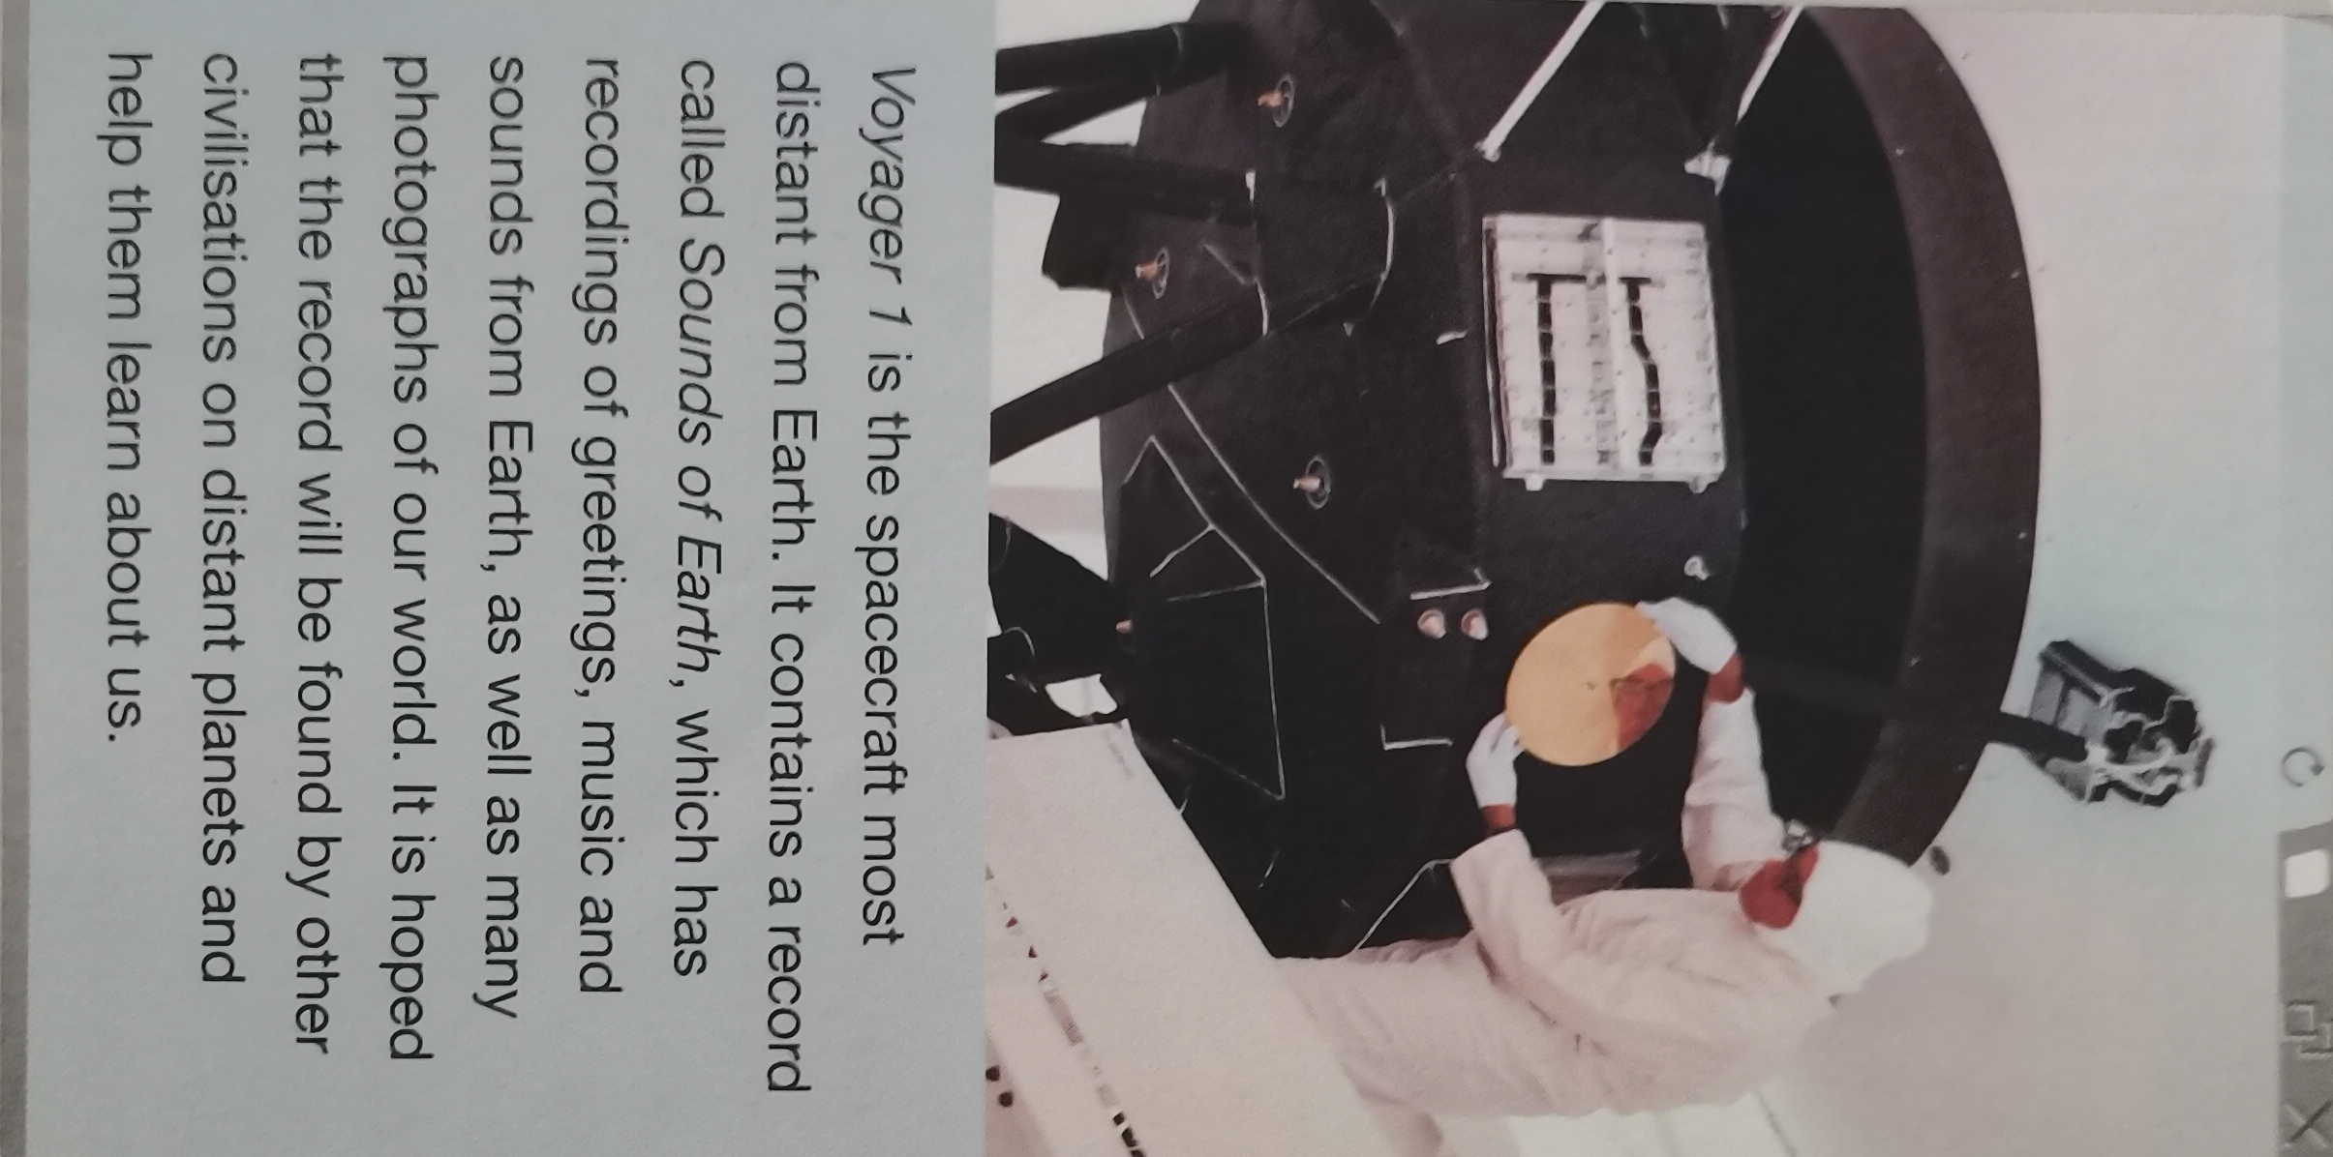
Part 3 Presenting ideas
1. Read the news report and find out what the Voyager 1 spacecraft took into space.
Voyager 1 spacecraft took a record called Sounds of Earth, which has recordings of greetings, music and sounds from Earth, as well as many photographs of our world.

Slide 23
Three things would be put on a disc to be set up on the next flight mission.
1. A video which shows the civilization from the earth;
2. Chinese classical music;
3. Some information about how to reduce the pollution of Earth

Slide 24
Language points
1 look across | 8 at the edge of...
2 in reality | 9 look back to...
3 work out | 10 the power to do sth
4 at an ever-increasing speed | 11 make the impression on sb
5 be engaged in ... | 12 on board
6 in search for ... | 13 out- of- reach
7 be composed of ... | 14 on a regular basis

Slide 25
Language appreciation
1. ... increasing as it did the power of the human eye and enabling us to understand that the universe is far larger than was previously imaginable.
[句式分析] as it did the power of the human eye是由as引导的状语从句，其中助动词did代替实意动词 “increased” ; 比较连词than连接的状语从句省略了主语the universe,其完全形式为 “the universe was previously imaginable” .
[尝试翻译] 它增加了人类眼睛的力量, 并且使我们能够理解宇宙比以前想象的要大得多。

Slide 26
Language appreciation
2. The 500-meter dish of the “Eye of Heaven”, as it is known, is being used in the search for dark matter, thought to be composed of subatomic particles invisible to ordinary telescopes.
[句式分析] “as it is known” as引导的状语从句, 意为“随着它被人们了解”;“thought to be composed of subatomic particles invisible to ordinary telescopes.”为过去分词短语着后置定语，其完整形式为 “which is thought to be composed of subatomic particles invisible to ordinary telescopes. “invisible to ordinary telescope” 为形容词短语作定语修饰名词 subatomic particles.
[尝试翻译] 人们逐渐了解，直径天500米的圆盘望远镜被用于寻找暗物质，人们认为暗物质是由普通望远镜无法观测到的亚原子粒子组成。

Slide 27
Assignments for this period
1. Review new words, phrases and useful expressions learned in this period.
2. Think back about how to write a journal entry about living in space.
3. Polish your writing in class.

Slide 28
感谢您的观看

