Slide 1

外研版高中英语 选择性必修第四册
Unit 6 Space and beyond
Period 1 Starting out & Understanding ideas

Slide 2


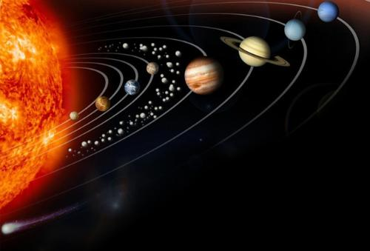
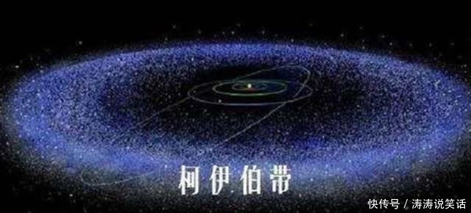
Starting out
the Kuiper Belt
the Asteroid Belt

Slide 3
About the solar sysytem
1. How was the Sun formed?
First, enough gas and dust pulled together to make a disc where formed. Then, building pressure heated up the center of the disc to one million degrees, and a nuclear reaction began, which formed the Sun.
2. Where are the Asteroid Belt and the Kuiper Belt in the solar system?
The Asteroid Belt lies between Mars and Jupiter. The Kuiper Belt exists just beyond the orbit of Neptune.

Slide 4
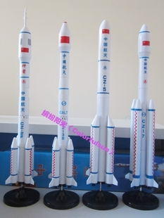
China’s space development and achievements
1 | 15th September 2016: China launched its second space lab, Tiangong-2, into orbit. It is a key element of the nation’s plan for a permanent space station.
2 | 2nd December 2013: China launched its third unmanned lunar probe, Chang’e 3, which made a soft landing on the Moon and then released a lunar rover.
3 | 15th October 2003: Shenzhou V blasted off from the Jiuquan Satellite Launch Centre, sending China’s first astronaut into space.
4 | 24 April 1970: China launched Dongfanghong 1, becoming the fifth country to send a satellite into orbit.

Slide 5
China’s space development and achievements
1. Which of these spacecraft had a human on board when launched?
Shengzhou V.
2. What are the recent events in China’s space programme?
For example, on July 4, 2021, the Shenzhou-12 crew successfully completed all the scheduled tasks during the exit activity, which lasted about seven hours.

Slide 6
Reading The Call of the Challenger
1. The first satellite was launched by the USSR in _______. A 1945 B 1962 C 1957
2. The first person in space was _______. A Robert Crippen B Yuri Gagarin C Neil Armstrong
3. The person to walk in space was _______. A Alexiei Leonov B William McCool C Yang Liwei
C
B
A

Slide 7
4. The first space station was Salyut Ⅰ, which was launched by __________. A the USA B the USSR C the European Space Agency
5. The first spacecraft to leave the solar system was __________. A Vostok 1 B Discovery C Voyager 1
B
C

Slide 8
Reading comprehension 1
1. When people witnessed the first lunar landing on 20th July 1969, they felt_________. A. Nervous B. Excited C. Sad D. Grateful
2. Why was McAuliffe’s space flight special? ___________. A. She was going to give a speech. B. She was the first civilian to go into space. C. She was a space scientist. D. She was brave enough to go into space.
A
B

Slide 9
Reading comprehension 2
3. What can be inferred from McAuliffe’s space failure according to Paragraph? _______
A. People no longer dare to try space flight. B. Space flight has certain risk. C. People prefer to travel by air. D. No more civilians will go into space.
4. The Challenger’s sacrifice remind us that __________. A. Man will live on the stars. B. Space exploration is too far away from us. C. The lives of astronauts are too important. D. Man will continue to explore space.
B
D

Slide 10
The structure and the main idea of the text
Parts | Paragraphs | The main idea of each part
Part 1
Part 2
Part 3
That the Challenger successfully launched had a positive effect on people.
Paras 1/2
The disaster of the Challenger cast a shadow on space exploration.
Paras 3/4 /5
Para 6
The space program will continue despite the disaster of the Challenger.

Slide 11
Choose the ideas mentions in the text
A. People thought space travel was no longer dangerous. B. Christa would have inspired lots of people if she hadn’t lost her life on board the Challenger. C. People were determined to continue with the space program after the disaster. D. The disaster proved we should use robots to explore space instead of people. E. The shuttle was not reliable and should not have been used.
Suggested answer：___________
A/B/C

Slide 12
The ideas mentions & the evidence
Ever Since Nei Armstrong first set foot on the Moon back on 20 July 1969, people have become accustomed to the notion of space travel.
A. People thought space travel was no longer dangerous.
B. Christa would have inspired lots of people if she hadn’t lost her life on board the Challenger.
.she might have inspired an entirely new generation of astronauts and space scientists.
C. People were determined to continue with the space program after the disaster.
On 29 September 1988, the space shuttle program resumed with the successful launch of Discovery.

Slide 13
Complete the fact file
Space shuttle Challenger disaster
Time: ¹ ______________________ Place: Space Centre in Florida, USA Crew: ² ____________________, including a teacher
3. What was special about the Challenger launch?
28th January 1986
seven astronauts
It’s special because Christa aged 37, an ordinary teacher and mother, was about to become the 1st civilian in space.

Slide 14
Space shuttle Challenger disaste
4. What was the teacher’s mission on board the the Challenger?
She planned to give two 15-minute lessons from orbit the first to demonstrate the controls of the spacecraft and explain how gravity worked, and the 2nd to describe the objectives of the Challenger program.

Slide 15
Space shuttle Challenger disaste
5. What was done in the three years following the disaster?
6. Which shuttle followed the the Challenger, and when was it launched?
Space shuttle flights were suspended for nearly three years while the cause of the disaster was investigated, and some of the shuttle’s components were resigned.
Discovery followed the Challenger, and was launched on 29 September 1988.

Slide 16
Think & Share
1. What were people’s feelings before and after the the Challenger disaster?
Before the disaster people felt optimistic and excited. And after the disaster people felt shocked and terrified.
The evidence is that the world went into shock, most people having assumed that this space flight would be no more dangerous than travelling in an aeroplane. Instantaneously, excitement and optimism tuned into terror and failure. It was the most disastrous space accident ever, and it cast a shadow on people’s hearts.

Slide 17
Think & Share
2. Would you like to go into space? Give your reasons.
In my view, humans are intelligent creatures, and therefore have a natural tendency to explore the unknown. Through the exploration of the universe, we can better understand the universe, understand the evolution of the universe, formation and so on.
The evolution of the whole universe is a complete physical book, which is worth exploring and studying by human beings.

Slide 18
Language appreciation 1
1. Millions watched that first lunar landing on black and white TV sets, their hearts in their mouths, aware of how arduous and hazardous undertaking it was. [句式分析] “aware of how arduous and hazardous undertaking it was”作伴随状语，相当于承接性的并列句：and were aware of how arduous and hazardous undertaking it was. 其中“how arduous and hazardous undertaking it was”为感叹句充当aware of的宾语。
[尝试翻译] 数百万人通过黑白电视观看了第一次月球登陆，他们心惊胆战，意识到这是多么艰巨和危险的任务。

Slide 19
Language appreciation 2
2. The sacrifice of the Challenger calls to us, reminding us that we must continue to reach for the stars, no matter how distant they might seem. [句式分析] 现在分词短语reminding us that...作伴随状语， 其中that引导宾语从句，no matter how引导让步状语从句，其结构为“no matter how + adj+ 主语+谓语+...”。
[尝试翻译] 挑战者号的牺牲召唤着我们，提醒着我们，无论它们看起来多么遥远，我们都必须继续追寻星星

Slide 20
Language appreciation 3
3. But there was never any doubt that manned flights would continue.
[句式分析] there was never any doubt that...意为“毫无疑问......”， that 引导同位语从句。同位语从句,指的是在句中充当名词的同位语，属于名词性从句的范畴，同位语从句用来对其前面的抽象名词进行解释说明。
[尝试翻译] 但载人飞行将继续下去，这一点毫无疑问。

Slide 21
Language points
1 become accustomed to ... | 8 set foot on...
2 be aware of ... | 9 call to sb
3 a sense of excitement | 10 cut...short
4 cast a shadow on ... | 11 make it to...
5 take one’s place | 12 tune in
6 inspire sb. to do sth | 13 rekindle interest in...
7 reach for the stars | 14 one’s heart in one’s mouth

Slide 22
Assignments for this period
1. Review the basic usage of the new words and expressions learned in this period.
2. Read and listen to the text learned in this period again.
3. Writing a 60-word summary of the passage.

Slide 23
感谢您的观看

