Slide 1
Words and phrases

Slide 2
blessing n.
appreciative adj.
worthy adj.
worthy of
mere adj.
gentleness n.
companionship n.
fingertip n.
outline n.
intoxicate v.
pageant n.
the pageant of
probe v.
幸事，幸运
感激的
值得尊敬的；值得赞赏的
值得……的
仅仅，只不过
和蔼，温和
友谊，友好交往
指尖
外形，轮廓
使兴奋，使陶醉
盛大的（露天）演出
（历史事件的）缤纷场景
调查，探究

Slide 3
dawn n.
delight n.
revelation n.
workaday adj.
amid prep.
haunt n.
permanent adj.
descend v.
mighty adj.
strains of
orchestra n.
tactile adj.
黎明，破晓
使人高兴的事
展现，显示
平凡的，平淡的
在……之中
（某人）常去的地方
长久的；永久的
降临；来临
强有力的，雄伟的
音乐的曲调或旋律
（大型的）管弦乐队
触觉的

Slide 4
香味
享受，乐趣
（尤指食物的）一小片，一小块
令人愉快的，讨人喜欢的
文学的
难堪的，尴尬的
perfume n.
relish n.
morsel n.
delightful adj.
literary adj.
embarrassed adj.

Slide 5
Pre-reading

Slide 6
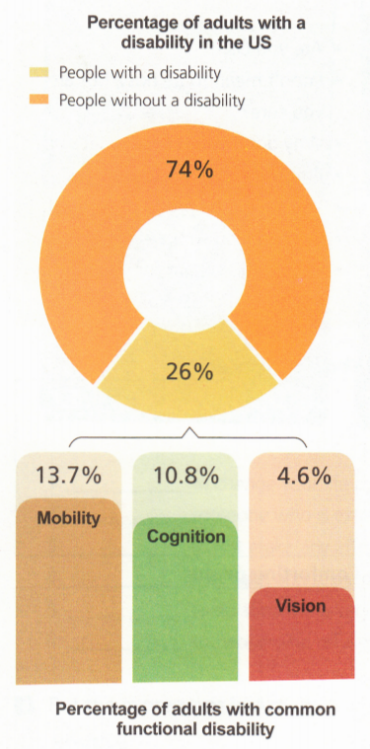
Activity 1 Look at the charts and answer the questions.
1. Are the numbers different
from what you expected?
In what way?
2. What special assistance can
people with disabilities make
use of in their daily lives?

Slide 7
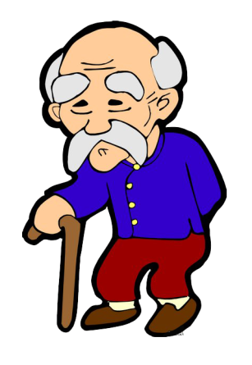


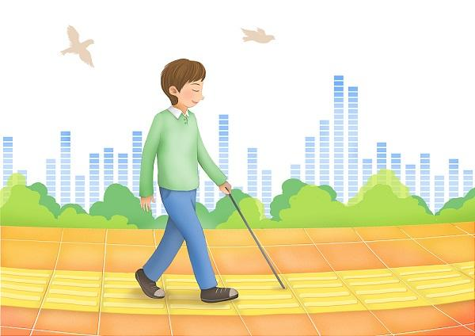

Answer the questions
Special assistance
People with limited mobility problems could use
People who have reduced vision could use
weelchairs,
walking sticks,
handrails…
special
pavements for the blind,
Braille (布莱叶盲文) signs...

Slide 8

Activity 2 Look at the picture and answer the questions
Have you ever read this book?
Who is the writer of this book?
2. What do you know about the author?
Helen Keller

Slide 9
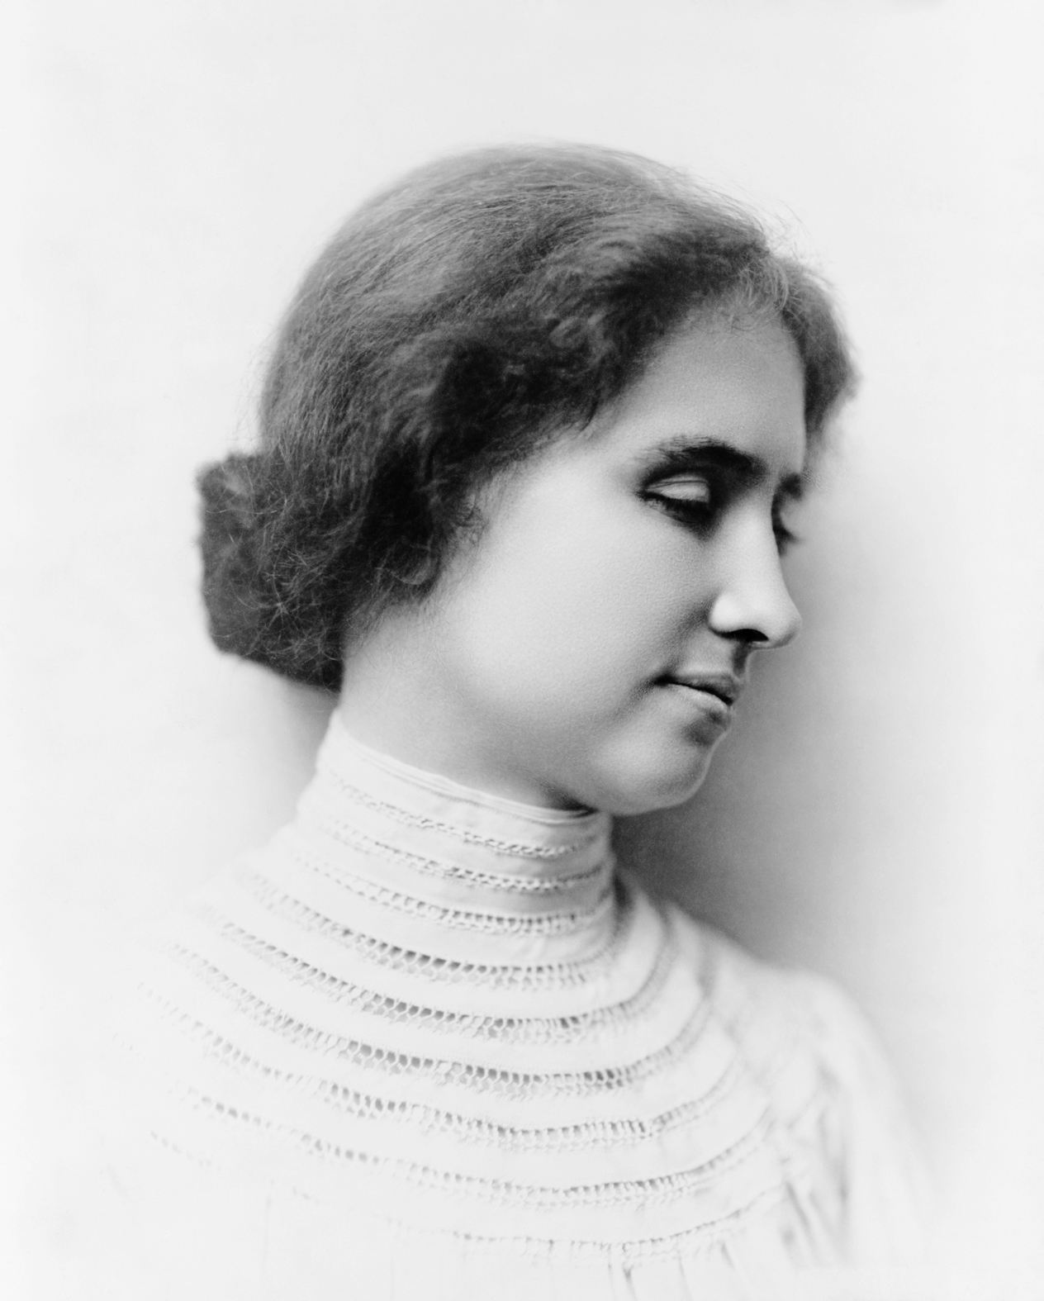
A short introduction to Helen Keller
Helen Keller (1880 –1968) was an American writer, lecturer and social activist. Aged just 19 months old, she became ill and lost both her hearing and sight. With the help of her teacher, Anne Sullivan, she overcame her disabilities and went on to earn a Bachelor of Arts degree.

Slide 10
While-reading

Slide 11
Task 1 Read for the main idea and structure.
Go through the passage quickly to figure out the structure of it.
Part 1 Para (__-__) ________________________________
Part 2 Para (__-__) ________________________________
Part 3 Para (__-__) __________________________________

Slide 12
The structure of the passage
The reason for Helen Keller’s wishes
Part 1
P1-3
Part 2
Helen Keller’s wishes for three days to see
P4-7
Part 3
P8
Helen’s hint for people who can see

Slide 13
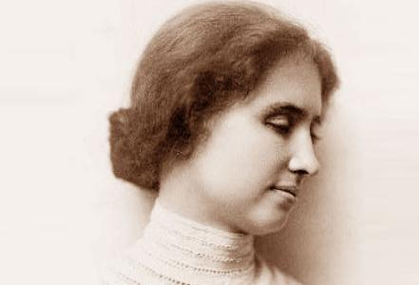
Task 2 Read for details
Activity 1 Read part 1 answer the question.
What motivated Helen Keller to have such wishes?
Part 1
People without disabilities are not appreciative of their sight and hearing.

Slide 14

Activity 2 Read part 2 and finish the tasks
Part 2
P4-7
Read the passage and find out what Helen Keller would do if she could see.

Slide 15
On the first day
people
books
On the second day
museums
theater or movies
On the third day
dawn, new delights and new revelations of beauty
workaday life
nature
Helen’s love of her loved ones
Helen’s love of science
love of life

Slide 16
Answer the questions
How did Helen Keller feel at the end of the three days?
Helen must feel upset/sad/disappointed, thinking it was a pity not to be able to see any more.

Slide 17
Activity 3 Read part 3 and finish Helen’s suggestion to those who can see.
Part 3
P8
By using parallelism, Helen expressed her strong desire for light, the love of life and positive attitude towards life.
Use
as if
(1)_____ your eyes ________tomorrow you would be stricken blind.
⑵__________the music of voices, the song of a bird, the mighty strains of an orchestra, _______you would be stricken deaf tomorrow.
⑶________each object you want to touch _______tomorrow your tactile sense would fail.
⑷_______the perfume of flowers, taste with relish each morsel, _____ tomorrow you could never smell and taste again.
Hear
as if
Touch
as if
Smell
as if
In a word, people should make full use of all the five senses: see, hear, touch, smell, taste.

Slide 18
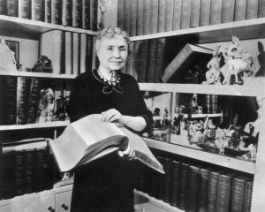
What is the author’s purpose in writing the passage？
A. To help readers understand what it is like to be blind.
B. To make readers without disabilities appreciate what they have.
C. To persuade readers to care about the blind.

Slide 19
Post-reading

Slide 20



Think Share
Read and discuss the meaning of the sentence with your partners and decide whether you agree or disagree with it.
… it would be a blessing if each human being
were stricken blind and deaf for a few days at
some time during his early adult life.

Slide 21

Organize your talk and make notes.
… it would be a blessing if each human being were stricken blind and deaf
for a few days at some time during his early adult life.
Present your talk to the class.
Discussion
Point of view
Arguments
Supporting examples

Slide 22
My opinion
Point of view | I agree with what Helen Keller said.
Arguments | Darkness would make a person more appreciative of sight; silence would teach him the joys of sound.
Supporting examples | Dining in the Dark

Slide 23
Homework

Slide 24

What would you do if you had only three days to see? Make a list of the thing you would do on each day.
To master the key language points in this unit and do relevant exercises.

