Slide 1
Lead in

Slide 2

Activity 1 Answer the question.
As a high school student, we have gone through many failures and successes. What do you often do when you fail, lose heart and give up or just adjust yourself and go on fighting?

Slide 3

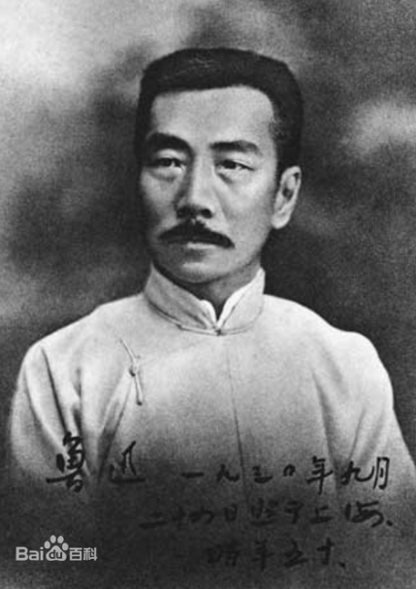
Activity 2 Read the two points of view and explain their meanings in your own words..
If at first you don't succeed, try, try on and on.
VS
J.K.Rowling
If at first you don't succeed, set yourself another goal.
Lu Xun

Slide 4
Think and explore

Slide 5

Activity 1 Decide which opinion you agree with more.
Point of view: _________________________
Arguments:___________________________
Supporting examples: __________________
_____________________________________

Slide 6

Think of arguments to support your point of view and make notes.
Point of view: _____________
Arguments:________________
Supporting examples: _______
__________________________
Point of view: _____________
Arguments:________________
Supporting examples: _______
__________________________

Slide 7
Argumentaion
Tense: simple present tense
Structure: introduction
discussion
conclusion

Slide 8
How to write a good argumentation?
argumentation ≠ quarrel
1. find a detatable point
2. provide the sufficient evidence
3. the logical appeal
4. the emotional appeal
5. essential elements

Slide 9
Useful expressions:
We are for …
There have been many reports of…
My reasons are as follows.
On the contrary
Instead,
In my opinion/view
Personally, I think…
Taking everything into consideration, we…
Only in this way, can we…

Slide 10


Activity 2
Prepare for a debate. Consider the following:
1 the roles and responsibilities for each member of your group
2 your arguments, opening and summary
3 the opposing arguments you might face and how you can respond to them
4 useful words, expressions and structures

Slide 11
Presentation

Slide 12
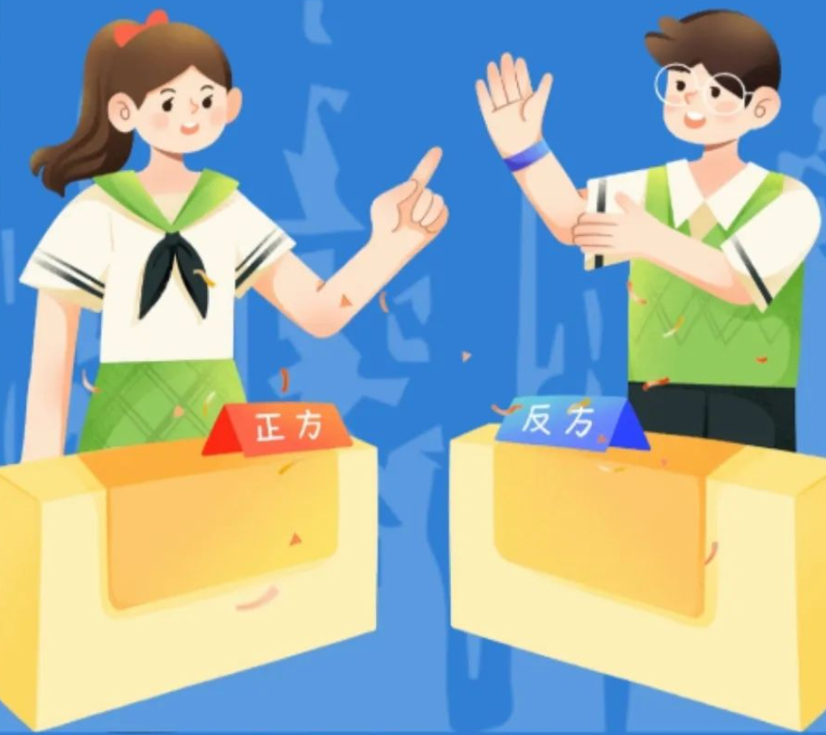
Team up with a group with the opposite
point of view and hold the debate.
 | Evidence (sufficient) | Logical thinking | Presentation skills | Team cooperation | Total score
A
B
C

Slide 13
Reflection

Slide 14
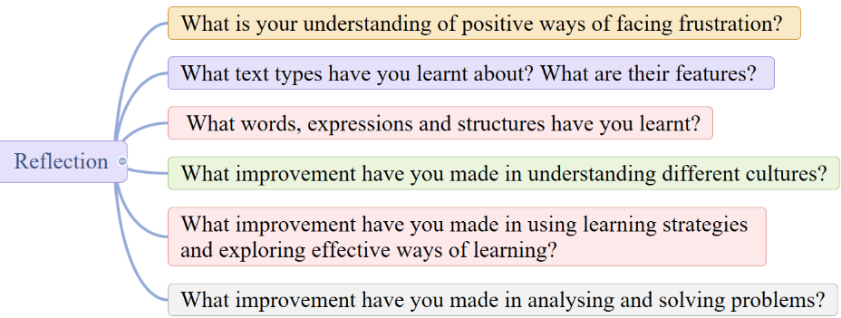
Write a reflection after completing this unit. Consider the following:

Slide 15
Homework

Slide 16

Master the key language points in this unit and write an article about how to face difficulties.

