Slide 1
Lead in

Slide 2
Look at the sentences and answer the questions
a J.D. Salinger started writing short stories in high school, …
b J.D. Salinger started to write short stories in high school, …
c Nevertheless, the sisters didn’t stop trying.
d Nevertheless, the sisters didn’t stop to try.
e These are the words that every writer dreads receiving, …
1 Do sentences (a) and (b) have the same meaning?
2 Do sentences (c) and (d) have the same meaning?
3 Can “receiving” in sentence (e) be changed into “to receive”?
Yes, they do.
No, they don’t.
No, it can’t.

Slide 3
Analyze and Identify

Slide 4
Activity 1: Look for more sentences with -ing and to do infinitive in the reading passage, and summarise their uses in your own words. (Group work)
-ing and to-infinitive as object
动词后接非谓语动词作宾语的情况分为三种：定式
1. 一般接不定式作宾语的词有:
decide, learn want, expect, hope, manage, offer, pretend, plan, choose, promise, refuse, afford, agree ...
2. 一般接动名词作宾语的词有:
consider, suggest, admit, avoid, delay, miss, practise, enjoy, mind, finish, imagine, risk, fancy, appreciate ...

Slide 5
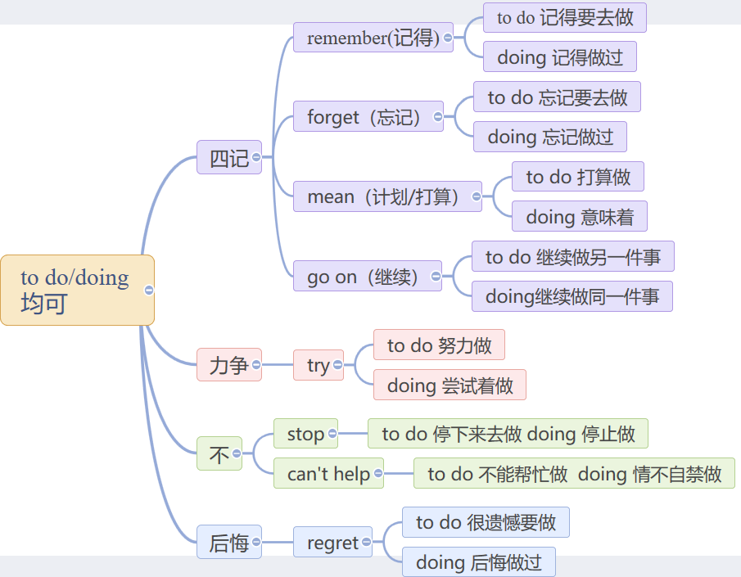
3. 接动名词和不定式皆可:

Slide 6
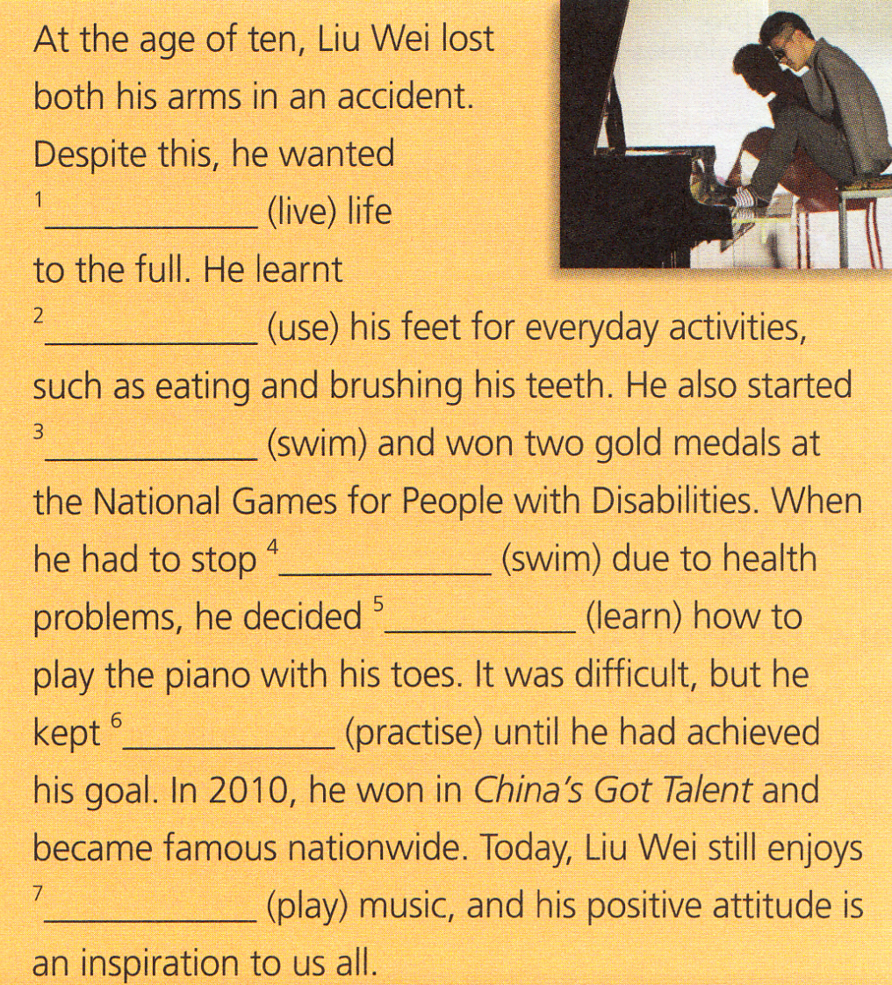
Activity 2：Complete the passage with the correct form of the verbs in brackets.

Slide 7
At the age of ten, Liu Wei lost both his arms in an accident. Despite this, he wanted (1)_______(live) life to the full. He learnt (2)______(use) his feet for everyday activities, such as eating and brushing his teeth. He also started (3)__________________(swim) and won two gold medals at the National Games for People with Disabilities. When he had to stop (4)_________ (swim) due to health problems, he decided (5)_______ (learn) how to play the piano with his toes. It was difficult, but he kept (6)________(practise) until he had achieved his goal. In 2010, he won in China’s Got Talent and became famous nationwide. Today, Liu Wei still enjoys (7)________(play) music, and his positive attitude is an inspiration to us all.
to live
to use
to swim/swimming
Swimming
to learn
practising
playing

Slide 8
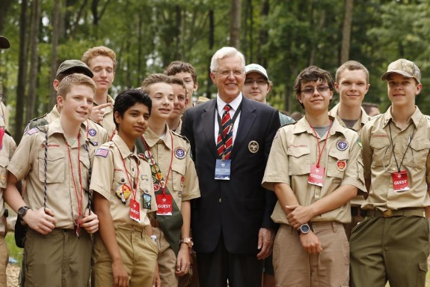
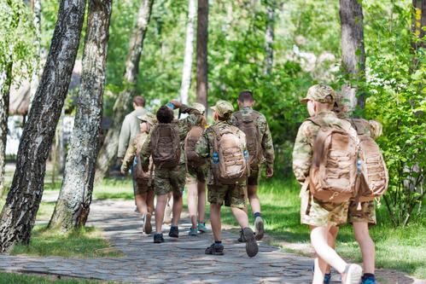
Background Information
The Boy Scouts of America (the BSA) is one of the largest organizations of young people in the United States. Around more than 2.4 million young people take part in BSA activities, and almost one million adults are
volunteers.

Slide 9
Since it was founded in 1910, more than 110 million Americans have been involved in BSA activities. The aim of the BSA is to train young people in responsible citizenship, character development, and self-reliance. This is done through taking part in a wide range of outdoor activities and educational programs. Career-oriented programs in partnership with community organizations are also available for older age levels.

Slide 10
Activity 3: Write a report based on the interview with the words in the box.
admit decide enjoy fail regret want
Sure. I joined the sports camp because I like to challenge myself. I also like to meet new friends. The camp was fun, but not without its challenges! Each day began with a 5-kilometer cross-country run—at 6 am! At first I couldn’t finish the whole route. On the fourth day, I was so tired that I even didn’t want to get out of bed. I felt homesick and almost phoned my dad to take me home. But I didn’t give up. Things soon got better. I felt I had become stronger and more confident and had made new friends. Even though being a camper has its challenges, I feel it is worthwhile.
Many students choose to take a camping programme during the summer holiday, aiming at building character and developing physical fitness. Today, we’re with camper Jamie Wells. Hi, Jamie. Could you share your experience with us?

Slide 11
Jamie Wells decided to join the Boy Scouts because he enjoyed challenging himself as well as meeting new friends. He thought scout camp was fun, but not without its challenges! Each day began with a 5-kilometer cross-country run at 6 am! At first he failed to finish the whole route. On the fourth day, he was so tired that he even didn’t want to get out of bed. Feeling homesick, he regretted attending the scout camp and wanted to phone his dad to take him home. But he didn’t give up. He became stronger and more confident and made new friends. He admitted being a scout had its challenges, but it was worthwhile.

Slide 12
Listening

Slide 13
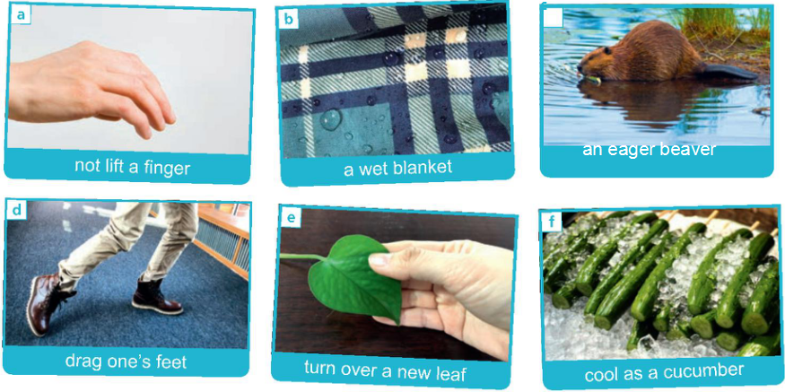
Task 1 Listen to the first text
Activity 1：Listen to the conversations and match the expressions to their meanings.

Slide 14

a. not lift a finger
b. a wet blanket
c. an eager beaver
d. drag one's feet
e. turn over a new leaf
f. cool as a cucumber
e
1.______ to change your life by starting to be a better person or stopping a bad habit
2. ______ someone who is extremely enthusiastic and enjoys working extremely hard
3. ______ to not make any effort
4. ______ very calm and relaxed, especially in a difficult situation
5. ______to do something very slowly because you do not really want to do it
6. ______ someone who refuses to join in, or wants to stop other people having fun
c
a
f
d
b

Slide 15
Activity 2: Put the expressions in Activity 1 into the boxes. Add any more you can think of.
Positive | Negative
an eager beaver
turn over a new leaf
cool as a cucumber
like a duck to water
not lift a finger
a wet blanket
drag one’s feet
a fish out of water

Slide 16
Task 2 Listen to the second text
Activity 1 Lead in Read the passage and answer the questions.
With life being made up of ups and downs, it is not always easy to maintain a good and enthusiastic attitude. Nevertheless, looking on the bright side is the best thing that we can do for ourselves as well as for others. A good attitude can have a positive effect on other people. So if someone you know is feeling low, lend them an ear and try to cheer them up. Remember, your attitude is contagious, so make sure you pass on a good one!
1. Why is it important to “look on the bright side” ?
2. How can our attitude affect others?

Slide 17
Answer the questions
1. Why is it important to “look on the bright side” ?
Because looking on the bright side is a type of good attitude, which can have a positive effect on other people. In this way, looking on the bright side is the best thing that we can do for ourselves as well as for others.

Slide 18
Answer the questions
2. How can our attitude affect others?
Our attitude is likely to spread to and affect others. If we have a good attitude, others will also feel it and be cheered up by it.

Slide 19

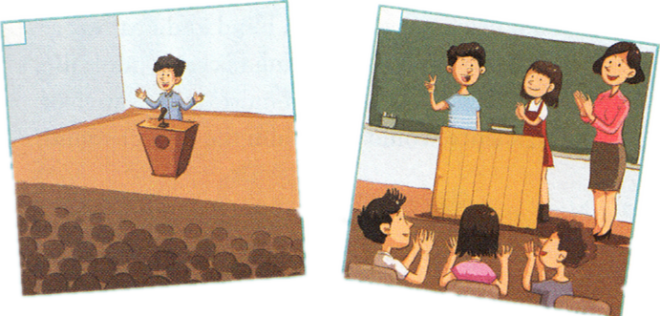
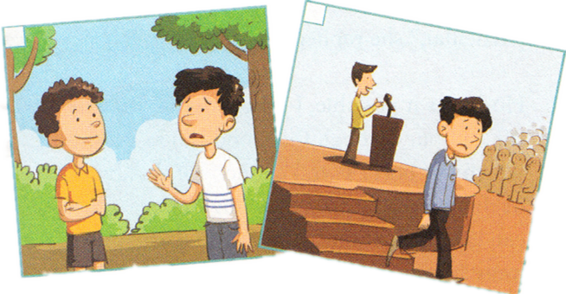
Activity 2 Listen to the conversation and number the pictures according to the sequence of events.
1
3
2
4

Slide 20
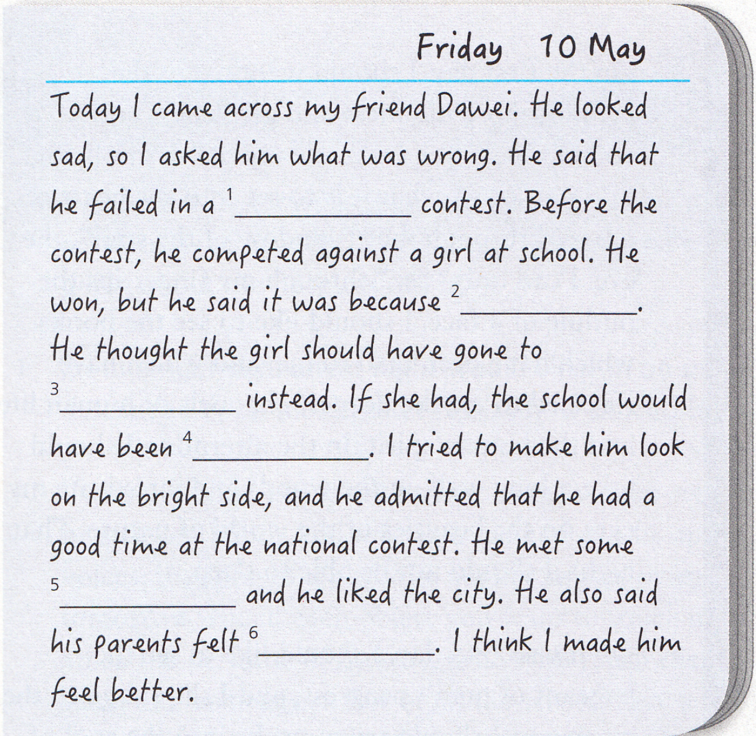
Activity 3 Listen again and complete the journal entry.

Slide 21
Friday 10 May
Today I came across my friend Dawei. He looked sad, so I asked him what was wrong. He said that he failed in a (1) _________________ contest. Before the contest, he competed against a girl at school. He won, but he said it was because (2)__________. He thought the girl should have gone to (3)_________________ instead. If she had, the school would have been (4)_________. I tried to make him look on the bright side, and he admitted that he had a good time at the national contest. He met some (5)_____________ and he liked the city. He also said his parents felt (6)___________. I think I made him feel better.
national English speaking
he was lucky
the national competition
well-known
fantastic people
proud of him

Slide 22
Activity 4 Complete the boxes with the expressions from the conversation.
• Are you OK?
• I don’t mean to be nosy, but are you sure?
• Why don’t you tell me what’s up?
• I’m sure you did your best.
• You should be proud of yourself.
• Why are you so upset?
• I know this is hard for you, but you should cheer up.
Showing concern | Comforting people

Slide 23
Showing concern | Comforting people
I’m sure you did your best.
You should be proud of yourself.
I know this is hard for you, but you should cheer up.
Are you OK?
I don’t mean to be nosy, but are you sure?
Why don’t you tell me what’s up?
Why are you so upset?

Slide 24
Group discussion

Slide 25

Pair work
Choose one situation and act out a conversation to show concern for people and comfort them. Use the expressions in this section.
Situation 1:
You ran for Head of the Student Committee but weren’t elected.
Situation 2:
You feel annoyed because a group member doesn’t want to contribute to your group’s work.

Slide 26
Homework

Slide 27

Summarize the usage of ing and to-infinitive as object and do the relevant exercises.
Memorize the key expressions about looking on the bright side

