Slide 1
B4U1
Using language
Vocabulary & Listening

Slide 2
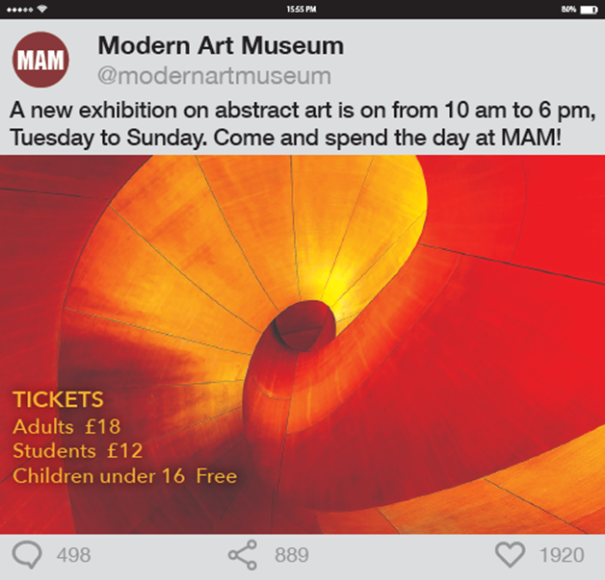
Art exhibitions
Activity 5
Exhibition 1
Read the comments and answer the questions.
What is the exhibition about?
What artworks might you see in it?

Slide 3
Art exhibitions
Activity 6
Match the compound adjectives in Activity 5 to their meanings. Think of other words and expressions with the same meanings.
1 ____________: extremely impressive so as to take one’s breath away
2 ____________: known by a lot of people
3 ____________: making you feel great respect and admiration, and sometimes fear
4 ____________: very good at doing something
5 _______________: innovative, using new methods or achieving new results
6 _____________: very expensive
breathtaking
well-known
awe-inspiring
highly-skilled
ground-breaking
over-priced

Slide 4
Compound adjectives
Activity 6
Think of more compound adjectives.
1. n. + n.-ed 娃娃脸的
2. adj. + n.-ed
有礼貌的 心胸狭窄的
心不在焉的 过时的
近视的
3. 数字 + n.-ed
独脚的
五个边的
baby-faced
good-mannered
narrow-minded
absent-minded
old-fashioned
short-sighted
one-legged
five-sided

Slide 5
Compound adjectives
Activity 6
peace-loving
4. n. + v.-ing 爱好和平的
5. adj. + v.-ing
美貌的
6. adv. + v.-ing 影响深远的
7. n. + past participle
伤心的 手工的
8. adv. + past participle
直言的 守规矩的
good-looking
far-reaching
heart-broken
hand-made
out-spoken
well-behaved

Slide 6
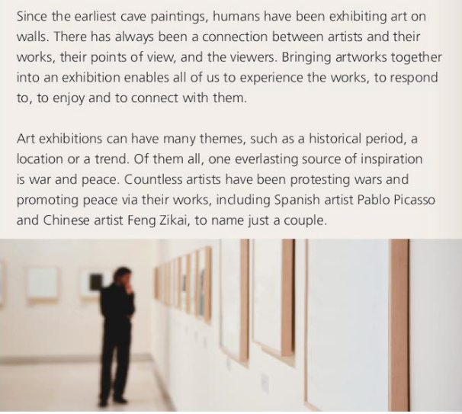
Art exhibitions
Activity 7
Exhibition 2
Theme? Artists?

Slide 7
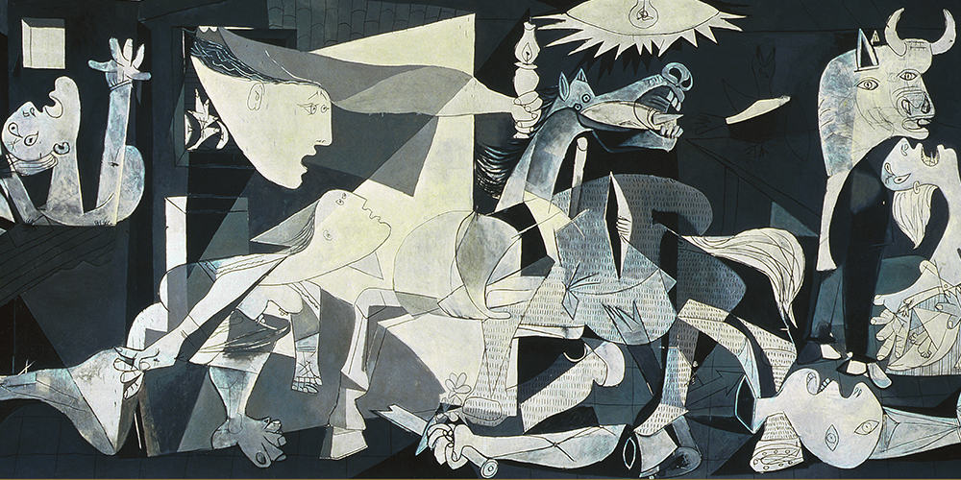
What can you see? How do you interpret the painting?

Slide 8
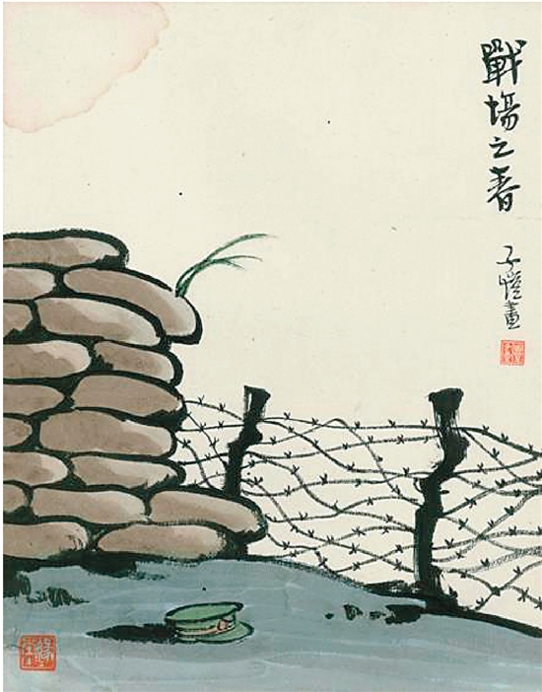
What can you see?
How do you interpret the painting?

Slide 9

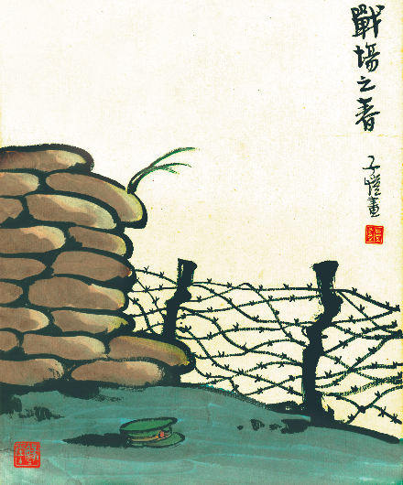
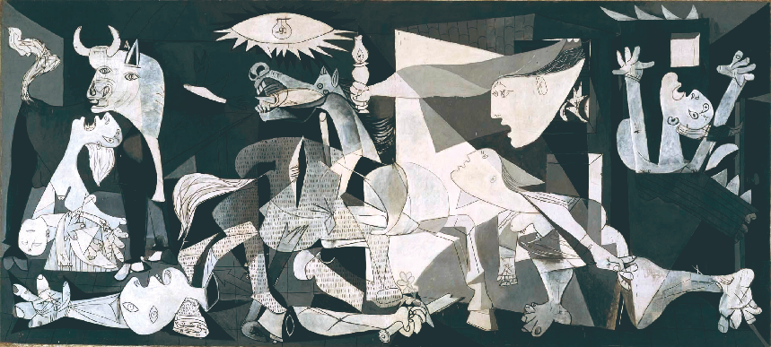
Art exhibitions
Activity 8
Listen to the audio guide and find out the main message of each artwork.
The Battlefield in Spring
Guernica

Slide 10
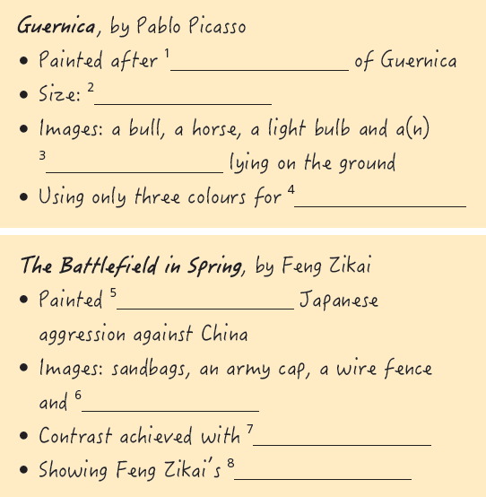
Art exhibitions
Activity 9
Listen again and complete the notes.

Slide 11
Art exhibitions
Activity 9
Listen again and complete the notes.
Guernica, by Pablo Picasso
• Painted after ¹ _____________________ of Guernica
• Size: ² ___________________________________________
• Images: a bull, a horse, a light bulb and a(n) ³ ________________
______ lying on the ground
• Using only three colours for ⁴ ___________________
the attack on the town
3.5 metres in height and almost 8 metres in width
dead or wounded
man
a more powerful effect

Slide 12
Art exhibitions
Activity 9
Listen again and complete the notes.
The Battlefield in Spring, by Feng Zikai
• Painted ⁵ ____________ Japanese aggression against China
• Images: sandbags, an army cap, a wire fence and ⁶ ____________
______
• Contrast achieved with ⁷ _________________________________
• Showing Feng Zikai’ ⁸ _____________________________
_______________________
in protest of
some grass
leaves
the lifeless objects and the grass leaves
encouragement to the Chinese people as
well as his hope for peace

Slide 13
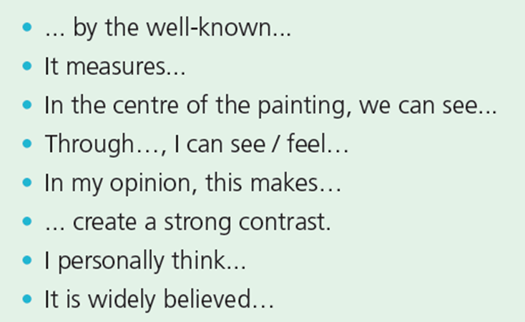
Art exhibitions
Activity 10
Complete the table with the expressions from the audio guide.
About an artwork
Basic information | What you see | How you feel

Slide 14
Art exhibitions
Activity 9
Now work in pairs. Discuss which artwork makes the greater impression on you and why.

Slide 15


Slide 16
Words and expressions
exhibiting
There are many well-known artists __________ (exhibition) their awe-inspiring works.
敬畏；惊叹
掉落的树叶
值得参观
巨大的；压倒性的
表达态度
艺术装置；安装
长久不衰的
反对战争，维护和平
只列举一二
侵略
awe
be/stand in awe of sb/sth 对...敬畏
fallen leaves
be worth visiting
overwhelming
voice/state one’s attitude
installation
ever-lasting
protest wars and promote peace
to name just a couple/few
aggression

Slide 17
Check out the ground-breaking installations.
Check out the ground-breaking installations.
(1) (informal) to look at or examine a person or thing that seems interesting or attractive
察看，观察（有趣或有吸引力的人或事物）
Check out the prices at our new store!
看一看我们新商店的价格吧！
Hey, check out that car!
嘿，看看那辆车！

Slide 18
check out
We’ll have to check him out before we employ him.
我们得先调查一下再雇用他。
(2) to find out if sth. is correct, or if sb is acceptable
调查；查证；核实
Guests should check out of their rooms by noon.
客人必须在中午以前办理退房手续。
(3) to pay your bill and leave a hotel, etc.
结账离开（旅馆等）

