Slide 1
新标准《英语》高中选择性必修第一册
Unit 5 Revealing nature
Developing ideas

Slide 2
Content
organise
information
understand
globally
homework
know
personification
think
&
share

Slide 3
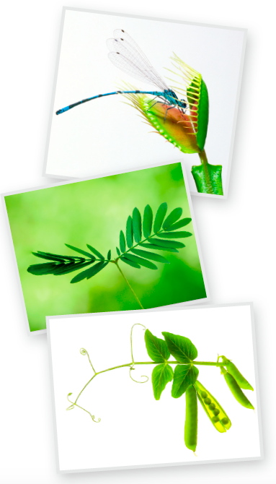
Activity 1
Look at the pictures and tick what plants can do.
attack
breathe
eat
sleep
move
speak
steal
think
√
√
√
√
√

Slide 4

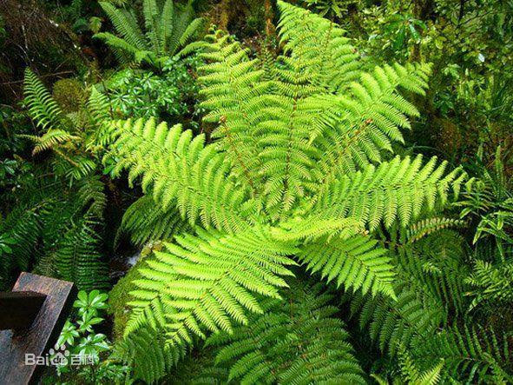
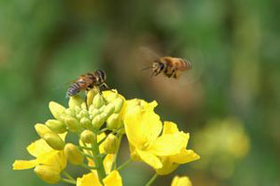
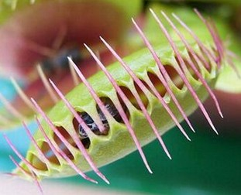
Plants can communicate with each other ?
Can they hear each other?
Can they touch each other?
Can they see each other?
.
.
.

Slide 5
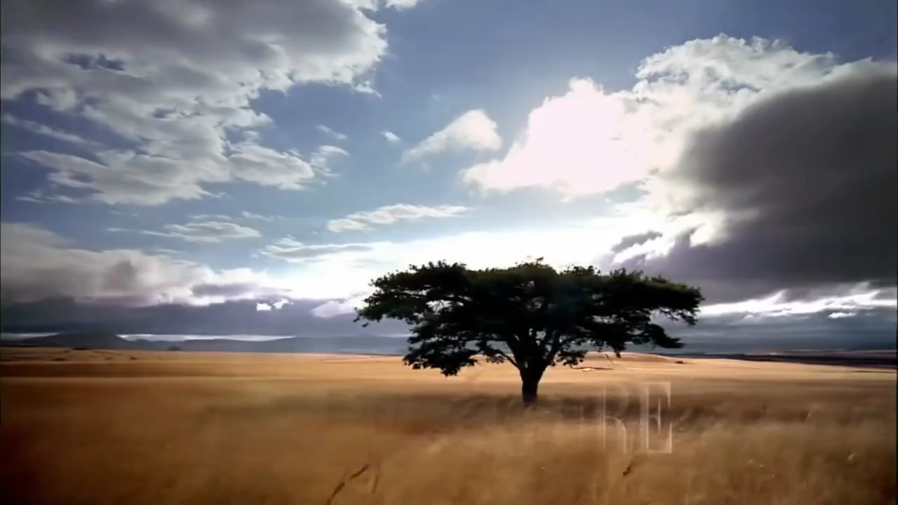
The Secret Language of Plants

Slide 6


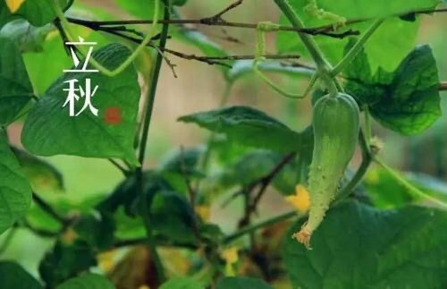

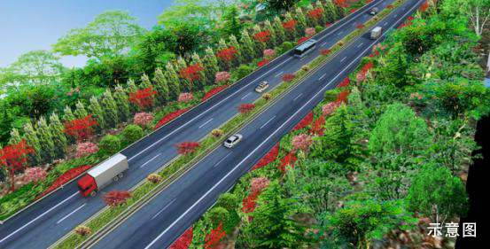
Discussion
Now talk about what else you think the plants can do
and give examples.
make medicine
reduce noise
protect
environment
predict the solar terms

Slide 7
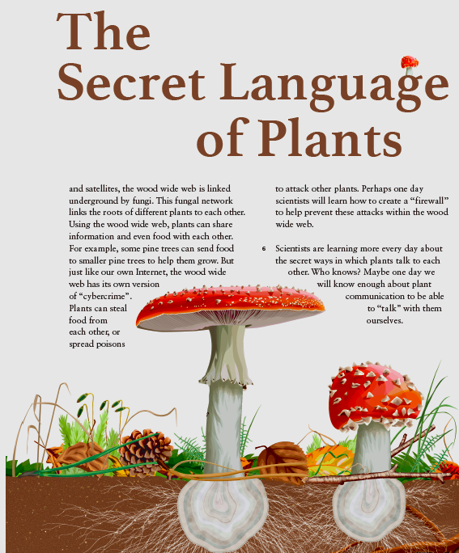
Activity 2
Read the passage and find out the
ways in which plants communicate.
1.
They may communicate with each other by using chemicals, sound and “wood wide web”.
what's “wood wide web”
“wood wide web” refers to an amazing system of communication that can link nearly every plant in a forest.

Slide 8
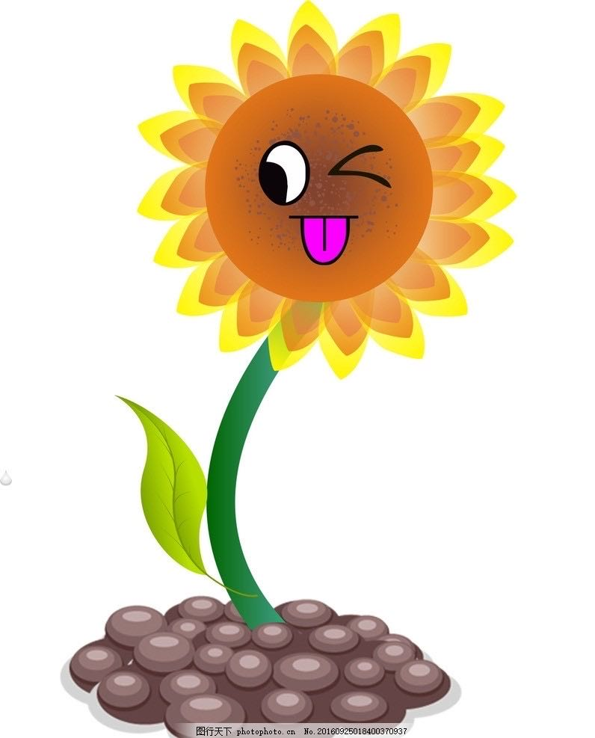
2.Choose the right answer
1.What do trees often do in stories in many cultures?
A.Giving warnings. B.Telling jokes.
C.Dancing. D.Singing.
2.How does a bean plant act first when attacked by insects?
A.To run away.
B.To release chemicals.
C.To call for help.
D.To drive insects away.
3.What’s the function of the roots of corn plants?
A.To communicate.
B.To listen to other plants.
C.To indicate drought.
D.All of the above.

Slide 9

2.Choose the right answer
4.What’s the most surprising thing for plants?
A.They can use the Internet.
B.They have their own satellite.
C.They can walk near to their friends.
D.They can link nearly every plant in a forest.
5.What does the last paragraph mean?
A.The plants can own their world in the future.
B.The plants will do harm to human.
C.The plants might be talked with one day.
D.The plants may show us the secret of talking.

Slide 10
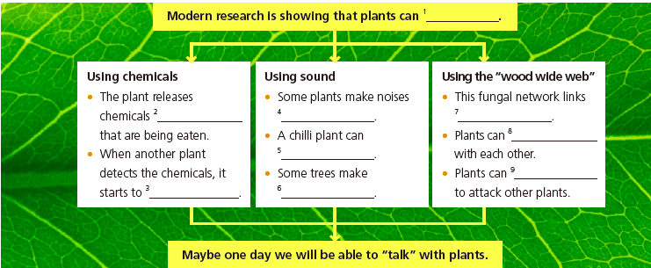
Activity 3
Complete the diagram.
communicate
with each other
from the leaves
with their roots
the roots of different plants to each other
share information
and even food
tell if a neighbouring plant
is helpful, or unfriendly
steal food from each other, or spread poisons
release its own,
different chemicals
clicking noises when there is
not enough water, indicating drought is arriving.

Slide 11

Maybe oneday we will be able to“talk”with plants !

Slide 12
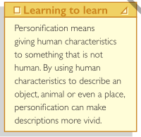

Think & Share
1 What figure of speech is being used when the plants are described as calling for help? What is its function?
Personification. It can make descriptions more vivid.
2 What does “wood wide web” mean?
“wood wide web” refers to an amazing system of communication that can link nearly every plant in a forest. It is linked underground by fungi and this fungal network links the roots of different plants to each other. Using the wood wide web, plants can share information and even food with each other.

Slide 13

Think & Share
3 What do you think are the benefits of studying plant communication?
It will help us know more about the world of plants and then get a
better understanding of the secret of nature and encourage us to explore more about the mysterious nature. What’s more, it will teach us an important lesson, that is, human should live in harmony with mother nature.
4 What secrets do the two reading passages in this unit reveal and what do they have in common?
Passage 1 reveals the secret of evolution and Passage 2 reveals
the secret of communication between plants. They all reflect that
there are numerous secrets in nature that are waiting to be explored.

Slide 14
Activity 4
Work in groups.
1 Read the passage again and talk about how plants communicate.
2 Think about and discuss the following ways of communication in the
animal world. What other ways can you think of?
• Bees “dance” to signal to other bees that they have found food.
• Ants communicate with each other through touch, chemical signals,
moving their bodies and even using their legs to make sounds.

Slide 15
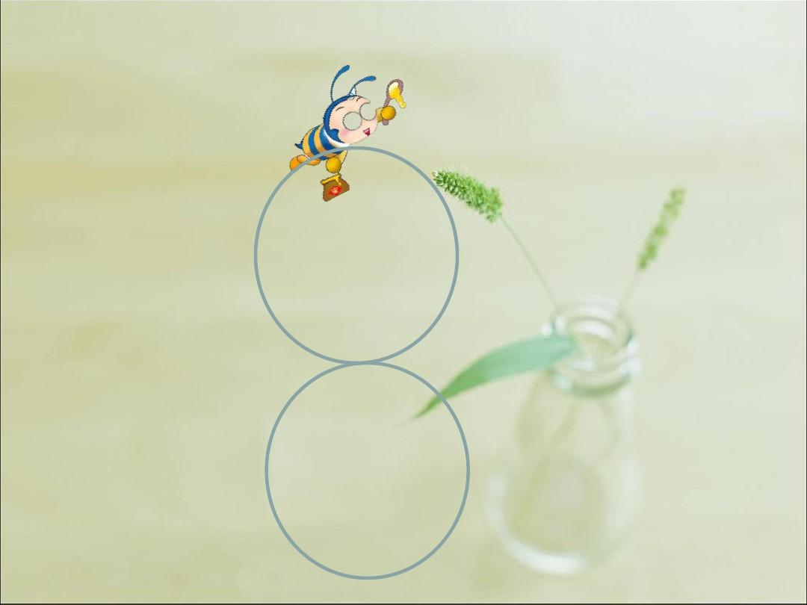
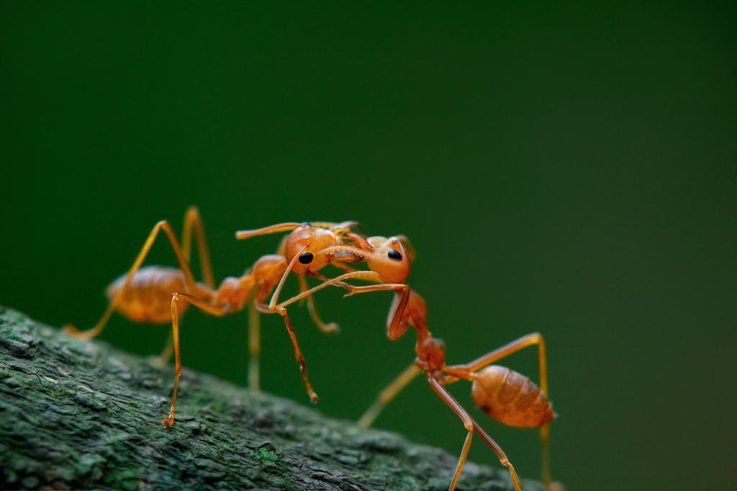
Retell plants communication
personification
1.Talking plants have long been a thing of myths and legends.
2.Many cultures have stories of talking trees that give advice as well as warnings to people.
3.Most surprisingly of all,plants have an amazing system of communication that can link nearly every plant in a forest.
4.This is like a warning, or a call for help: “I’m being attacked!” When another bean plant detects the chemicals from its injured neighbour, it starts to release its own, different chemicals.
5.Some of these chemicals drive insects away. Others attract insects—the wasps!
6.They also “listen” to the noises from other plants. A chilli plant can tell if a neighbouring plant is helpful, or unfriendly.

Slide 16
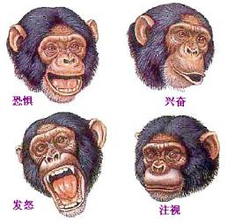
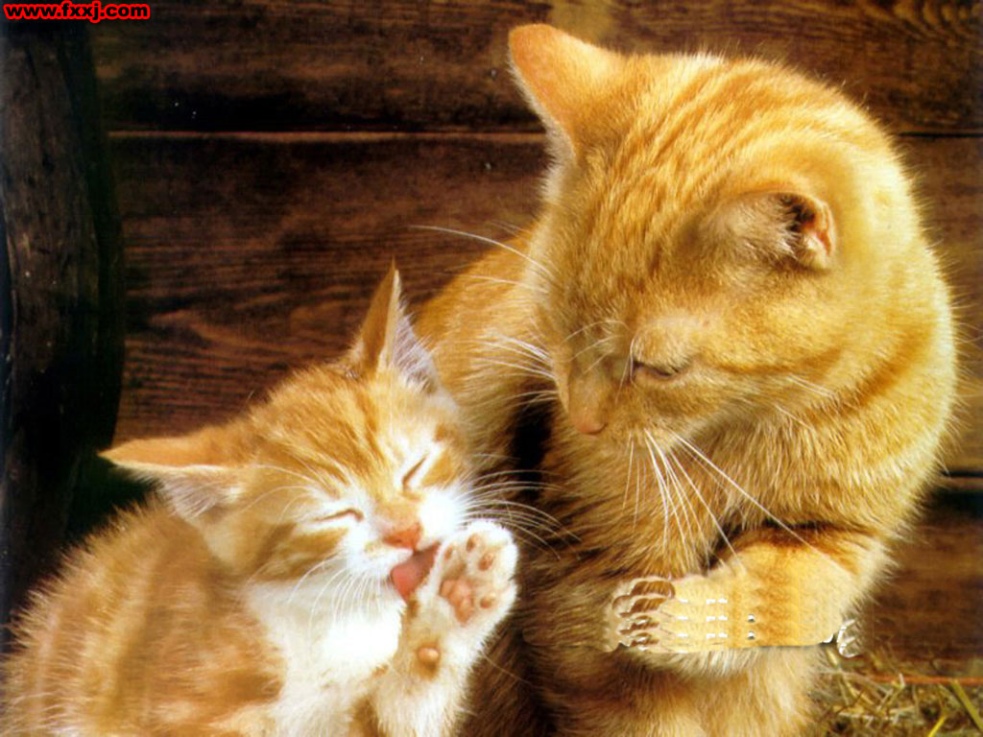
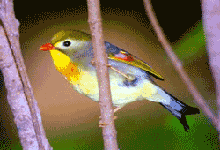
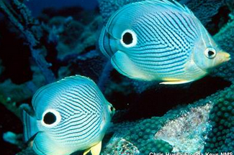
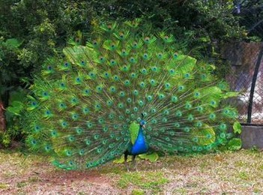
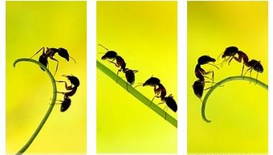
Other ways of animal communication
标题数字等都可以通过点击和重新输入进行更改。文字数字大小颜色等参考此模板
expression
body movement
sound
sound wave
vision
touch

Slide 17
3.Organise your ideas following the steps below.
Step 1 Begin with what living things you have chosen to talk about.
Step 2Explain how they communicate and give examples.
Step4 Give a talk to
the class about
communication
between living
things.
Step3Concludesth by explaining what we
have learnt from
their behaviour.

Slide 18
Homework
Write down your ideas in the notebook.
Work in pairs to help each other to make improvements.
Collect and organise more information about the description of living things.

Slide 19
Thank
for
watching
you

