Slide 1
新标准《英语》高中选择性必修第一册
Unit 5 Revealing nature
Starting out &
Understanding ideas

Slide 2
Content
reading
for
details
starting
out
homework
reading
for
theme
think
&
share
延迟符

Slide 3
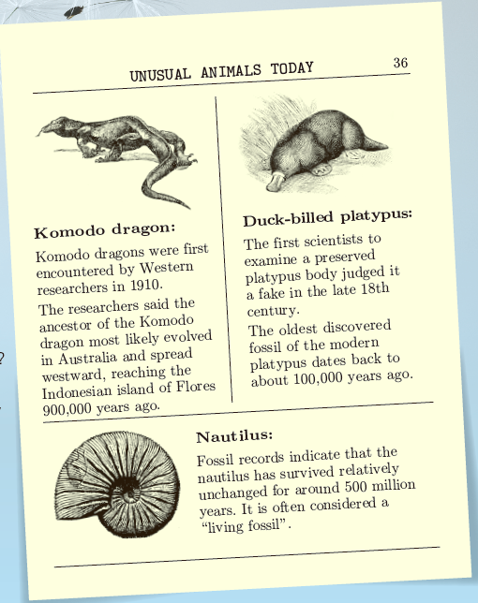
Activity 1
Look at the page from a science magazine
and answer the questions.
1. What do you know about these animals?
What makes them special?
Komodo dragon: It evolved in Australia and
spread westward …
Duck-billed platypus: The oldest discovered fossil
of it dates back to about 100,000 years ago …
Nautilus: It often considered “living fossils” …
They are all species that exit thousands of years
on earth; They are old and rare (unusual).
2. What other similar animals do you know
about? Share your knowledge with the class.

Slide 4
Activity 2
Watch the video and answer the questions.
1. How can seeds travel? How can this benefit plants?
Seeds usually are carried by the wind, water, and animals.
Plants can have a better chance at life.
2. Can you think of another example of seeds travelling? Share it with the class.
• Dandelion seeds have little parachutes to catch the wind and go further;
• Humans can spread seeds if seeds get stuck to their clothing or shoes.

Slide 5
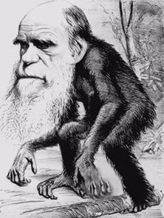
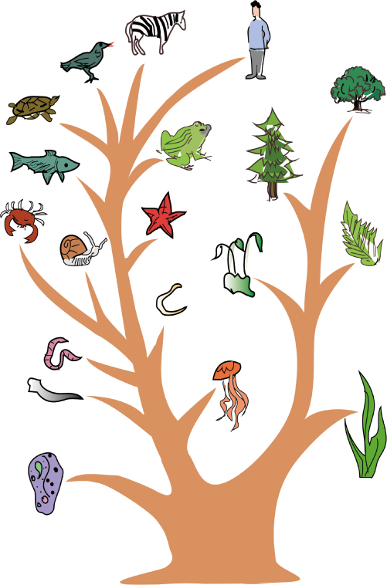
A Journey of Discovery
Activity 1 Look at the evolutionary tree and answer the questions.
higher forms of life
evolve---evolution
lower forms of life
ape
祖先
An evolutionary tree

Slide 6
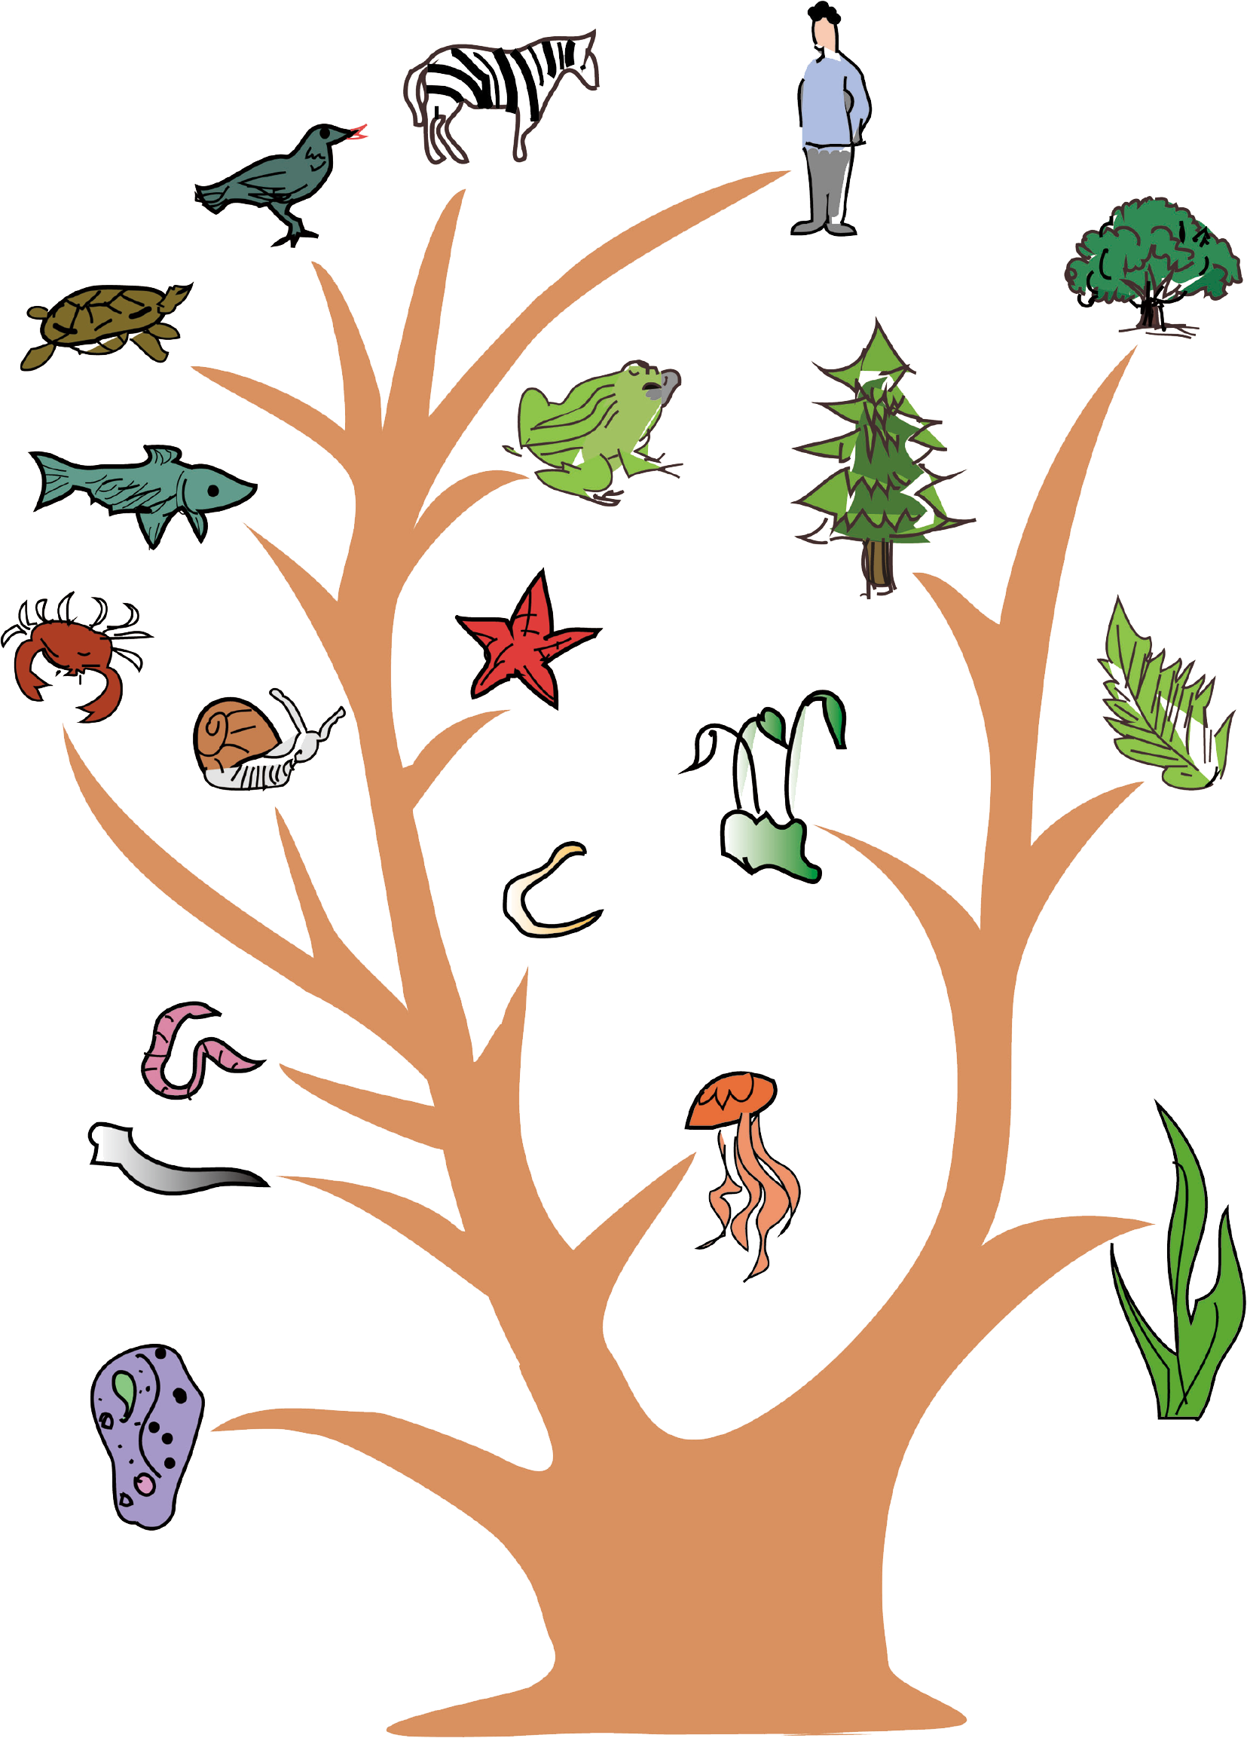
Activity 1 Look at the evolutionary tree and answer the questions.
1 What species do you recognise in the picture?
Paramecium, earthworm, snail, crab, fish, tortoise,
bird, horse, human, frog...; alga, moss, fern, plant...
2 What factors can cause the process of evolution?
The ever-changing environment of nature;
environmental changes; population immigration;
genetic mutation; cultural preferences...

Slide 7
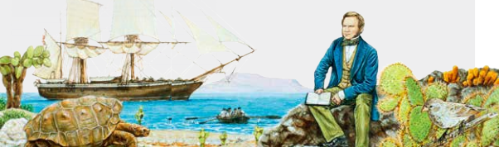

Activity 2
Read the passage and talk about your
understanding of the title.

Slide 8
Activity 2
Read the passage and talk about your
understanding of the title.
Most commonly, people believe that a journey means a trip from one place to another, especially over a long distance and literarily a journey refers to the process by which something gradually changes and develops. The title may indicate that Darwin’s research work leading to his discovery of evolution and the origin of species took quite a long time and
great efforts, determination
and courage to achieve.

Slide 9
Activity 3
Choose the main idea of the passage and give your reasons.
Which one is the best?
A. Darwin’s interest in various living things made him
a great naturalist.
B. Darwin’s journey on the Beagle inspired his Theory of Evolution.
C. Darwin went on a journey to confirm his theory that humans had
evolved over time.
The title of the passage is “a journey of discovery”. So the passage is mainly about how Darwin’s Theory of Evolution generated and developed on his journey on the Beagle.

Slide 10





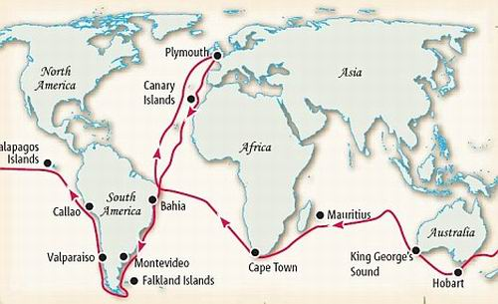
The structure
The text is organized in order of____ .
time
Before
the journey
During
the journey
Para___
Para___
Para 6-7
1
2--5
In 1831
In 1835
England

Slide 11
Read for detailed information
Para 1：Labels on a young man
in captain’s eyes
in common people’s eyes
in his families’ eyes
He was not the captain’s first choice.
He was a young man who had left medical school without completing his degree.
He was a disgrace to himself and all his family
Writing purpose: Set the suspense to attract reader’s interests

Slide 12
Read for detailed information
Charles Darwin was a geologist and naturalist, fascinated by rocks, plants and animals.
Para 2：Start a journey
who
what
collecting samples
asking himself a question
How did different species come to exist?

Slide 13
Read for detailed information
All species had appeared on Earth at the same time, and had not changed since
Para 3：Generate new ideas
old ideas
new ideas
what
how to prove
Animals evolved as they adapted to their changing environments
To look for more evidence

Slide 14
Read for detailed information
Darwin noticed finches’ beaks had evolved according to what food was available on that particular island.
Para 4-5
Develop the ideas
how
answer of that question
New species of plants and animals evolved from earlier ancestors.

Slide 15
Read for detailed information
Para 6-7
Propose a theory
what
how
people's reaction
Influence
A theory of evolution.
Darwin explained this theory in his book, On the Origin of Species.
Many people refused to believe. They were shocked. Later, more and more people started to believe his theory.
On the Origin of Species is regarded as one of the most important works ever written. It has changed ideas about life on Earth forever.

Slide 16
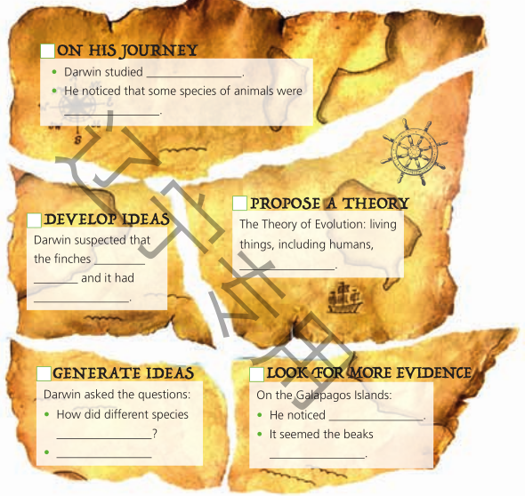
Activity 4 Number the puzzle pieces in order.
Organise information from the passage and complete them.
1 On his journey on the Bealge:
various living things in their natural
environments and samples of the plants and
animals he had collected.
very similar to each other.
2 Generate ideas
• come to exist?
• Maybe animals evolved as they adapted to their
changing environments？
3 Look for more evidence
that there was a difference between the finches on
each of the islands.
had evolved according to what food was available
on that particular island.
4 Develop ideas
had evolved from a common ancestor, which had
arrived on the islands a long time before
slowly evolved into many new species.
5 Propose a theory
• had evolved from lower forms of life.
1
5
4
2
3

Slide 17
Retell the passage according to the clues
started his journey
published the book (proposed a theory)
answered the question(developed an idea)
asked himself a question(generated an idea)

Slide 18
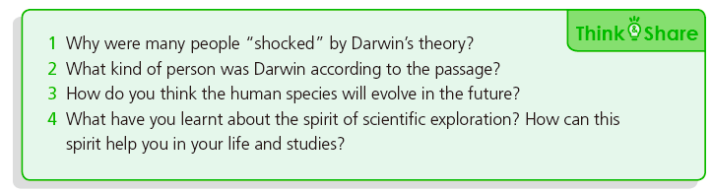
Think & Share
1.At that time, many people believed that all species had appeared on Earth at
the same time and had not changed since, but Darwin’s theory proposed that
living things, including humans, had evolved from lower forms of life, which,
as a result, shocked many people.
2.Darwin was a determined man. He had strong curiosity and interests in
science and was good at thinking and making discoveries.

Slide 19
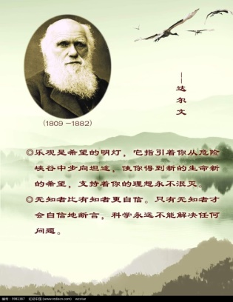
Darwin’s scientific spirit
I can succeed in science, the most important thing is the love of science and insisting on
long- term exploration.
---Charles Robert Darwin

Slide 20
Homework
1. Write a short passage to tell the story of Darwin’s journey
of discovery using your own words (about 100 words)
2. Do further research on why Darwin did not publish
his Theory of Evolution until 1859---about twenty years
after his discovery.
No practice, no gain in one's wit.

Slide 21
Thank
for
watching
you

