Slide 1
新标准《英语》高中选择性必修第一册
Unit 5 Revealing nature
Using language

Slide 2
Content
observing
exercises
homework
the useage
of past
perfect
learning
biodiversity
延迟符

Slide 3
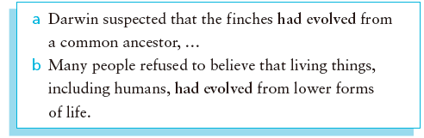
Activity 1 Look at the sentences from the reading passage and
answer the questions.
1. In sentence (a), which action happened first, “suspected” or “evolved
from a common ancestor”?
“evolved from a common ancestor.”
2. In sentence (b), which action happened first, “refused to believe” or
“evolved from lower forms of life”?
“evolved from lower forms of life.”
3. What does the structure had done indicate?
It indicates the action happened before a certain past action.

Slide 4
Using Language
原文再现
Darwin suspected that the finches had evolved from a common ancestor,...
Action A
Action B
happening later
happening first
In this sentence the two actions both hanppened in the past, Action B happened first, Action A happened later. In this situation, past perfect
is used to describe Action B and simple past is used to describe Action A .

Slide 5
Uning language
原文再现
Many people refused to believe that living things, including humans, had evolved from lower forms of life.
happening later
happening first
The past perfect is a verb tense which is used to show that an action took place once or many times before another action / point in the past.

Slide 6
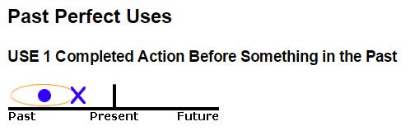
Uning language
past perfect
simple past
The past perfect expresses the idea that something occurred before another action in the past. It can also show that something happened before a specific time in the past.

Slide 7
Now look for more sentences with the past perfect tense in the reading passage, and summarise its use in your own words.
1. It was a young man who had left medical school without completing his degree.
2. ... he had recently received a letter from his father predicting that he would be “a disgrace to yourself and all your family.
3. After Darwin had spent some time in South America, his room on the ship was crowed with samples of the plants and animals he had
collected.
4. At that time, people believed that all species had appeared on Earth at the same time, and had not changed since.
5. It seemed their beaks had evolved according to what food was available on that particular island.
6. Over time, it had slowly evolved into many new species.

Slide 8
Activity 2 Complete the paragraphs with the information from
the given sentences.
1 a Natural disasters led to food shortages in the 1960s.
b Yuan Longping began to do research on hybrid rice.
c Yuan Longping developed a better type of rice.
Yuan Longping 1__________ to do research on hybrid rice because natural
disasters 2_____________ food shortages in the 1960s. In the end, he
3_____________ a better type of rice.
2 a Gregor Mendel chose to study pea plants because their characteristics were
easy to control.
b Gregor Mendel made important discoveries about genetics.
c Gregor Mendel died in 1884.
Gregor Mendel 4_______________ study pea plants because their
characteristics were easy to control. By the time of his death in 1884, he
5____________ important discoveries about genetics.
began
had led to
developed
chose to
had made

Slide 9
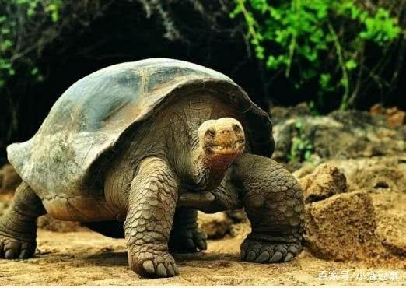
Activity 3 Complete the online encyclopaedia entry with the
correct form of the words in the box.
Lonesome George was the last Pinta Island tortoise. He died in 2012. After George`s death, the Pinta Island tortoise was declared extinct.
The extinction of the Pinta Island tortoise blamed on humans. Before humans 1_________ on the island, the species 2_______________ in isolation and 3_____________ the plants that naturally grew there. George was discovered many years after their arrival, and by then humans 4_______________ new species that 5_________ for the food the tortoises ate. After goats in particular had been brought to the island, the Pinta Island tortoise population 6__________. Eventually, only George remained.
compete decline eat
live introduce arrive
arrived
had lived
eaten
had introduced
competed
declined

Slide 10
Biodiversity

Slide 11

Activity 5 Listen to the podcast and choose the statements
that are made.
1 Biodiversity is important.
2 Bacteria are always harmful to humans.
3 Some species of bacteria are used in food production.
4 Many species of bacteria recycle dead organic matter.
5 Our immune systems are able to fight off all germs.

Slide 12
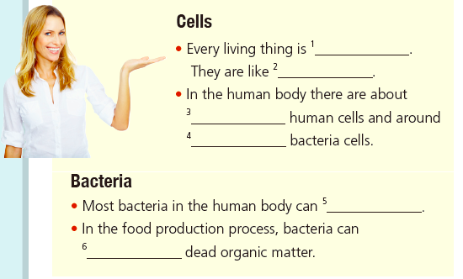
Activity 6 Listen again and complete the fact sheet.
made up of cells
bricks that are used to build houses
thirty trillion
thirty-nine trillion
help with digestion
break down

Slide 13
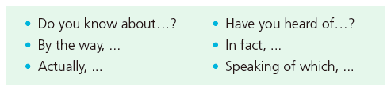
Activity 7 Complete the boxes with the expressions from the podcast.
Checking background knowledge
Adding information
Do you know about......?
Have you heard of ......?
By the way......
Actually......
In fact,......
Speaking of which,…

Slide 14
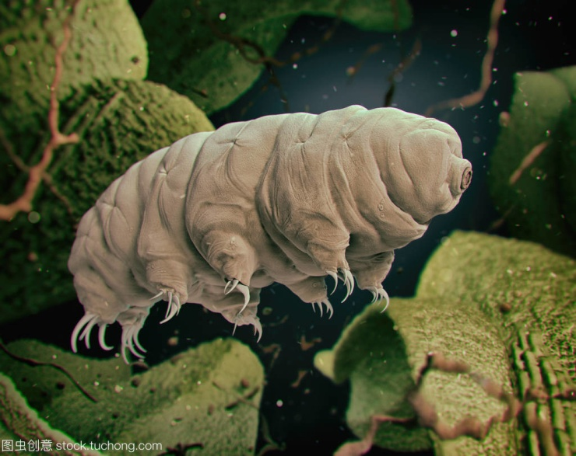
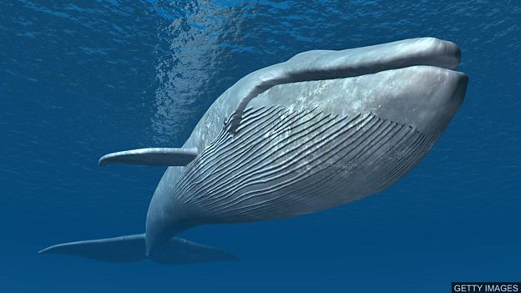
Activity 8 Read the passage and answer the questions
What species are mentioned and what is special about them?
Two species are mentioned:the blue whale and the water bear.
The blue whale is the largest animal species on Earth, which can
grow up to almost 30 metres in length and weigh over 130,000 kilos.
The water bear is probably the toughest species, which can survive temperatures from 150ºC to a below freezing -272ºC.

Slide 15
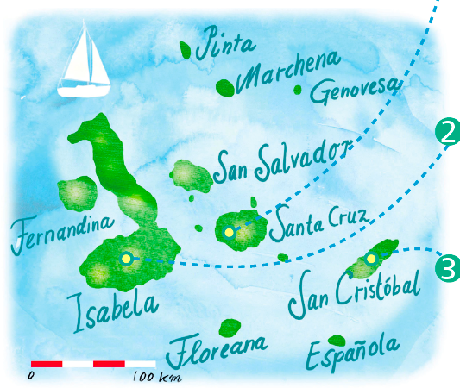
Activity 9 Complete the paragraphs with the correct form of the
words and expressions in the box.
ancestor scientific be native to primitive habitat appearance be home to ecosystem
The Galapagos Islands are renowned worldwide for their unique biodiversity. The Giant Tortoise Reserve on Santa Cruz 1_________ several species of giant tortoise that 2__________ the Galapagos Islands. The island is also home to the Charles Darwin Research Station, where 3_______ studies are carried out.
is home to
are native to
scientific

Slide 16
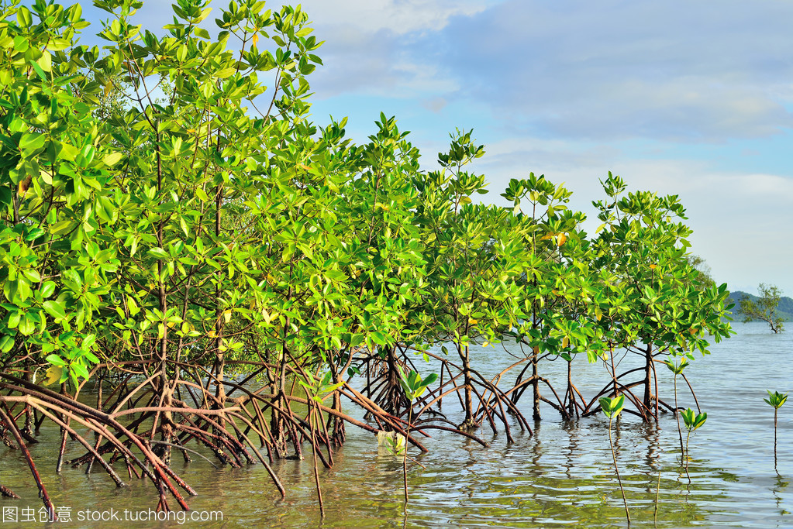
Mangroves are one of the coastal plants that grow on Isabela. They serve as the 4________________ for various birds and fish, and are very important to the 5________________.
habitats
ecosystem

Slide 17
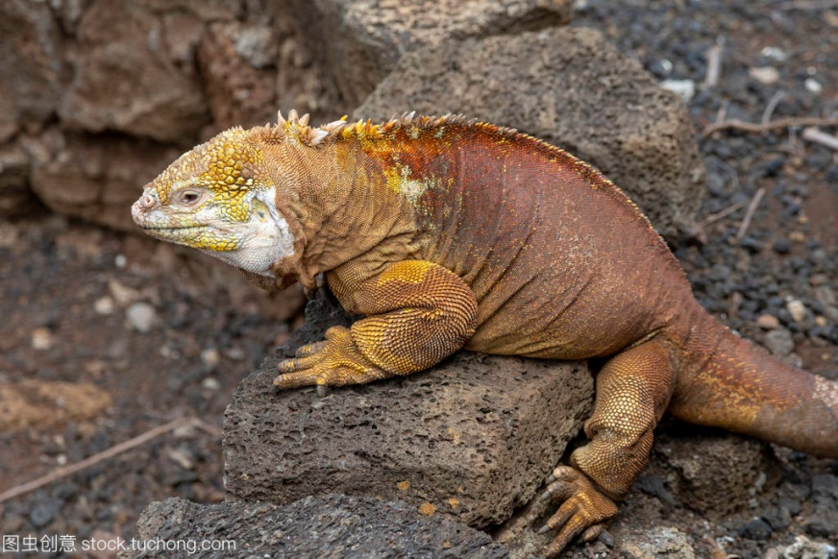
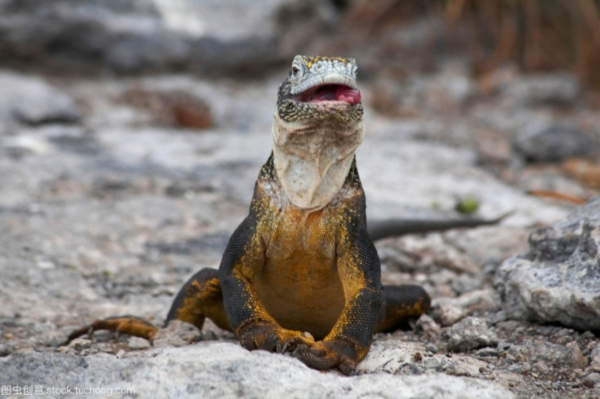
Lguanas can be found on San Cristobal. They have a very special 6___________, with comb-like spines on their back.
ancestor
There is evidence that all the different iguanas have developed from more 7_____________ ones and share a common 8________________.
primitive
appearance

Slide 18
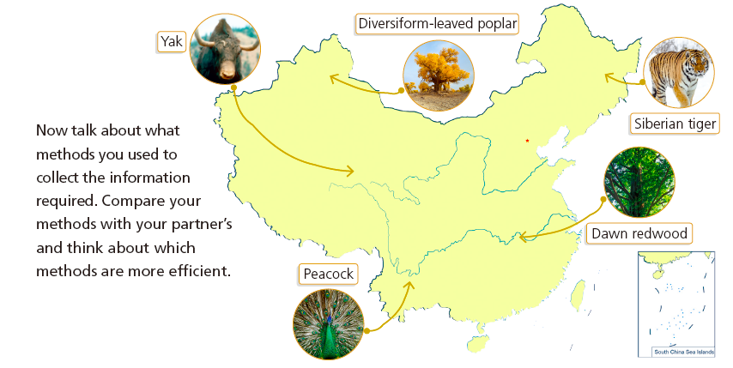
Activity 10
Look at the pictures of the species native to different regions of China.
Talk about biodiversity in China using the words and expressions in
this section.

Slide 19
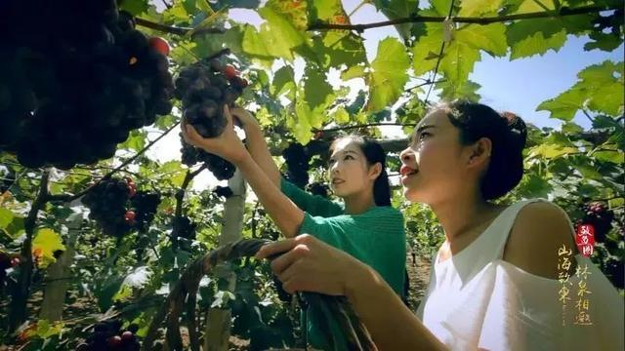
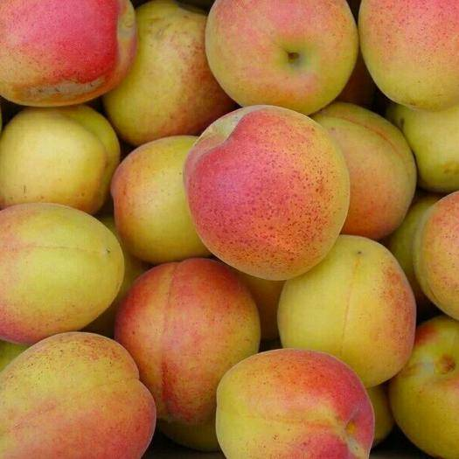
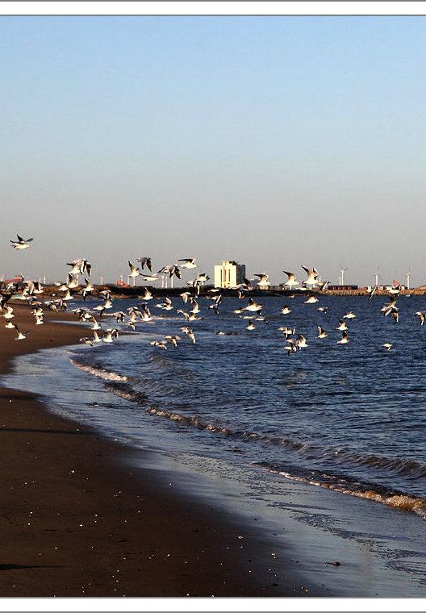
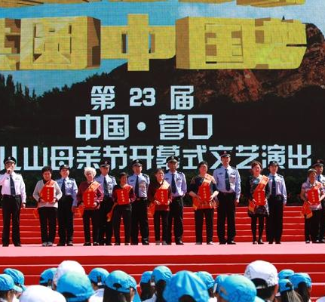
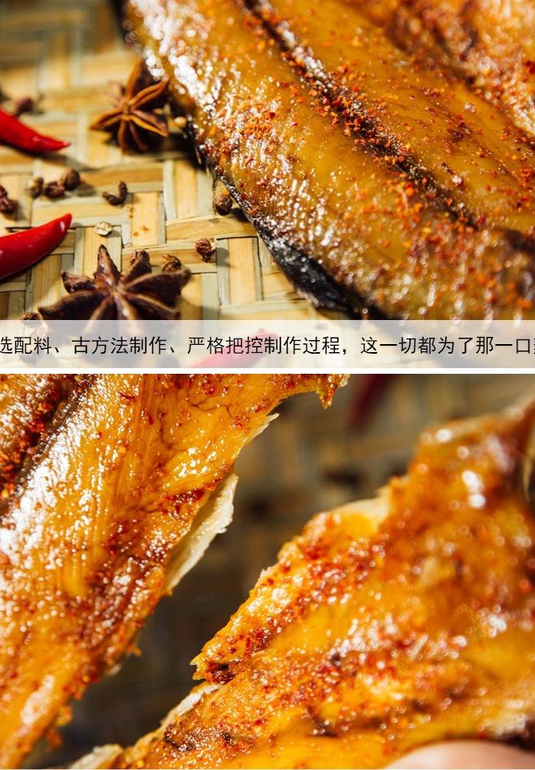
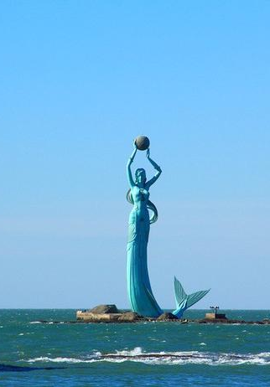
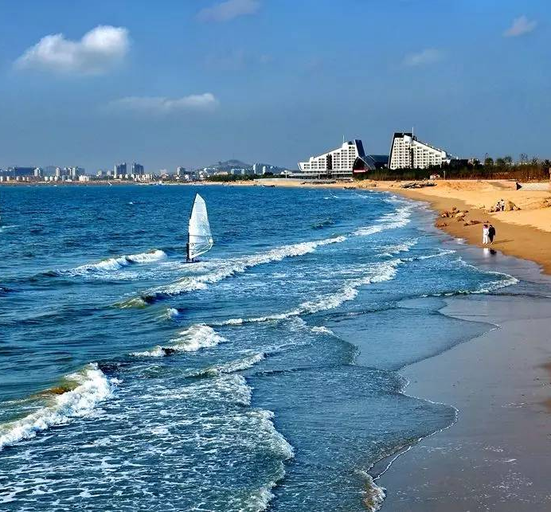
Homework
1. Review past perfect in
the class.
2. Write about introducing
species in our hometown,
using sentence structure
in Activity7 and vocabulary
in Activity 8 and 9.

Slide 20
Thank
for
watching
you

