Slide 1
Unit 6
Nurturing nature
Grammar

Slide 2

Look at the following sentences:
What can you find?
I have been writing the letter since then.
Has he been studying hard since the new term began?
I have been meeting her at the library.
I have been looking forward to seeing my family.
Sorry, I'm late. Have you been waiting long?
have/has been +动词的现在分词

Slide 3

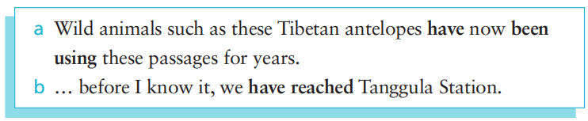
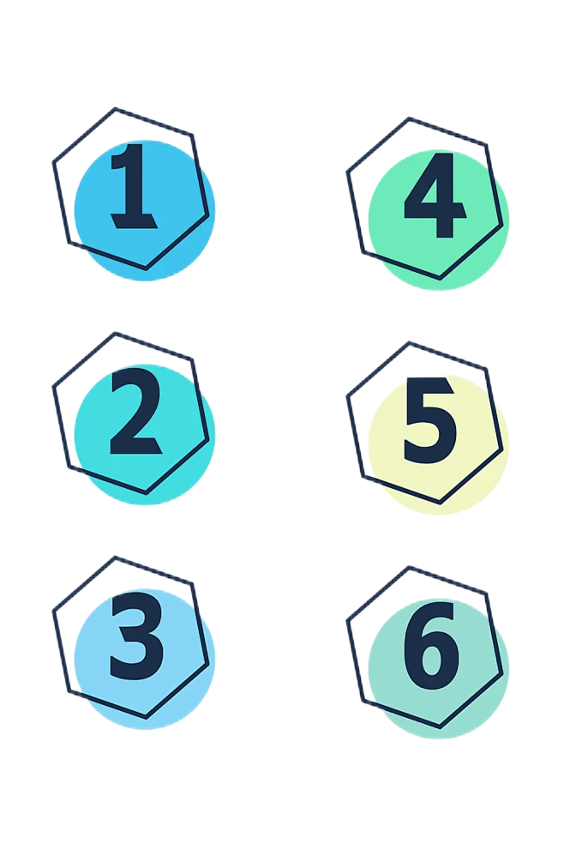

Look at the sentences from the reading passage and answer the question.
What is the difference between the expressions in bold in sentences (a) and (b)?
They are different in form and meaning. For sentence (a) the form is "have been doing", while for sentence (b) the form is "have done" In meaning, the bold part in sentence (a) means the action is continuous from the past; while the bold part in sentence (b) means the action happened once in the past.
Which of these statements are true about sentence (a)?
1) Wild animals started using these passages in the past.
2) Wild animals used these passages only once.
3) Wild animals still use these passages now.
√
√

Slide 4
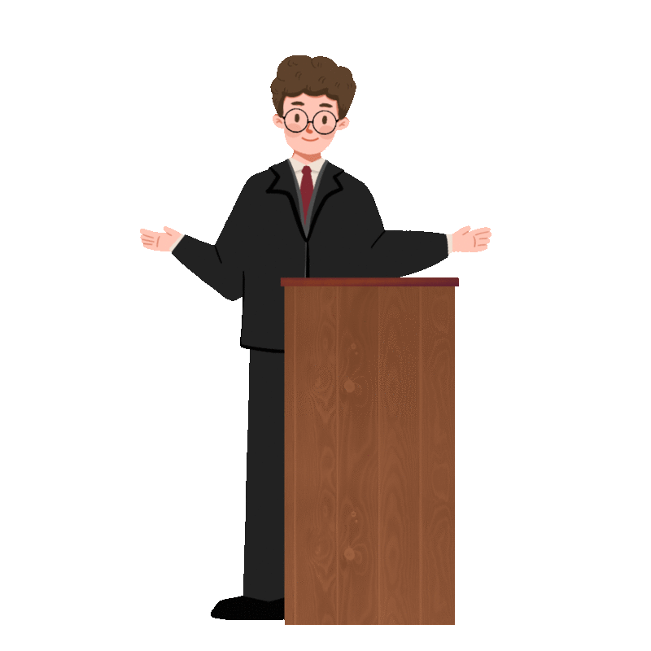
Present perfect continuous ——现在完成进行时
构成：
由“have/has been +动词的现在分词”构成，第三人称单数用 has，其他人称用 have。
用法：
①表示从过去开始一直持续到现在的动作，该动作在说话时仍在继续进行，
可能还要继续下去，也可能刚刚结束。
②带有某种感情色彩
③不能用现在完成进行时的情况
区分：
现在完成时和现在完成进行时的区别

Slide 5
用法
表示从过去开始一直持续到现在的动作，该动作在说话时仍在继续进行，可能还要继续下去，也可能刚刚结束。
这个时态常和 recently、all day、this week 等状语或 for、since 引导的时间状语从句连用。例如：
We have been studying for nearly 3 hours.
我们已经学了近3个小时了。
He has been studying traditional Chinese medicine since1999.
他从1999年开始学习中医。

Slide 6
用法
带有某种感情色彩：
Recently Li Hua has been helping his mother do housework regularly.
最近李华经常帮他妈妈做家务。 (赞许的感情色彩)
I'm glad the lecture is finished! I've been sitting for three hours.
很高兴演讲终于结束了，我已经整整坐了三个小时了。 (强调坐的时间长)

Slide 7
用法
不能用现在完成进行时的情况：
①某些不能用于进行时的动词同样也不能用于现在完成进行时，只能用现在完成时。如：see、hear、know、have、like、be 等。
他已经感冒两个星期了。
He has been having a cold for two weeks.
He has had a cold for two weeks.
②不具有延续意义的动词，如:finish、come、go、marry等不能用于现在完成进行时。
(×)
(√)

Slide 8
区分
现在完成时和现在完成进行时的区别：
①现在完成时强调动作已经完成，但对现在有影响或其结果现在仍然存在；而现在完成进行时着意于动作本身，是一种持续的(但不一定是结束了的)活动。
I have written a book on UFO. It was finished last year.
我写了一本关于 UFO的书，这本书是去年写完的。
I have been writing a book on UFO. I should be able to finish it early next year.
我一直在写一本关于 UFO的书，我应该在明年年初就能写完。

Slide 9
区分
现在完成时和现在完成进行时的区别：
②现在完成时陈述事实；而现在完成进行时则强调动作在不久以前持续进行的情景,并带有感情色彩。
My father has lost his keys.
我父亲把钥匙丢了。(陈述事实)
My father has always been losing his keys.
我父亲老是弄丢自己的钥匙。(含责怪或无奈之意)

Slide 10
区分
现在完成时和现在完成进行时的区别：
③ 现在完成时既可用于状态性动词，也可用于动作性动词；
现在完成进行时通常只用于动作性动词。
I have had this computer for 10 years, with which I have written plenty of articles.
我已拥有这台电脑10年之久了，并用它写了大量的文章。
I have been writing articles with this computer for 10 years.
10年来我一直用这台电脑写文章。

Slide 11
区分
现在完成时和现在完成进行时的区别：
④有少数动词(如：work、study、live teach、stay 等)在表示持续一段时间时用这两种时态含义差不多，只是用现在完成进行时更强调动作的持续性。
—How long have you worked/been working here?
你在这儿工作多长时间了？
—Ten years.
10年了。

Slide 12


Exercise
(1) You should go to bed. You ___________________ (watch) TV for 5 hours.
(2) I _________________ (write) letters since 6 o'clock.
(3) I _________________ (look) for him everywhere. Where can he be?
have been watching
have been writing
have been looking

Slide 13
Exercise
(4) 三年以来，我们一直学英语。
________________________________ since three years ago.
(5) 近来他老是说厌倦了自己的工作。
______________________ he is tired of his work recently.
(6) 在过去的几个月，西南地区的人们一直遭受严重旱灾的影响。
People in the southwestern areas _________________________
_______________ in the past few months.
We have been studying English
He has been saying
have been suffering from
serious drought

Slide 14

Exercise
4．The debate between homework or no homework ________ on in American schools for years and no one has come up with a solution yet.
A．is going B．has been going C．was going D．had gone
5．Over the last three months, my roommate Lin Tao________ in the library every night.
A．worked B．had been working C．has been working D．is working
6．—Where is Mother?
—She is in the kitchen. She ______the housework all morning.
A．does B．has been doing C．has done D．was doing

Slide 15
Exercise
7．The media________ the trade-unions for years and the unions have called for a change.
A．has been attacking B．has been attacked C．had attacked D．had been attacked
8．You know, I ______ for a job for three months, but I haven’t had any luck.
A．have been looking B．have looked C．had been looking D．had looked
9．The children are dirty from head to foot because they ________ in the mud all morning.
A．play B．had played C．will play D．have been playing
10．— Shall we take a break? We ________ for a whole morning.
— I’m sorry we can‘t. We are on a tight schedule.
A．was working B．have been working C．worked D．had work

Slide 16


Homework
Review the language points and complete the exercises.

Slide 17
See you next class!

