Slide 1

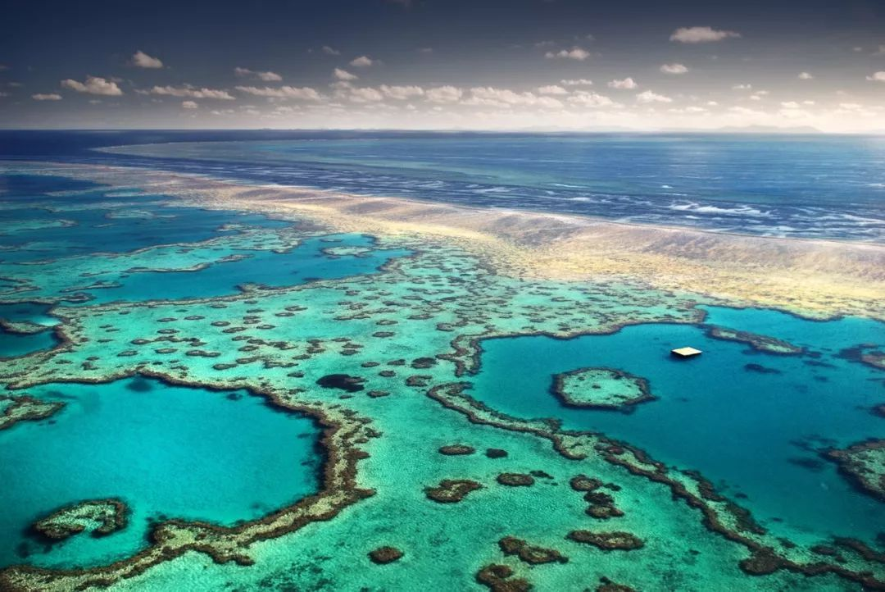



Slide 2
Video-Watching
Watch the video and answer the questions.
1.What is Heritage?
2.What are the three types of World Heritage Sites?

Slide 3
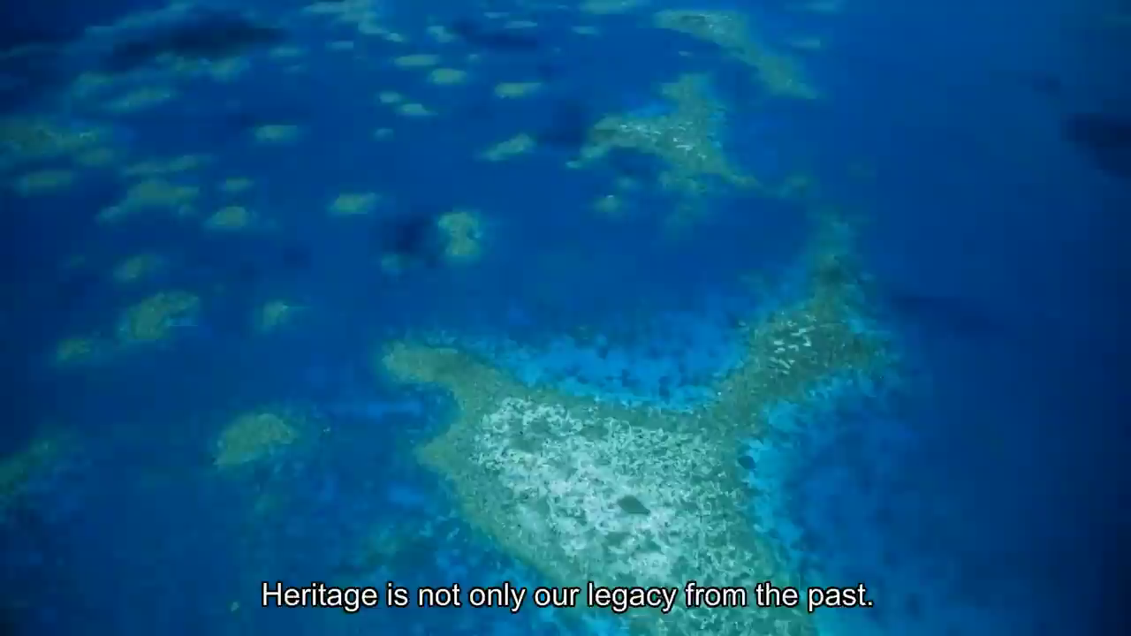

Slide 4
1.What is Heritage?
past
Heritage is not only our legacy(遗产) from the _____. It is what we ______ _____ today and what we _______ _______ to future generations.
live
with
pass
on
2.What are the three types of World Heritage Sites?
cultural heritage
World Heritage Sites include_______________, _______________or_____________ .
natural heritage
mixed heritage
文化遗产
自然遗产
混合遗产

Slide 5
Video-Watching
Watch the video and answer the questions.
1. Which natural heritage site is introduced in the video?
2. What kind of threat(danger) is it facing?

Slide 6


Slide 7
Video-Watching
Watch the video and answer the questions.
1. Which natural heritage site is introduced in the video?
2. What kind of threat(danger) is it facing?
Australia's Great Barrier Reef.(大堡礁)
water pollution
illegal(非法的) fishing
climate change

Slide 8
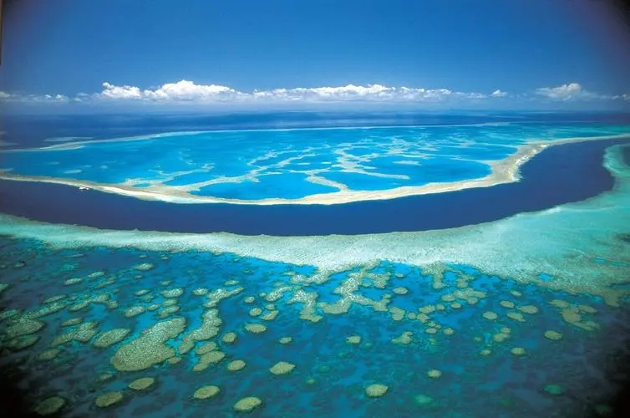
Introduction
The Great Barrier Reef(大堡礁)is made up of over 2,000 reefs of more than 2,300 kilometres in Australia. It is the world's largest coral(珊瑚)reef. The Coral reef can be seen from outer space!
You can swim, dive and sail the World Heritage Site(世界遗产)--the Great Barrier Reef.

Slide 9
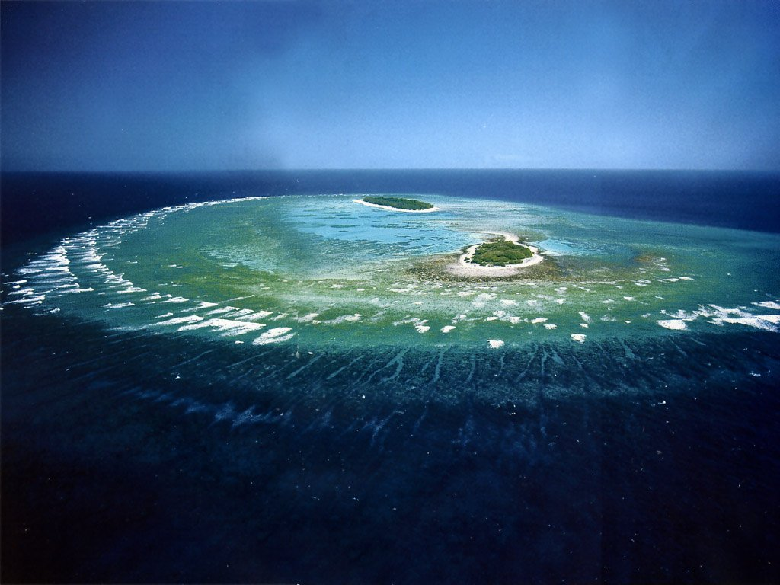
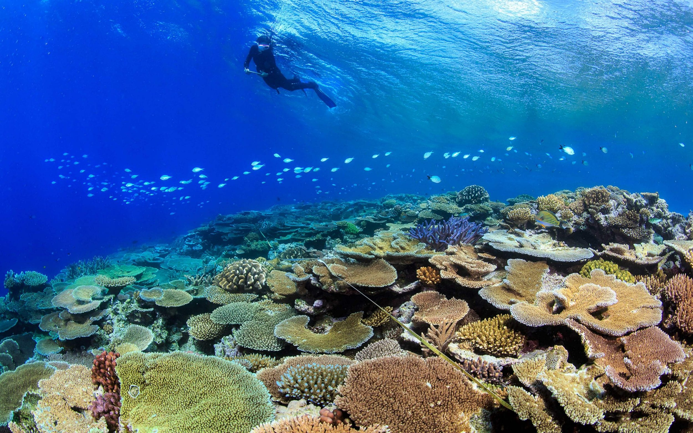
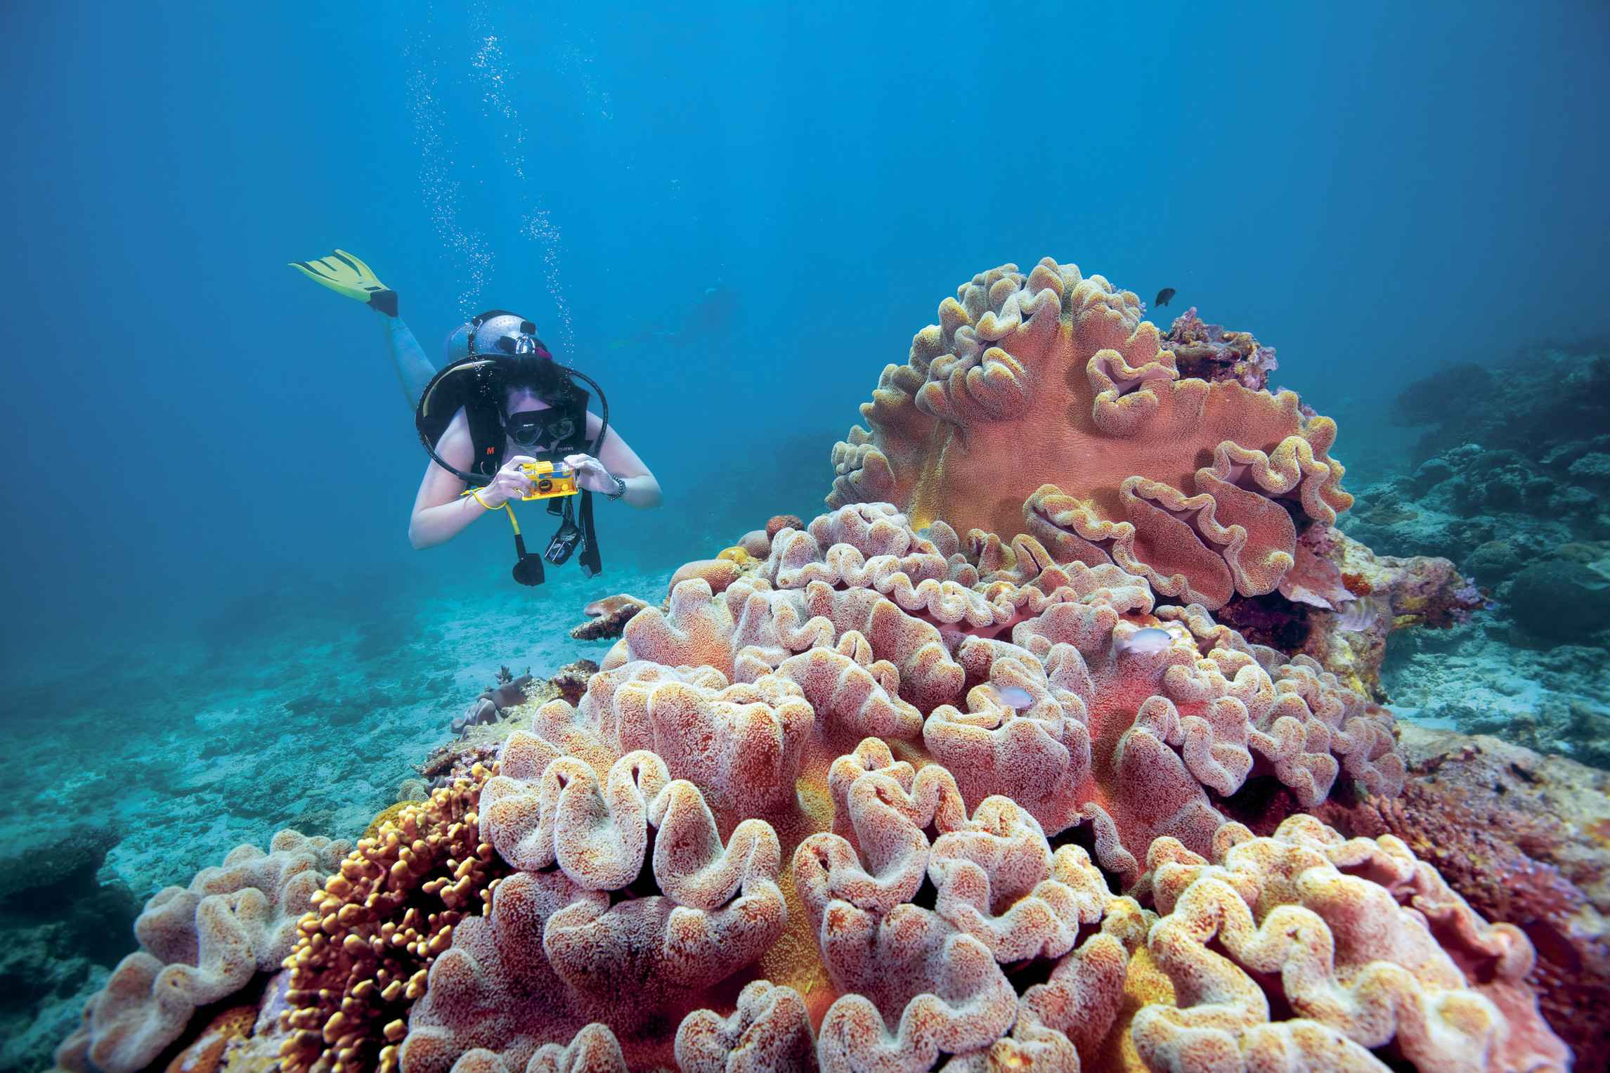
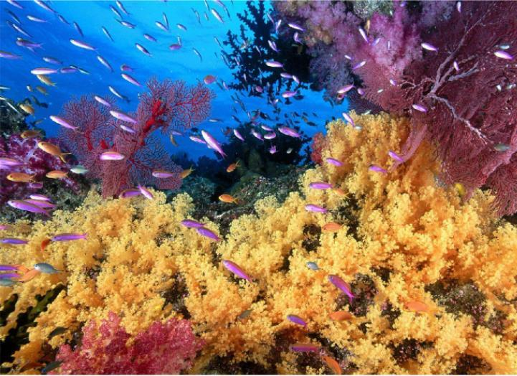

Slide 10
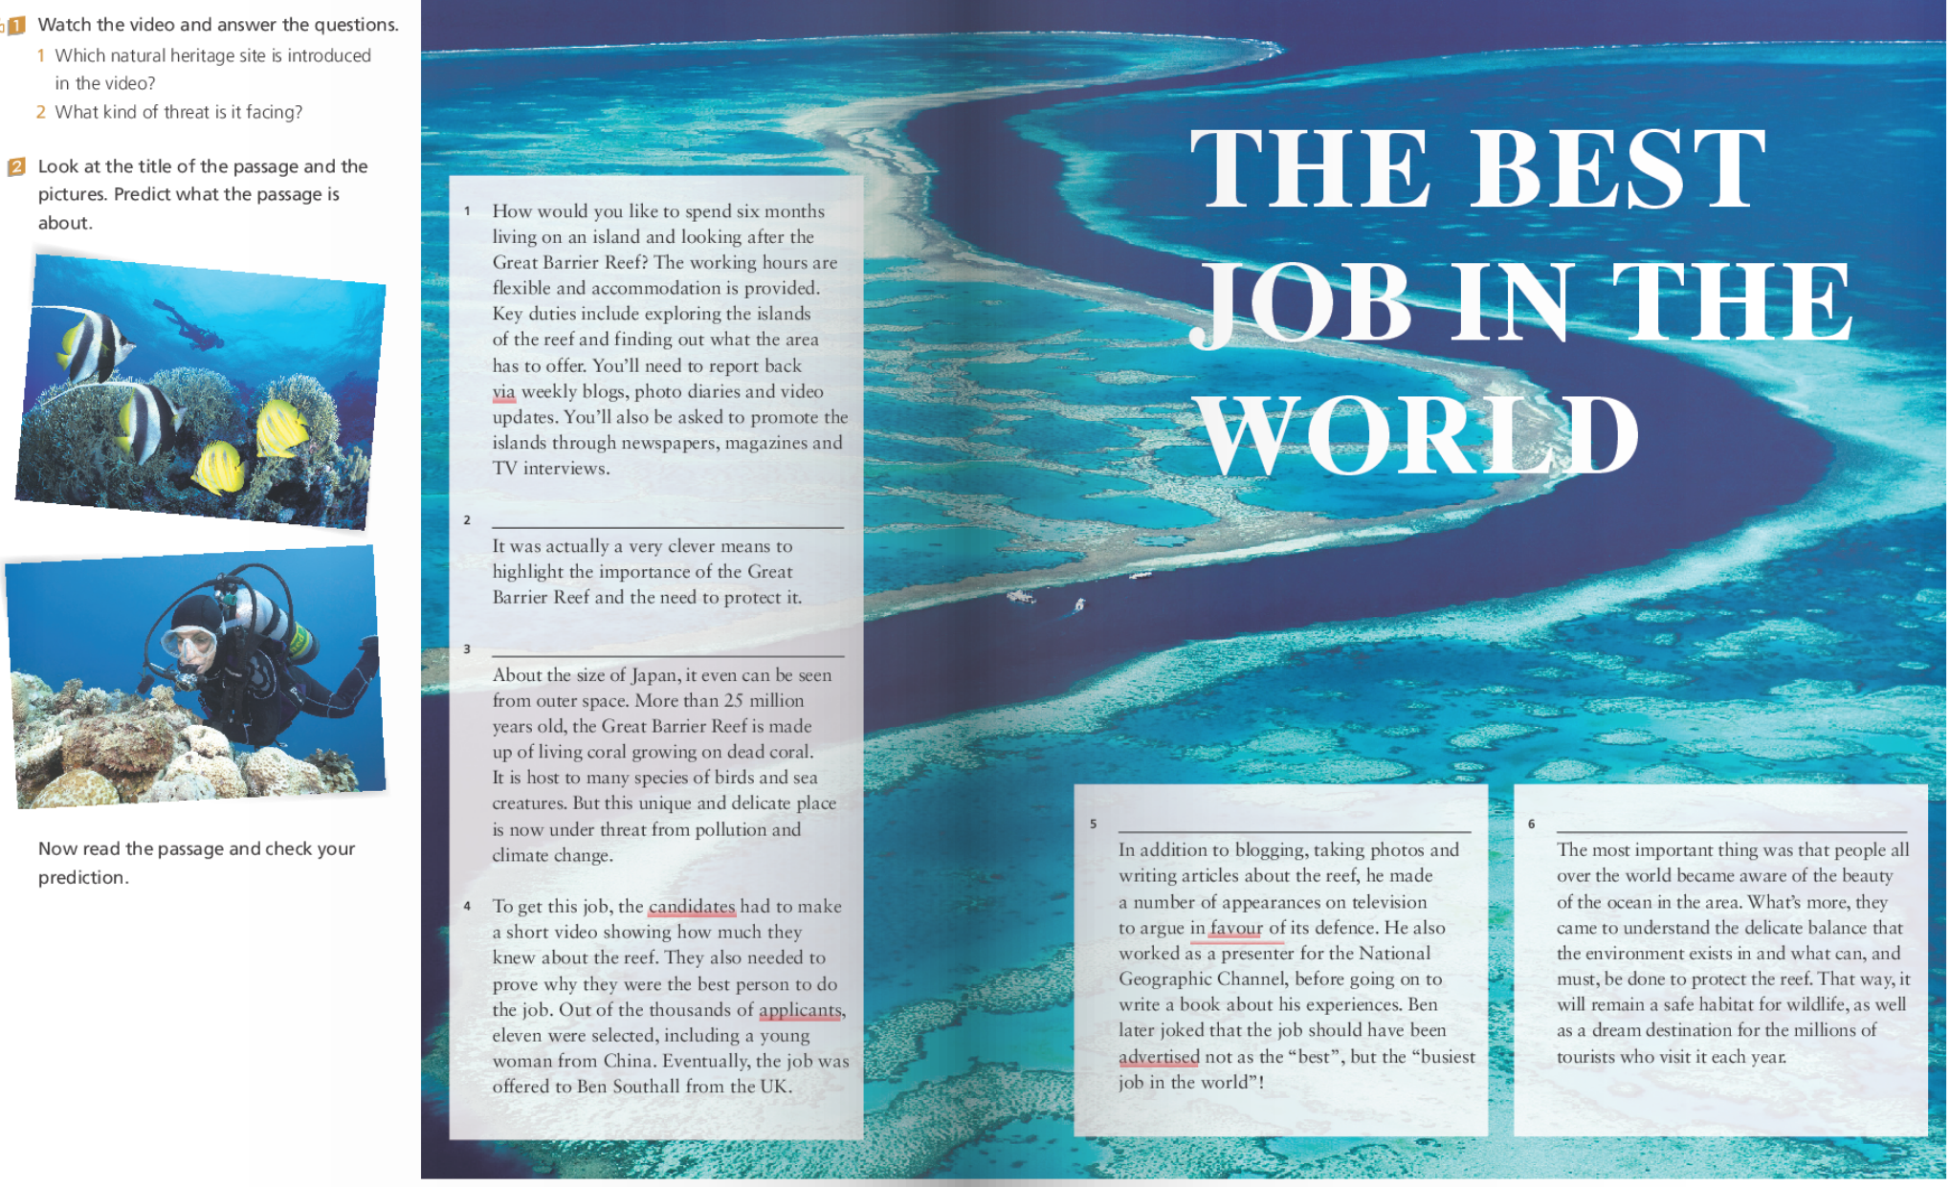
Prediction
How?
what
why
how
where

Slide 11
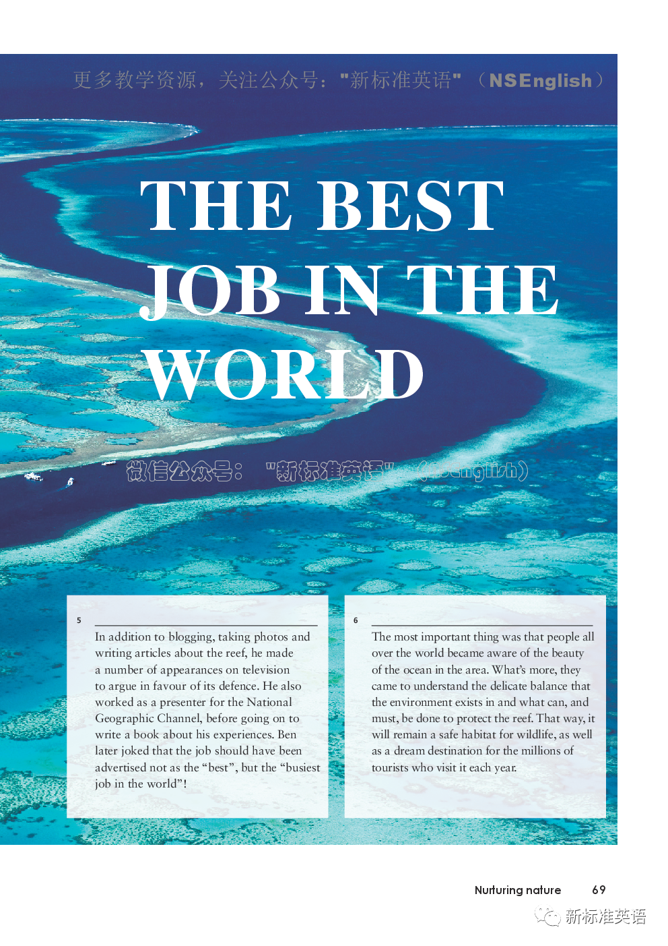
Scan(浏览) to answer the questions.
Para. 1
what
Para. 1
why
Para. 4
how
1. What is the best job in the world?
2. Why is it the best job in the world?
3. How to get the best job in the world?
To look after the Great Barrier Reef.
The working hours are flexible and accommodation is provided.
The candidates had to make a short video showing how much they knew about the reef. They also needed to prove why they were the best person to do the job.

Slide 12
What happened in Para 2, 3, 5, 6?.
Para 1
what
Para 1
why
Para 4
how
Tips: First, read the topic sentences on P70. Then, according to the topic sentences, guess what will probably be discussed next.

Slide 13

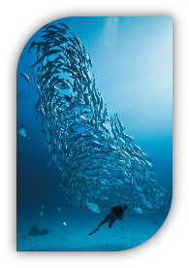
What happened in Para 2, 3, 5, 6?.
Located off the coast of North-east Australia, the Great Barrier Reef is the largest living thing on the planet.
Whether it was a genuine job offer or an eye-catching marketing event isn’t really important.
This call for an island caretaker attracted interest from all over the world.
Ben did a lot during his time as an island caretaker.
genuine = real
attracted
a. It will tell us __________________________________.
b. It will tell us __________________________________.
c. It will tell us __________________________________.
d. It will tell us __________________________________.
the Great Barrier Reef
what is really important
the benefits of this call
what Ben did

Slide 14
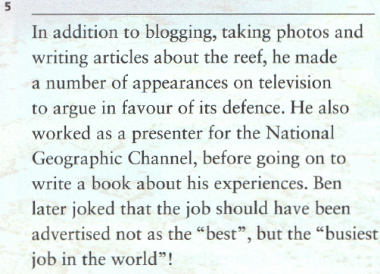
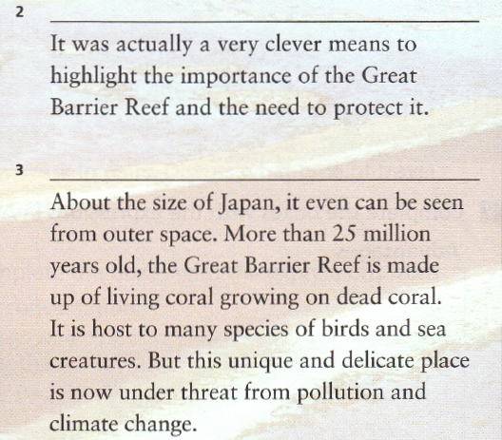
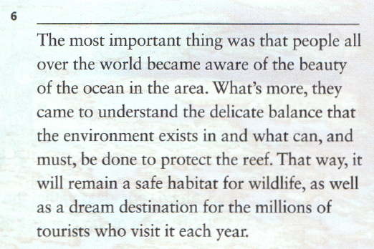
Choose the topic sentences for the paragraphs and write them on the lines to complete the passage.
a Located off the coast of North-east
Australia, the Great Barrier Reef is
the largest living thing on the
planet.
b Whether it was a genuine job offer
or an eye-catching marketing
event isn’t really important.
c This call for an island caretaker
attracted interest from all over the
world.
d Ben did a lot during his time as an
island caretaker.

Slide 15
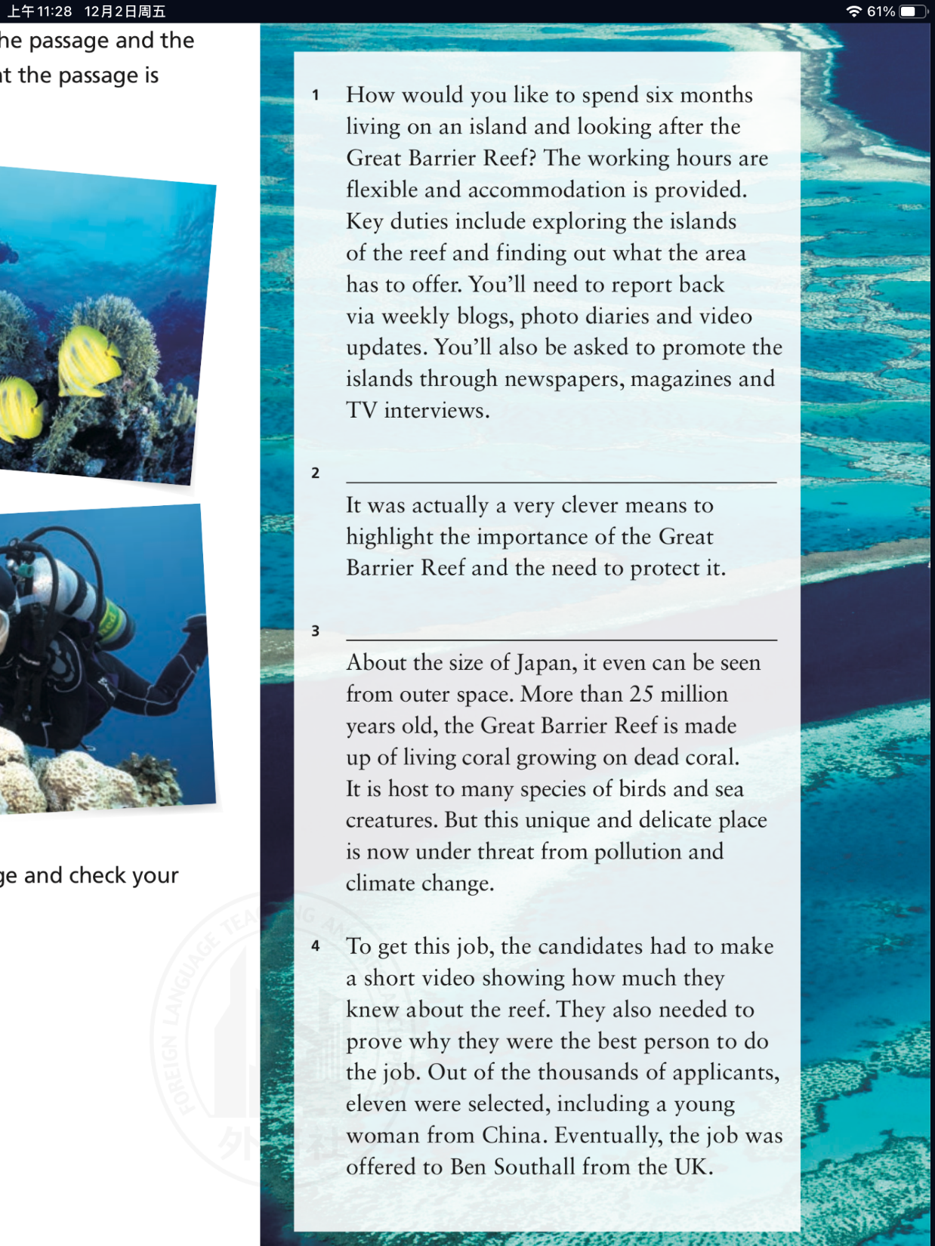
a Located off the coast of North-east
Australia, the Great Barrier Reef is
the largest living thing on the
planet.
b Whether it was a genuine job offer
or an eye-catching marketing
event isn’t really important.
c This call for an island caretaker
attracted interest from all over the
world.
d Ben did a lot during his time as an
island caretaker.
代词指代

Slide 16
a Located off the coast of North-east
Australia, the Great Barrier Reef is
the largest living thing on the
planet.
b Whether it was a genuine job offer
or an eye-catching marketing
event isn’t really important.
c This call for an island caretaker
attracted interest from all over the
world.
d Ben did a lot during his time as an
island caretaker.
话题一致/词汇共现——经常在同一语境出现，用于对某物描述和介绍。

Slide 17
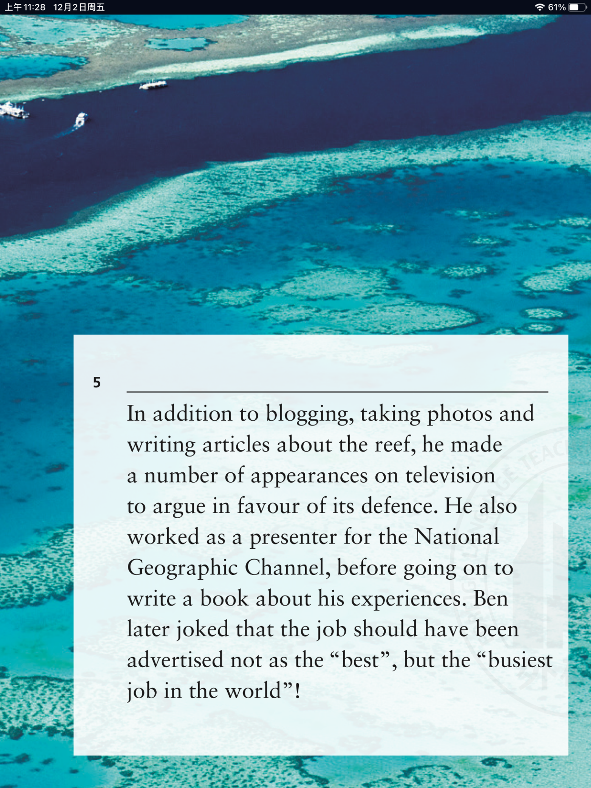
a Located off the coast of North-east
Australia, the Great Barrier Reef is
the largest living thing on the
planet.
b Whether it was a genuine job offer
or an eye-catching marketing
event isn’t really important.
c This call for an island caretaker
attracted interest from all over the
world.
d Ben did a lot during his time as an
island caretaker.
代词指代/词汇重现

Slide 18
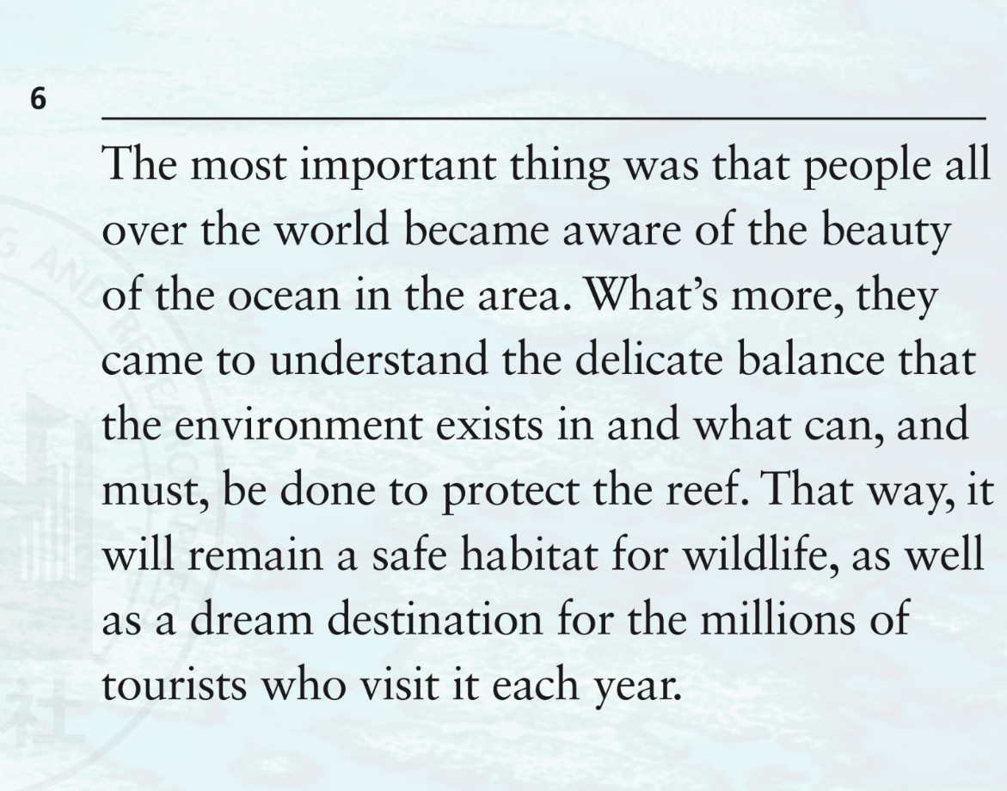
a Located off the coast of North-east
Australia, the Great Barrier Reef is
the largest living thing on the
planet.
b Whether it was a genuine job offer
or an eye-catching marketing
event isn’t really important.
c This call for an island caretaker
attracted interest from all over the
world.
d Ben did a lot during his time as an
island caretaker.
词汇重现、逻辑关系。

Slide 19
Para. 1
Job
Location
Duration
Working hours
Accommodation
Key duties
looking after the Great Barrier Reef
on an island of the Great Barrier Reef
six months
flexible
provided
1.Exploring the islands of the reef;
2.Finding out what the area has to offer;
3.Reporting back via weekly blogs, photo diaries and video updates;
4.Promoting the islands through newspapers, magazines and TV interviews.

Slide 20
Para. 2
1. What is the author’s attitude towards this call in Para. 2?
A. Unconcerned B. Positive C. negative D. Doubtful
2. Which words can show the author’s attitude?
This call for an island caretaker attracted interest from all over the world.

Slide 21
Para. 2
This call for an island caretaker attracted interest from all over the world.
means=way 方式；方法
highlight the importance 强调……重要性

Slide 22
Para. 3
Location
Special feature
Size
Age
Made up of
Host/Home to
Things threatening it
off the coast of North-east Australia
the largest living thing on the planet
about that of Japan
more than 25 million years old
living coral growing on dead coral
be host to=be home to ...的栖息地
unique=special=distinct 独特的
delicate 脆弱的
under threat = being threatened= in danger 正在受到威胁
many species of birds and sea creatures
pollution and climate change

Slide 23
Para. 4
1. What were the requirements(要求) for candidates to get the job?
2. How many people were wanted for the job and what 's the result?

Slide 24

Para. 5
Ben joked: it was the “_______ job in the world”！
busiest
blogged
1. _______, took photos and wrote articles about the reef
2. made appearances on television to argue _____________
the defence of the reef
in favour of
Things Ben did as an island caretaker
presenter
3. worked as a ________ for the National Geographic Channel
experiences
4. was going to write a book about his ______________

Slide 25

Para. 6
Where is the true meaning of this job?

Slide 26
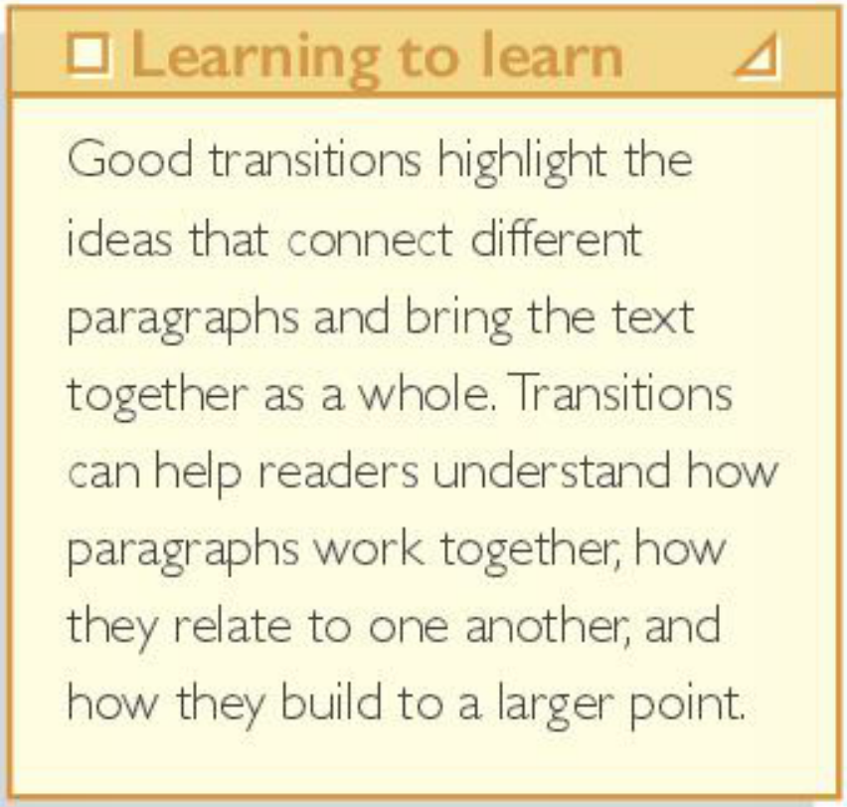
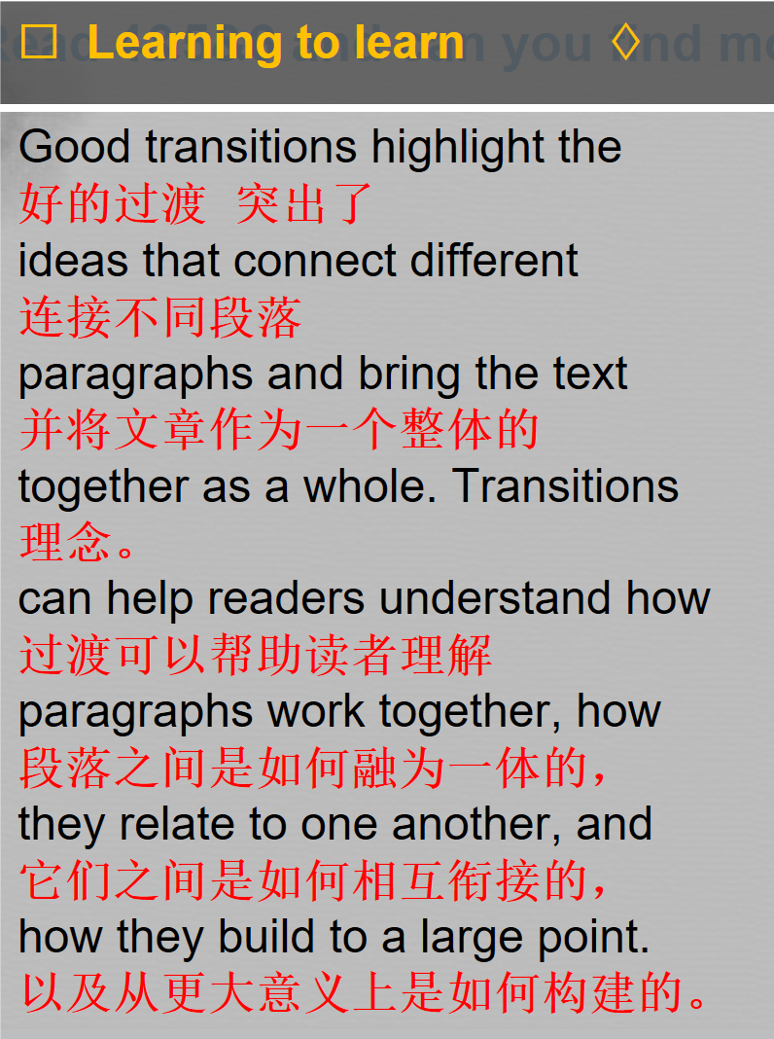
Read Paras. 4-6 to find more transitions(过渡词) in the passage.
Some transitions
Para 1: also
Para 3: But
过渡词
More transitions
Para 4:
Para 5:
Para 6:
also
Eventually
In addition to
also
The most important thing
What’s more
That way
as well as

Slide 27
Think & Share
1. What is the author’s purpose in writing the passage?
The author intends to make more people aware of _________________ and understand ___________ . Human beings should __________________ and ____________________.
the beauty of...
... is delicate
protect...
live in harmony with...
2. Can an island caretaker make a difference?
A few can make a difference. Even if you are the one to take the first step, and continue trying, others will someday join us, we will solve even our greatest problem.

Slide 28

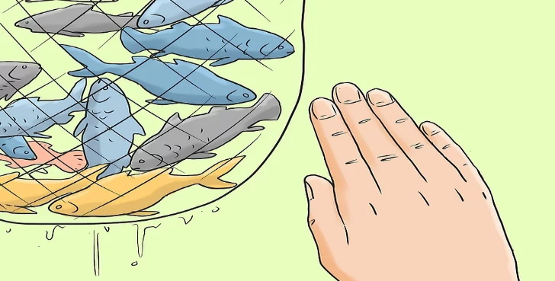

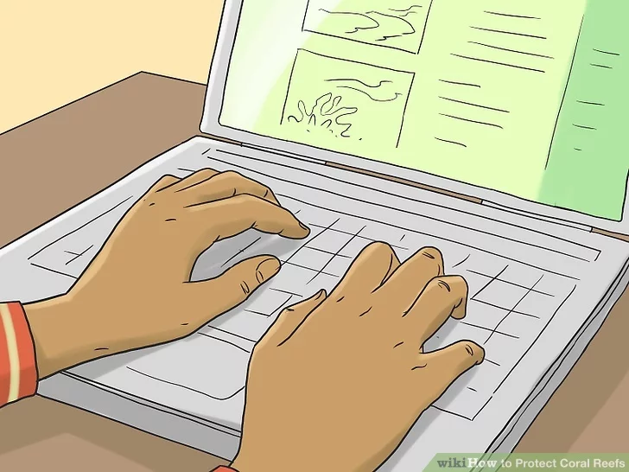
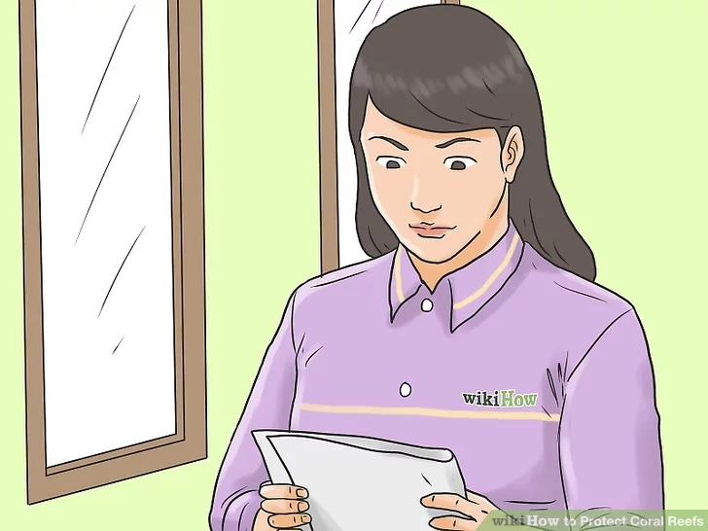
① Protect the coral reef from illegal fishing(非法捕鱼)/overfishing.
Can you think of some other creative ways of raising awareness of protecting the reef?
② Offer detailed information about coral reefs, their importance, and protection on the Internet.
③ Encourage government to make relevant policies to support reefs.

Slide 29
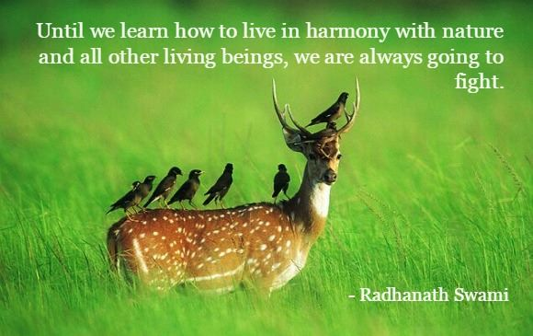
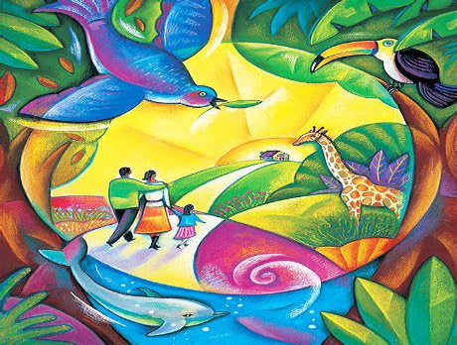
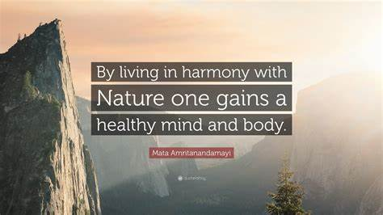
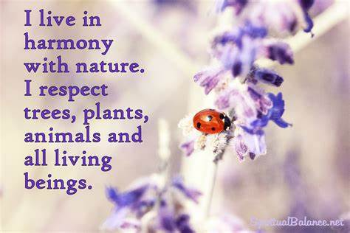

The land is where our roots are. The children must be taught to feel and live in harmony with the Earth..

Slide 30

Homework
Write an article to the school newspaper to talk about how to protect the ocean.

Slide 31
Thank you !

