Slide 1

Unit 6
Writing & Presenting ideas

Slide 2

新 课 导 入
What's your ideal job and what are the reasons?

Slide 3

1
Read the job advertisement and answer the questions.
Taihu, China's third-largest
freshwater lake, needs you!
• Environmental worker, full-time from 1 June to 30 September
• Taihu Lake, Wuxi, Jiangsu Province
• Monitoring the area for algae; working on ships removing
algae from water
• Salary negotiable; accommodation and meals provided
All applications welcome, but preference will be given to those with diving qualifications.
* Visit our website for a detailed job description.
课 堂 学 习

Slide 4
1 How long will the job last?
The job will last for four months.
2 What are the responsibilities of the job?
The responsibilities of the job are to monitor the area for algae, work on ships removing algae from water.
3 What benefits does it offer?
It provides accommodation and meals and the applicant can negotiate with the salary with the employer.

Slide 5
structure and content of the passage
state the writing purpose; be attractive to the applicants
title
Writing a
job
advertisement
main body
basic elements: job, working time, location, responsibilities, benefits etc.
preference; website for detailed information
ending

Slide 6
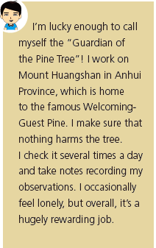
2
Read what the three people say about their jobs. Choose one of the jobs and complete the notes. Do research if necessary.
I'm lucky enough to call myself the “Guardian of the Pine Tree”! I work on Mount Huangshan in Anhui Province, which is home to the famous Welcoming-Guest Pine. I make sure that nothing harms the tree. I check it several times a day and take notes recording my observations. I occasionally feel lonely, but overall, it's a hugely rewarding job.

Slide 7
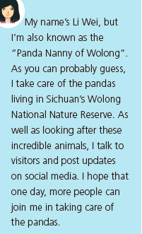
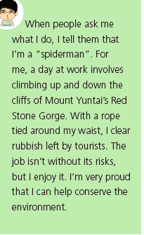
My name's Li Wei, but I'm also known as the “Panda Nanny of Wolong”. As you can probably guess, I take care of the pandas living in Sichuan's Wolong National Nature Reserve. As well as looking after these incredible animals, I talk to visitors and post updates on social media. I hope that one day, more people can join me in taking care of the pandas.
When people ask me what I do, I tell them that I'm a “spiderman”. For me, a day at work involves climbing up and down the cliffs of Mount Yuntai's Red Stone Gorge. With a rope tied around my waist, I clear rubbish left by tourists. The job isn't without its risks, but I enjoy it. I'm very proud that I can help conserve the environment.

Slide 8
Job location
responsibility
Benefits

Slide 9
Job location
responsibility
Benefits
Guardian of the Pine Tree
Mount Huangshan, Anhui Province
making sure that nothing harms the Welcoming-Guest Pine; checking the tree several times a day; taking notes recording the observations
hugely rewarding; accommodation and meals provided; 15-day-vacation with pay every year

Slide 10
Job location
responsibility
Benefits
Sichuan's Wolong National Nature Reserve
pandas keeper
taking care of / looking after pandas; talking to visitors; posting updates on social media
three days’ paid leave every month; meals and a free medical check provided

Slide 11
Job location
responsibility
Benefits
environmental worker
Mount Yuntai’s Red Stone Gorge
climbing up and down the cliffs of Mount Yuntai’s Red Stone Gorge; clearing rubbish left by tourists
helping conserve the environment; feeling proud

Slide 12
Now write a job advertisement. Do further research if necessary.
________________________________________________________________________________________________________________________________________________________________________________________________________________________________________________________________________________________________________________________________________________________________________________________________________

Slide 13
3
Work in pairs. Make improvements to each other's job advertisements and share them with the class.
Sample:
PANDAS NEED YOU!
•Pandas keeper, full-time job
•Wolong National Nature Reserve, Sichuan Province
•Taking care of pandas; talking to visitors; posting updates on social media
•Three days' paid leave every month; meals and a free medical check
provided
All applications welcome, but preference will be given to those with
qualifications in veterinary medicine or zoology.
Please visit our website for more information.

Slide 14

4
Work in groups. Read the two points of view about whether natural heritage sites should be open to the public and take sides.
Opening natural heritage sites to the public would mean people could get to know more about them...
Natural heritage sites should not be open to the public because crowds of visitors can cause damage to them...

Slide 15
5
Think of arguments to support your point of view and make notes.
Point of view
Arguments
Supporting examples

Slide 16
6
Prepare for a debate. Consider the following:
1 the roles and responsibilities for each member of your group
2 your arguments, opening and summary
3 the opposing arguments you might face and how you can
respond to them
4 useful words, expressions and structures
7
Team up with a group with the opposite point of view and hold a debate.

Slide 17
1. How can we write a job advertisement?
2. Talk about the advantages and disadvantages
of natural heritage sites open to the public.

