Slide 1
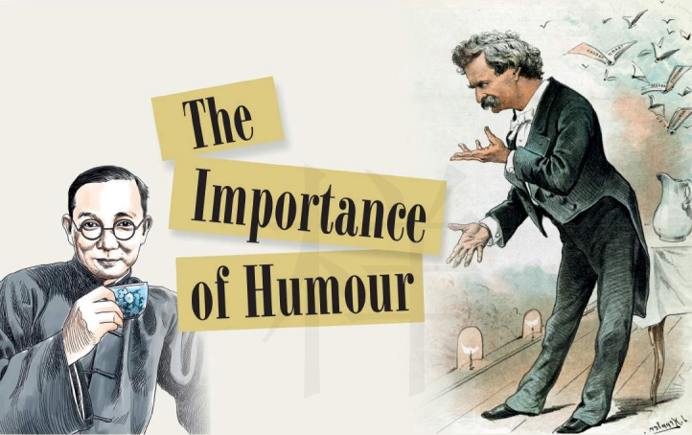
SB1U1 Laugh out loud!
Developing ideas

Slide 2

1. Acquire the main idea and the structure of the passage;
2. Get the specific information, understand the wisdom of
celebrities and learn the positive attitude to life from them;
3. To form a positive attitude towards life.

Slide 3
Before reading
Make a prediction
title
What will the text be about?
illustration (插图)
Who are they?
What are they doing?
What is their relationship?

Slide 4
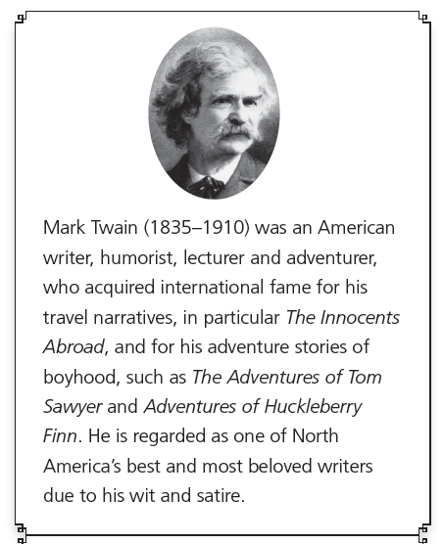
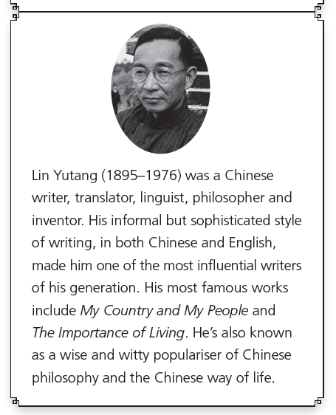

Before reading
What elements does the author include when introducing them?
Are there any similarities or differences between them?
ldentities
Achievements (honors,awards, publications)
Judgment
Both of the two writers have their unique brand of humour.

Slide 5
Before reading
Skim briefly the first two sentences in the first two paragraph to identify the genre(体裁) of the text.
1 Humour has been an essential part of human behaviour for thousands of years. There is comedy in the texts of Ancient Greece, and medieval writings are filled with jokes. While these same jokes might not be as funny to us now as they were then, their authors understood that humour could not only entertain but also throw new light on sensitive or emotiveissues.
2 Closer to modern times,someone who is remembered for his ability to combine humour with more serious messages is American writer Mark Twain. Twain's particular ….
exposition
narration
argumentation
autobiography to tell one’s lifetime experiences
to explain, introduce…
to tell a story
√
to argue/defend

Slide 6
Detailed reading
1
Question 1
Why is humor important?
2
Question 2
What is the purpose of two examples?
3
Question 3
Why is Lin Yutang’s joke about the man and wild animals called quick wit?
4
Question 4
How do you understand “humor is mankinds’ greatest blessing?

Slide 7
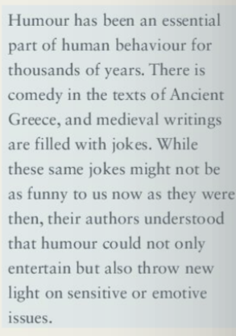
Read para 1 carefully and answer the question.
1
Question 1
Why is humor important?
throw light on
使…较容易理解

Slide 8
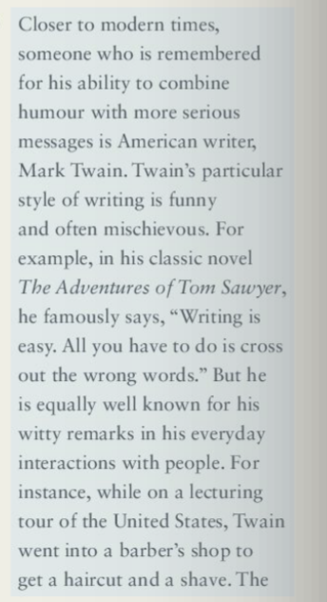
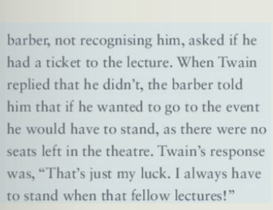
Read para 2 carefully and answer the question.
2
Question 2
What is the purpose of two examples?

Slide 9
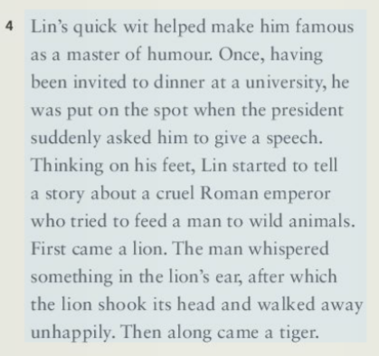
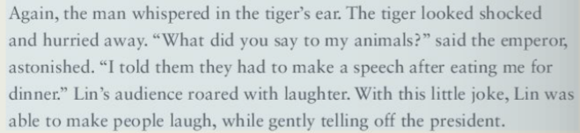
Read para 4 carefully and answer the question.
3
Question 3
Why is Lin Yutang’s joke about the man and wild animals called quick wit?
think on one’s feet
反应敏捷，反应快

Slide 10
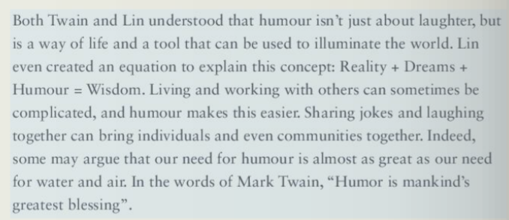
Read para 5 carefully and answer the question.
4
Question 4
How do you understand “humor is mankinds’ greatest blessing?

Slide 11

Read para 2 carefully and answer the question.
What did Twain’s response to the barber’s question imply?
He gave the lecture himself.
He couldn’t get a ticket to every lecture.
He had to stand because of his bad luck
He didn’t like the fellow that lectured.

Slide 12
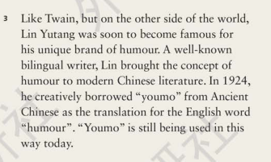
Read para 3 carefully and answer the question.
What is the function of paragraph 3 in this text?
Introducing Lin Yutang.
Comparing the achievements of the two writers.
Making a transition to another example.
Explaining the origin of “youmo”.

Slide 13
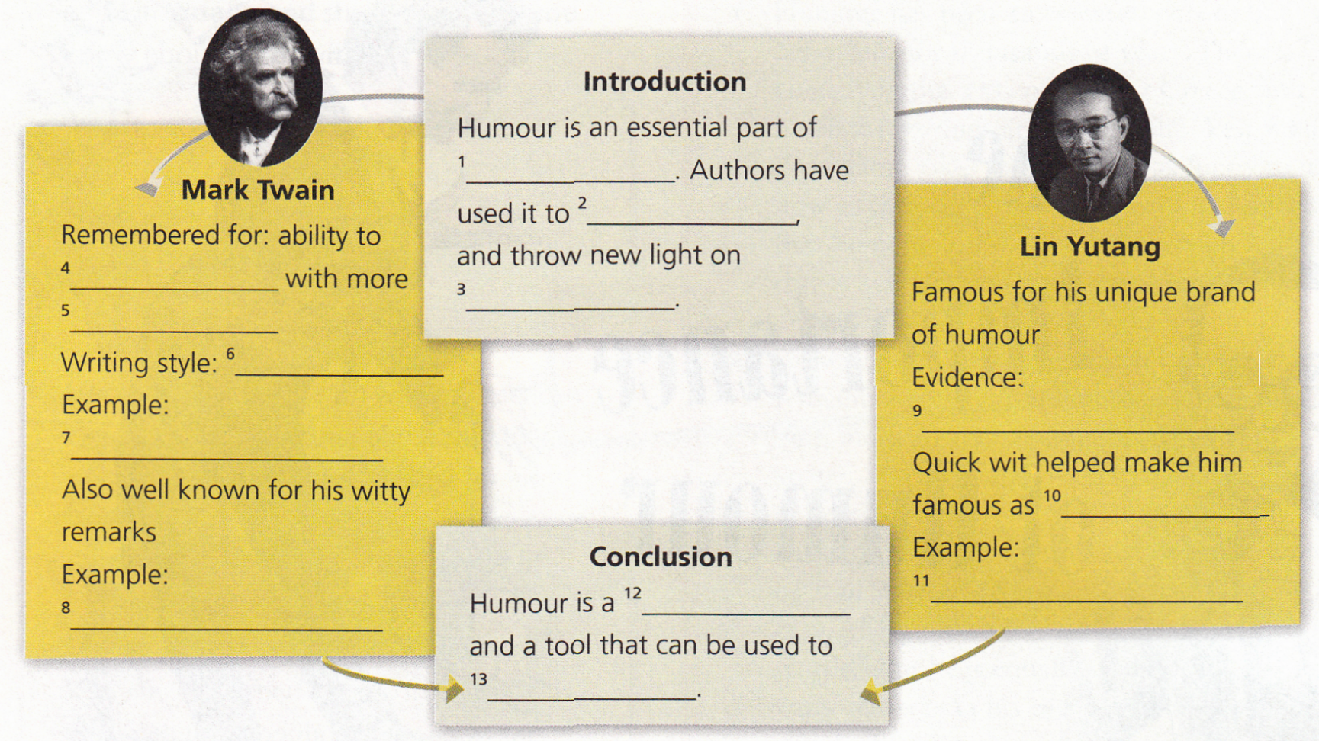
After reading:
Task 1.Organise information from the passage and complete the diagram.

Slide 14

After reading:
Task 2.Review the basic structure of an argument.
What is the structure of the passage?
A. P1 B. P1 C. P1 D. P 1
P2
P2
P3
P4
P2
P3
P2
P4
P3
P3
P3
P4
P4
P3
P5
P5
P5
P5

Slide 15
state your claim/opinion
Introduction
Humour is an essential part of 1 _________________ . Authors have used it to 2 ______________, and throw new light on 3 _______________________________.
human behaviour
entertain
sensitive or emotive issues
The importance of humour
Notes:
15

Slide 16
Mark Twain
Remembered for: ability to ______________ with more _______________
Writing style: ___________________________
Example: _______________________
Also well known for his witty remarks
Example:
________________________________________________________________________
combine humor
serious messages
funny and often mischievous
The adventures of Tom Sawyer
“That’s just my luck. I always have to stand when that fellow lectures!”
give your reasons and supporting details

Slide 17
Lin Yutang
Famous for his unique brand of humor
Evidence:
He borrowed “youmo” from Ancient Chinese as the translation for the English word “humor”.
Quick wit helped make him famous as__________________
Example:
___________________________________________________
___________________________________________________
a master of humor.
He told a story about a cruel Roman emperor who tried to feed a man to wild animals during the dinner at a university.
give your reasons and supporting details

Slide 18
Restate your claim
Conclusion
Humour is a ________________ and a tool that can be used to _______________________.
way of life
illuminate the world
Notes:
18

Slide 19
Introduction
The importance of humour
Body
Giving examples of Mark Twain and Lin Yutang to support the topic
structure
Conclusion
Humour is a tool and can be used to illuminate the world.

Slide 20
Excerpt from The lmportance of Living
Human society would be like an idealistic couple forevergetting tired of one place and changing their residence regularly once every three months, for the simple reason that no one place is ideal and the place where one is not seems always better because one is not there. Very fortunately, man is also gifted with a sense of humor, whose function, as l conceive it, is to exercise criticism of man's dreams, and bring them in touch with the world of reality. lt is important that man dreams, but it is perhaps equally important that he can laugh at his own dreams. That is agreat gift, and the Chinese have plenty of it.
The sense of humor, which l shall discuss at more length in a later chapter, seems to be very closely related to the sense of reality, or realism.lf the joker is often cruel in disillusioning(使..醒悟)the idealist, he nevertheless(不过) performs a very important function right there by not letting the idealist bump his head against the stone wall of reality and receive a ruder shock. He also gently eases the tension of the hot-headed enthusiast and makes him live longer. By preparing him for disillusion, there is probably less pain in the finalimpact, for a humorist is always like a man charged with the duty of breaking a sad news gently to a dying patient. Sometimes the gentlewarning from a humorist saves the dying patient's life. lf idealism anddisillusion must necessarily go together in this world, we must saythat life is cruel, rather than the joker who reminds us of life's cruelty.

Slide 21

Important lexical chunks
1.重要的一部分
2.使了解（某事）
3.把A和B结合起来
4.划去，删除
5.日常交流
6.使某人难堪
7.匆忙离开
8.做演讲
9.大笑
10.斥责; 训斥
11.照亮世界
an essential part
throw light on
combine A with B
cross out
everyday interaction
put sb on the spot
hurry away
make a speech
roar with laughter
tell off
illuminate the world

Slide 22
Important lexical chunks
1. cross out
2. brand of...
3. think on one's feet
4. roar with laughter
5. tell off
划掉，删掉(字句)
某种……；……的品牌
头脑反应很快；才思敏捷
发出哄笑，哈哈大笑
批评，谴责，斥责

Slide 23

Work out the meaning of “ Reality + Dreams + Humour = Wisdom”. Write your understanding down (no less than 100 words).

