Slide 1
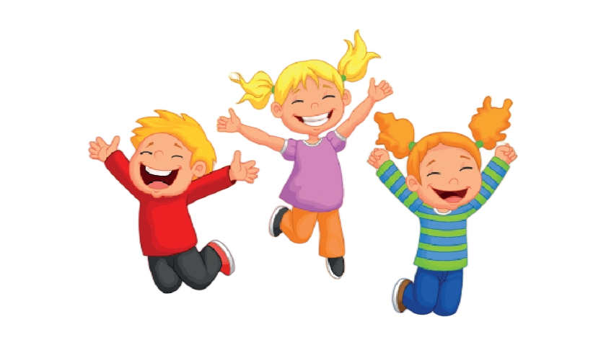

Unit 1 Laugh out loud！
Listening

Slide 2
Learning Objectives
In this class, you will be able to:
· learn the expressions about laughing by listening to the dialogues;
· know about April Fool’s Day and get some information about 3 practical jokes in history;
· get to know some expressions about telling a story or making comments;
· share your funny story with your classmates.

Slide 3


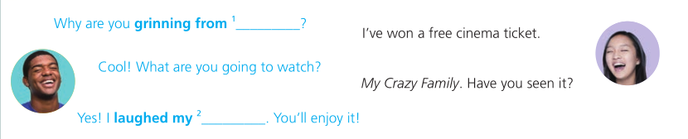

Fun time!
Listen and complete the conversations.
Why are you grinning from ¹ ____________?
I’ve won a free cinema ticket.
Cool! What are you going to watch?
My Crazy Family. Have you seen it?
Yes! I laughed my ² _________. You’ll enjoy it!
ear to ear
head off
Tapescripts
A: Why are you grinning from ear to ear?
B: I’ve won a free cinema ticket.
A: Cool! What are you going to watch?
B: My Crazy Farmily. Have you seen it?
A: Yes! I laughed my head off. You’ll enjoy it!
Conversation 1

Slide 4


I really don’t get Harry.
Why? Is he still not talking to you?
No. Today, he was all ³ ___________.
He asked me to help him with that website of his.
Really? What did you say?
Well, I said yes. We all deserve a second chance, I guess.
smiles
Tapescripts
A:I really don’t get Harry.
B: Why? Is he still not talking to you?
A: Well... Today, he was all smiles and asked me to help him with
that website of his.
B: Really? What did you say?
A: Well, I said yes. We all deserve a second chance, I guess.
Conversation 2

Slide 5


What’s the matter? Why the long face?
Yesterday, I stepped on a banana skin and fell
over in front of the whole class.
That’s so funny!
I was the ⁴ __________ stock of the class.
Even my teacher cracked ⁵ ______________.
laughing
a smile
Tapescripts
A: What’s the matter? Why the long face?
B: Yesterday, I stepped on a banana skin and fell over in front of the whole class.
A: That’s so funny!
B: I was the laughing stock of the class. Even my teacher cracked a smile!
Conversation 3

Slide 6
Match the expressions you have completed in Activity 5 to their meanings.
________________: a person that everyone laughs at because they have done something funny or silly
________________: to look friendly and happy, especially when other people are not expecting you to
________________: to look extremely happy because you are very pleased about something
________________: to smile slightly
________________: to laugh very loudly and for a long time
laughing stock
be all smiles
grin from ear to ear
crack a smile
laugh one’s head off

Slide 7

Work in pairs. Discuss other situations in which you could use these expressions.
laughing stock
grin from ear to ear
be all smiles
crack a smile
laugh one’s head off

Slide 8
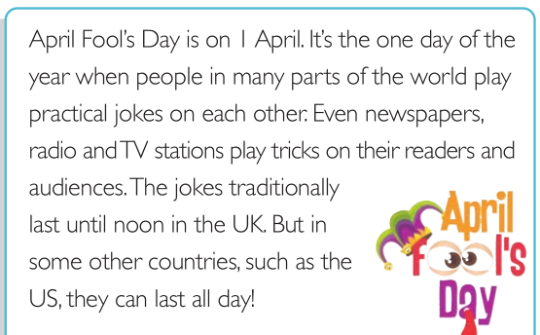
Did you know?

Slide 9

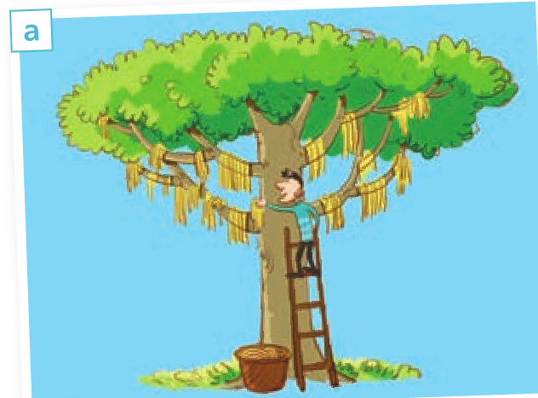
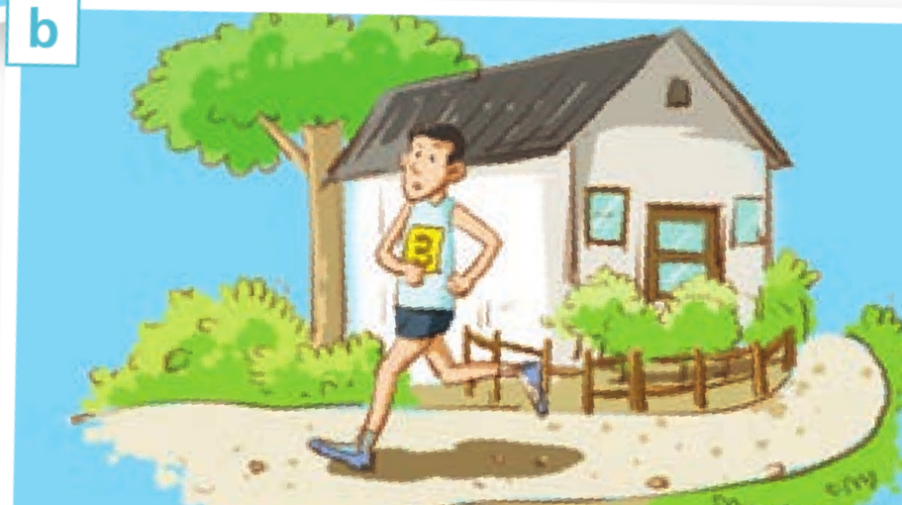
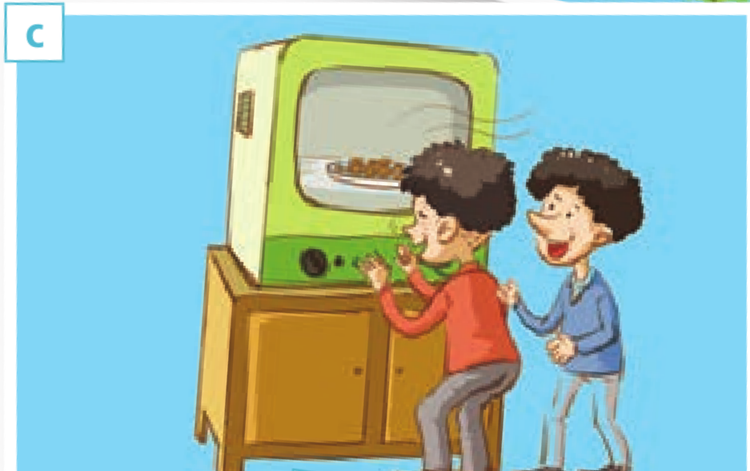
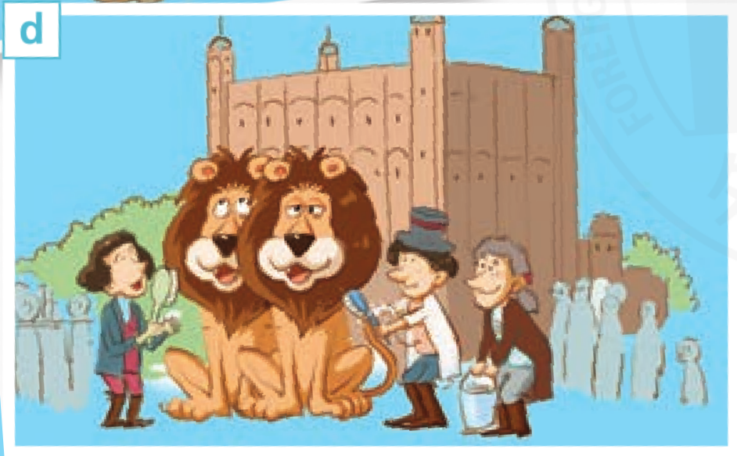
Listen to the radio programme and choose the pictures mentioned.
√
√
√

Slide 10
Tapescripts
Karen: Hi, I’m Karen and this is “Fun Time”. I’m joined today by Mark Cllin. Hi, Mark.
Mark: Hello!
Karen: As you know, today is the 1st of April or, as we call it, April Fool’s Day, and Mark’s here to tell us about three of the best practical jokes in history.
Mark: Indeed. Let’s start with the oldest recorded April Fool’s joke, which took place on the 1st of April 1698. Some people were told to go to the Tower of London to watch “the washing of the lions”. Of course, there were no lions at the Tower of London. This was reported in a newsletter - similar to today’s newspapers - on the second of April that year. Apparently, this practical joke worked so well that it was played on visitors throughout the 18th and 19th centuries.
Karen: Well, I’d be pretty annoyed if someone did that to me. OK, let’s hear the next one.
Mark: OK. This is a practical joke from 1965. The BBC News Channel invited a university professor to talk about his invention called “Smellovision”.
Karen: Smell-o-what?
Mark: Smellovision! This was a type of machine that allowed smells to be carried over the airwaves. During the interview, the BBC showed images of people actually smelling aTV screen!
d
c
c

Slide 11
Tapescripts
Karen: But I don’t get it... How on earth did people actually believe that there was such a thing as “Smellovision”?
Mark: The professor did a demonstration. He placed coffee beans and onions inside the Smellovision and asked people watching the programme at home to phone him if they could smell anything. And people did! Some really believed they could smell the coffee beans and onions. Some even said that the onions made their eyes water!
Karen: I see... I guess you can convince yourself of anything if you really want to.
Mark: Indeed! Now, my favourite one. The “spaghetti tree” joke.
Karen: Oh,I know it! It’s a good one!
Mark: It’s another BBC joke and probably the most famous one. On the 1st of April 1957, a news programme told viewers that the spagheti trees in Switzerland were having a really good harvest. The programme even showed people picking spagheti off trees and laying it in the sun to dry.
Karen: That’s so funny!
Mark: Many people fell for the joke because spaghetti wasn’t that common in England a the time.
Karen: I can imagine!
a

Slide 12

Listen again and complete the notes.
Joke 1
● Year: 1698
● Main story: A newsletfer reported people going to watch ¹ _____________ at the Tower of London. The joke was played on visitors throughout the ² ________________.
Joke 2
● Year: ³ ________________
● Main story: The ⁴ ________________ introduced an invention called “Smellovision”. It allowed ⁵ ________________ over the airwaves.
Joke 3
● Year: ⁶ ________________
● Main story: A news programme told viewers that the spaghetti trees in Switzerland Were having ⁷ ________________.

Slide 13
Joke 1
● Year: 1698
● Main story: A newsletfer reported people going to watch ¹ ________________ at the Tower of London. The joke was played on visitors throughout the ² __________________.
“the washing of the lions”
18th and 19th centuries
Tapescripts
Mark: Indeed. Let’s start with the oldest recorded April Fool’s joke, which took place on the 1st of April 1698. Some people were told to go to the Tower of London to watch “the washing of the lions”. Of course, there were no lions at the Tower of London. This was reported in a newsletter - similar to today’s newspapers - on the second of April that year. Apparently, this practical joke worked so well that it was played on visitors throughout the 18th and 19th centuries.

Slide 14
Joke 2
● Year: ³ ________________
● Main story: The ⁴ ________________ introduced an invention called “Smellovision”. It allowed ⁵ ________________ over the airwaves.
1965
BBC News Channel
smells to be carried
Tapescripts
Mark: OK. This is a practical joke from 1965. The BBC News Channel invited a university professor to talk about his invention called “Smellovision”.
Karen: Smell-o-what?
Mark: Smellovision! This was a type of machine that allowed smells to be carried over the airwaves. During the interview, the BBC showed images of people actually smelling aTV screen!

Slide 15
Joke 3
● Year: ⁶ ________________
● Main story: A news programme told viewers that the spaghetti trees in Switzerland Were having ⁷ _______________________.
1957
a really good harvest
Tapescripts
Mark: Indeed! Now, my favourite one. The “spaghetti tree” joke.
Karen: Oh,I know it! It’s a good one!
Mark: It’s another BBC joke and probably the most famous one. On the 1st of April 1957, a news programme told viewers that the spagheti trees in Switzerland were having a really good harvest. The programme even showed people picking spagheti off trees and laying it in the sun to dry.
Now work in pairs. Discuss which of the practical jokes you think is funny.

Slide 16


Complete the boxes with expressions from the radio programme.
• Let’s start with… • It’s a good one!
• I don’t get it. • That’s so funny!
• Now, my favourite one... • I can imagine!
It’s a good one!
Let’s start with…
I can imagine!
Now, my favourite one...
I don’t get it.
That’s so funny!

Slide 17

Work in pairs. Tell each other a funny story and make comments using the expressions in this section.
It’s a good one!
Let’s start with…
I can imagine!
Now, my favourite one...
I don’t get it.
That’s so funny!
Now give feedback on each other’s stories and help your partner to improve theirs.

Slide 18
Thank you!

