Slide 1
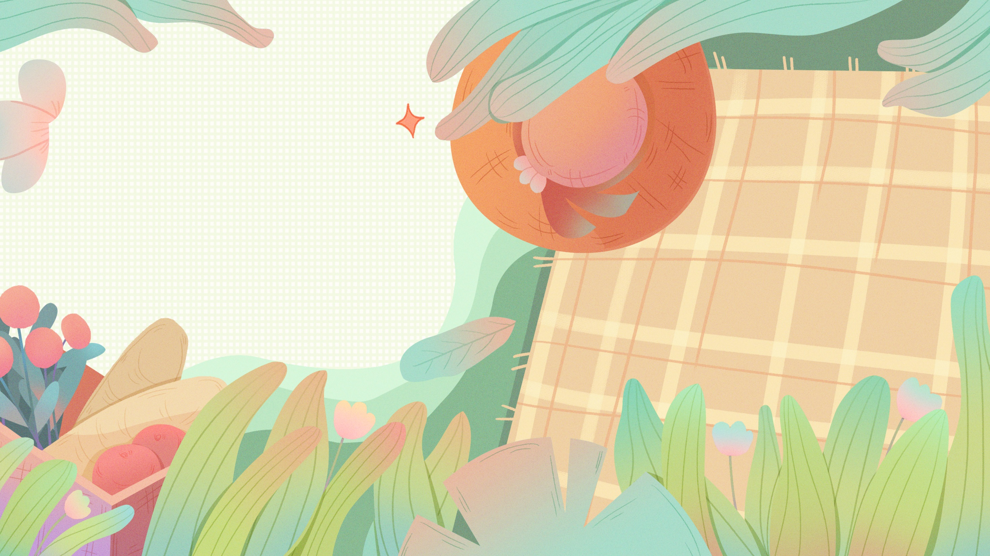
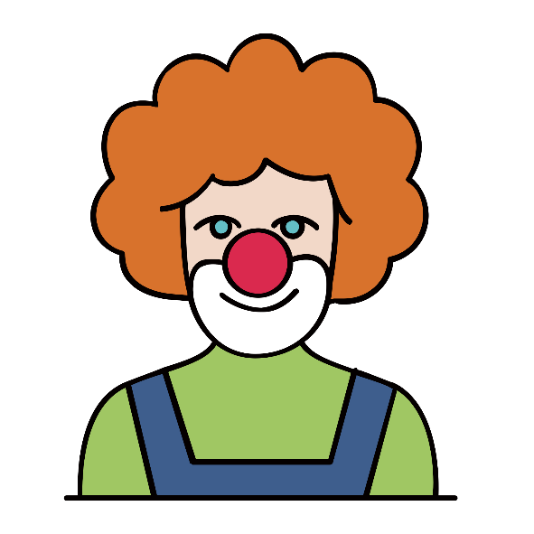
Unit 1
Laugh out loud
Starting out & Understanding ideas

Slide 2
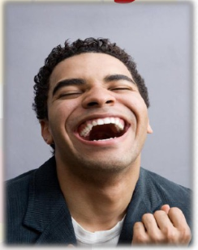
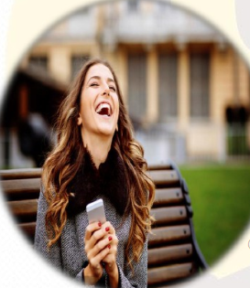
Starting out
Laughter is good to our health.
In your opinion, how to create the opportunities to laugh?
Watch a funny film or a TV show.
Go to a comedy club.
Share a funny book or a good story.

Slide 3


Watch and answer
1. What forms of comedy are mentioned in the video?
2. Have you ever been to a comedy show? Share your experience with the class.

Slide 4
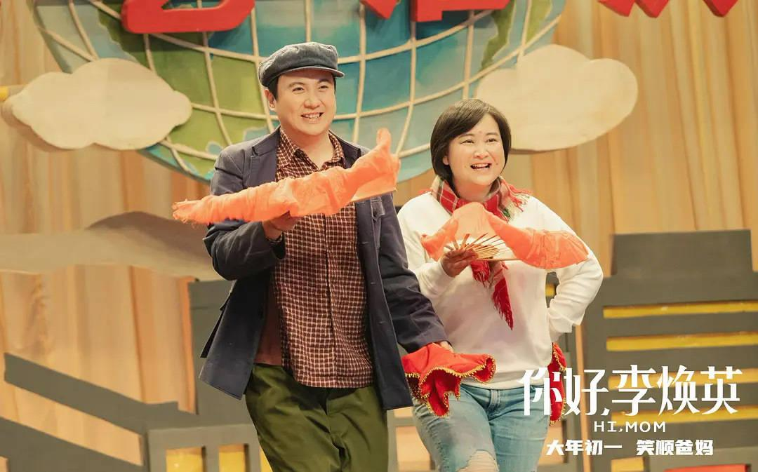
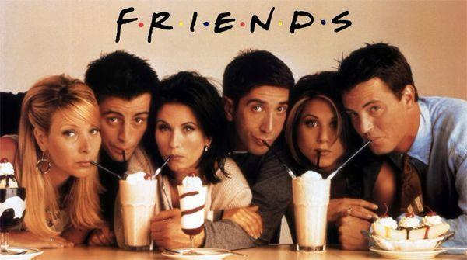


Watch and answer
1. What forms of comedy are mentioned in the video?
2. Have you ever been to a comedy show? Share your experience with the class.
Stage plays with happy endings, comedy acts with clowns, cross-talk, stand-up, sitcom and comedy film.

Slide 5
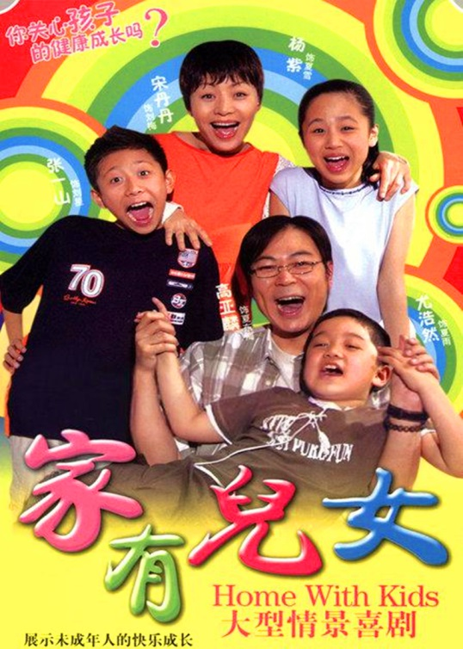

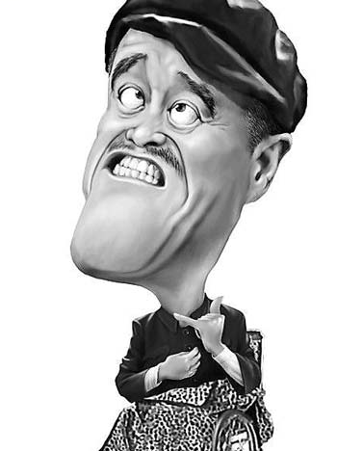
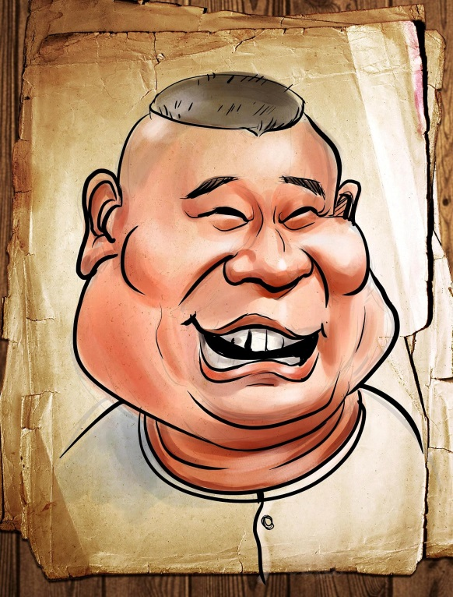
Do you know about which famous comedies and comedic figures ?
The Xia Familiy
Wu Lin Wai Zhuan
Zhao Benshan
Guo Degang

Slide 6
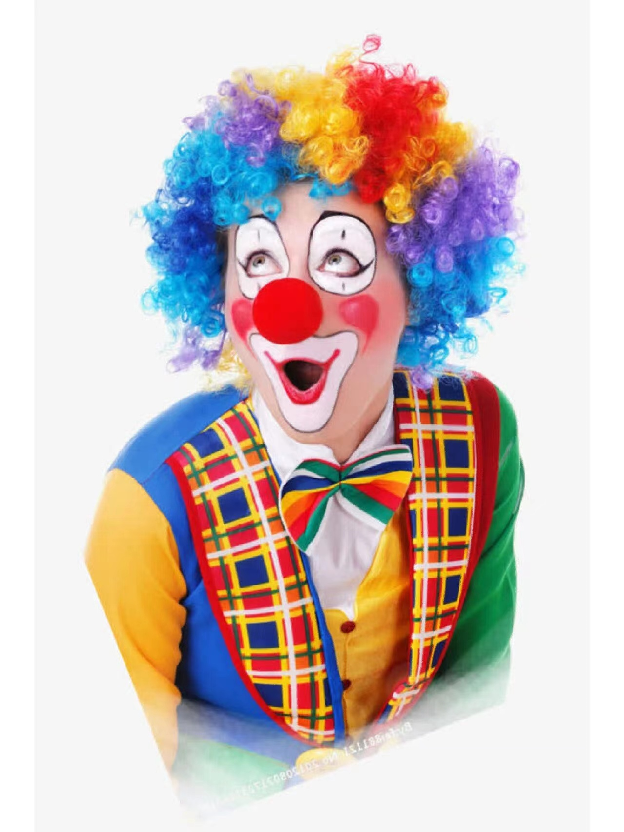
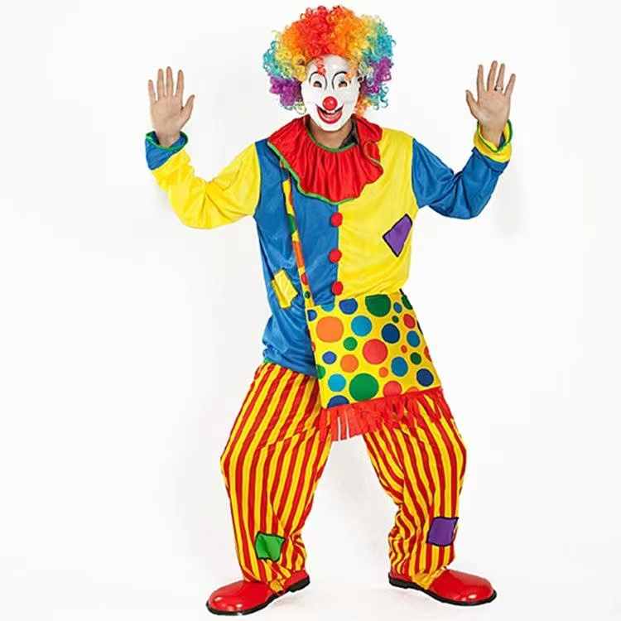
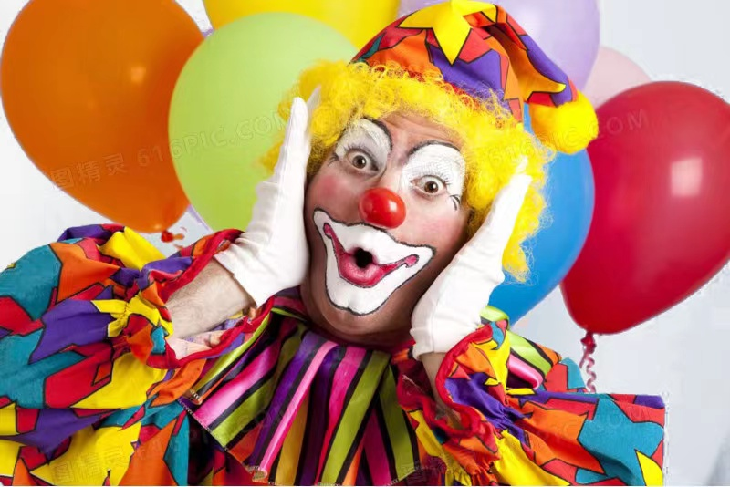
Understanding ideas

Slide 7
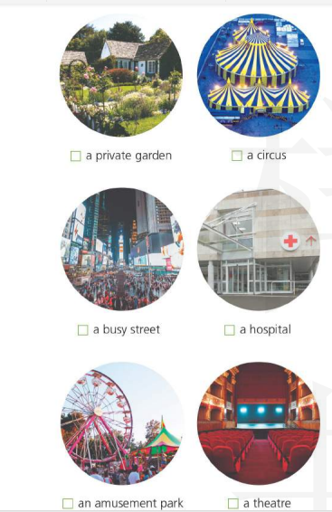
Where would you expect to see a clown?
a private garden
a circus
a hospital
an amusement park
a busy street
a theatre

Slide 8


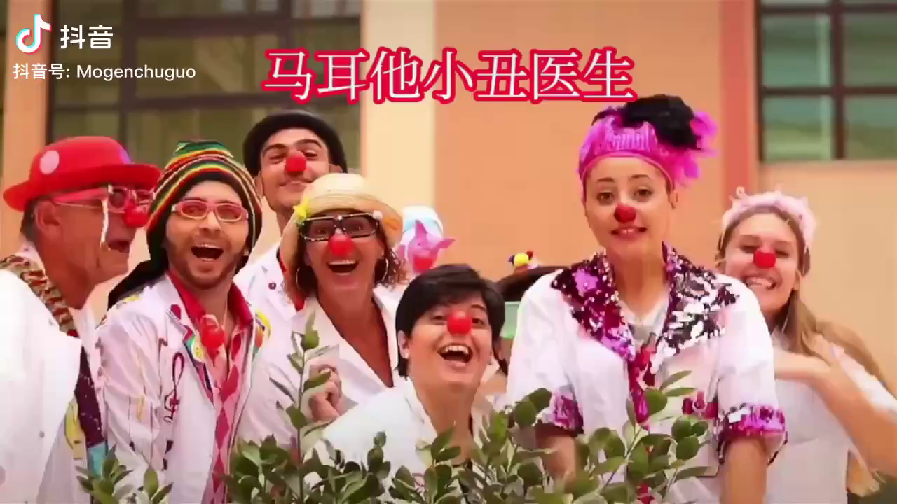


Can a clown be a doctor?
Yes, he/she can.
No, he/she can't.
Background knowledge
Clown Doctors treat sick children with fun and laughter.
A doctor
A clown

Slide 9
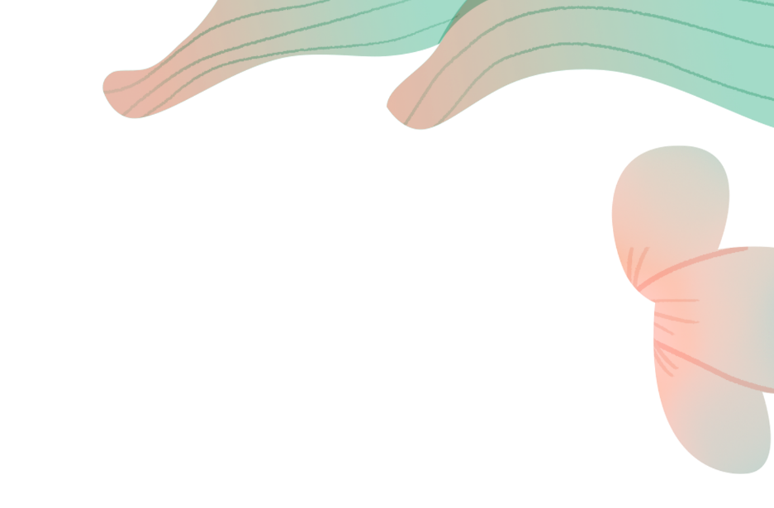


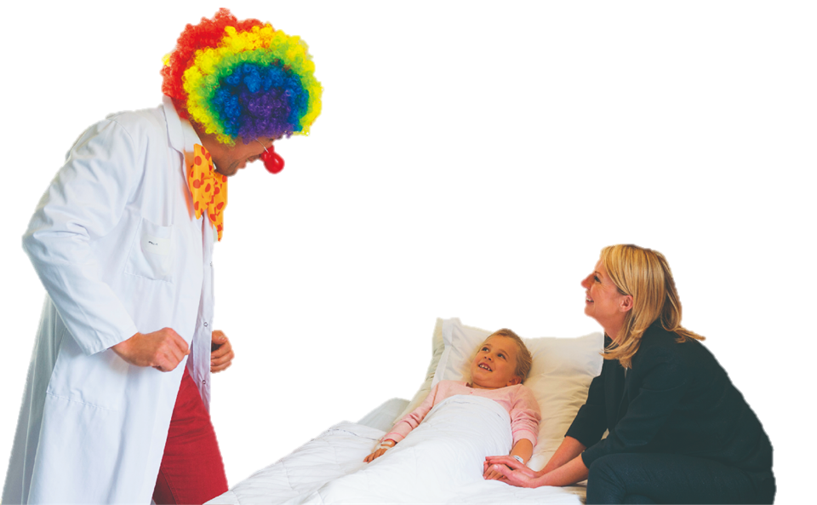
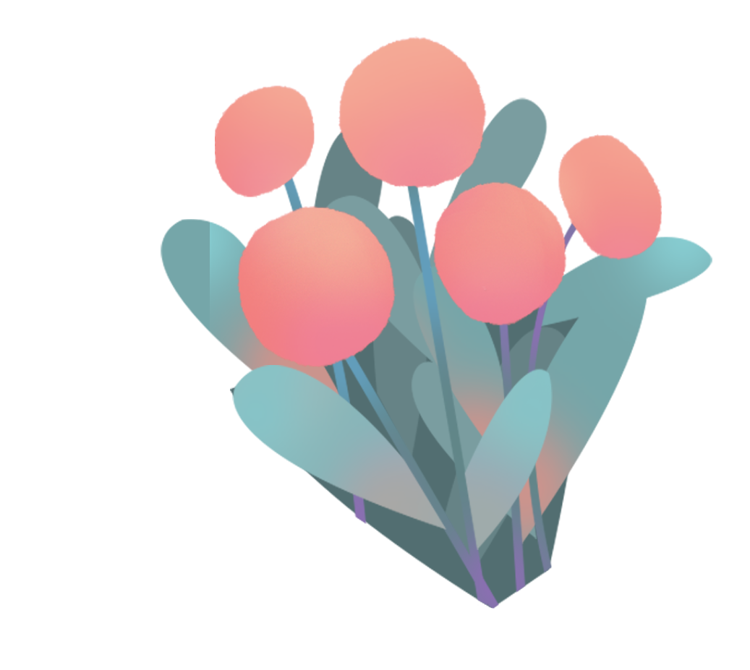

Slide 10

Understanding Ideas: Fast-reading
Quick Quiz
1.What is the author's job?
A.A clown doctor. B.A clown.
C.A professional psychologist. D.An assistant doctor.
2.What is the main idea of the text?
A.Smiling makes you younger.
B.Clown doctors help to treat patients.
C.Clown doctors are funny.
D.Doctors work hard.

Slide 11
Match the main ideas with the paragraphs
a. Which patient is in need of the clown doctor’s attention and why?
b. What is a clown doctor and why did the author choose to be one?
c. How does the author feel after a day's work?
d. What are the responsibilities of
a clown doctor?
e. How does the clown doctor help the patient?
f. What does this clown doctor wear and what is his working environment like?
para.1
para.2
para.3
para.4
para.5
para.6

Slide 12
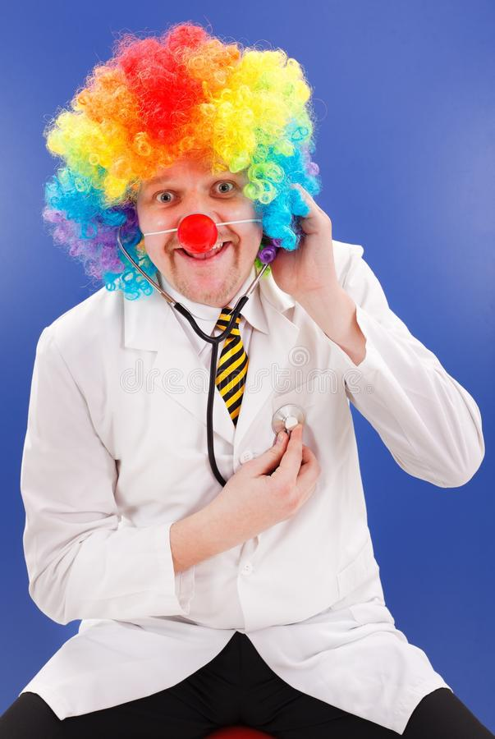
Understanding Ideas: Careful-reading
Doctor Larry Laugh-Out-Loud

Slide 13
Patients
Working Reason
Appearance
Responsibilities

Slide 14
Appearance
Para.1
What does this clown doctor wear and what is his working environment like?
He wears
a white coat, a curly rainbow wig, and a big red nose.
boring and tense.
His working environment is

Slide 15
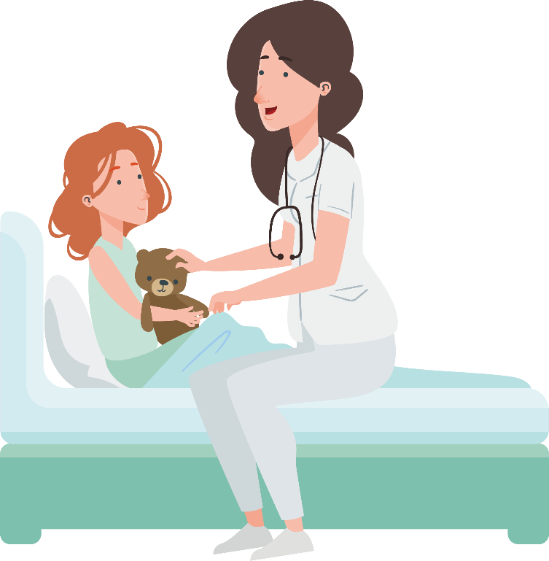
Patients
Para.2
Who is the clown doctor's patient and why?
A small girl called Lara is the clown doctor's patient,
because she fell off her bicycle and spent her time crying in pain.

Slide 16


Working Reason
Why does he choose to be a clown doctor?
Para.3
The author chose to be a clown doctor because of his frightening and boring experience of going to hospital when he was a kid. Being a clown doctor means he can help people by entertaining them.

Slide 17
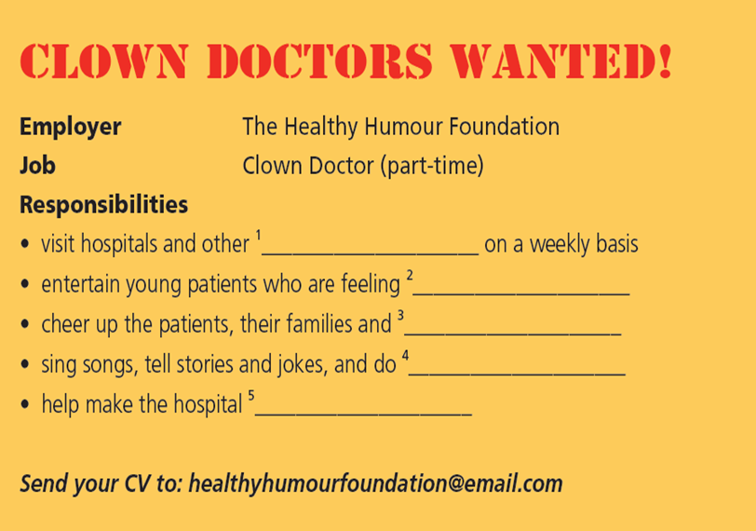
Job Advertisement
Para.4-6
health care facilities
nervous, painful or bored
the hospital staff
magic tricks
a friendlier place to visit

Slide 18
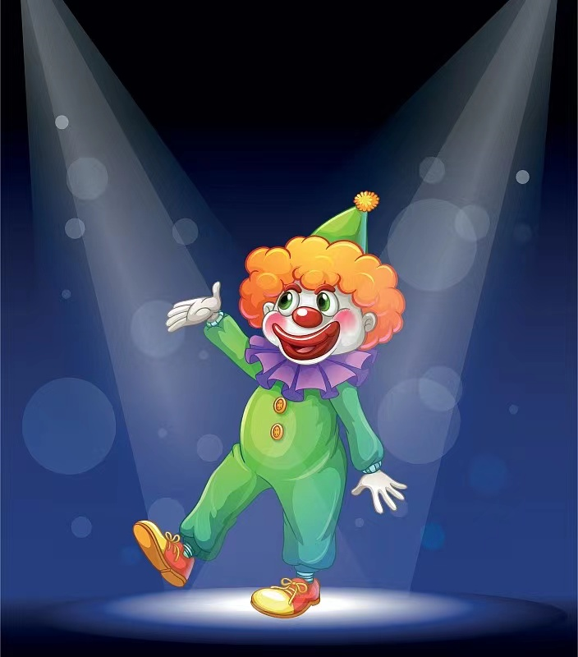
Show Time

Slide 19
Laughter
is the best medicine

Slide 20
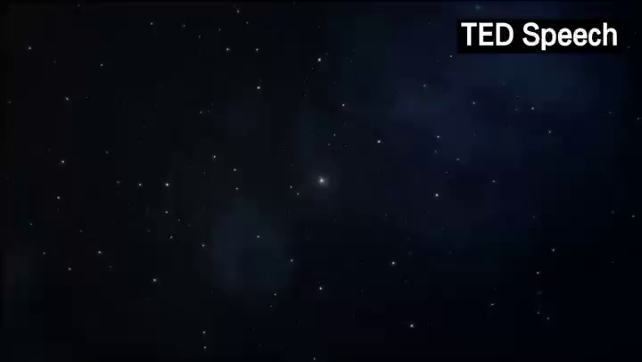

Slide 21
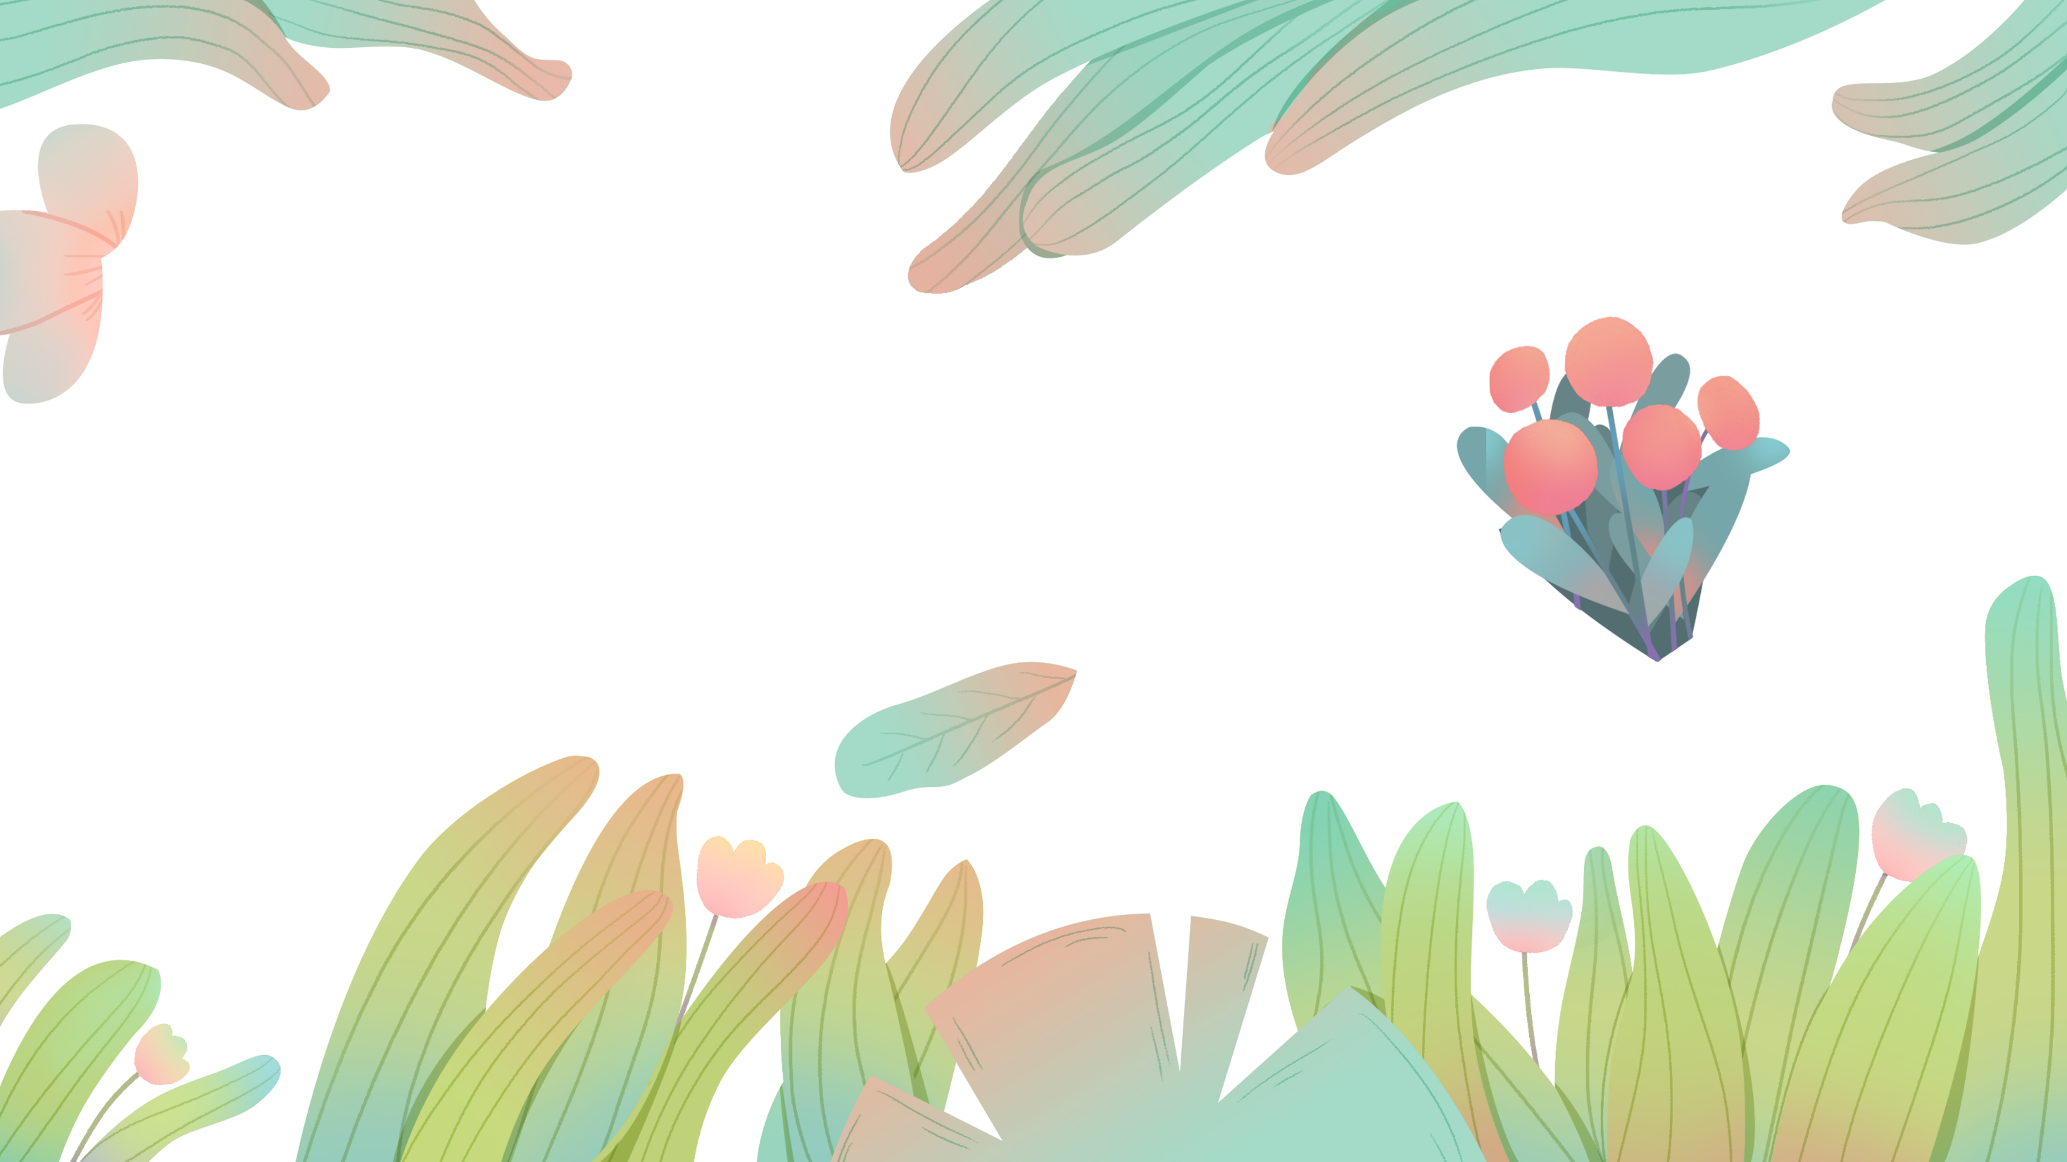
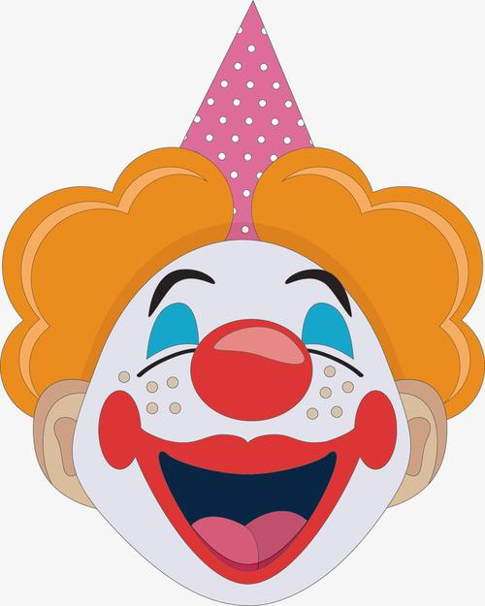

Hope you laugh every day！

