Slide 1

Unit 1
Laugh out loud!
Using language

Slide 2
Activity 1 Look at the sentences from the reading passage.
0,000 people reading my blog! b I love to photograph the rising sun, …
(P1) I walk through the doors into the waiting area, where there’s a familiar atmosphere of boredom and tension.
(P1) People sit uncomfortably on plastic chairs, looking through old magazines, all of which have been read hundreds of times previously.
(P2) I speak with the on-duty nurse, who tells me that Lara’s parents rushed her to the hospital after she fell off her bicycle.
(P3)... laughter produces chemicals to make people feel
better, which means clown doctors can be helpful.
(P4) We have to be very sensitive and work closely with the doctors and nurses, who keep us updated on each patient.

Slide 3

Lead-in
I like the boy.
I like the boy who is cleaning the room.
I like Tom, who is cleaning the room.
限制性定语从句
修饰限制先行词
翻译为“...的...”
我喜欢那个正在打扫房间的男孩
非限制性定语从句
补充说明主句
翻译时另起一句
我喜欢汤姆，他正在打扫房间

Slide 4
限制性定语从句
定语从句
非限制性定语从句

Slide 5
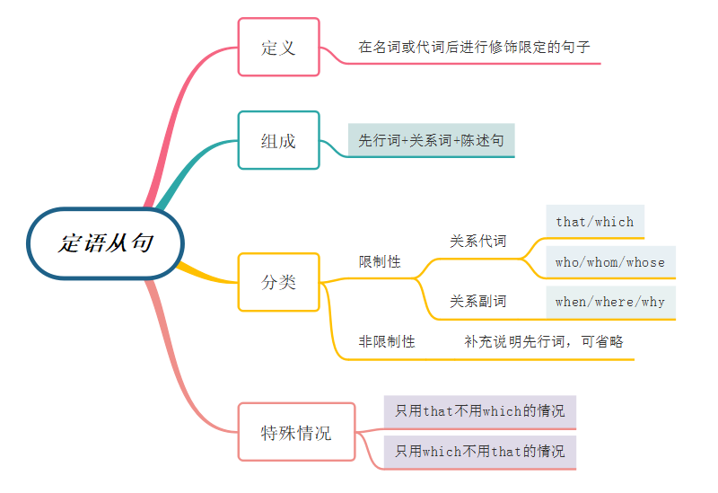
Review
Draw a mind map of attributive clauses.
修饰名词或代词做定语的从句
先行词+关系词+从句
人:
who, whose, that, whom
that, which, whose
物:
when, where, why
非限制性？

Slide 6
非限制性定语从句
概述
是对先行词加以描述、解释或补充说明的定语从句。它不是句中不可或缺的部分，去掉此句不会影响主句意思的完整性。
关系词
 | 关系代词 | 关系副词
限制性 | 人：that, who, whom | 时间：when
 | 物：which, as | 地点：where
 |  | 原因：why
 | 所属：whose
非限制性 | 人：who, whom | 时间：when
 | 物：which, as | 地点：where
 | 所属：whose | 原因：

Slide 7

限制性定从和非限制性定从的区别
一、形式功能不同
限制性定语从句的主句和从句之间不用逗号隔开，如果把从句去掉,句意会发生变化，甚至不能成立
My sister who works in Shanghai sends me an email every day.
非限制性定语从句的主句和从句之间用逗号隔开，省略从句对句意没有太大影响。
My sister, who works in Shanghai, sends me an email every day.

Slide 8
限制性定从和非限制性定从的区别
二、翻译方式不同
限制性定语从句一般把从句翻译在它所修饰的先行词之前
He is the man whose car was stolen.
他就是汽车被窃的那个人。
非限制性定语从句通常与主句分开翻译，译成并列句
I’ve invited Mary, who lives in the next flat.
我邀请了Mary，她就住在隔壁。

Slide 9
非限制性定语从句的主要应用场合
1. 关系词指代整个主句的内容时
In the presence of so many people he was a little tense, which was understandable.
在那么多人面前他有点儿紧张，这是可以理解的。
2. 当出现 “some/many/few/a few/little/much/most/half + of + which/ whom”等结构时
There are many badges on the table, most of which are new.
桌子上有很多徽章，大部分都是新的。
3. 先行词指的是世界上独一无二的事物、专有名词或表示类属事物时
China, which is my motherland, is developing fast.
中国是我的祖国，正在快速发展。

Slide 10
Practice
根据句意或中文提示完成句子。
This city, ________ lies in the northeast and _________ I spend my childhood, has been one of the country’s busiest ports since the 1950s.
They were well trained by their masters ______________ had great experience with caring for these animals.
3. She and her family bicycle to work, ___________ helps them keep fit.
4. In 1963 the UN set up the World Food Programme, one of _________ purposes is to relieve worldwide starvation.
5. Many young people, most of ________ were well-educated, headed for remot region to chase their dream.
which
where
who/that
which
whose
whom

Slide 11
非限制性定语从句需要注意的问题
1.非限制性定语从句常常位于句末,但也可位于句中, 这时前后都需要用逗号隔开。
The children, who wanted to play football, were disappointed when it rained. 那些孩子都想踢足球,（因而）因下雨感到失望。
2.“介词+关系代词”也可以引导非限制性定语从句。
先行词指人时, 关系代词用whom, 不可用who/that
先行词指物时, 关系代词用which, 不能用that。
3. 注：非限制性定语从句的关系词不能用that和why.

Slide 12
Practices
The factory _________ his father works is faraway from my hometown.
Last night I took part in a party and lost my key, ___________ I can’t open the door.
I introduced some subjects to her, __________ she may be interested.
In the dark street, there wasn’t a single person_________ she could turn for help.
in which
without which
in which
to whom

Slide 13

拓展思考：关系词as和which引导非限定从的区别？
As everyone knows, China is a country with a long history.
She is a great hero, as is described in the report.
He invited me to dinner, which made me very happy.
This novel, which I have read three times, is very touching.
Conclusion：
as和which在引导非限制性定语从句时可代替整个主句。
as和which引导非限制性定语从句时的位置不同:
as引导的定语从句可置于___________________，而which引导的非限制性定语从句不可放在_______________________________。
句首、句中、句后
句首，只能放在句中、句后

Slide 14
Ⅰ. 用适当的关系词填空
As
1. is known to everybody, the moon travels around the earth once every month.
2.English is a language shared by several diverse cultures, each of uses it differently.
3.She gave another piece of advice, I think was of great help to the research work.
4.She showed the visitors around the museum, construction had taken more than three years.
which
which
whose

Slide 15
5.The number of smokers, is reported, has dropped
by 17 percent in just one year.
6.The meeting, was held in the park, was attended
by 1,000 people.
7.They came to China in the 1970s, China was not open
to the outside world.
as
which
when

Slide 16
Activity 3 Read the passage and rewrite the tips using non-defining attributive clauses.
SECRETS TO HAPPINESS
• Go for a walk in the countryside. There you can enjoy the beautiful views and a peaceful atmosphere.
• Spend time with your family and friends. This will activate chemicals in your brain to make you feel happier.
• Try to accept your mistakes. You can learn a lot through them.
• Close your eyes and picture the future. You’ve made your dreams come true.
Achieving a positive state of mind isn’t easy for everyone. But there are ways to maintain a healthy mind even during times of difficulty.

Slide 17

Grammar: Non-defining attributive clauses
• Go for a walk in the countryside. There you can enjoy the beautiful views and a peaceful atmosphere.
• Spend time with your family and friends. This will activate chemicals in your brain to make you feel happier.
• Try to accept your mistakes. You can learn a lot through them.
• Close your eyes and picture the future. You’ve made your dreams come true.
Go for a walk in the countryside, where you can enjoy the beautiful views and a peaceful atmosphere.

Slide 18
Grammar: Non-defining attributive clauses
• Go for a walk in the countryside. There you can enjoy the beautiful views and a peaceful atmosphere.
• Spend time with your family and friends. This will activate chemicals in your brain to make you feel happier.
• Try to accept your mistakes. You can learn a lot through them.
• Close your eyes and picture the future. You’ve made your dreams come true.
Spend time with your family and friends, which will activate chemicals in your brain to make you feel happier.

Slide 19
Grammar: Non-defining attributive clauses
• Go for a walk in the countryside. There you can enjoy the beautiful views and a peaceful atmosphere.
• Spend time with your family and friends. This will activate chemicals in your brain to make you feel happier.
• Try to accept your mistakes. You can learn a lot through them.
• Close your eyes and picture the future. You’ve made your dreams come true.
Try to accept your mistakes, where / through which you can learn a lot.

Slide 20
Grammar: Non-defining attributive clauses
• Go for a walk in the countryside. There you can enjoy the beautiful views and a peaceful atmosphere.
• Spend time with your family and friends. This will activate chemicals in your brain to make you feel happier.
• Try to accept your mistakes. You can learn a lot through them.
• Close your eyes and picture the future. You’ve made your dreams come true.
Close your eyes and picture the future, where you’ve made your dreams come true.

Slide 21
Activity 4 Complete the joke with the sentence parts in the box using who / which and put commas in the correct position.
has lost his patience by now
he thinks will impress Holmes
is lying next to him
he finds annoying

Slide 22
Grammar: Non-defining attributive clauses
One day, Sherlock Holmes and Dr Watson go camping. They put up their tent under the stars and go to sleep. Suddenly, in the middle of the night, Watson is woken up by Holmes 1 ______________________ “Watson,” Holmes says, “look up at the stars, and tell me what they tell you.” Not quite sure what he means, Watson thinks Holmes is joking 2 ______________________ at this time of night.
,who is lying next to him
,which he finds annoying

Slide 23
Grammar: Non-defining attributive clauses
Even so, he replies, “I see millions of stars and it’s quite likely there are some planets like Earth. And if so, this means that there might also be life on other planets.” Watson is pleased with his answer 3 _______________________________. But Holmes 4 ____________________________ shouts, “Watson, look around you! Use your eyes! Somebody’s stolen our tent!”
,which he thinks will impress Holmes
,who has lost his patience by now

