Slide 1
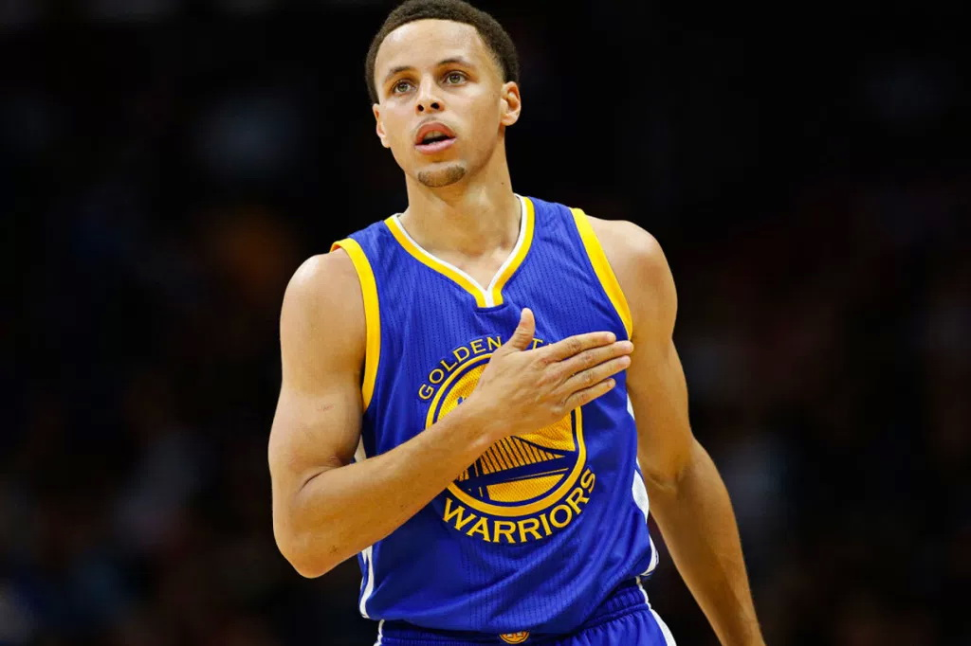


Slide 2


Slide 3


To learn something about the basketball positions.
2. To find out what has Stephen Curry achieved.
3. To analyse the structure of the text.
4. To think about what you’ve learnt from doing sport or from your favourite basketball player.

Slide 4


Think of a successful person that you admire. What does he or she do and why do you admire this person?
Here is a short video about Nick Vujicic, an Australian-American born without arms or legs who has become a world-renowned speaker. Watch the video and find out his road to success.

Slide 5
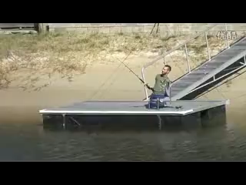
Everyone wants to succeed, but the road to success is not so smooth. It needs hard work, strong mind and many other factors. But first of all,

Slide 6

You have to believe in yourself. That's the secret of success.
Charles Chaplin

Slide 7


Today’s story is about Stephen Curry’s road to success. He is a basketball player. First, let’s learn some terms about basketball.
frontcourt 前场
halftime 中场休息
hook shot 钩手投篮
layup 单手上篮
set shot 原地投篮
slam dunk 灌篮，扣篮
three-pointer 三分球
backboard 篮板
backcourt 后场
bank shot 擦板投篮
court 球场
free throw lane 罚球区
free throw line 罚球线

Slide 8

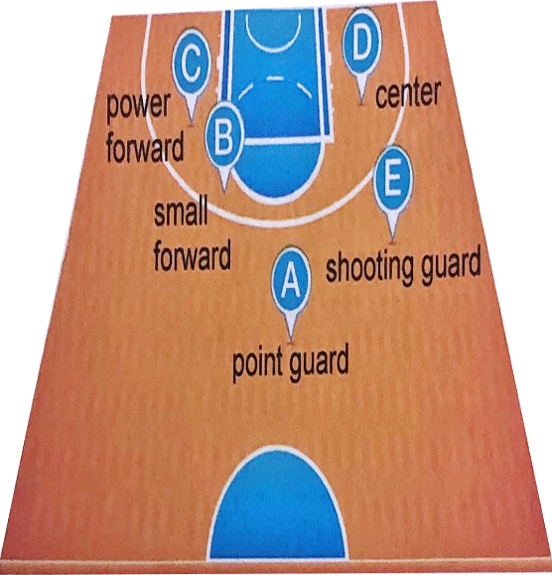
Research online and match the five basketball positions to their descriptions.
1 usually the best ball handler and / or best passer
A
2 usually the main shooter playing on the wing
E
3 usually the most athletic player on the team who can play inside and outside the key
B
4 usually a taller player who catches the ball after a player has tried but failed to get a point
C
D
5 usually the tallest player on the team who plays inside the key and should be a good scorer

Slide 9

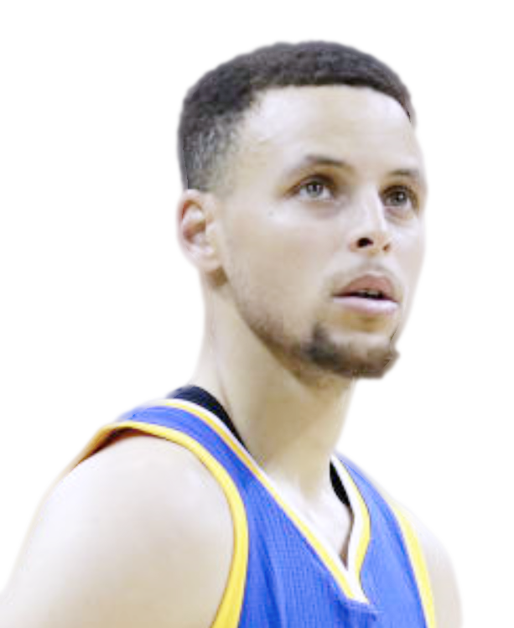
Here is one of the famous point guard, Stephen Curry.
Stephen Curry is an American professional basketball player. He first garnered national attention for his impressive play at Davidson College. He first joined the NBA in 2009, playing for the Golden State Warriors, his shooting skills making him one of the top players. Given the Most Valuable Player award in
2015, Stephen helped the Warriors win the NBA
championship in the same year. In 2016, Stephen
was once again named Most Valuable Player, his
team the Warriors again winning the NBA title in
2017 and 2018.

Slide 10
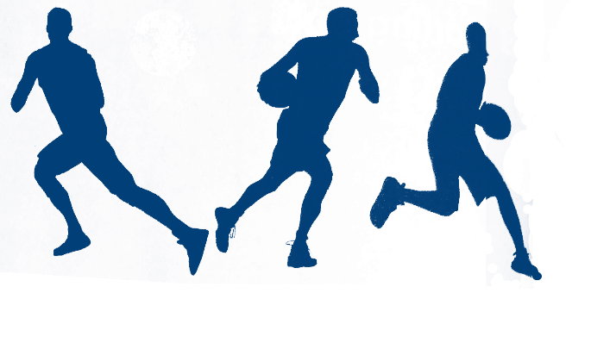

Read the passage and find out what Stephen Curry has achieved.
In 2015, Stephen Curry won his first NBA championship, and he led the Warriors to their first championship since 1975. He also received the Most Valuable Player award for two years in a row.

Slide 11

Match the main idea with each paragraph.
Para. 1
Para. 2
Para. 3
Para. 4
Para. 5
Stephen’s brilliant performances brought him remarkable achievements.
Stephen cleared up people’s doubts with his perseverance with basketball.
Stephen’s grandfather built a simple basket.
Stephen explained the key to his success.
Practising on the muddy basketball court helped Stephen sharpen his skills.

Slide 12
本文语篇类型为新闻报道，采用记叙文的结构介绍了体育明星Stephen Curry的成功之路。
记叙文通常包括介绍背景、描述经过、交代结局、发表议论四个结构成分。
文章的第一段通过一个特写镜头（位于弗吉尼亚州的一个名为Grottoes的小镇上的一条窄窄的土路）交代了事件发生的背景，并引出了本文的主人公——Stephen Curry。
第二、三段用大量的篇幅向读者介绍了年少的Stephen是如何在艰苦的条件下坚持练习，如何从一个不被看好的球员成为球队的明星球员。

Slide 13
第四段讲到Stephen入选NBA并带领金州勇士队取得自1975年以来的第一个NBA冠军，这可以看作是Stephen的辛勤付出得到的回报。
最后一段超越了故事本身，通过Stephen分享他的人生哲学启发读者——不要在意别人对你的看法，只要你对自己有信心，并足够努力，坚持下去，一切皆有可能！

Slide 14

Choose the author’s purpose in writing the passage and give your reasons.
1. To explain why Stephen Curry was doubted by many people.
2. To inform people about Stephen Curry’s basketball skills.
3. To inspire people with Stephen Curry’s determination to succeed.

Slide 15
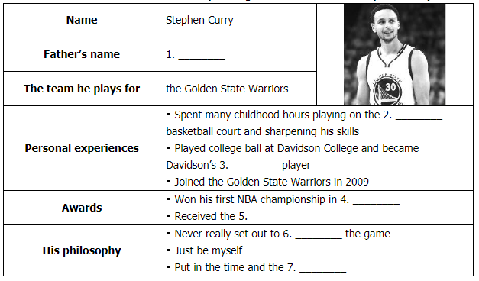
Please fill in the boxes with the corresponding information about Stephen Curry.
Dell Curry
muddy
star
2015
Most Valuable Player
change
work

Slide 16
Decide whether the following statements are True (T), False (F) or Not Given (NG).
1. Stephen’s grandfather built a simple basket which was significantly different from the bright lights and shiny courts of the NBA. ( )
2. Dell Curry always played basketball on the muddy basketball court during his childhood. ( )
3. Stephen learned to shoot with great accuracy from his father. ( )
T
T
NG

Slide 17
4. People thought Stephen would make a good career for himself in basketball like his successful father. ( )
5. Stephen deserved great popularity at Davidson College because of his creativity and perseverance. ( )
6. Stephen showed that self-belief, hard work, perseverance and some help from an old hoop can make anything possible. ( )
F
T
T

Slide 18
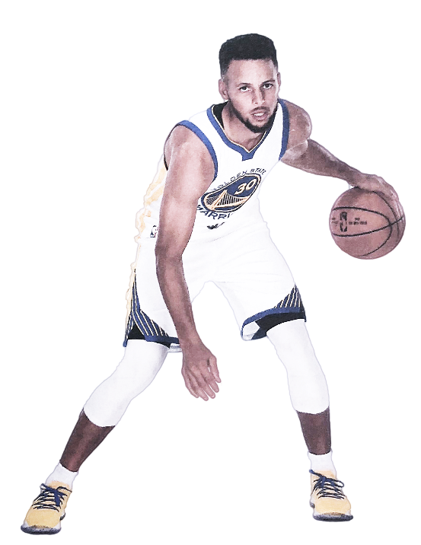
Organize information from the passage and complete the profile of Stephen Curry.
Stephen Curry is the son of the famous basketballer Dell Curry. He spent his childhood years practicing basketball on _______________________________. The poor conditions helped him develop his own playing style.
He also learnt to __________________________.
a muddy basketball court
be creative and flexible
Despite this, it seemed unlikely to many people that Stephen would be a great basketball player, as he was _____________________________.
too thin, too short, and too weak

Slide 19
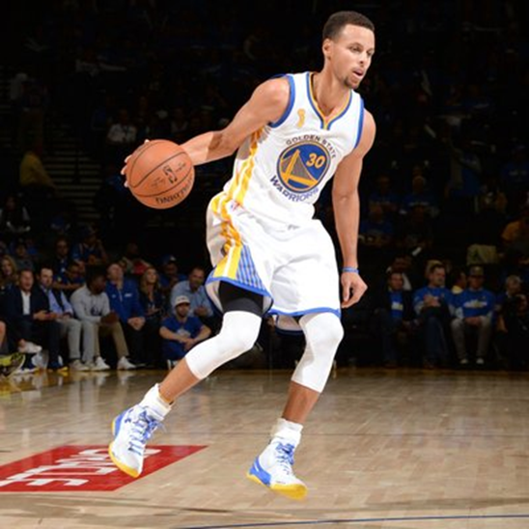
give up
Nonetheless, Stephen refused to _________________________, and ended up playing college ball for Davidson College.
In 2009, he joined the NBA’s Golden State Warriors. In 2015, he led them to their first NBA Championship since 1975. Stephen achieved his dream through_____________________ _________________________________________.
self-belief, hard work,
perseverance and some help from an old hoop
Nationality: _____________________
American
Basketball player
Occupation: ____________________
the Most Valuable Player
Awards: ________________________

Slide 20

Complete the mind map with supporting details.
Self-belief
Despite many people thinking he couldn’t follow in his father’s footsteps, he carried on playing basketball.
Hard work
Practising day in and day out helped Stephen sharpen his skills.
Stephen never gave up and valued the fact that he could work every single day to get better.
Perseverance

Slide 21
Below is a summary of the text with some content missing. Choose the right item from the box and make the summary complete. Change the form when necessary.
shoot, self-belief, basket, sharpen, influence, short
Stephen Curry’s grandfather built a simple 1. ____________ along a narrow dirt road near the small town of Grottoes. Like his father, Stephen spent much of his childhood playing basketball. In this way, he 2. ______________ his skills.
basket
sharpened

Slide 22
shoot, self-belief, basket, sharpen, influence, short
Playing basketball was his dream, despite many people thinking he was too 3. _____________, too thin, and too weak. Finally, his accurate 4. ____________ and continuous efforts made him perform beyond everyone’s expectations and achieve extraordinary results. Stephen Curry proves that what other people think of you doesn’t 5. ____________ what you become. Anything is possible through 6. _____________, hard work, perseverance, and some help from an old hoop.
short
shooting
influence
self-belief

Slide 23


1. Do you like doing sports? What benefits do sports bring to you?
2. Are you a basketball fan? Which player do you like best?
Choose one question and write down your answer.

Slide 24


