Slide 1
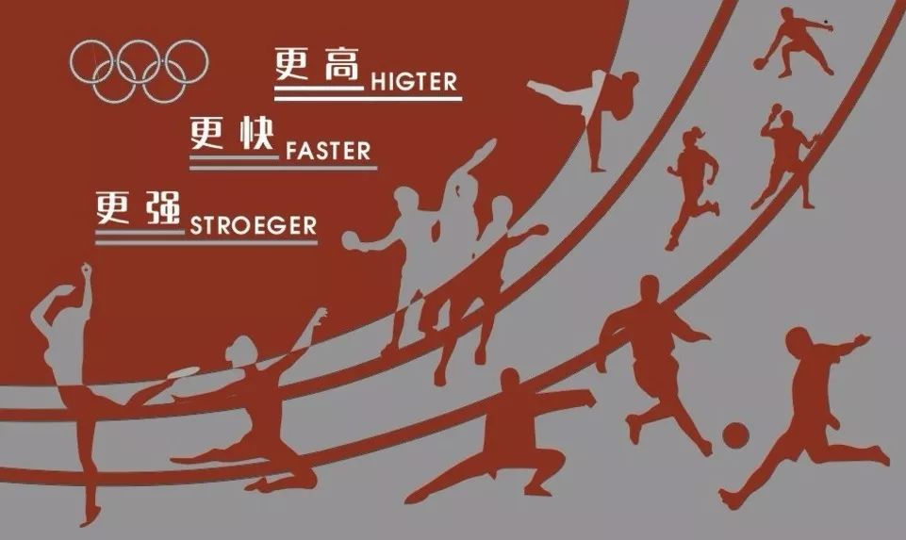
Unit 3
Faster, Higher, Stronger

Slide 2

-ing as subject

Slide 3


To summarise the use of -ing as subject
To practice the use of –ing as subject by doing some exercises

Slide 4

Look at the sentences from the reading passage and answer the question.
a Knowing where the ball would go wasn’t easy.
b Shooting with great accuracy was another thing he learnt.
1 What are the subjects in sentences (a) and (b)?
In sentence (a), the subject is “Knowing where the ball would go”.
In sentence (b), the subject is “Shooting with great accuracy”.

Slide 5
Compare them with the following sentences and answer the questions.
c Stephen Curry knew where the ball would go. It wasn’t easy.
d Stephen Curry shot with great accuracy. It was another thing he learnt.
2 What does “it” refer to in sentences (c) and (d)?
In sentence (c), “it” refers to “knew where the ball would go”.
In sentence (d), “it” refers to “shot with great accuracy”.

Slide 6
3 Why does the author choose to use sentences (a) and (b) in the reading passage?
Considering the genre of the reading passage - a news report, it requires more concise and formal language. So the author chooses to use sentences (a) and (b) in the reading passage, which are suitable for a news report.

Slide 7
Now look for more sentences with –ing as subject in the reading passage, and summaries its use in your own words.
① Practicing day in and day out helped Stephen sharpen his skills.
② Playing basketball was his dream.

Slide 8

-ing as subject 动名词作主语
动词-ing 形式作主语常用来表示经常性或习惯性的动作且通常放在句首。
e.g. Fishing is my pleasure.
Talking mends no holes. (空谈无济于事。)
动名词作主语，还可以是复合结构，前面可以有物主代词：
e.g. My opening the door annoyed him.
我开门使他烦恼。

Slide 9
动名词作主语常见的三种形式：
1) 在句首直接作主语；
2) it在句首作形式主语，动词的-ing形式是真正的主语；
常用于：It is no use / no good / useless, etc + 动词-ing
It is nice / good / interesting / a waste of etc +动词-ing
e.g. Trying to persuade him to stop smoking is no use.
= It is no use trying to persuade him to stop smoking.
Learning theory without practice is no good.
= It is no good learning theory without practice.

Slide 10
3) There be + no +动词的-ing形式
There was no telling when this might happen again.
【注意】
1) 动词的-ing形式作主语，谓语动词通常要用单数。
e.g. Reading aloud is vital to learn a second language.
Seeing is believing.
Going to bed early and getting up early is a good habit. (早睡早起可看成同一件事)
2) 动词的-ing形式的否定式可以在其前面加not

Slide 11
动词的-ing形式作主语和动词不定式作主语区别：
1) 动词的-ing形式作主语通常表示抽象动作，往往是普通的、一般的行为；动词不定式作主语通常表示某次具体动作或行为。前者表示一直的事情和经验，后者通常表示一件未完成的事情或未达成的目的。
eg Reading French is easier than speaking it.
读法语比讲法语容易。
To stop the work now seems impossible.
现在把工作停下来似乎已不可能。

Slide 12
2) 动词-ing形式的逻辑主语可能泛指人们，而不定式的逻辑主语则常是句子中的名词或代词。
eg Trying without success is better than not trying at all.
To achieve his dream of being an excellent basketball player, he practice day in and day out.

Slide 13

Rewrite the underlined sentences with the –ing form as subject.
Etenesh Diro had almost completed two thirds of the 3000m steeplechase, when disaster struck. She got tangled up with some other competitors. It made her fall.
Getting tangled up with some other competitors made her fall.

Slide 14
But trying to pull the shoe back on cost her precious time.
Her right shoe started to come off. She tried to pull the shoe back on, but it cost her precious time. One after the other, the runners overtook her.
She threw the shoe away. This meant she could get up quickly and fight for her position in the race.
Throwing the shoe away meant she could get up quickly and fight for her position in the race.

Slide 15
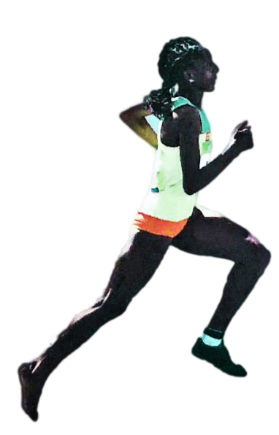
Running the rest of the race with just one shoe on and her right foot bare raised a big cheer for her.
She ran the rest of the race with just one shoe on and her right foot bare. It raised a big cheer for her. Luckily, she was later given a chance to compete in the final. She lost a shoe. But it didn’t keep her from taking part. This is the true spirit of sport.
Losing a shoe didn’t keep her from taking part.

Slide 16
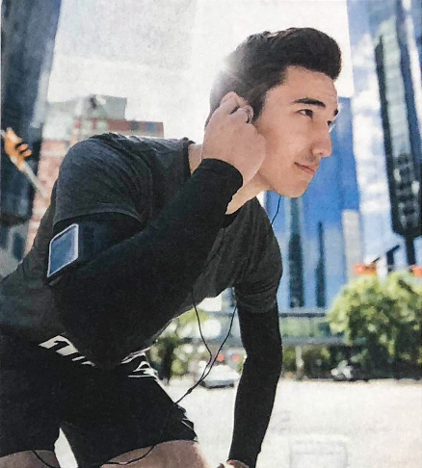
Complete the passage with the correct form of the words in the box.
wear let miss make use
I like how technology is changing sports. ___________ the latest equipment, such as smart earphones, allows people to get the best out of their training. ___________ video technology to help judge our sporting competitions can ____________ sure that no one cheats.
Wearing/ Using
Using
make

Slide 17
wear let miss make use
Best of all, instant replay facilities _________ us see all the action all over again.
_________ our favorite sporting moments is now a thing of the past!
let / make
Missing

Slide 18


Think about whether you agree with the point of view in Activity 3 and share your opinion with the class. Use the –ing form as subject where appropriate.

Slide 19


I. 用所给词的正确形式填空。
1. __________ (Listen) to music is one of my favourite hobbies.
2. It’s no use ________ (talk) to him; he won’t change his mind.
3. As we all know, __________ (smoke) does harm to one’s health.
4. __________ (Drink) a lot of water _____ (be) good for you.
Listening
talking
smoking
Drinking
is

Slide 20
II. 根据括号内的汉语提示，完成句子。
_______ ________ ________ ________ (他们来帮忙) is a great encouragement to me.
________ ________ _________ ________ _________(上课不迟到) is my decision.
In some parts of London, _________ _________ _________ (错过一趟公交车) means waiting for another hour.
It is a waste of time _________ _________ _________ (和他争论) about it.
Their coming to help
Not being late for school
missing a bus
arguing with him

Slide 21


Read the text again and underline all sentences with –ing as subject.

Slide 22


