Slide 1
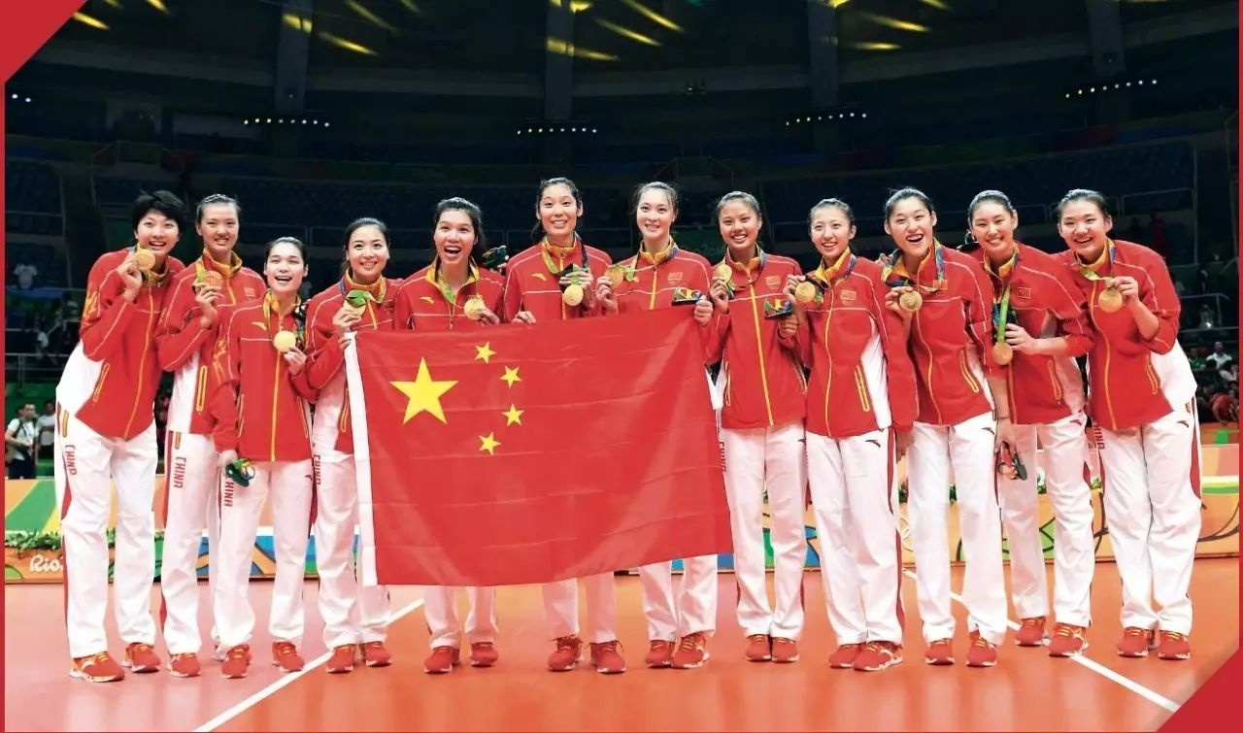
Unit 3
Faster, Higher, Stronger

Slide 2


Slide 3



1. Understand the key differences between team sports and individual sports.
2. Understand the structure of the text.
3. Lean to distinguish facts and opinions.
4. Give your opinion by offering examples.

Slide 4


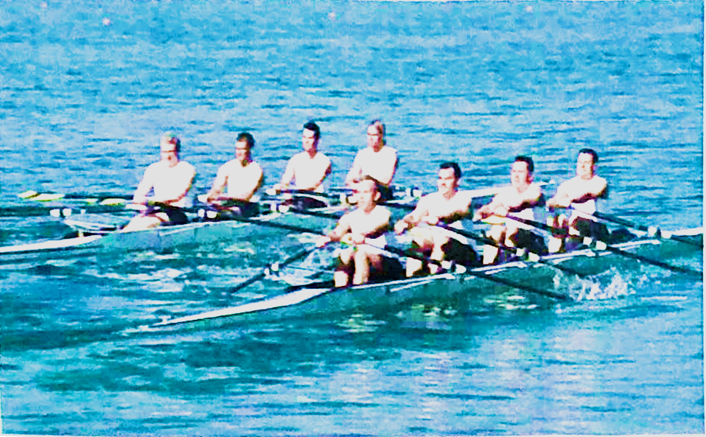
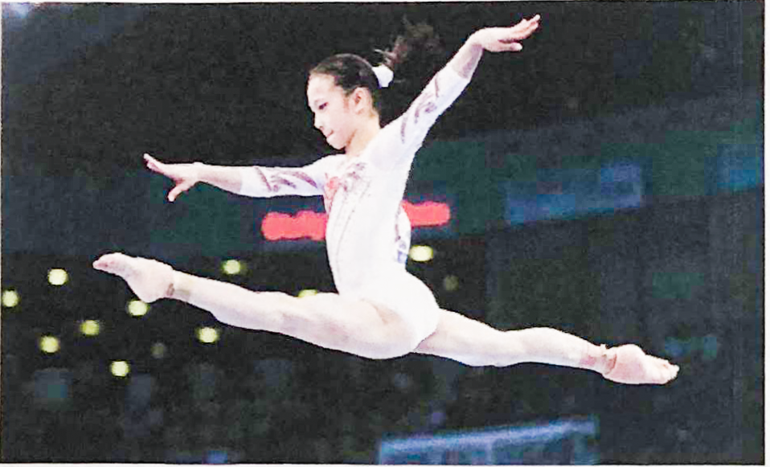
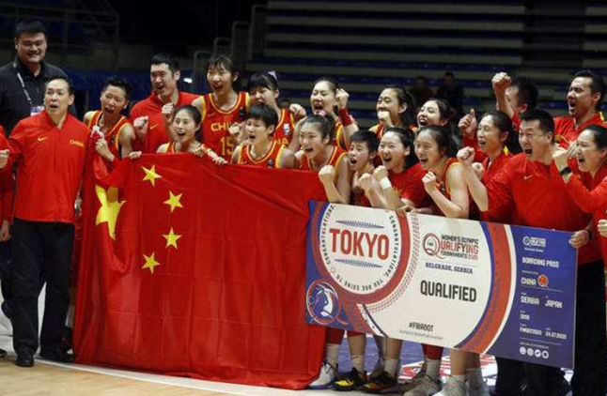
Look at the pictures and answer the questions.
1. What are the key differences between
team sports and individual sports?
2. Can you think of any famous sports teams? Why are they so well-known?

Slide 5
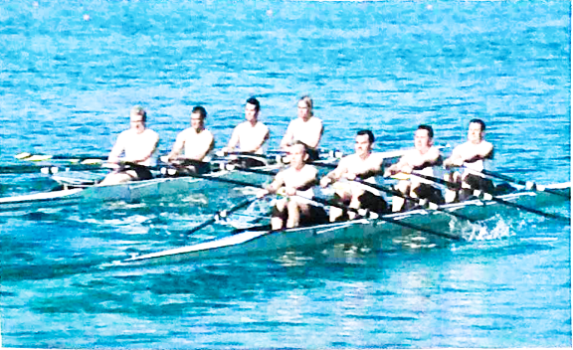
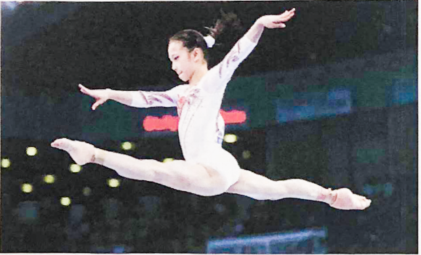
In individual sports one player competes against other players. Team sports require no less than two players on each side. In team sports, every player needs to learn to trust and depend on others, to accept help and give help, and to work together to reach a common goal.
Players who excel at individual sports, however,
find satisfaction pushing themselves to achieve
personal goals rather than relying on the team
to help them get there. But even individual
sports also need back up from a wider team.

Slide 6

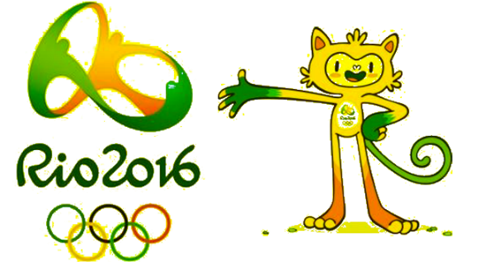
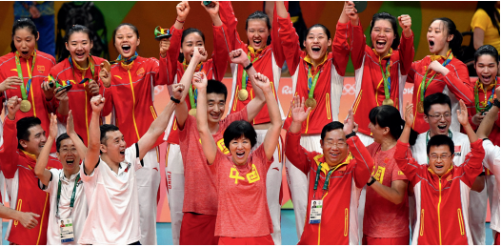
Do you know something about the Chinese Women's Volleyball Team in 2016 Rio Summer Olympic Games?
In 2016 Rio Olympic Game, Chinese Women Volleyball Team successively defeated Brazil, Holland and finally won over Serbia, gaining back its Olympic gold medal again after a whole 12 years.

Slide 7


Read the passage and find out about the events mentioned.
The 1984 Los Angeles Olympics, the 2004 Athens Olympics, and the 2016 Rio (de Janeiro) Olympics.

Slide 8
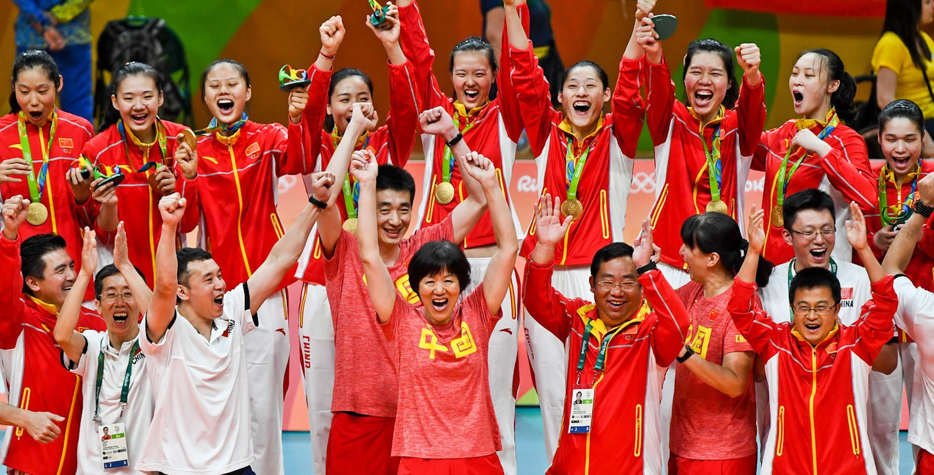
本文语篇类型为新闻报道。课文介绍了中国女排如何凭借坚忍不拔的毅力和奋斗精神以及团队合作精神战胜困难，赢得各类国际赛事，成为名副其实的世界冠军。

Slide 9

Setting a scene involves establishing the time and place where events take place and describing any main sights and sounds. The scene you set at the beginning of your writing---whether it is fiction or non-fiction---will engage your readers and help set the right atmosphere for the remainder of your writing.

Slide 10
交待了事件发生的时间、地点、人物、背景等
文章第一段采用了场景描写的方法。作者选取新闻事实中最重要、最精彩、最富有特征和表现力的片断，引用现场解说，生动地再现了中国女排在2016年里约奥运会上夺冠的一幕。

Slide 11
文中的“electric”、“... that’s it! It’s over! It’s gold for China!”及多处感叹号的运用，渲染并烘托出现场热烈的气氛；
“the crowd has gone wild ... see the joy and pride on the faces of the Chinese fans ... the Chinese players embracing, with tears of happiness in their eyes ...”一系列细致的描写，表现出人们在中国女排夺冠后的激动与自豪之情。
场景再现能起到交待背景、渲染气氛、深化主题的作用，而现场感越强便越能打动读者。

Slide 12
Read the sentences and decide if they are facts (F) or opinions (O).
1. The Chinese women’s volleyball team won a three-set victory in the final of the 1984 Los Angeles Olympics. ______
F
2. Facing several strong competitors in Rio, the Chinese women’s volleyball team eventually won in the final. ______
F

Slide 13
3. Fighting spirit alone was not enough for victory. ______
O
4. Strong team spirit is more important than the skills of individual players. ______
O
5. Zhu Ting was voted Most Valuable Player at the Rio Olympics. ______
F

Slide 14
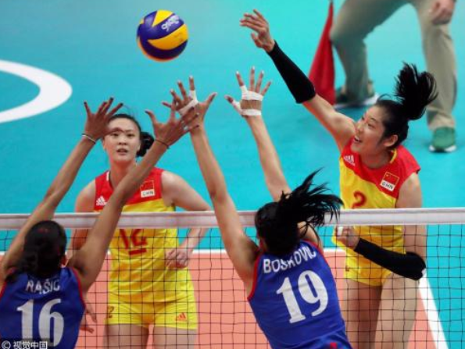

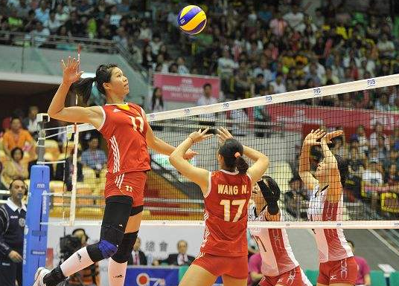
Read the text again and talk about why the Chinese Women’s Volleyball Team won.
competitive spirit
fighting spirit
perseverance
team spirit
cooperation
…

Slide 15

1. How does the author start the passage? What effect does it achieve?
The author starts the passage by describing an event as if it is happening in the present. It engages the readers and helps set the right atmosphere for the remainder of the writing.

Slide 16

2. What do you think of the opinion that a team needs to start from zero after winning a gold medal?
It’s a good idea. That’s because you can have a new beginning. If you select the right people, work on your leadership, and actively aim to improve the team once it's formed, you can build a winning team.

Slide 17
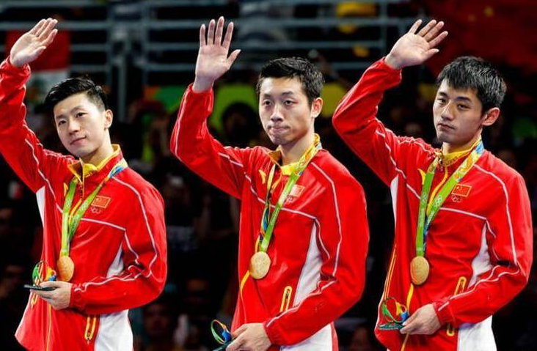
3. What achievements by other Chinese sports teams have made the greatest impression on you? Give an example of their sporting spirit.
As a player of the Chinese table tennis team, everyone bears the responsibility, and everyone will treat every match with all his strength. They also have team spirit and sense of responsibility.
The Chinese Table Tennis Team

Slide 18
4. What kind of sporting spirit does each of the reading passages in this unit reflect? Talk about their similarities and differences.
Similarity: Both the two passages reflect that hard work and perseverance contribute to success.
Differences: Stephen Curry also showed self-belief. Despite what many people including his teammates and coaches thought, he never gave up. As for the Chinese women’s volleyball team, their strong team spirit was the key to their victory.

Slide 19


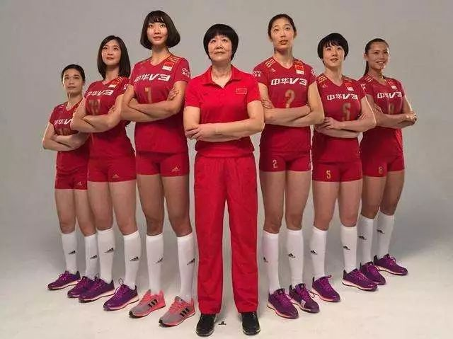

Work in groups. Give a talk about the spirit of the Chinese women’s volleyball team.
Here is a passage about the Chinese Women’s Volleyball Team. Please read it if necessary.

Slide 20


Write a passage about what you have
discussed today.

Slide 21


