Slide 1
外研选择性必修
第二册
Unit 1
Period 4
Reading

Slide 2
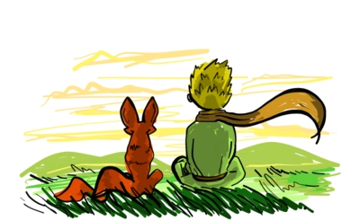
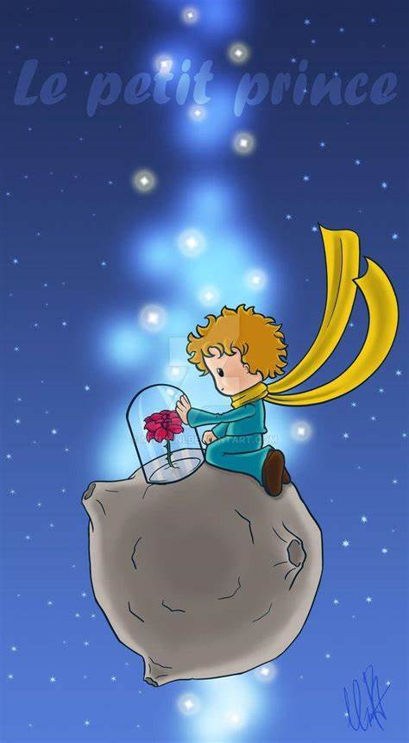
Lead-in
教学目
1 Do you know which book these pictures are taken from?
2 Can you share the main idea of the book?

Slide 3
To get relevant information about Antoine de Saint-Exupéry, find out what the passage is about, infer the author’s attitude towards grow-ups and find the evidence, then talk about your attitude towards grow-ups
To use the key language points from the passage correctly
1
2

Slide 4
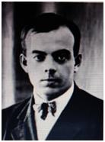
目标一: To get relevant information about Antoine de Saint-Exupéry, find out what the passage is about, infer the author’s attitude towards grow-ups and find the evidence, then talk about your attitude towards grow-ups
Activity 1: Please read the introduction to Antoine de Saint-Exupéry and answer the questions.
Antoine de Saint-Exupéry (1900-1944) was a French writer and pilot. As a young boy, he was obsessed with aeroplanes, riding in one for the first time at the age of 12. He spent much of his life flying and writing about his adventures.

Slide 5
Saint-Exupéry’s most successful work, The Little Prince, is one of the best-selling books ever published. The story was probably inspired by his plane crash in the desert in 1935. Saint-Exupéry nearly died, and wandered around for four days before being rescued. In 1944, Saint-Exupéry left on a wartime mission over occupied France, from which he never returned. Although the remains of his plane were discovered in 2000, Saint-Exupéry’s body has never been found, and the cause of his death remains unknown.

Slide 6
1 What experience made the author write The Little Prince?
The story was probably inspired by his plane crash in the desert in 1935.
2 What kind of person do you think Saint-Exupéry was?
He was a person with great imagination.
3 What does the introduction mainly tell you?
The introduction tells Antoine de Saint-Exupéry’s personal information, including the year of his birth, his hobby and experience, his successful work, the background information of creating The Little Prince and his death.

Slide 7
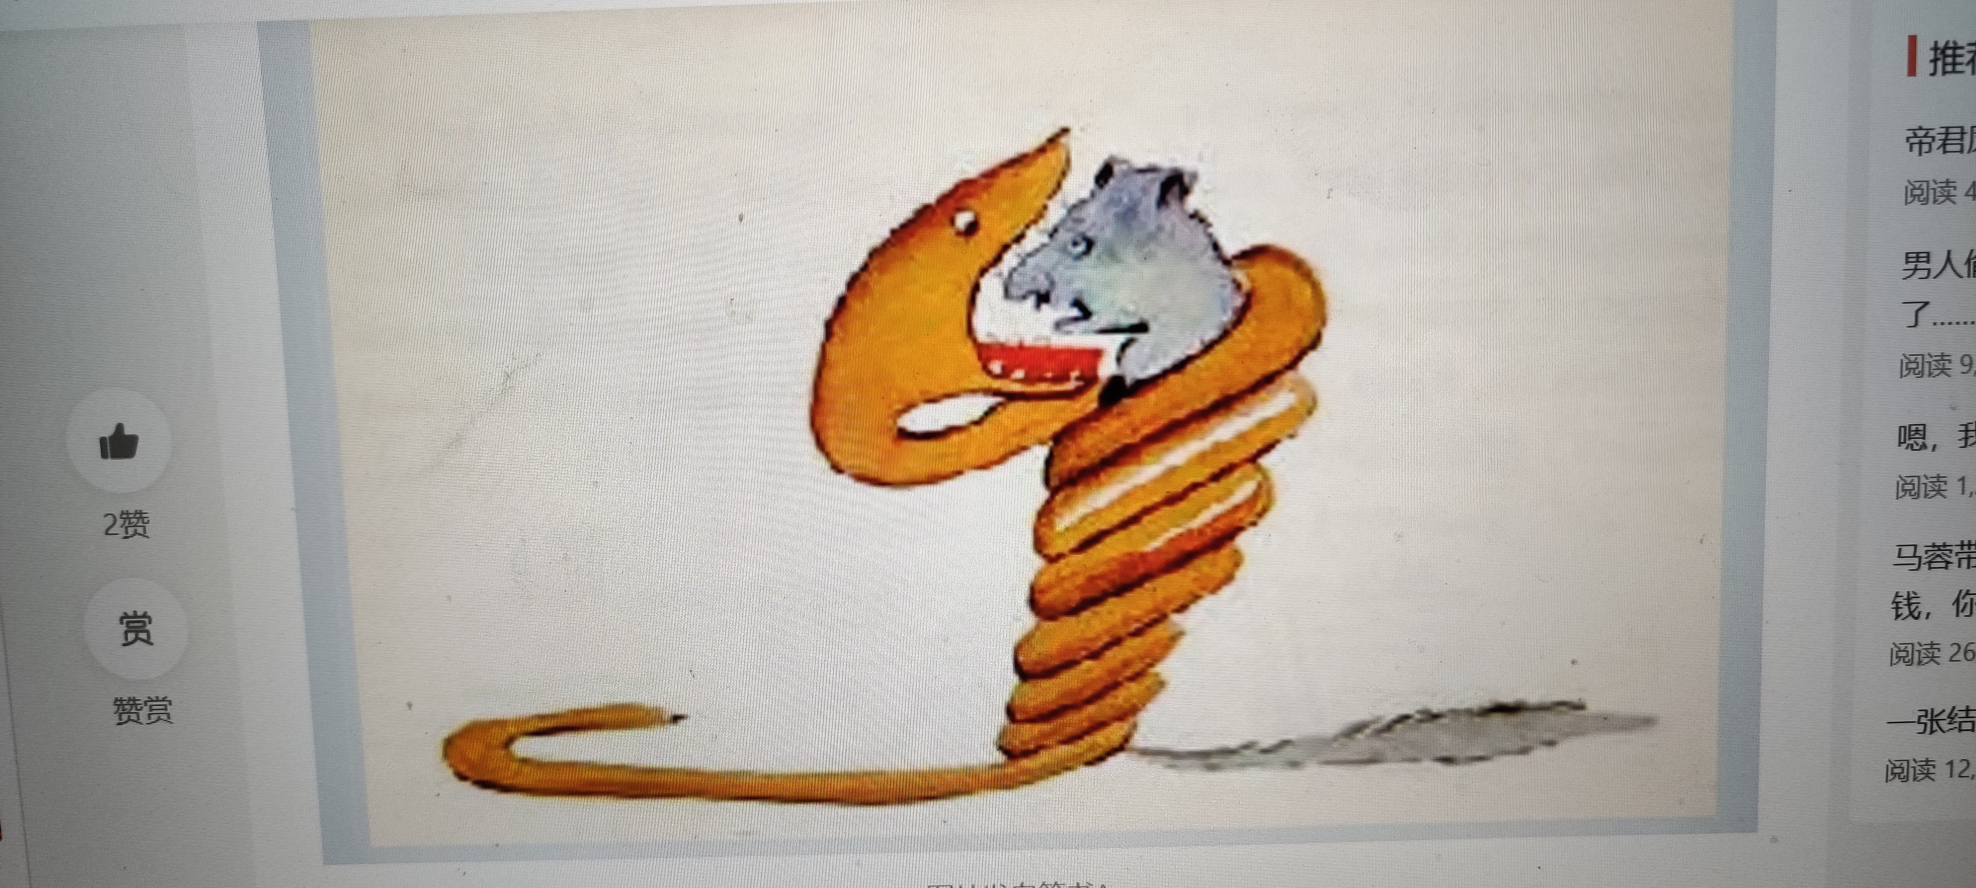
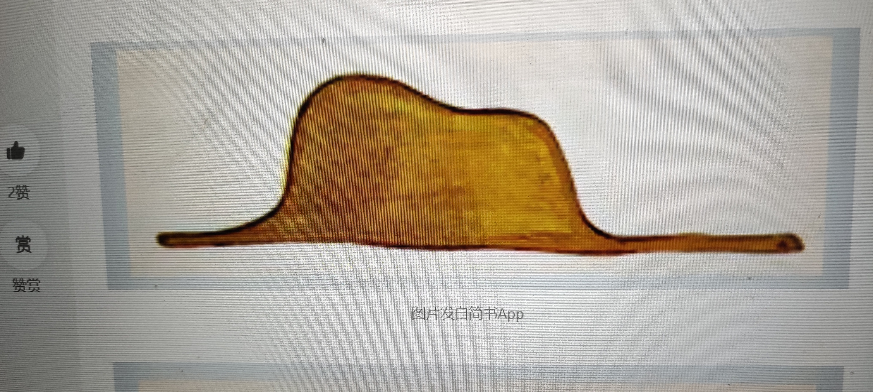
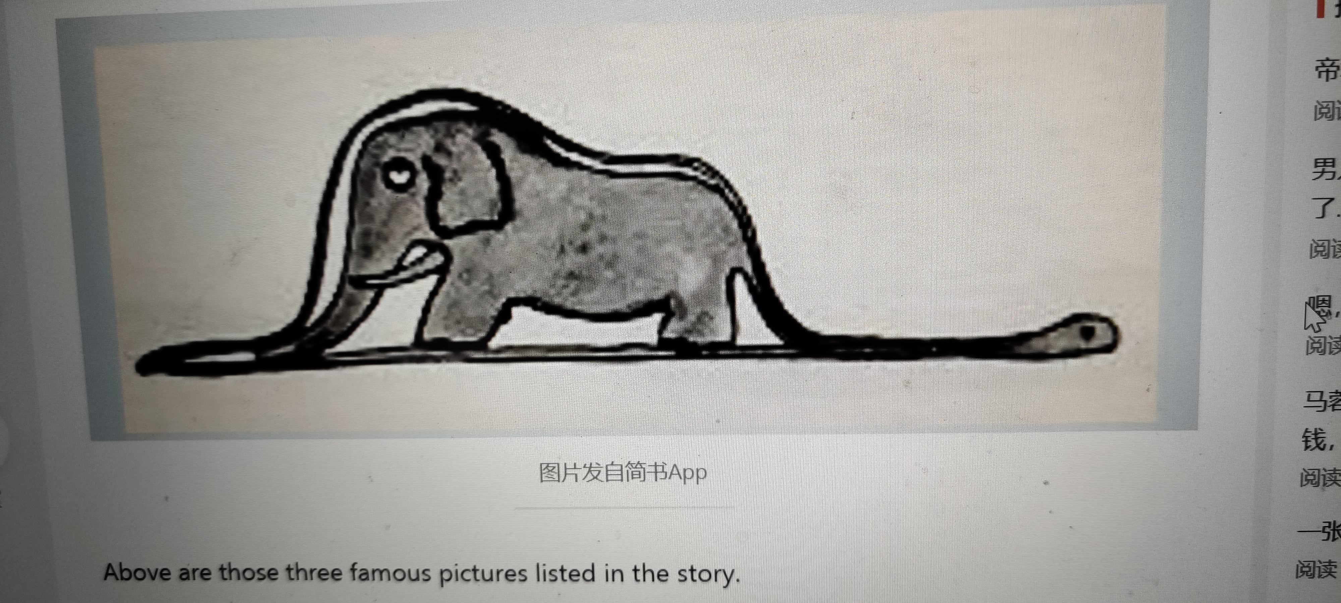
Activity 2: Look at the three drawings and predict what the story is about.
The text is probably an excerpt from the novel The Little Prince. And it is probably about something related to the three pictures.

Slide 8
Please read the excerpt of The Little Prince quickly and check the prediction and get the general idea of it.
The passage is written from a child’s perspective. It shows the different understandings of two pictures between grown ups and children.

Slide 9
Activity 3: Please read the passage carefully and find the plot and pay attention to the characters and the setting. Highlight the key words while reading.
made a drawing
Development of the plot | The beginning:
 | The development:
 | The climax:
 | The ending:
Grown-ups thought it was a hat and did not seek true understanding
All the grown-ups had the same answer
talked about other topics
The characters:
I, grown-ups, one of the grown-ups

Slide 10
Activity 4: Choose the author’s attitude towards grown-ups and find evidence to support your choice.
1. Grown-ups are more practical than children. They want to teach children knowledge that will be useful in the future.
2. Grown-ups are no better than children. They lack imagination and only care about matters of consequence.
3. Grown-ups are more knowledgeable than children. They can understand everything by themselves.

Slide 11
Evidence:
1. They always need to have things explained. (Para 6)
2. Grown-ups never understand anything by themselves, and it is tiresome for children to be always and forever explaining things to them. (Para 7)
3. …, I have had a great many encounters with a great many people who have been concerned with matters of consequence. (Para 9)
4. I would bring myself down to his level. I would talk to him about bridge, and golf, and politics, and neckties. And the grown-up would be greatly pleased to have met such a sensible man. (Para 12)

Slide 12
Activity 5: Read the sentences from the passage and answer the questions.
... I have had a great many encounters with a great many people who have been concerned with matters of consequence. And the grown-up would be greatly pleased to have met such a sensible man.
1 What does the author really mean by these sentences?
These sentences mean: Most of the adults he had met were the same. They focused on practical matters only and seldom paid attention to imagination or creativity. If the author pretended to think the way they did, the adults would conclude that he was sensible and mature.

Slide 13
2 What figure of speech does the author use?
How does this figure of speech help to express the author’s attitude?
Irony. This figure of speech enables the author to indicate his low opinion of adults’ behaviour and values by stressing such things.
Learning to learn
Irony is a subtle figure of speech that refers to things one says that are the opposite of what one really means. It has a humorous, emphatic or sarcastic effect. For example: Fine, don’t buy me an airline ticket, I’ll just swim across the ocean!

Slide 14
Activity 6: Think & Share
1 What were the grown-ups’ responses to the author’s Drawing Number One and Drawing Number Two?
Why do you think they responded in this way?
They thought the author’s Drawing Number One was just about an ordinary hat. When seeing the authors Drawing Number Two, they advised him to change his focus to his school subjects, because they knew they were wrong. But they didn’t pursue true understanding of it. They were more keen on fame and wealth.

Slide 15
2 According to the author, what is a child’s most valuable trait? Do you agree with him?
In the author’s opinion, a child’s most valuable trait is the seeking of the real nature of things. I agree with him because seeking true understanding is the driving force of self-development.
3 After reading the two passages in this unit, think about what you may acquire and lose as you grow up? Share your ideas with the class.

Slide 16
After reading the two passages in this unit, I have learnt a lot. Being a child or an adult may have its own advantages and disadvantages. As far as I am concerned, being a child is much happier because I don’t take a lot of responsibilities, and I must be taken good care of by my parents, although I have to be supervised by them as well. Being an adult means I will be allowed to do a lot of things that I can’t when I am a child, while I must be mature and strong enough to take responsibilities.
Above all, I can acquire a lot, meanwhile, I may also lose something precious as I grow up. So I hope I will keep a childlike innocence deep in my heart.

Slide 17
Activity 7: Work in groups. Give a talk about your attitude towards grown-ups.
1 Decide whether you agree with the author’s attitude towards grown-ups and why.
2 Think of some examples to support your opinions and make notes.
Opinions | Examples

Slide 18
3 Organise your talk following the steps below.
• Explain the author’s attitude towards grown-ups.
• State your own opinions
• Give supporting examples.
• Conclude by summarising your opinions.
4 Give your talk to the class.
Now think about your performance during the group discussion. How well did you actively participate and contribute ideas?

Slide 19
目标二: To use the key language points from the passage correctly
Activity 1: Find the important words, phrases, and language points you want to share with your partner. Then discuss in groups and share their usage with the class.
1 be obsessed with痴迷于
【教材原文】As a young boy, he was obsessed with aeroplanes,... 作为一个小男孩，他痴迷于飞机，......
【知识归纳】
（1）obsessed adj.（对）痴迷的，受困扰的
（2）obsess vt. 使痴迷，使迷恋，使着迷
（3）obsession n. 痴迷，着魔，困扰
obsession with. 对......的痴迷

Slide 20
【即学即用】单句语法填空
(1) He’s so ____________ (obsess) with the football game that he can’t focus on what his father is saying.
(2) This novel is based on a real-life incident of a man’s ___________ (obsess) with the famous actress.
obsessed
obsession
2 in the act of doing..正在；正在做的过程中
【教材原文】It was a picture of a boa constrictor in the act of swallowing an animal.
这是一幅蟒蛇正在吞咽一只动物的图片。

Slide 21
【知识归纳】
catch sb.in the act（of doing sth.）当场抓住某人（在做非法之事）
an act of kindness善行
act as 充当
【即学即用】完成句子
(1) He _______________________（被当场抓住）breaking into the house.
(2) The old man is good-hearted, and I have seen him do many _______________（善行）.
was caught in the act of
acts of kindness

Slide 22
3 lay aside把......放在一边（或搁置一旁）；留存备用（相当于put aside, set aside）
【教材原文】The grown-ups’ response, this time, was to advise me to lay aside my drawings of boa constrictors, whether from the inside or the outside, and devote myself instead to geography, history, arithmetic, grammar.
这次，大人的反应是建议我把蟒蛇的图画放一边，不管是从里还是从外的，而让我沉心于地理、历史、算术及语法。

Slide 23
此句中，whether from the inside or the outside为插入语，对上文进行补充说明与解释，不影响整个句子的结构。常见的插入语有形容词（短语）、副词（短语）、介词短语、非谓语动词（短语）、分句等。
例如：Yes, indeed, I intend to go.
（是的，我真的想去。）
You may, if you please, come and join us in the game.
（如果你愿意的话，你可以加人我们的游戏。）

Slide 24
devote oneself to致力于，献身于（to是介词）
（1）devote vt. 献身，奉献，专心，致力
devote one’s time/energy/attention/...to（doing）sth.
把某人的时间/精力/注意力/......用到（做）某事上
（2）devoted adj. 挚爱的，忠诚的，全心全意的
a devoted friend一个忠诚的朋友
be devoted to... 深爱/忠于......，致力于.
（3）devotion n.[U] 奉献，忠诚；关爱

Slide 25
4 at a glance 一瞥，看一眼
【教材原文】At a glance I can distinguish China from Arizona.
乍一看我能区分中国与亚利桑那州。
【知识归纳】
glance vi.匆匆一看，扫视；浏览，粗略地看
n.[C]一瞥，扫视
glance at 乍一看
glance through 匆匆看一遍，浏览
take/have a glance at... 看一眼
at first glance 乍一看

Slide 26
5 a great many 许多
be concerned with/about 关心、在意
【教材原文】In the course of this life, I have had a great many encounters with a great many people who have been concerned with matters of consequence.
在这一生中，我与许多只关注事件结果的人有过很多次相遇。
a great many相当于a large number of, many, lots of 和 plenty of, 意为“很多"。例如：He’s been to a great many places.（他去过很多地方。）需要注意的是，a great many后接可数名词的复数形式，谓语动词也用复数形式。例如：A great many experts have come there.（很多专家都去那儿了。）本句中两次使用a great many，是为了强调作者对成年人的看法是有依据的，也为后文的观点埋下了伏笔。

Slide 27
6 be pleased to do sth. 高兴/乐于做某事
【教材原文】And the grown-up would be greatly pleased to have met such a sensible man. （Irony）
而这个成年人可能很高兴遇到了一个这么机敏的人。
be pleased with（=be satisfied/content with）
对......感到满意
be pleased that.. 对......感到高兴
be willing/ready to do sth. 乐于做某事
be content/satisfied to do sth. 满意于做某事

Slide 28
7 Grown-ups never understand anything by themselves, and it is tiresome for children to be always and forever explaining things to them.
Paraphrase：Adults can’t always understand the world of children,so children feel tired and bored when they have to explain their thoughts to adults again and again.
本句从儿童的视角描述了成年人与儿童在理解事物方面的差异，以幽默的口吻表达了儿童的无奈，启发读者要学会保护心中的纯真与智慧。it is tiresome for sb to do sth意为“某人厌烦去做某事”，句中it是形式主语，to do结构为真正的主语。例如：It is important for you to get there on time.（对你来说，准时到达很重要。）

Slide 29
Activity 2: Complete the summary with the correct words or the correct forms of the words in the bracket according to the passage.
When I was six years old, I 1.__________ (success) in making my first picture, after having read the book 2.__________ (call) True Stories from Nature and pondered 3.__________ (deep). But to my disappointment, when showed to the grown-ups, the picture was misunderstood. They all thought of the picture of a boa constrictor 4 __________ (digest) an elephant as a hat. I had to make another drawing, because they need to have things explained. This time, 5.__________, they advised me 6.__________ (be) devoted to geography, history, arithmetic and grammar. I had to give 7.__________ my early dream. And I chose another profession. In the course of my life, I have had many 8. __________ (encounter) with people who have been concerned with matters of consequence. The result was 9.__________ no one was a person of true understanding, and that I was the only 10. __________ (sense) one.
succeeded
called
deeply
digesting
however
to be
up
encounters
that
sensible

Slide 30
1 Can you introduce the author Antoine de Saint-Exupéry?
2 Can you retell the grown-ups’ response to the two drawing and share your view about them?

