Slide 1
Period 3
Listening and Speaking
Unit 1

Slide 2

新 课 导 入
What's your attitude towards life?

Slide 3
1
Read the passage and answer the questions.
课 堂 学 习
Like a musical symphony, life has high and low moments, and somewhere in between are those moments we call “bittersweet”. As students, it's likely that those moments are mainly about school life, such as sitting a major exam, giving a presentation, or becoming a boarder for the first time. But as life continues, we're presented with more varied experiences: starting university, getting a job and raising a family. Whatever our choices are, we should cherish and embrace these moments in life. After all, each step we take is one more step forward to becoming a stronger and better person.

Slide 4
1 What is your understanding of the first sentence?
There are bad moments as well as good moments in our life. There are a lot of ups and downs in life. Our life is full of happiness and sadness.
2 What is the author's attitude towards life? Do you agree with it?
The author suggests that we should cherish and embrace the good and bad moments in life. From this we can say the author is positive about life.
I quite agree with the author's attitude. Life is wonderful!

Slide 5

2
Listen to the conversation and answer the questions.
1 What is the relationship between the speakers?
They are (good) friends.
2 What are they talking about?
They are talking about Susan's future life as a boarder.

Slide 6
3
Listen again and complete the table.
Concerns | Suggestions
I've never been away from home, so I don't know how to ¹_____________. | Think how it will help you prepare for ²____________, and ask others ³__________.
I might have a different routine to ⁴____________ and they might not be very pleasant to ⁵__________. | When living in a group, ⁶____________________________ are really important.
I will no longer be able to ⁷_____________________ as much as before if I have to follow a strict dorm schedule. | Try joining some clubs. You might make ⁸________________.
I suppose that I will ⁹____________________. | Speak to them regularly over the phone or via ¹⁰ _______________.
university life
live on my own
for help
my roommates
communication and compromise
live with
hang out with my friends
new friends
miss my parents a lot
video chats

Slide 7
4
Complete the boxes with the expressions from the conversation.
• I'm afraid I can't... • I'm concerned that...
• Don't be afraid! • Perhaps you could...?
• I'm worried that... • How about...?
• What if...? • Good luck with...
• It's a good idea to...

Slide 8
Expressing concerns
• I’m afraid I can’t... • I’m concerned that...
• I’m worried that... • What if...?
Giving encouragement
• Don’t be afraid! • Good luck with...
Making suggestions
• Perhaps you could... • How about...?
• It's a good idea to...

Slide 9

5
Work in pairs. Discuss a challenging moment in your life.

Slide 10









6
Listen to the conversation and tick the words and expressions mentioned.

Slide 11
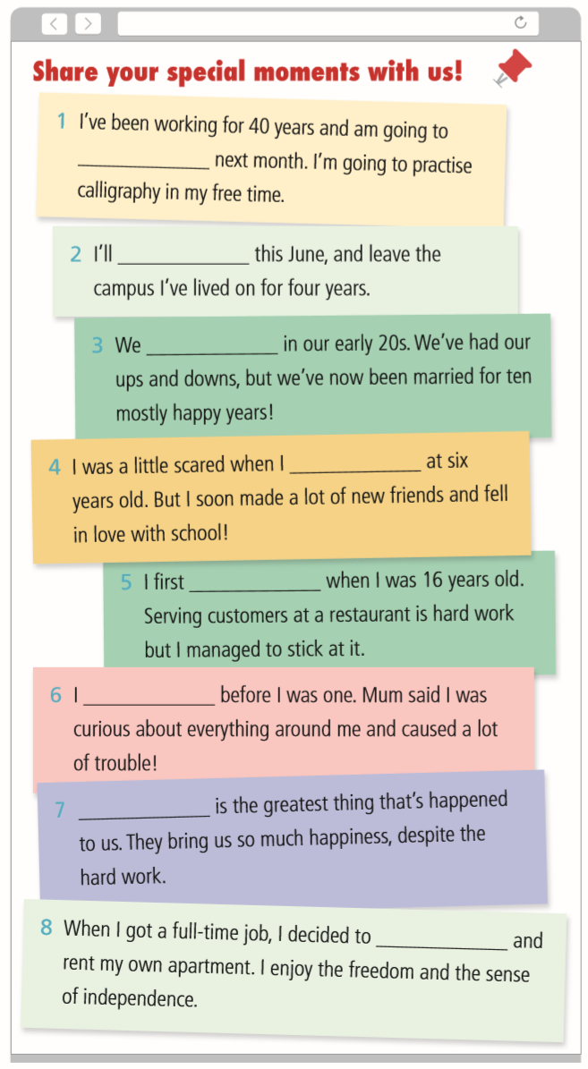
7
Complete the online message board with the correct form of the following expressions.

Slide 12
Answers:
1. retire
2. graduate from college
3. got married
4. started school
5. got a job
6. learned to walk
7. Having children
8. leave home

Slide 13
8
Work in pairs. Share a most memorable moment from your life using the words and expressions in this section.
Example:
It was my first time that I had been required to read a poem aloud to the club by our English teacher. When I appeared in front of the class, I was very nervous at first, but everyone sitting around me was so nice and friendly that I stopped feeling nervous soon. When hearing loud applause, I seemed to realize that I had done a good job in the reading activity. Especially when my teacher came up to give me five with a big smile, I became self-confident about reading poems.

Slide 14
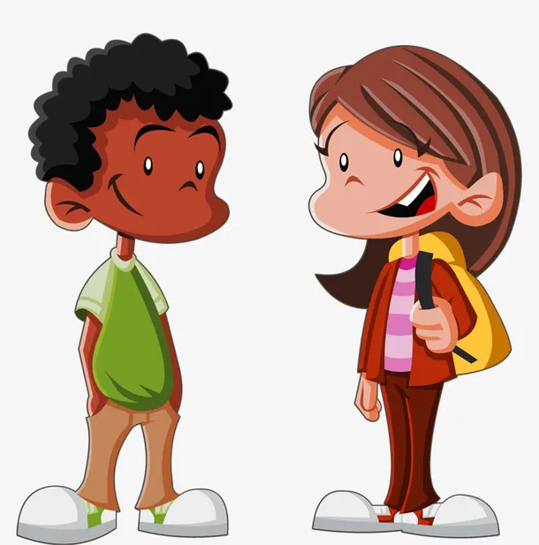
Now think about your performance. How well did you understand your partner and give an effective response?

Slide 15
1. Talk about some expressions about expressing concerns,
giving encouragement or making suggestions.
2. Share a challenging moment or most memorable moment
in your life.

