Slide 1
Period 1
Starting out & Understanding ideas
Unit 1

Slide 2
Starting out
课 堂 学 习
1
Watch the video and answer the questions.
1 What is a coming-of-age ceremony? How do
people celebrate in the video?
2 Which celebration makes the greatest impression
on you? Why?

Slide 3
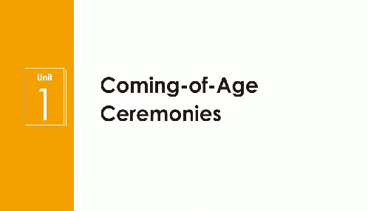

Slide 4
1 What is a coming-of-age ceremony? How do people celebrate in the video?
A coming-of-age ceremony is an event that marks the time when a young person moves from childhood to adulthood.
In Ancient China, people held a traditional “capping ceremony” for a man at the age of 20 and a “hair-pinning ceremony” for a woman around her 15th birthday. On the South Pacific island of Pentecost, a ceremony of land diving takes place only for boys. In the US, a particularly modern celebration takes place for a girl or a boy at the age of 16.
2 Which celebration makes the greatest impression on you? Why?

Slide 5
2
Listen and read the poem. Answer the questions.
1 What is the poem about?
2 According to Kipling, what qualities does his son need to “be a Man”?
Tick those mentioned in the poem and add your own ideas.
self-belief honesty
confidence kindness
modesty pride
integrity patience
Other __________________________
3 Which of these qualities are most important to you as you grow up?

Slide 6

If-
If you can keep your head when all about you
Are losing theirs and blaming it on you;
If you can trust yourself when all men doubt you,
But make allowance for their doubting too;
If you can wait and not be tired by waiting,
Or, being lied about, don't deal in lies,
Or, being hated, don't give way to hating,
And yet don't look too good, nor talk too wise;
...
If you can talk with crowds and keep your virtue,
Or walk with kings - nor lose the common touch;
If neither foes nor loving friends can hurt you;
If all men count with you, but none too much;
If you can fill the unforgiving minute
With sixty seconds' worth of distance run -
Yours is the Earth and everything that's in it,
And -which is more - you'll be a Man, my son!
(Excerpts from If - by Rudyard Kipling)

Slide 7
1 What is the poem about?
The poem is a father's advice to his son about the qualities needed to become a virtuous or good man.
2 According to Kipling, what qualities does his son need to “be a Man”?
Tick those mentioned in the poem and add your own ideas.
self-belief honesty
confidence kindness
modesty pride
integrity patience
Other __________________________
√
√
√
√
√
√
√
3 Which of these qualities are most important to you as you grow up?

Slide 8
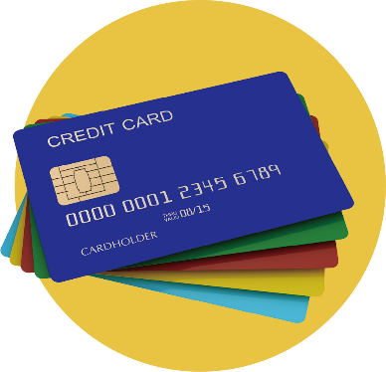
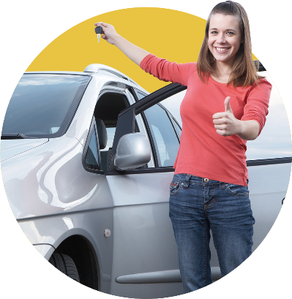
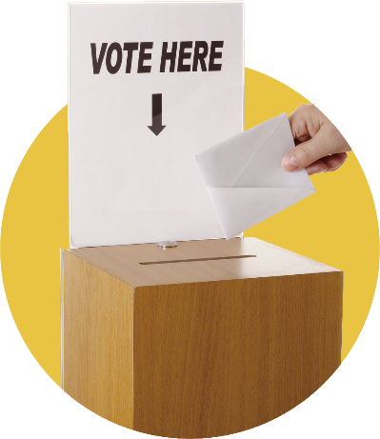
Understanding ideas
1
Discuss at what age you are allowed to do the following things in China.
• Get a credit card.
• Get a driver's licence.
• Get a full-time job.
• Get the right to vote.
• Get a bank loan.
• Rent an apartment.
We are allowed to get a full-time job and rent an apartment at 16. Getting a credit card, getting a driver's licence, getting the right to vote, and getting a bank loan are allowed at 18 in China.

Slide 9
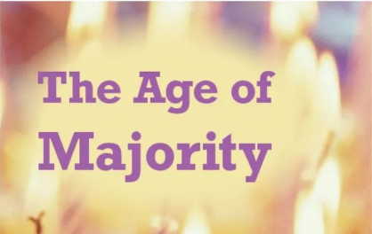
Predicting
2
Look at the title, try to guess the meaning of it.

Slide 10
Read the passage and find out the meaning of “the age of majority”.
The Age of Majority
In most countries, turning 18 marks the start of adulthood. But what does reaching this milestone, the age of majority, really mean? Will you be completely in charge of your own life and able to express yourself in new and exciting ways? What new responsibilities will this freedom bring? Here, three young people tell us what turning 18 means, or meant, to them.

Slide 11
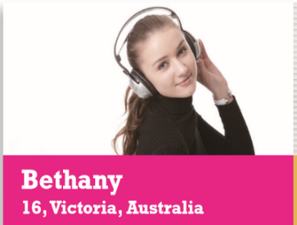
¹ I can't wait to be 18. One reason is that although I've been working ever since leaving school, I won't be voting in the next general election. Why? Because I still won't be old enough. Surely, if you're old enough to earn a wage and pay taxes, you should be allowed to have a say on how the government spends them! I've also been taking driving lessons, and in fact I will be taking my driving test on the very day I turn 18. My mum worries about me being behind the wheel. As an ambulance driver, she's seen a lot of car accidents involving teenagers and thinks the legal age for getting a driving licence should be 21. But I think I'm already mature enough to understand that driving a car also means taking responsibility for my life and the lives of other people.

Slide 12

² I celebrated my 18th birthday just before I went to university. I expected to feel instantly different, as if I had closed the door on my childhood and stepped into a whole new adult world. But it wasn't like that. When I woke up the next day, there were still rules to obey and lessons to attend. In fact, the change has been more subtle and gradual than I imagined. Instead of being the selfish teenager I used to be, I have begun to feel more aware of other people and to develop a stronger sense of social responsibility. To give an example, I will be signing an organ donation agreement this time tomorrow. This was a big decision for me and I made it without asking my parents (although I knew they would approve). Turning 18 also changed the way that society viewed me. I was really surprised when a bank contacted me with a credit card offer. Of course, I would like to have more freedom with money and no doubt I will be getting a credit card at some point, but I currently don't have a steady income, so getting a credit card might tempt me to spend more money than I have!

Slide 13
³ People say that 18 marks a new chapter in our lives, and that we should become more independent. I used to believe this, but the reality for me has been very different. I assumed I'd already have a well-paid job and that I'd be moving into a rented apartment as soon as I turned 18, but how wrong I was! My librarian's salary means that I'll be living at home with my parents for a while longer. Because I contribute to the household bills and my commute to work is quite expensive, I find it hard to save any money. I'll be starting a new job next month, however, so maybe things will get easier. I know I could get a bank loan to pay the deposit on my very own apartment, but I don't feel ready to make that kind of commitment, and I do like my mom's cooking. I guess some responsibilities are more about attitude than age.

Slide 14
Skimming
Read the passage and find out the meaning of “the age of majority”.
The age of majority means the moment when you turn 18, which is a milestone marking the beginning of adulthood.

Slide 15
Scanning
3
Choose another suitable title for the passage and give your reasons.
1 Eighteen - the Age of Indecision
2 Teenagers' Hopes for the Future
3 The Right to Vote - Your Views
4 Turning Eighteen - What Does it Mean?

Slide 16
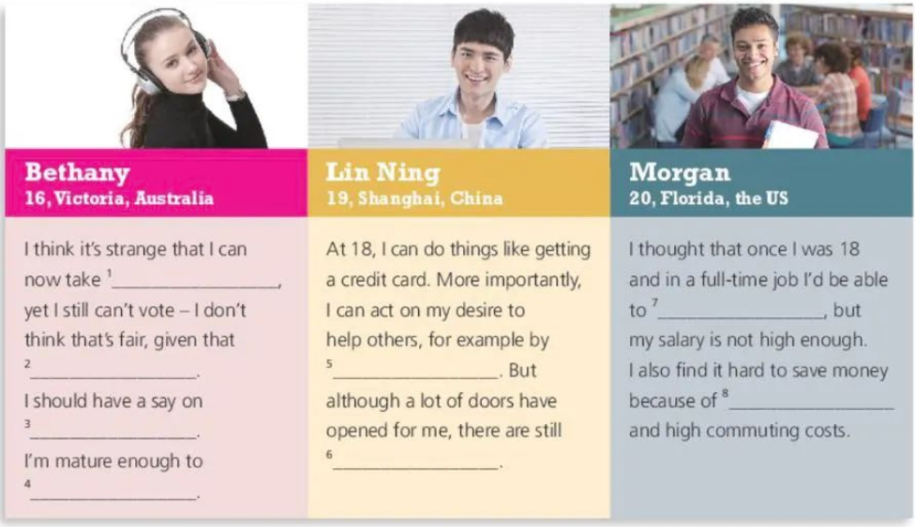
Careful reading
4
Organise information from the passage and complete the table.

Slide 17
Answers:
1 driving lessons
2 I'm old enough to earn a wage and pay taxes
3 how the government spends taxes
4 understand that driving a car also means taking responsibility
for my life and the lives of other people
5 signing an organ donation agreement
6 rules to obey and lessons to attend
7 move into a rented apartment
8 the household bills

Slide 18
5
Read the sentences from the passage and decide if they are facts (F) or opinions (O).
1. Surely, if you're old enough to earn a wage and pay taxes, you should
be allowed to have a say on how the government spends them! _____
2. ... I will be taking my driving test on the very day I turn 18. _____
3. When I woke up the next day, there were still rules to obey and
lessons to attend. _____
4. I guess some responsibilities are more about attitude than age. _____
O
F
F
O

Slide 19
Now look for more opinions in the passage and talk about whether you agree with them.
As an ambulance driver, she's seen a lot of car accidents involving teenagers and thinks the legal age for getting a driving licence should be 21.
People say that 18 marks a new chapter in our lives, and that we should become more independent.
...

Slide 20
Think & Share
1 Do you think the minimum age limits in the passage are sensible? Why
or why not?
2 What right are you most looking forward to having as an adult? Why?
3 What do you think it means to be a responsible adult?
4 How can you use the language you have learnt in the passage to express
your ideas clearly?

Slide 21
1 Do you think the minimum age limits in the passage are sensible? Why
or why not?
2 What right are you most looking forward to having as an adult? Why?
3 What do you think it means to be a responsible adult?
4 How can you use the language you have learnt in the passage to express
your ideas clearly?
I think the minimum age limits are sensible. Adults have to take many responsibilities. Being too young means he or she has no ability to face troubles and difficulties in life.
The right to be educated and to work. Only by being educated will a person have the ability to be independent and only by working can a person support himself.
It means taking on more responsibilities in the family and society.

Slide 22
Language points
1. Will you be completely in charge of your own life and able to
express yourself in new and exciting ways? 你能完全掌控
自己的生活，并能以新的、令人兴奋的方式表达自己吗?
in charge of 负责，掌管
in the charge of (=in one's charge) 由……负责/掌管
take charge of 负责，掌管
free of charge (=for free) 免费
charge sb. some money for sth. 因某物向某人收费
charge sb. with doing sth. 指控某人（做）某事

Slide 23
2. Here, three young people tell us what turning 18 means, or meant,
to them. 在此，三个年轻人告诉我们年满18岁对他们意味着
或者曾经意味着什么。
what turning 18 means, or meant, to them 为what引导的宾语从句，
what 在从句中充当mean的宾语；其中从句由动名词短语
turning 18作其主语。
3. I can't wait to be 18. 我迫不及待想到18岁。
can't wait to do sth 迫不及待做某事 ，等不及做某事
e.g. We can't wait to get started. 我们迫不及待地想要开始了。

Slide 24
4. One reason is that although I've been working ever since leaving school,
I won't be voting in the next general election. 其中一个原因是虽然我
一毕业就工作了，但我依然不能在下一届大选中投票。
(1) that引导表语从句，although引导让步状语从句。
(2) election 选举，推选（尤指从政），当选
elect v. 选举，推选，选择，决定
elective adj. 选举的，由选举产生的，选任的，可选择的
win/lose an election 在选举中莸胜/失败
run for election 参加竞选
elect sb as+职位 选举某人为……
general election 大选

Slide 25
5. Surely, if you're old enough to earn a wage and pay taxes, you should
be allowed to have a say on how the government spends them!
当然，如果你的年龄足够大，可以挣工资和交税，你就应该被
允许对政府如何使用这些钱有发言权！
have a say on 对……有发言权
拓展：have a try 试一试
have a command of 精通，掌握
have a good knowledge of 有好的知识储备
have a good view of 饱览，清楚看到
have a reservation 有预定

Slide 26
6. I've also been taking driving lessons, and in fact I will be taking my driving
test on the very day I turn 18.
我也一直在上驾驶课，事实上，我将在18岁的那天参加驾驶考试。
省略that的定语从句，修饰the very day。
7. My mum worries about me being behind the wheel.
我妈妈担心我开车。
(1) “me being behind the wheel” 为动名词的复合结构，构成“宾格代词+
动名词”形式。
e.g. How about me doing it for you? 不如我来帮你吧?
(2) “behind the wheel” 意思为“在驾驶汽车”

Slide 27
8. As an ambulance driver, she's seen a lot of car accidents involving teenagers
and thinks the legal age for getting a driving licence should be 21.
作为一名救护车司机，她目睹过很多涉及青少年的车祸，她认为获得
驾驶执照的法定年龄应该是21岁。
(1) “the legal ... 21”为省略that的宾语从句。
(2) legal 合法的，与法律有关的，法律的
illegal 不合法的
the legal profession/system 法律行业，体系
seek legal advice 寻求法律咨询
be legally responsible for sb./sth. 对某人、某事负有法律责任
legal aid 法律援助

Slide 28
9. But I think I'm already mature enough to understand that driving a car also
means taking responsibility for my life and the lives of other people. 但我认
为我已经足够成熟，能够理解开车也意味着对自己和他人的生命负责。
(1) 本句为主从复合句。“I'm already …”是 I think 后接的宾语从句，
此处省略that，“driving a car …” 是understand 的宾语从句，that 为
连接词，同时driving a car 为动名词作主语。。
(2) be + 形容词 + enough + (for sb.) to do sth. 结构。
e.g. He is old enough to take care of himself.
他已经足够大了，完全可以照顾自己了。
(3) take responsibility for (doing) sth.=be responsible for (doing) sth. 意为
“承担（做）某事的责任”
e.g. We need to take responsibility for looking after our own health.
我们需要对自己的健康负责。

Slide 29
10. I celebrated my 18th birthday just before I went to university.
就在我上大学之前，我庆祝了我的18岁生日。
before引导时间状语从句。
11. I expected to feel instantly different, as if I had closed the door on
my childhood and stepped into a whole new adult world.
我本以为会立刻有感觉不一样，就好像我关上了童年的大门，
步入了一个全新的成年世界。
(1) instantly=immediately 立即、马上
instant 立刻的，立即的(=immediate) 速食的，速溶的 adj.
instant coffee 速溶咖啡 instant noodles 方便面
instant messaging 即时通信
the instant/minute/moment/second (that)... 一……就……

Slide 30
(2) as if意为“似乎，好像”用作连词引导状语从句，表示的情况与客观事实相符，用陈述句；表示与客观事实不符或相反，则用虚拟语气。as if/though引导从句，若从句表示的事实与现在事实相反，从句用一般过去时；从句表示的事实与过去的事实相反，从句用过去完成时。
12. But it wasn't like that. 但事实并非如此。
该句在文中是承上启下的作用，其中but是很明显的标志词，
进一步表明作者的态度和看法。

Slide 31
13. When I woke up the next day, there were still rules to obey and lessons
to attend. 当我第二天醒来的时候，仍然有规则要遵守，有课要上。
“rules to obey and lessons to attend”结构中“to obey 和to attend 两个不定式短语作名词的后置定语，分别修饰rules 和lessons”. 又如： 名词+to do作定语，常用主动ability, chance, decision, freedom, opportunity, plan, promise, responsibility, the first, way等。
14. Instead of being the selfish teenager I used to be, I have begun to feel
more aware of other people and to develop a stronger sense of social
responsibility.
我不再是过去那个自私的青少年，而是开始更加关心他人，并培
养了更强的社会责任感。
I used to be为定语从句，修饰the selfish teenager。

Slide 32
15. This was a big decision for me and I made it without asking my parents
(although I knew they would approve).
这对我来说是一个重大决定，我没有征求父母的意见就做出了决定
（尽管我知道他们会同意）。
approve v. 批准；赞成；同意；核准；认可；通过(计划、要求等)
approve of (sb./sb.'s doing) sth. 同意（某人做）某事
approval n. 同意，批准
give one's approval to 某人批准……
反义词 disapprove
approving adj. 赞成的，同意的（观点态度）

Slide 33
16. Turning 18 also changed the way that society viewed me.
年满18岁也改变了社会对我的看法。
“Turning 18” 动名词短语作句子的主语。 定语从句的先行词是the way “方式、方法”，在从句中充当方式状语，引导从句的关系词可以使用“that/in which 或者省略”。
17. I was really surprised when a bank contacted me with a credit card offer.
当一家银行联系我提供信用卡服务时，我真的很惊讶。
(1) when引导时间状语从句。
(2) contact v. 联系，联络
e.g. Please don't hesitate to contact me if you have any queries.
如果有任何疑问，你尽管联系我。

Slide 34
18. Of course, I would like to have more freedom with money and no doubt I will be getting a credit card at some point, but I currently don't have a steady income, so getting a credit card might tempt me to spend more money than I have! 当然，我希望在金钱上有更多的自由，毫无疑问，我会在某个时候获得信用卡，但我目前没有稳定的收入，所以获得信用卡可能会吸引我花更多的钱！
(1) doubt n. 怀疑；疑问；不确定 v. 怀疑
no/without/beyond doubt 无疑；很可能；确实
There is no doubt that... 毫无疑问……
There is some doubt about/whether... 对……有一些疑问
doubt whether/if 怀疑是否…… don't doubt that 不怀疑……
(2) “I will ... at some point”为同位语从句。

Slide 35
(3) at some point 在某些时候，在某一时刻
be on the point of doing... 即将做……（常与when连用）
There is no point (in) doing sth. 做……没有意义/没有用
come to the point/get to the point 谈正题
to the point 中肯，切题 off the point 离题
(4) tempt sb. to do sth. 引诱某人做某事
e.g. Credit cards can tempt you to overstretch yourself.
信用卡能诱使你超额消费。
拓展：resist temptation 抵制诱惑
19. People say that 18 marks a new chapter in our lives, and that we should become more independent. 人们说18岁标志着我们生活的新篇章，我们应该变得更加独立。
两个that引导宾语从句，由and连接，为并列关系。

Slide 36
20. I assumed I'd already have a well-paid job and that I'd be moving into a rented apartment as soon as I turned 18, but how wrong I was!
我以为我已经有了一份高薪工作，一到18岁就会搬进租来的公寓，
但我大错特错了！
and连接两个宾语从句，为并列关系。
21. My librarian's salary means that I'll be living at home with my parents for a while longer. 我的图书管理员的薪水意味着我还要和父母住在一起一段时间。
that引导宾语从句。

Slide 37
22. Because I contribute to the household bills and my commute to work is quite expensive, I find it hard to save any money. 因为我要支付家庭账单，而且我上班的通勤费用很高，所以我发现很难攒钱。
(1) Because引导原因状语从句。
(2) contribute to 增加，为……做出贡献；是……的原因，导致；
投稿，撰稿；捐赠
e.g. The volunteers also contribute to the project.
志愿者们也为这个项目做出了贡献。
(3) commute 为名词，意为“上下班路程”。
e.g. My morning commute takes 45 minutes.
我早上上班路上要花45分钟。

Slide 38
23. I know I could get a bank loan to pay the deposit on my very own apartment, but I don't feel ready to make that kind of commitment, and I do like my mom's cooking. 我知道我可以得到银行贷款来支付我自己公寓的订金，但我还没准备好做出这样的承诺，而且我确实喜欢我妈妈做的菜。
(1) “I could ...”为省略that的宾语从句。
(2) pay the deposit on … 意为“支付……的订金”。
e.g. We paid the deposit on the house. 我们支付了买房子的订金。
(3) commitment n. 投入，花费，承诺，许诺，奉献
make a commitment to sb./sth. 对……做出承诺
make a commitment to do/doing sth. 保证/承诺做某事
committed adj. 尽心尽力的；坚信的；坚定的
be committed to (doing) sth. 致力于（做）某事

Slide 39
commit v. 犯（错、罪），承诺，保证
commit suicide 自杀 commit a crime/mistake 犯罪/错
commit sb./oneself to (doing) sth. 保证某人/自己（做）某事
commit to sb./sth. 忠于某人/全心全意投入某事
(4) do 的作用是强调谓语动词like。强调谓语动词时，可借用助动词do/does/did, 表示“的确，确实”。
e.g. I do get up very early every morning. 我每天早晨确实起得很早。
She does work very hard at her maths. 她的确很努力地学习数学。
Yesterday afternoon, I did go there to visit him.
我昨天下午的确去探望过他。
24. I guess some responsibilities are more about attitude than age.
我想有些责任更多的是关于态度而不是年龄。
“some responsibilities...”是宾语从句。

Slide 40
Retelling The Age of Majority

