Slide 1

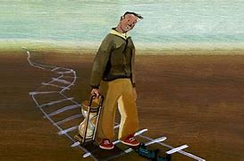
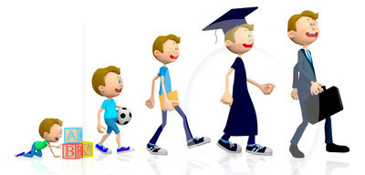

Unit 1 Growing up
P3
Using language
—Future Continuous

Slide 2



will / shall do
HOW
be going to do
be about to do
be doing
to express
the simple
future tense
be to do
do / does

Slide 3
The Usage of the Simple Future Tense
FORM | USAGE
will/shall do
be going to do
be about to do
be doing
be to do
do/does
表示将来发生的动作或出现的状态, shall仅与第一人称连用
表示主语计划打算的行动或看来就要发生的事情
表示即将发生的动作，一般不带时间副词或短语
表示计划或安排好的动作(go, come, leave, begin等动词)
表示客观上计划或安排好的动作
表示与安排，计划或时刻表有关的动作；或用于if, when等状语从句中代替will do

Slide 4

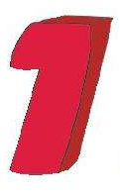

Observe and say
P5 1
Look at the sentences and answer the questions. Sentence (a) is from the reading passage.
a. …I will be signing an organ donation agreement this time tomorrow.
b. …I will sign an organ donation agreement tomorrow.
1. Which sentence signifies an activity in progress at a particular time in the future?

Slide 5

…I will be signing an organ donation agreement this time tomorrow.
…I will sign an organ donation agreement tomorrow.
Now look for more sentences
with the future continuous tense in the reading passage, and
summarise its use in your own
words.
2. Why does the author choose to use sentence (a) instead of sentence (b)?
Sentence (a) signifies that the author is going to sign an organ agreement at a particular time in the future.

Slide 6


Have A L k
1. ... I won't be voting in the next general
election.
2. ..., and in fact I will be taking my driving test on
the very day I turn 18.
3. ...no doubt I will be getting a credit card at
some point, but…
4. … I will be living at home with my parents for
a while longer.
5. I'll be starting a new job next month,...

Slide 7



Focus on
基本概念
Future Continuous
将来进行时
构成：will / shall + be + V-ing
shall用于第一人称单、复数;
will可用于各人称
 I/We will/shall be walking.
 He/She/It/You/They will be walking.

Slide 8
1
将来进行时
表示将来某一时刻或某段时间内正在进行或持续的动作。常与特定的将来时间状语连用。
1. I will be doing my homework this time
tomorrow.
2. We shall be travelling this time next year.
3. Don’t phone me between 9 and 11
tomorrow morning. I’ll be having a
meeting then.
时间状语有时不说出来
4. They will be discussing it.

Slide 9
2
表示按计划或安排将要做的事。
1. We shall be having a meeting in a minute.
2. I’ll be seeing her this evening.
3. We’ll be getting in touch with you.
4. He’ll be taking his exam next week.

Slide 10
3
表示说话人感到某事即将发生或预料中
要发生的事情。表示某种可能和推测。
1. The rose will be coming out soon.
2. Tom will be telling you about it this
afternoon.
3. Maybe nobody will be smoking in fifty
years.
4. We believe that farmers’ life will be
getting better and better in the future.

Slide 11
4
表示亲切或委婉的语气。
1. I shall be thinking of you.
2. Will you be staying here long?
3. When shall we be meeting again?
4. Will you be having some tea?

Slide 12

在时间、条件等状语从句中，用现在进行时代替将来进行时。
① You can’t be too careful when you are
crossing the busy street.
过马路时你再怎么小心也不为过。
② If I am sleeping when he comes, wake
me up, please.
如果他来时我正在睡觉,请叫醒我。

Slide 13
I. Choose the specific usage corresponding to the example sentence.选择例句1-5对应的A-E将来进行时的具体用法。
（ ）1. He will be giving a speech this time tomorrow.
（ ）2. I will be having a talk with her next week.
（ ）3. After you drink the water, you will be feeling better.
（ ）4. When will you be going to pick me up tomorrow?
（ ）5. You can use that bike. I won’t be using it this afternoon.
（ ）6. I’ll be loving you forever.
1.A. 表示在将来某一时刻正在进行的动作。
2.C. 表示按照计划或安排即将要发生的动作。
3.E. 表达预料不久要发生的事情或者将来的某种可能性，“我料想”“我估计”。
4.F. 表示亲切、委婉（请求）语气。
5.D. 表示原因或结果。
6.B. 表现将来的情景，带有感情色彩。

Slide 14
谓语动词时态 | 一般将来时 | 现在进行时 | 将来进行时
用法 | 将来要发生 | 可以表示有计划将要发生 | 将来某个时刻正在进行
结构
语气 |  | 十分肯定 | 委婉，更礼貌
will do
be doing
will be doing

Slide 15

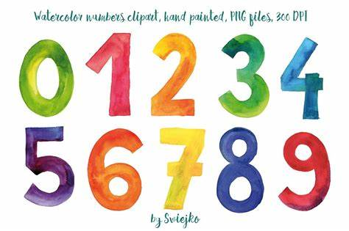
一般将来时是指将来某个时间将要发生的动作和状态，基本结构是：主语+will/be going to do.
一般将来时 VS 将来进行时
Let's compare!
⑴ I am going to Beijing next Sunday.
我下个星期天将要去北京。
⑵ What will you do tomorrow?
你明天干什么？
将来进行时是指将来某个时间正在进行的动作。基本结构是:主语+will be doing.
⑴ I will be sleeping at 12:00 pm.
十二点的时候我将在睡觉。
⑵ I will be studying in university at the age of 20.
我20岁的时候我将会在大学里学习。

Slide 16
两者均可表示将来，但用将来进行时语气更委婉。
① When will you finish these letters?
你什么什候处理完这些信件？
(直接询问，如上司对下属)
② When will you be seeing Mr White?
你什么时候见怀特先生？
(委婉地询问，如下属对上司)

Slide 17

一般将来时既可表示“将来”，也可表示“意志，意图”，而将来进行时表示“纯粹的将来”，指说话者一种无意图的动作。
① I'll do my best.
我愿尽最大的努力。
意愿
② I'll be doing my best.
我将尽最大的努力。
纯粹的将来

Slide 18

P5 2
Work in pairs. Take turns to ask and answer questions based on the information in the schedule.
A: What will you be doing at 8:50?
B: I’ll be attending the welcoming
ceremony. What will you be doing at 9:30?
A: …

Slide 19
Complete the email with the correct form of the verbs in brackets. Use the future continuous tense where possible.
Dear George,
It's great to hear from you. Thanks for the birthday card!
You asked if I have been thinking a lot about the future now that I'm 17. The answer is yes! Things change so quickly,
don't they? I mean, in just a year's time, I 1_________(be) an
adult. And this time next year, I 2_____________(take) my final
school exams. Hopefully I 3___________(pass) them! Then, in a couple of years' time, I 4______________(study) at university. It seems like no time at all! I 5 __________(choose) law, I think. After graduation, I 6__________(look) for a job related to law. In the long term, I hope that 20 years from today, I 7 _______ _______________(work) as a judge. Let's see how things go.
What are you hoping to do in the future? Tell me about
your plans.
Kind regards,
Diana
will be
will be taking
will pass
will be studying
will choose
will look
will be working
P5 3

Slide 20

将来进行时
1. 构成：will/shall + be + V-ing
2. 用法：
①表示将来某一时刻或某段时间内正在进行或
持续的动作。常与特定的将来时间状语连用。
②表示按计划或安排将要做的事。
③表示说话人感到某事即将发生或预料中要发
生的事情。表示某种可能和推测。
④表示亲切或委婉的语气。

Slide 21
Write a reply to Diana to tell her about your own plans for the future.
P5 4
Step 1: Learn and master the structure of the future continuous tense.
Step 2: Discuss your future plans in groups.
Step 3: Use different future tenses to describe your plans.
Step 4: Respond to the email by yourself.

Slide 22
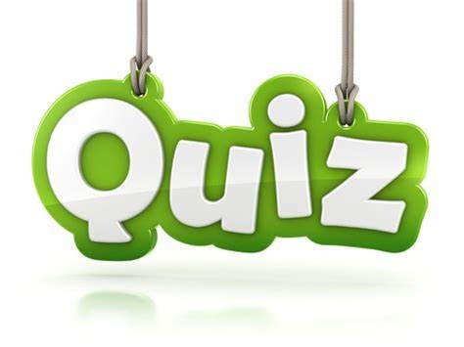

注:另附word文档，点此链接

Slide 23
I.单项选择。
1. - What will you do tomorrow evening?
- I _______ my favorite program between 8
and 11, then I will go out to drink in the bar.
A. will watch B. am about to watch
C. will be watching D. am watching
根据句意知，动作发生在明天晚上的8点至11点之间，符合将来进行时态的定义，发生在将来的具体时间的动作用将来进行时。答案：C

Slide 24
2. I'm afraid I won't be available then.
I_______a friend off at two o’clock this
afternoon.
see B. saw
C. will see D. will be seeing
句意为：恐怕那时我没空。下午两点钟我会去送一个朋友。表示发生在将来某一时刻正在进行的动作。答案：D

Slide 25


H
Finish the exercises in Learning
English.& 思维导图（笔记）

