Slide 1
Writing
The Little Prince

Slide 2
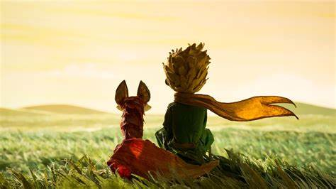
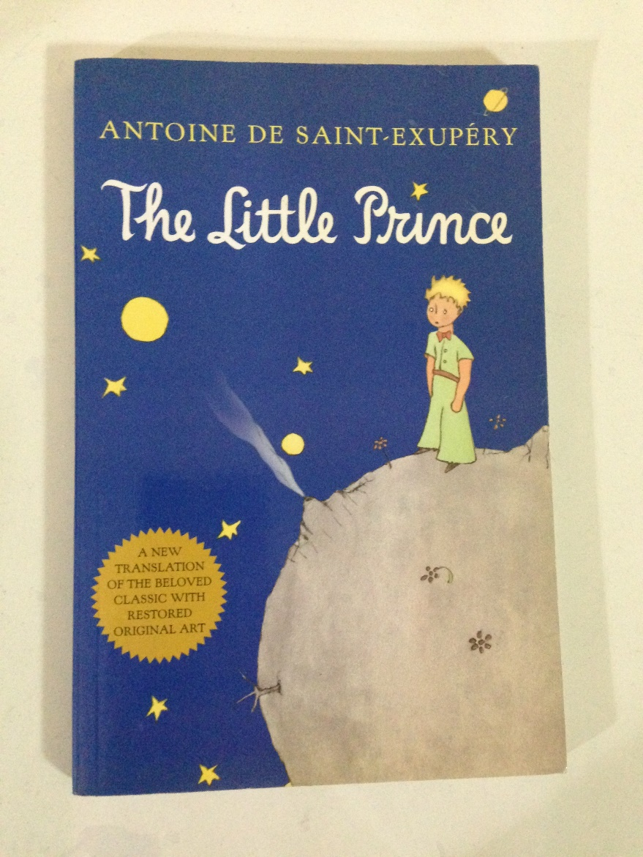
The Little Prince
What do you think of the book?

Slide 3
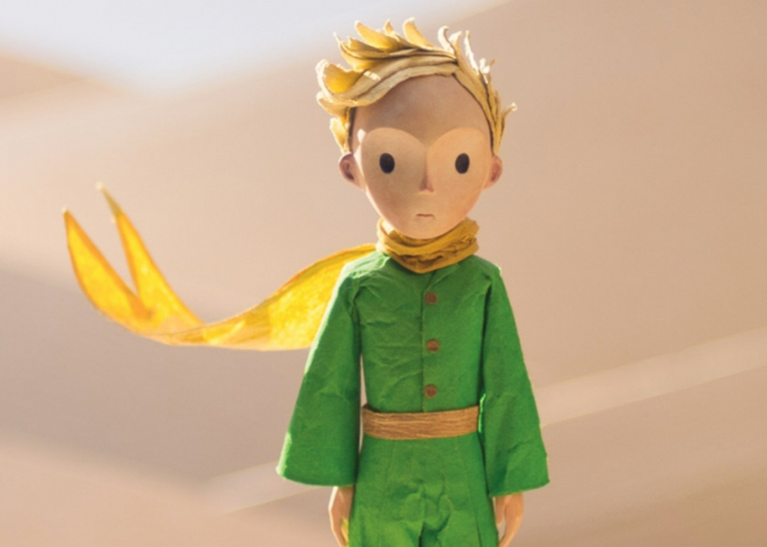
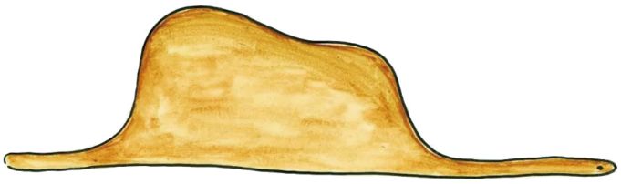
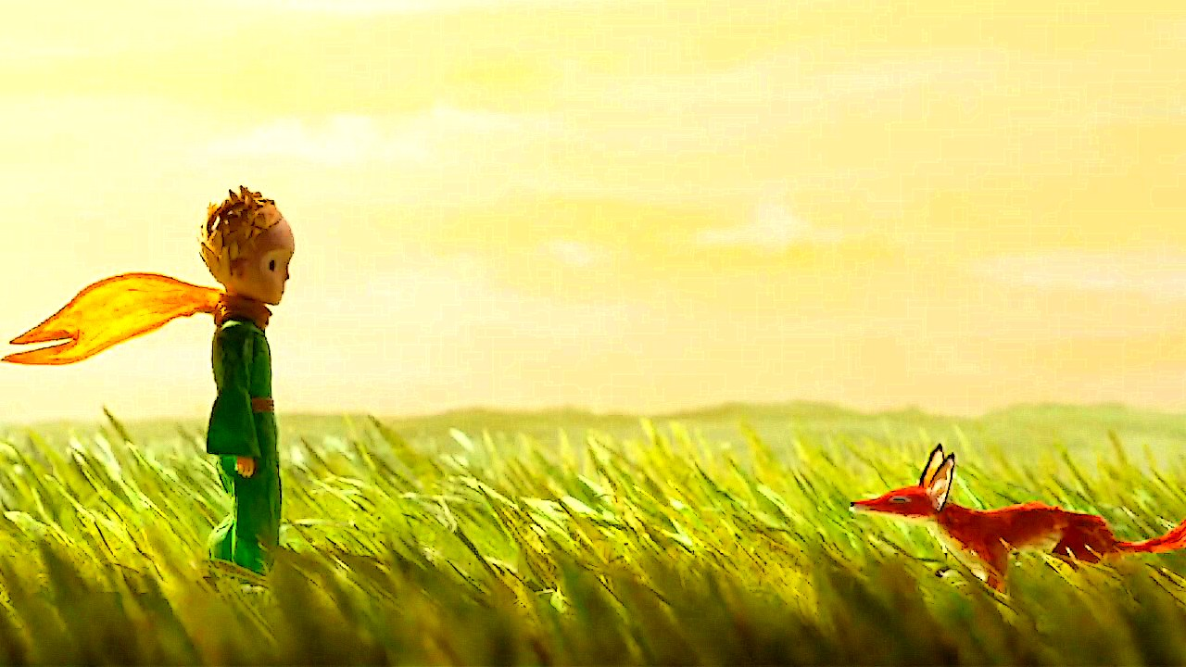
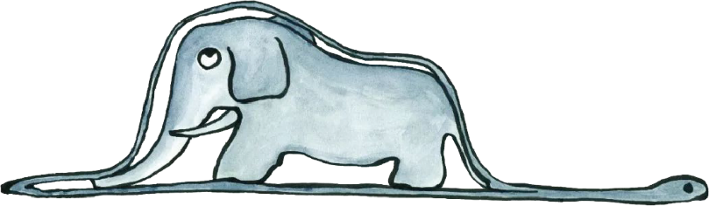
beautifully-illustrated
simple but intriguing
touching
ronmantic
engaging

Slide 4
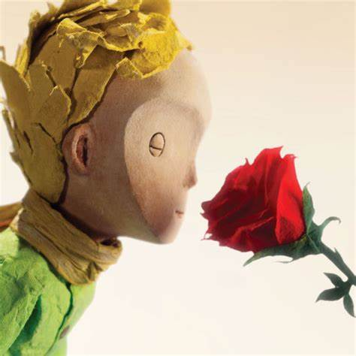
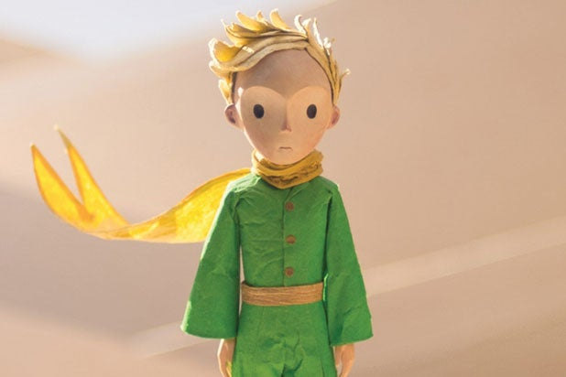
Book Review
The Little Prince was written and illustrated by the French writer Antoine de Saint-Exupéry during World War Ⅱ. It is a children’s fantasy book, but it is also enjoyed by adults.
It tells a story about a pilot who has crashed in the desert. While he is trying to fix his aeroplane, a little prince comes to him. Visiting from another planet, the little prince recounts his adventures to the pilot, and the two become friends.
The book talks about the importance of looking beneath the surface of

Slide 5
Book Review
things to uncover their real meanings. I like it because it is simple, and yet it really made me think a lot about life and death, love and responsibility, friendship and loneliness. One of the most memorable characters in the book is a rose, which the little prince fell in love with. I was really touched by the line — “It’s the time you spent on your rose that makes your rose so important.” — because it shows how we form special bonds with others by caring and taking responsibility for them.
Personally, I think this is a touching book that everyone should read, whatever their age.

Slide 6
How is it organized?
Introduction
Book Review
Main Body
Conclusion
General Facts
Main Plot
Key Message
Comments
Recommendation

Slide 7
How is it organized?
Introduction
General Facts
Main Plot
Book Review
Key Message
Main Body
Comments
Conclusion
Recommendation

Slide 8

Read para 1 carefully and complete the general facts about The Little Prince
• the title of the book: __________________________
• the name of the author: ________________________
• the genre:______________________
The Little Prince
Antoine de Saint-Exupéry
children’s fantasy
The Little Prince was written and illustrated by the French writer Antoine de Saint-Exupéry during World War Ⅱ. It is a children’s fantasy book, but it is also enjoyed by adults.

Slide 9
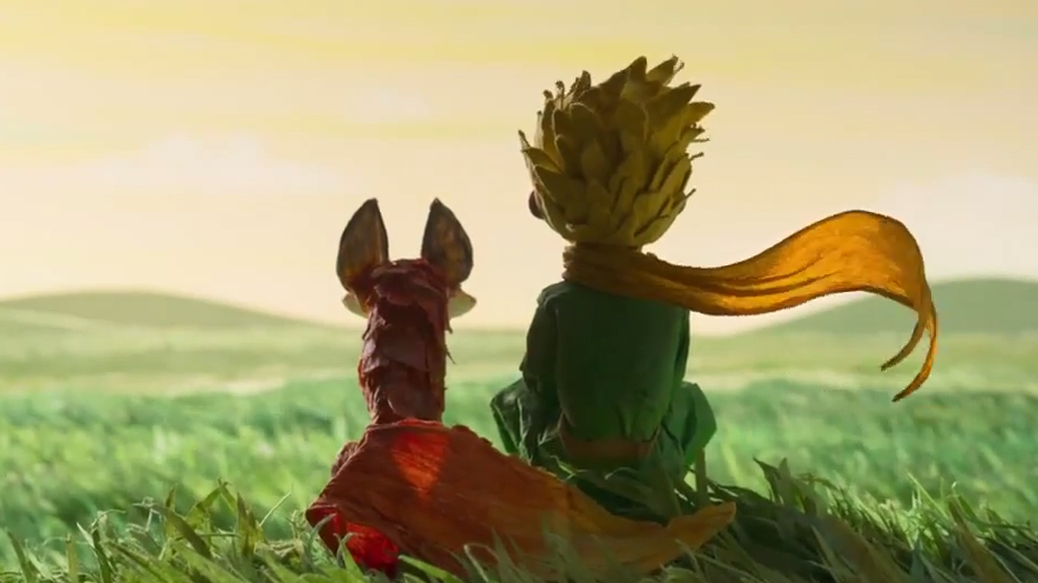
It tells a story about a pilot who has crashed in the desert. While he is trying to fix his aeroplane, a little prince comes to him. Visiting from another planet, the little prince recounts his adventures to the pilot, and the two become friends.
Do you agree with the description of the main plot?

Slide 10
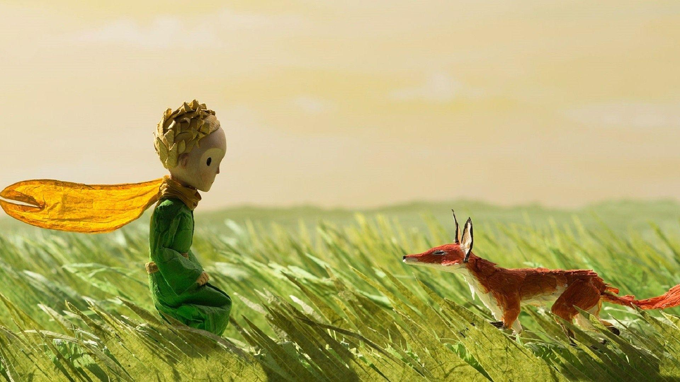
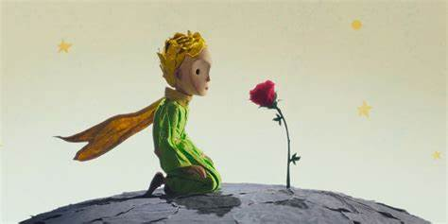
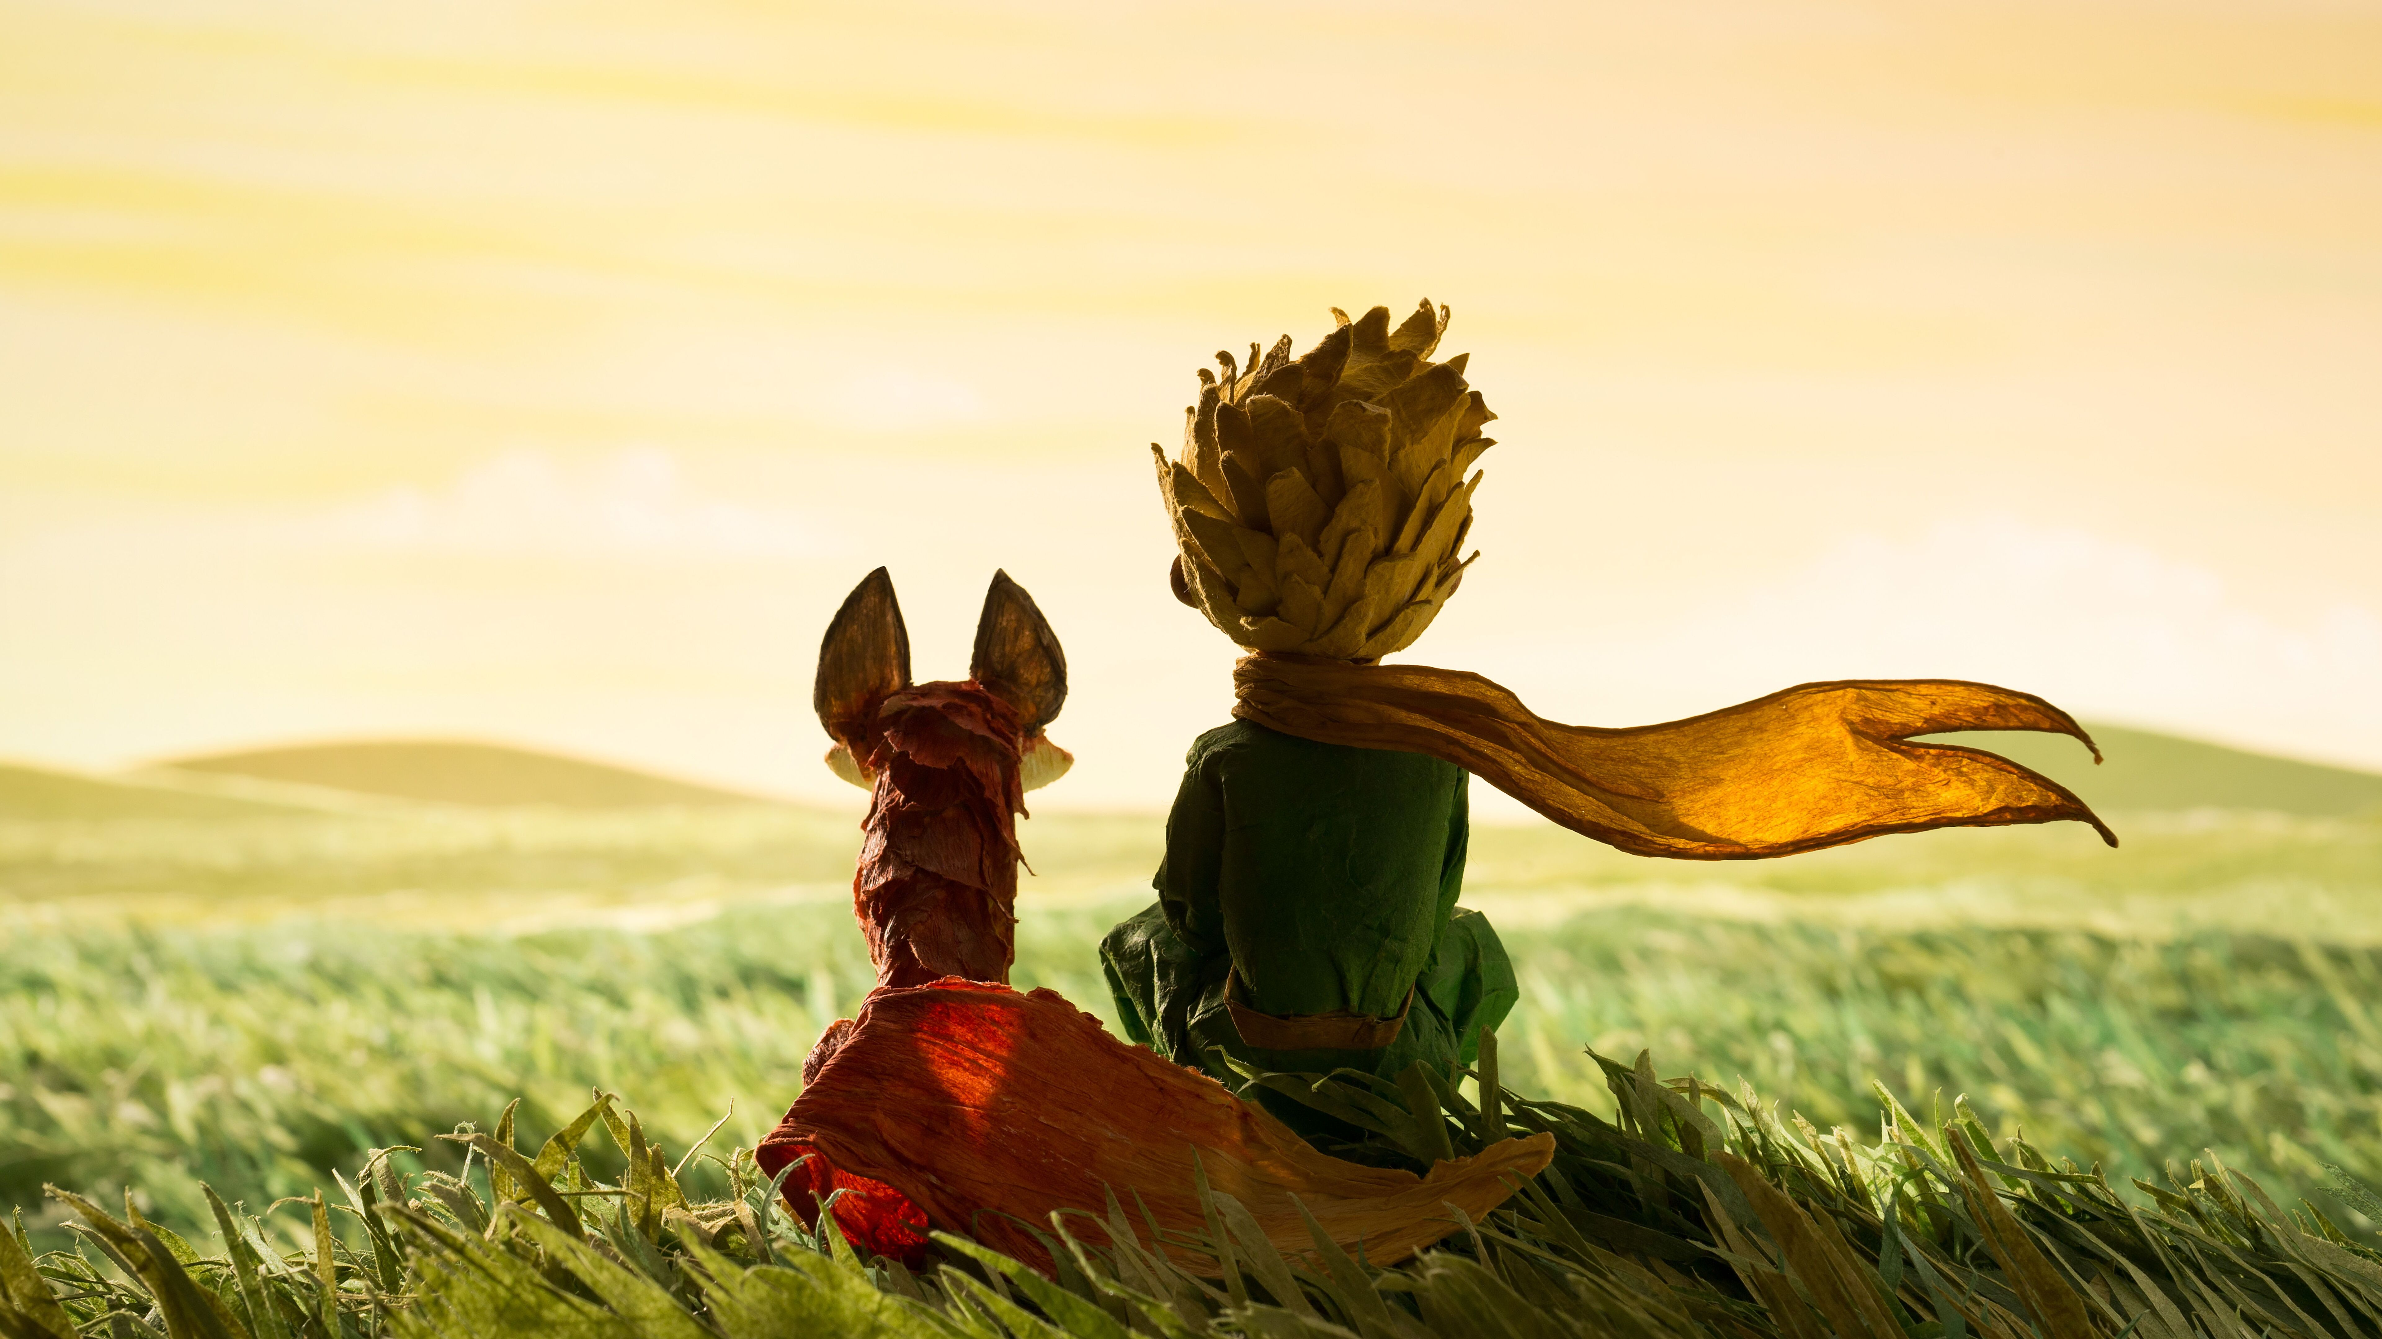
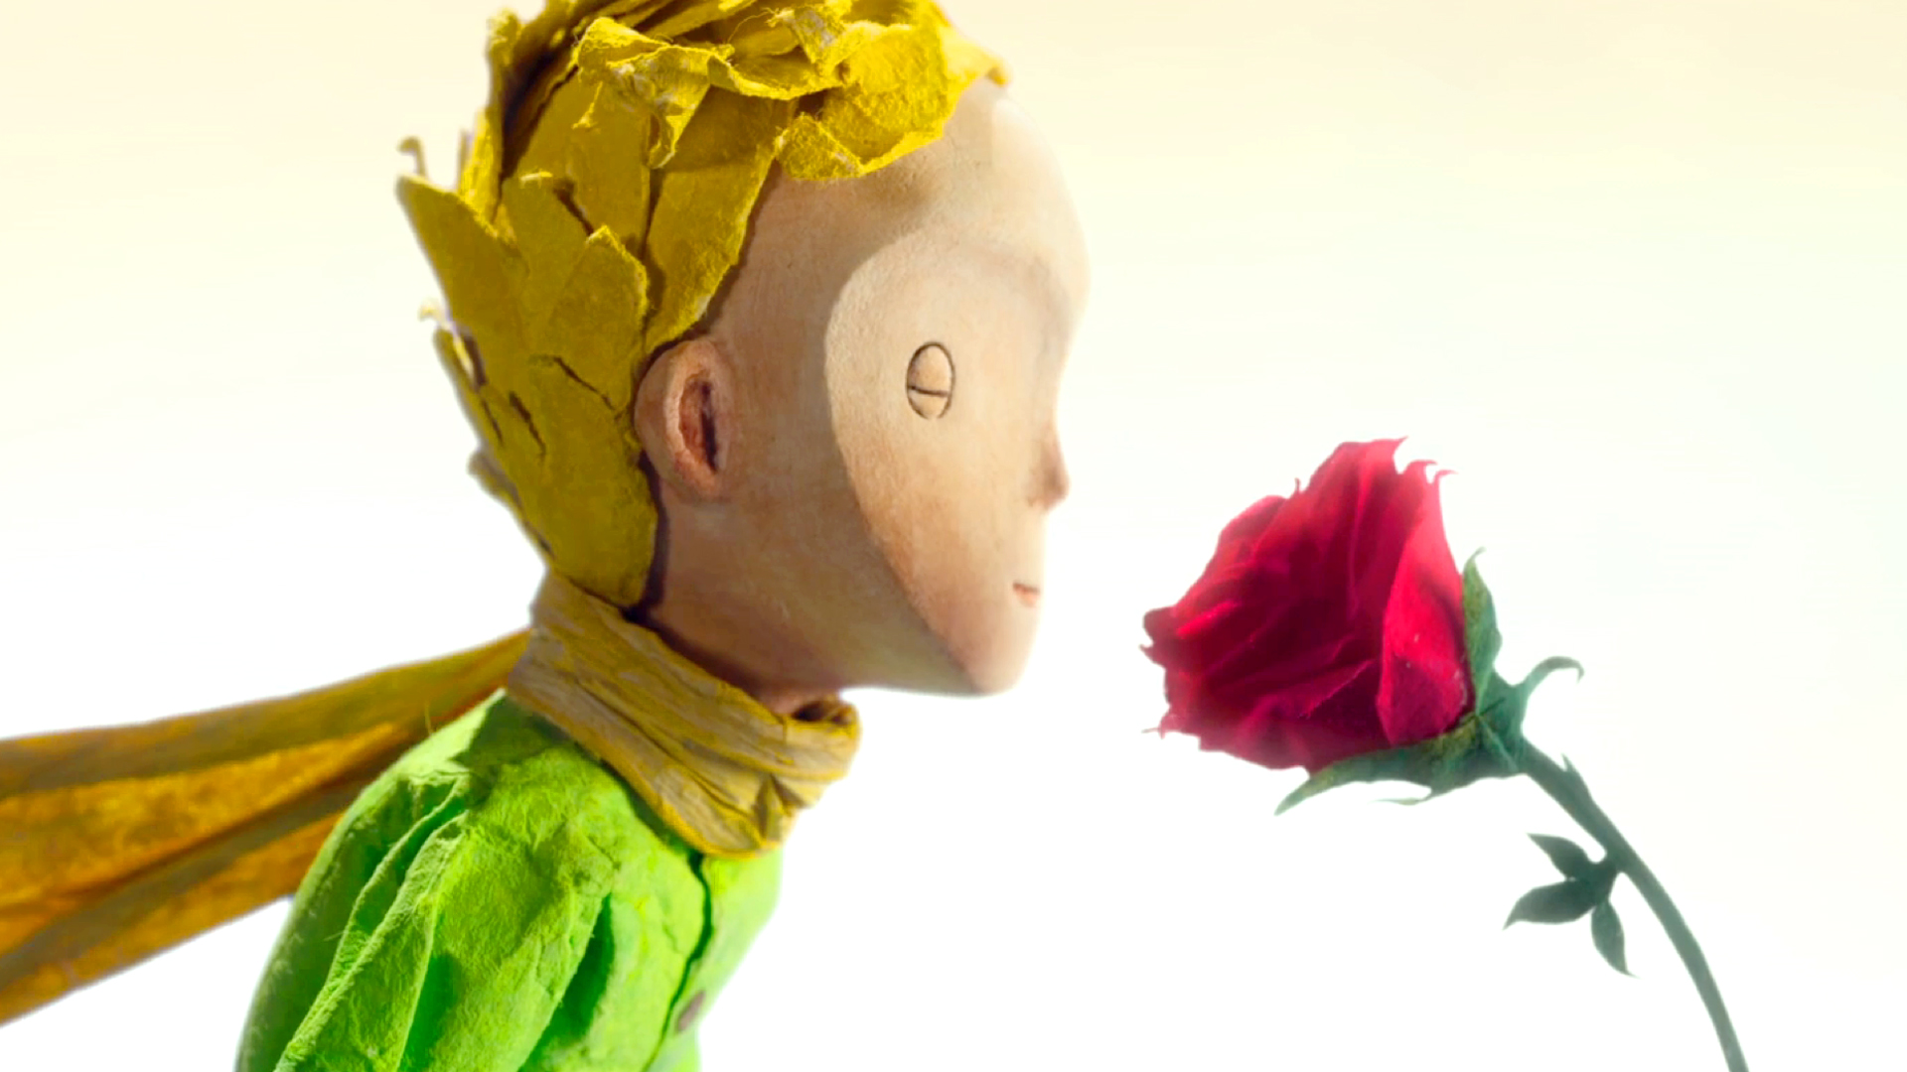
Use your own words to
describe these pictures.

Slide 11
A little prince fell in love with a beautiful rose on his planet.
Loving the rose made him so painful that he left her.
He encountered a fox on Earth and tamed him.
It was the fox who taught him the true meaning of love and the uniqueness of his rose.
Having learned how to love, the little prince came back to his rose

Slide 12
It tells a story about a pilot who has crashed in the desert. While he is trying to fix his aeroplane, a little prince comes to him. Visiting from another planet, the little prince recounts his adventures to the pilot, and the two become friends.
Can you recount the main plot of The Little Prince？
It tells a story about a little prince who fell in love with a beautiful rose on his planet. However, loving her made him so painful that he chose to leave her. While visiting the Earth, the little prince encountered a fox and tamed him. It was the fox who taught him the true meaning of love and the uniqueness of his rose. Finally, having learned how to love, the little prince came back to his rose.

Slide 13
Book Review
The book talks about the importance of looking beneath the surface of things to uncover their real meanings. I like it because it is simple, and yet it really made me think a lot about life and death, love and responsibility, friendship and loneliness. One of the most memorable characters in the book is a rose, which the little prince fell in love with. I was really touched by the line — “It’s the time you spent on your rose that makes your rose so important.” — because it shows how we form special bonds with others by caring and taking responsibility for them.
What are the key messages conveyed by the book?
What do I think of the book?
Which line and character impressed me most?

Slide 14
Book Review
The book talks about the importance of looking beneath the surface of things to uncover their real meanings. I like it because it is simple, and yet it really made me think a lot about life and death, love and responsibility, friendship and loneliness. One of the most memorable characters in the book is a rose, which the little prince fell in love with. I was really touched by the line — “It’s the time you spent on your rose that makes your rose so important.” — because it shows how we form special bonds with others by caring and taking responsibility for them.

Slide 15
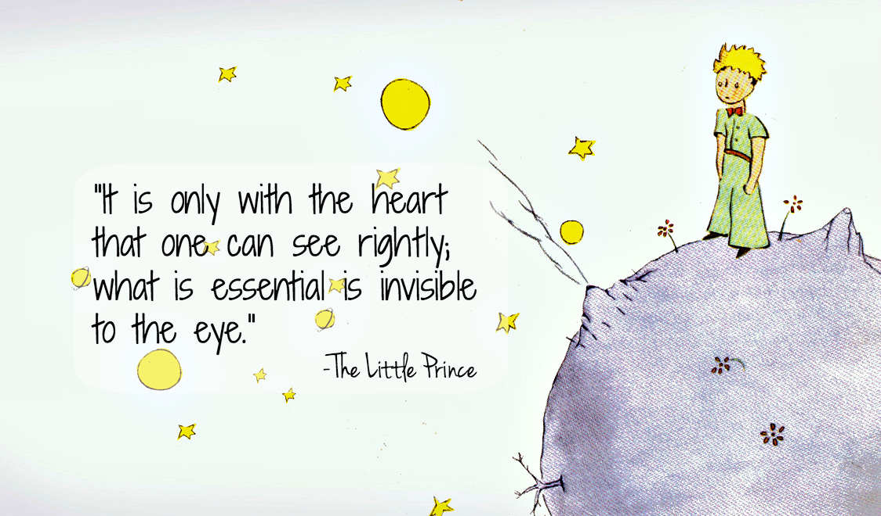
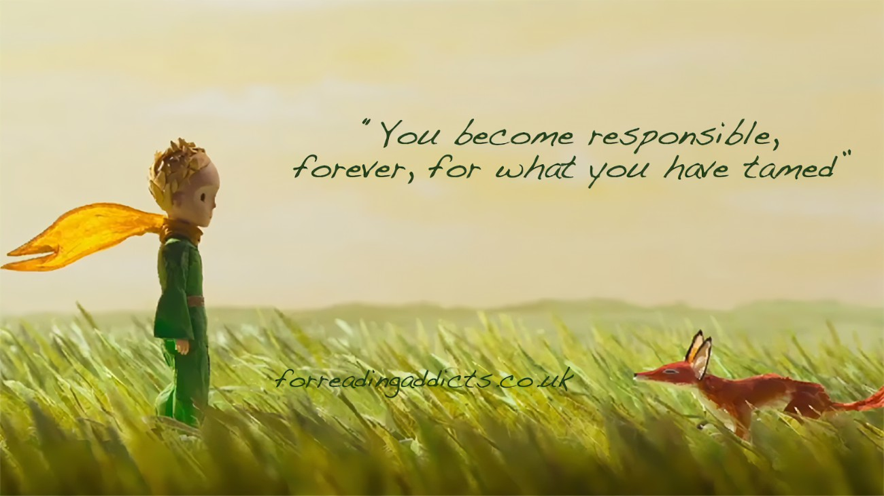
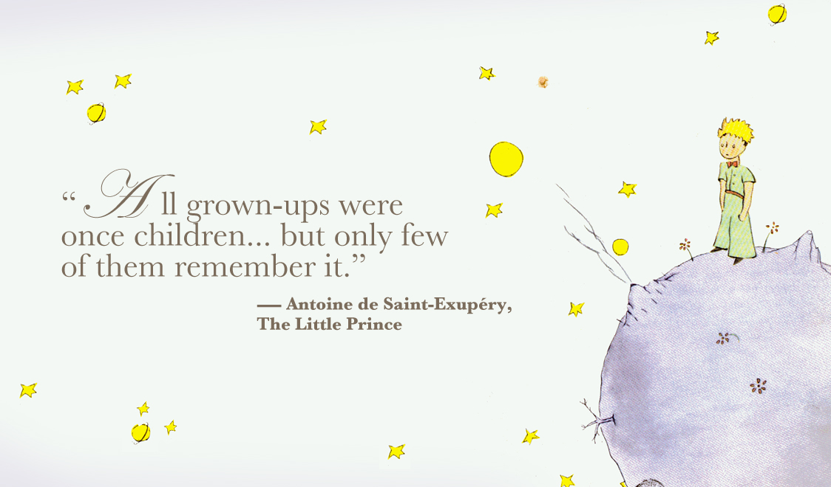
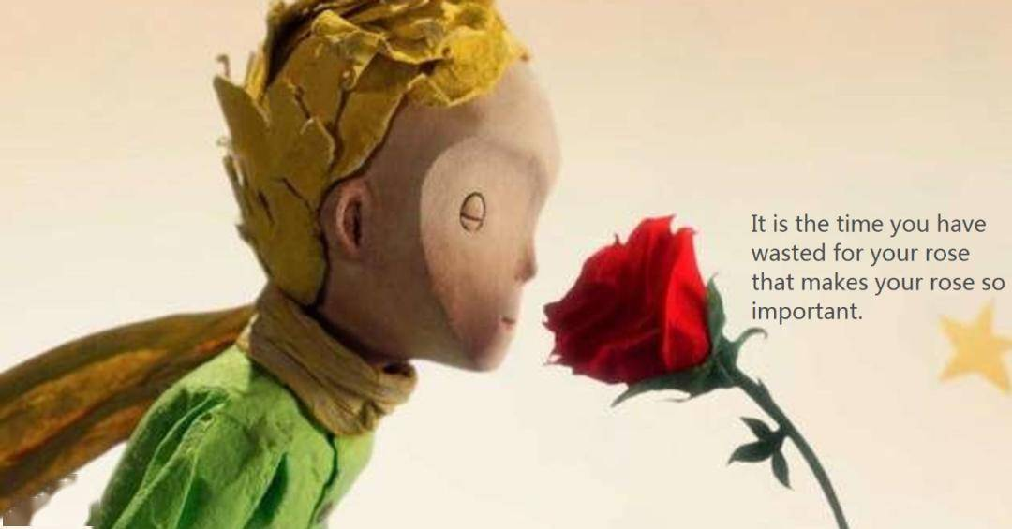
Translate the quotes from
The Little Prince

Slide 16
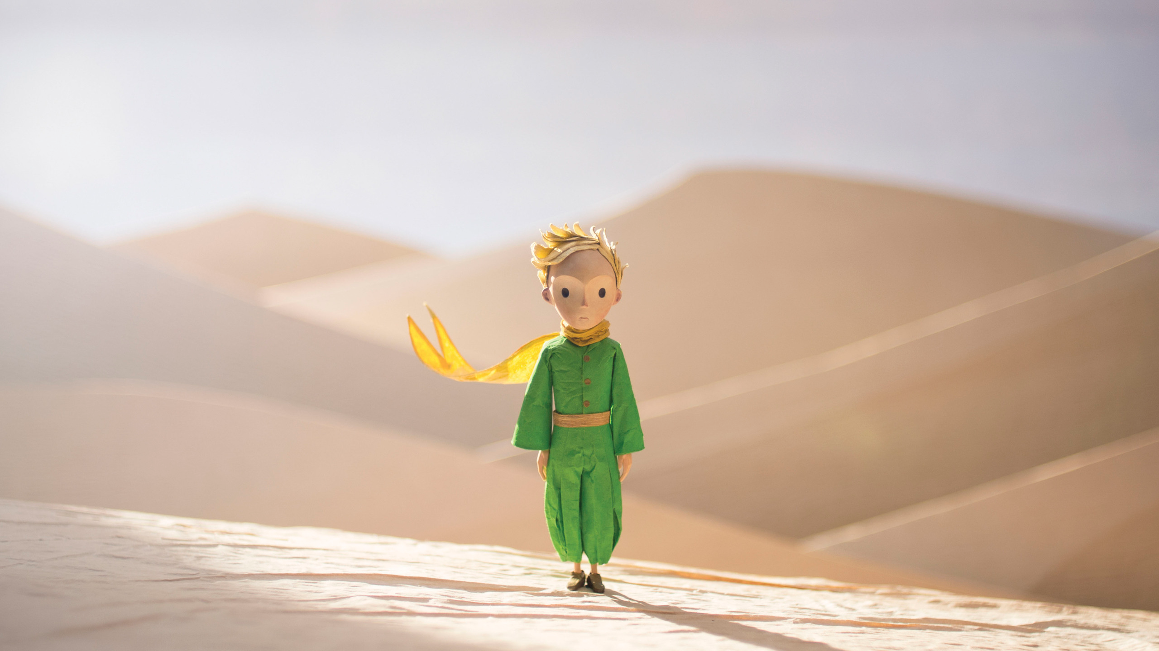
Book Review
Personally, I think this is a touching book that everyone should read, whatever their age.
Do I highly recommend The Little Prince? Why?
Yes

Slide 17
How is it organized?
Introduction
General Facts
Main Plot
Book Review
Key Message
Main Body
Quotes
Comments
Characters
Conclusion
Recommendation

Slide 18
How to write a book review?
Explain the key message and comments
Conclusion
Describe the main plot
Introduce general facts
Para 4
Para 3
Choose a book
Para 2
Para 1

Slide 19

Homework
Choose your favorite book and write a book review.

Slide 20
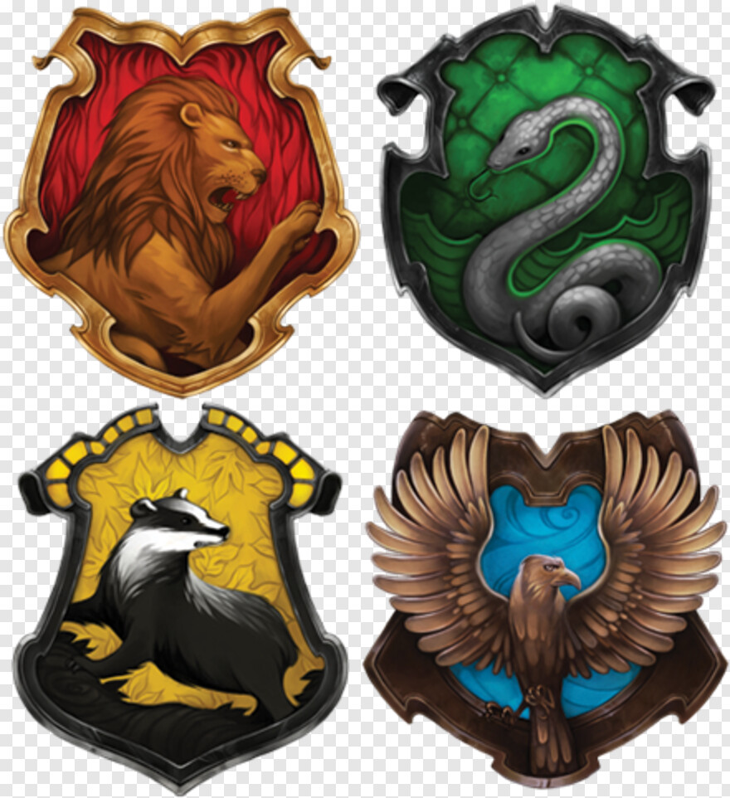
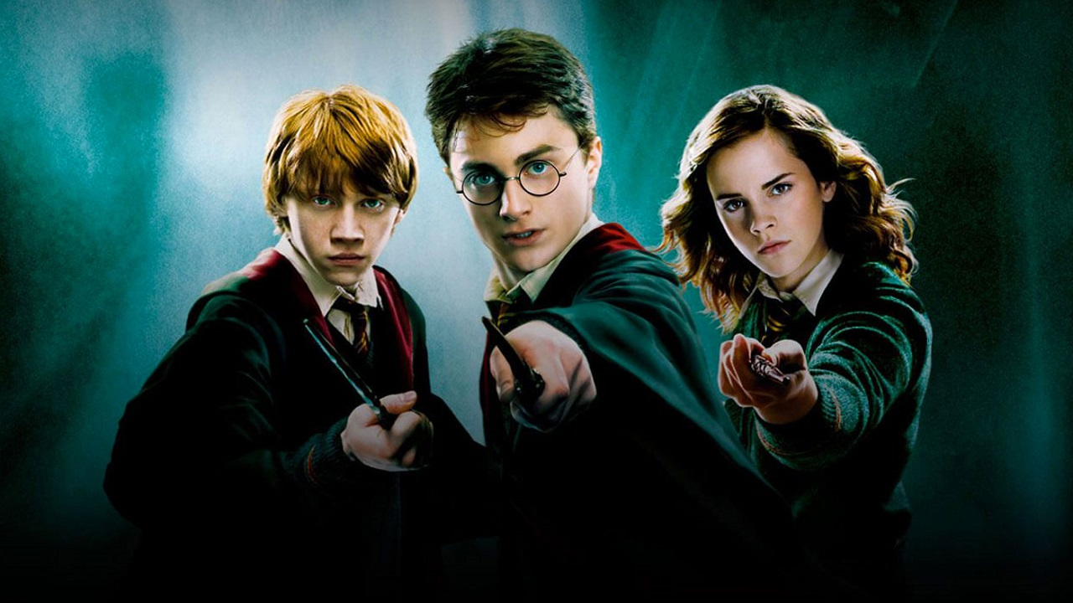
Sample
Published in 1997, Harry Potter written by JK Rowling has been strongly welcomed for over 25 years. The adventures in the magical world has attracted generations after generations.
One day, Harry Potter received a letter that said he had been admitted into Hogwarts-the greatest wizarding school of all time. It was at Hogwarts that he embarked on a journey to develop his magical talent, build special bonds with precious partners and exert the learned skills to defeat Voldemort.
General Facts
Main Plot

Slide 21
Sample
Harry Potter is far more than an adventurous story. It tells us how to stay a man of integrity and choose the right path in a dilemma. I’m greatly inspired by the wisdom and perception of the headmaster Dumbledore. What impressed me most is the line, “There will be a time when we must choose between what is easy and what is right”. It uncovers the true meaning of every little life choice, which gradually forms what our life is like.
Personally, Harry Potter is a must-not-miss series. It allows me to dig out different meanings at different life stages.
Key Message
Comments
Conclusion

Slide 22
Thank You

