Slide 1

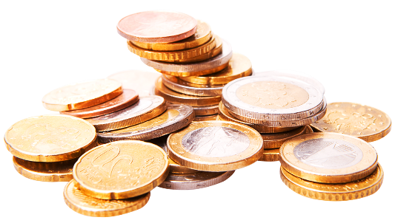
Learning objectives
At the end of the class, we will be able to
understand the main idea of the passage, including the genre and the structure.
sort out the detailed information about the four jars by using the reading strategies.
cultivate a positive attitude towards money and form the habit of managing money wisely.
docerID:4610637

Slide 2

www.www.2ppt.com.com/hangye
Unit 2 Improving yourself
Valuable Values

Slide 3
Warming up
Spending habits of students at No.2 Senior High School
7%
8%
snacks
computer games
53%
32%
books and magzines
other

Slide 4
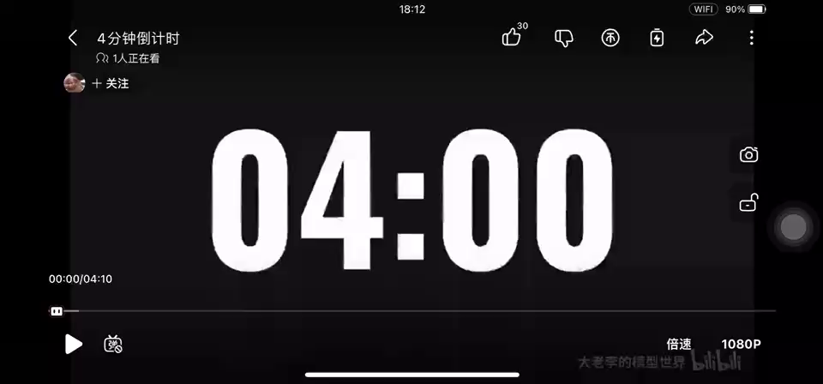
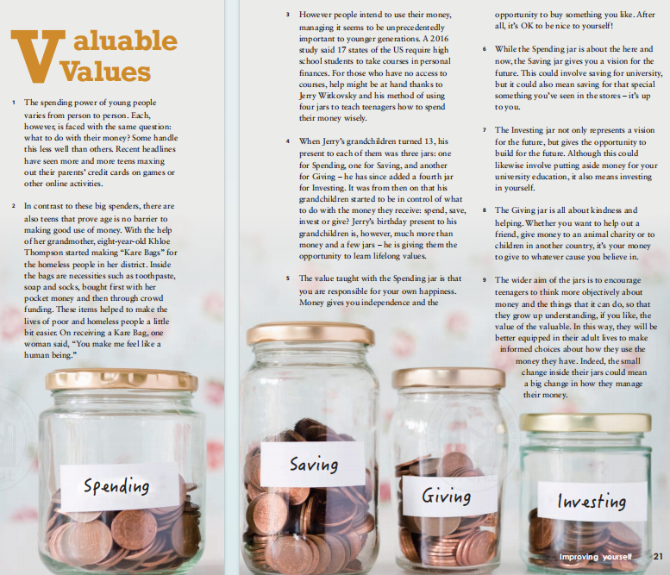

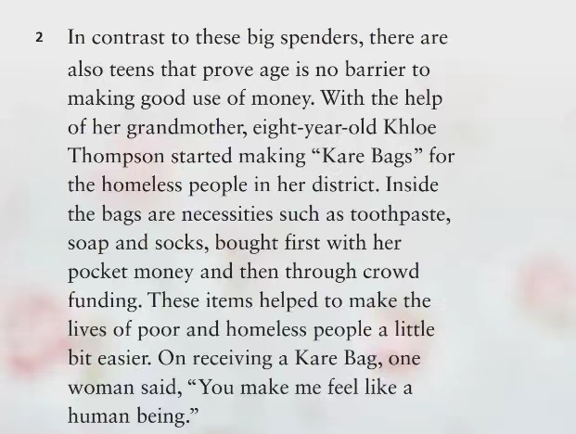
Read for structure
Four jars to teach teenagers how to spend money wisely
What’s genre(体裁) of this passage?
Two different ways to handle money among teens
Narration
Argumentation
Exposition
How many parts will you divide the passage into ?
What is the main idea of each part?
The wider aim of the jars
Exposition

Slide 5
Read for structure
Two different ways to handle money among teens
Part I (para.1-2)
Valuable
Values
Four jars to teach teenagers how to spend money wisely
Part II (para.3-8)
The wider aim of the jars
Part III (para.9)

Slide 6
Read for details—Part 1
1. What are the two different ways to handle money among teens?
2. Why does the author use the example of Khloe Thompson ?
2 In contrast to these big spenders, there are also teens that prove age is no barrier to making good use of money.With the help of her grandmother,eight-year-old Khloe Thompson started making “Kare Bags” for the homeless people in her district. Inside the bags are necessities such as toothpaste,soap and socks,bought first with her pocket money and then through crowd funding.These items helped to make the lives of poor and homeless people a little bit easier.On receiving a Kare Bag,one woman said,“You make me feel like a human being.
1 The spending power of young people varies from person to person. Each, however, is faced with the same question:what to do with their money? Some handle this less well than others. Recent headlines have seen more and more teens maxing out their parents’ credit cards on games or other online activities.

Slide 7
Part I (para.1-2)
Maxing out their parents’ credit cards on games
Two different ways to handle money among teens
Making good use of money
Valuable
Values
Part II (para.3-8)
Four jars to teach teenagers how to spend money wisely
Part III (para.9)
The wider aim of the jars

Slide 8

Read for details—Part 2
1. How can teens learn to make good use of money?
3 However people intend to use their money, managing it seems to be unprecedentedly important to younger generations. A 2016 study said 17 states of the US require high school students to take courses in personal finances. For those who have no access to courses, help might be at hand thanks to Jerry Witkovsky and his method of using four jars to teach teenagers how to spend their money wisely.
Jerry Witkovsky

Slide 9
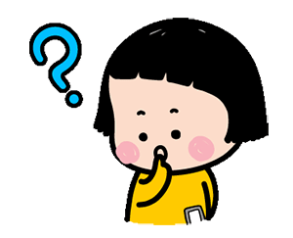
Read for details—Part 2
4 When Jerry’s grandchildren turned 13, his
present to each of them was three jars: one for Spending, one for Saving, and another for Giving – he has since added a fourth jar for Investing. It was from then on that his grandchildren started to be in control of what
to do with the money they receive: spend, save, invest or give? Jerry’s birthday present to his grandchildren is, however, much more than money and a few jars – he is giving them the opportunity to learn lifelong values.
2. Why did Jerry give four jars to his grandchildren ?
Jerry Witkovsky

Slide 10
Part I (para.1-2)
Maxing out their parents’ credit cards on games
Two different ways to handle money among teens
Making good use of money
Valuable
Values
Part II (para.3-8)
Spending jar
Saving jar
Investing jar
Giving jar
Four jars to teach teenagers how to spend money wisely
Part III (para.9)
The wider aim of the jars

Slide 11
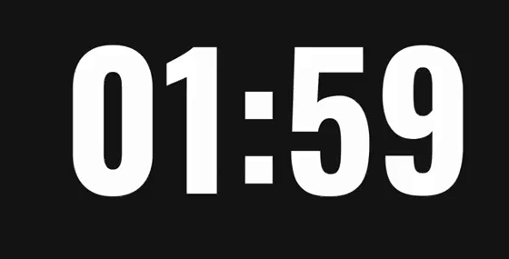
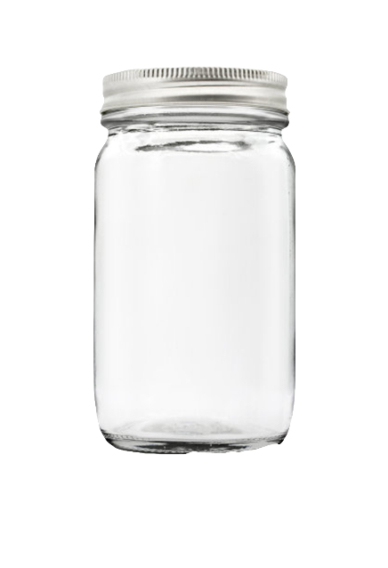

Read for details—Part 2
Read Para 5-8 and finish the mind-map.
The value is
________________________________________________
The value is
________________________________________________
Spending
saving
The value is
________________________________________________
The value is
________________________________________________
Investing
giving

Slide 12

Read for details—Part 2
The value is
________________________________________________
being responsible for your own happiness
Spending
It is valuable to ______________________.
yourself
/ the individual
or others

Slide 13
Read for details—Part 2
The value is
________________________________________________
giving you a vision for the future
saving
It is valuable to _____________________.
yourself / the individual

Slide 14
Read for details—Part 2
7 The Investing jar not only represents a vision for the future, but gives the opportunity to build for the future. Although this could likewise involve putting aside money for your university education, it also means investing in yourself.
3. What can we do to invest in ourselves?
Investing
The value is
________________________________________________
giving the opportunity to build for the future
Health
Education
It is valuable to ______________________.
Hobbies
yourself / the individual

Slide 15
Read for details—Part 2
It is valuable to _____________________.
others / the society
giving
The value is
________________________________________________
kindness and helping

Slide 16
Part I (para.1-2)
Maxing out their parents’ credit cards on games
Two different ways to handle money among teens
Making good use of money
Valuable
Values
Part II (para.3-8)
Spending jar
Saving jar
Investing jar
Giving jar
Four jars to teach teenagers how to spend money wisely
Part III (para.9)
Thinking more objectively about money
The wider aim of the jars
Understanding the value of the valuable

Slide 17

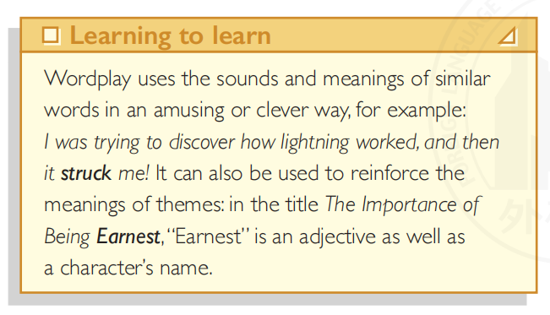
money
双关语
making good use of money
?
Valuable
Values
making a difference to the society
…

Slide 18

Think & Share
There is a scholarship of 1,000 yuan.
Please work out how to make the best use of it according to the four jars.

Slide 19

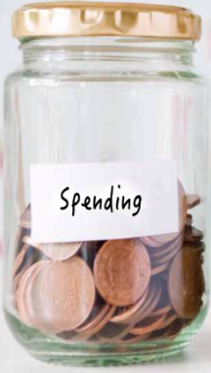
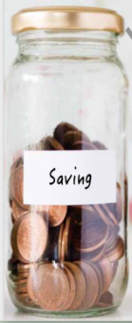
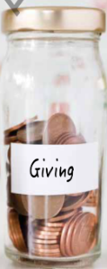
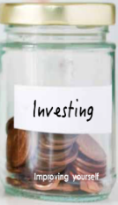
Summarize
What values have you learnt today?
i
ndependence
m
anaging money wisely
p
o portunity
r
esponsibility
o
thinking bjectively
v
ision for the future
e
Kindn ss and helping

Slide 20

Summarize
What values have you learnt today?
r
o
v
i
e
m
p
yourself

Slide 21
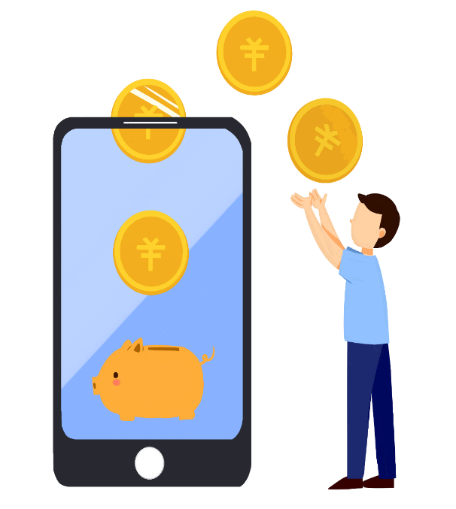
Assignment
Option1: Make a money management plan.
Option2: Make a survey about the spending habits of
your famliy or friends. Then offer them
some advice.

