Slide 1

新外研社高中英语选择性必修二
Unit 2 Improving Yourself
Starting Out&Understanding Ideas

Slide 2

Starting Out

Slide 3

Starting out
Watch the video and answer the questions.
1. What is the video about?
2. Watch the video again and list the time management tips mentioned in the video.

Slide 4

Starting out
Watch the video and answer the questions.
What is the video about?
The video is about time management tips for busy teenagers.

Slide 5
Starting out
Watch the video and answer the questions.
2. What time management tips does the video list?
Create a schedule(工作计划,日程安排）
Set small goals
Make the most of every second
Identify your productive time
Wear a watch
Focus your efforts

Slide 6
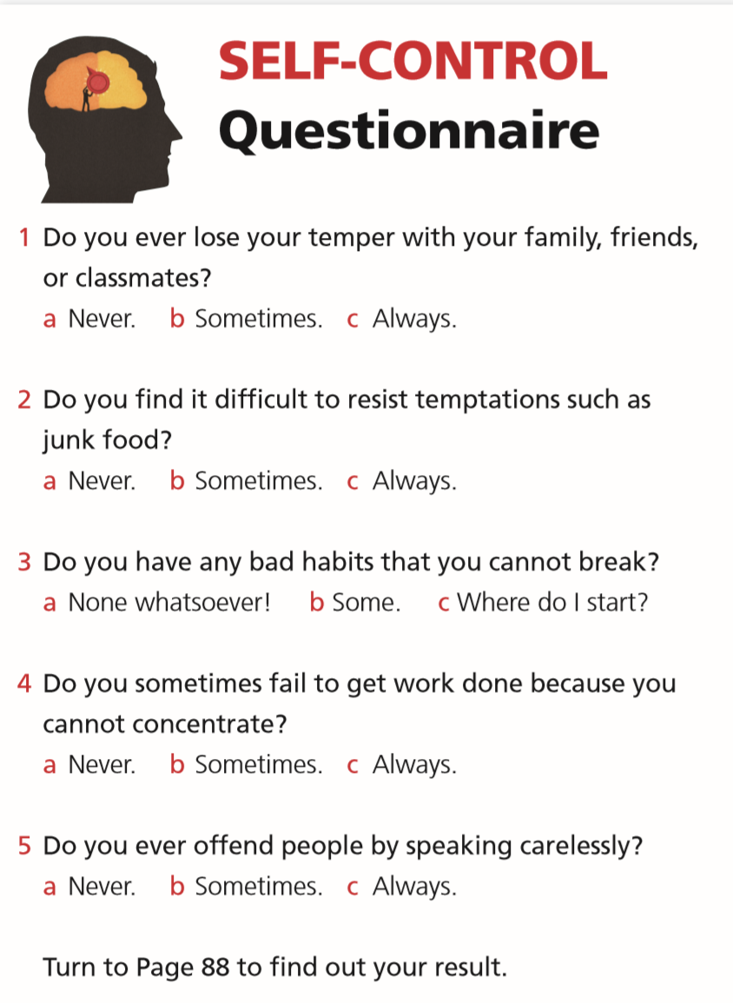
Starting out
Complete the questionnaire and find out how good your self-control is.
Self –Control Questionnaire
1 Do you ever lose your temper with your family, friends, or classmates?
a Never b Sometimes c Always.
2 Do you find it difficult to resist temptations such as junk food?
a Never b Sometimes c Always.
3 Do you have any bad habits that you cannot break?
a None whatsoever! b Some c Where do I start?
4 Do you sometimes fail to get work done because you cannot concentrate?
a Never b Sometimes c Always
5 Do you ever offend people by speaking carelessly?
a Never b Sometimes c Always
Turn to Page 110-111 to find out your result.

Slide 7
Starting out
Results of the questionnaire
Mostly “a”
You are the captain of self-control, the ruler of self-regulation（自我调节）! Not only are you conscientious/ˌkɒnʃiˈenʃəs/（认真的） and in control of your emotions , it also seems you can resist temptation. Be careful not to take everything so seriously though. Try to relax more and once in a while（偶尔） , do something impulsive/ɪmˈpʌlsɪv/（冲动的）.

Slide 8
Starting out
Results of the questionnaire
Mostly “b”
Hmm…whilst（尽管） you seem to have grasped the basics of self-management, there is still room for improvement! Take a step back（退一步） and think about how you could be more focused on your goals and gain more control of your emotions.
Mostly “c”
Far from being in control, it seems your emotional impulses（情感冲动） and temptations are controlling you ! Don`t just sit back（不采取行动） and let things happen. Assess and find our what`s going wrong and draw up a plan of action（制定一份行动计划）. Try to stick with it（坚持下去）!

Slide 9

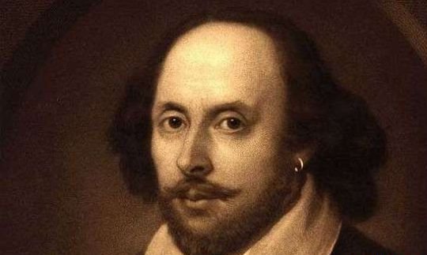
He who abandons time, time abandons him.
-----Shakespeare

Slide 10
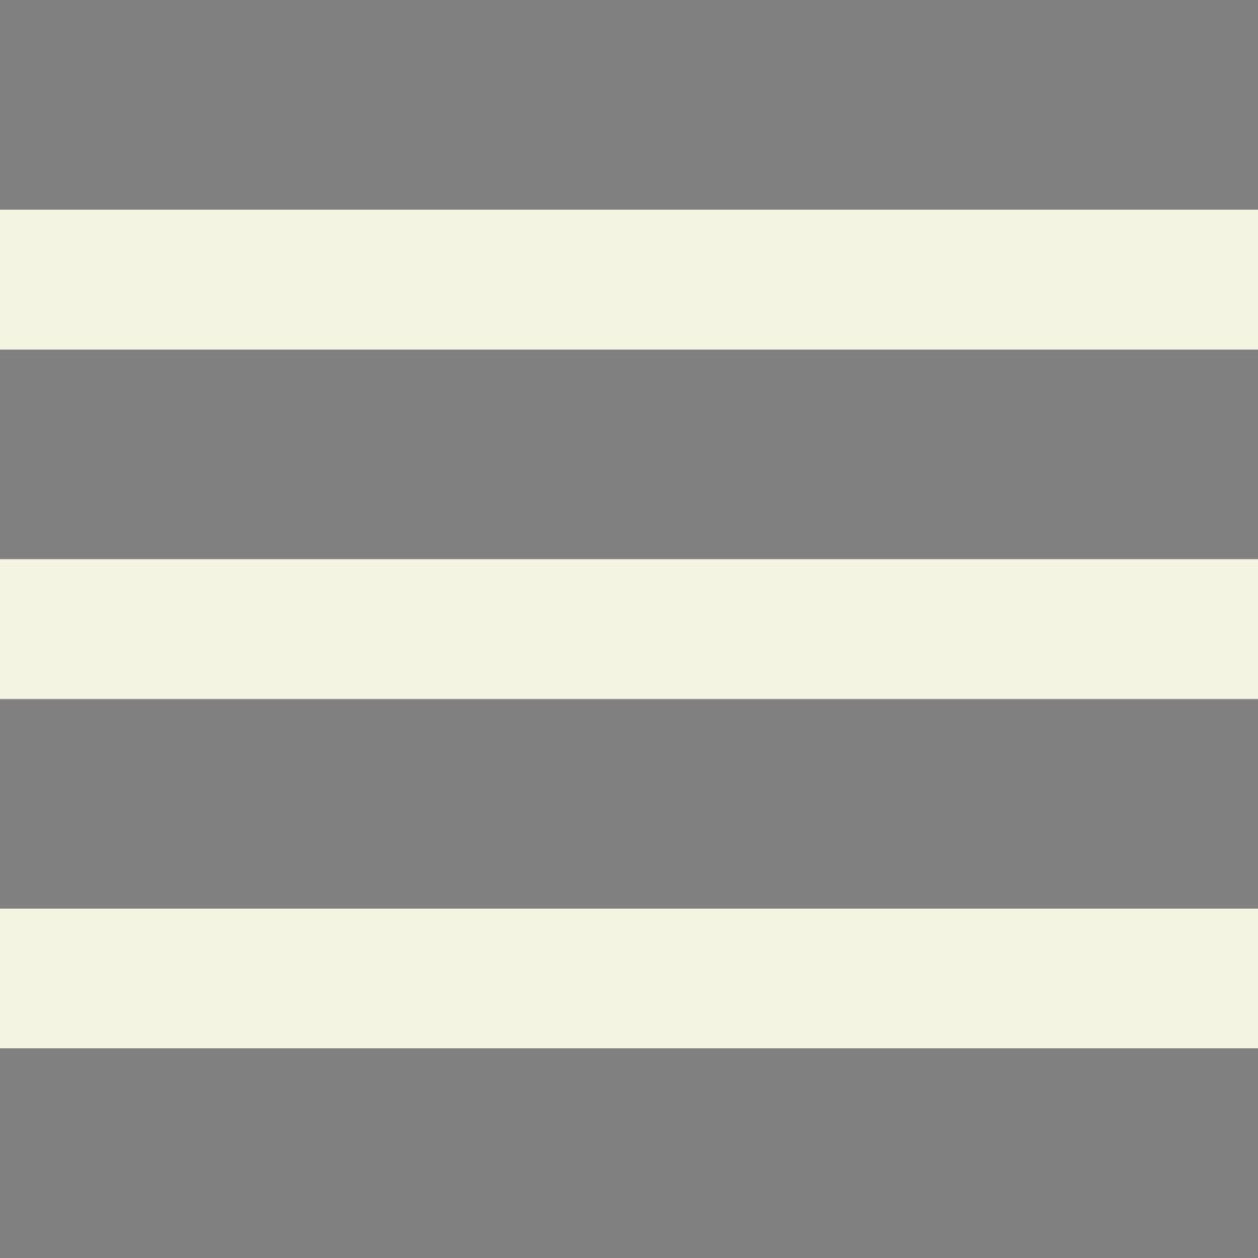
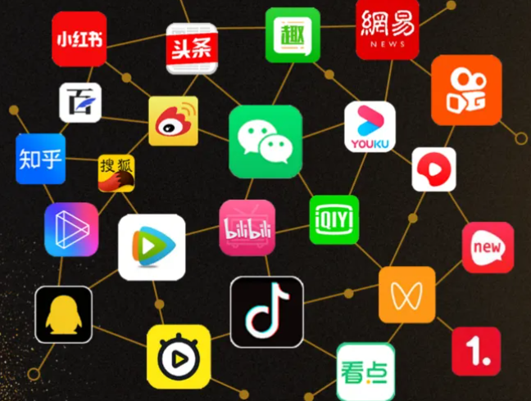
Can you control the time of playing with cell phone? How much time do you spend on social media on weekend?
Now read the facts on page 18 and answer the questions.

Slide 11
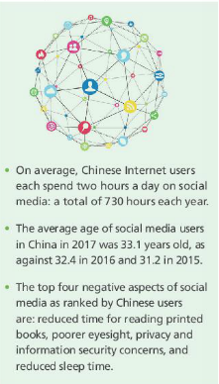
Pre-reading
Read the facts and answer the questions.
1.How much time do you spend on social media on weekend?
2. What negative effects does this have on you?

Slide 12
poorer eyesight
less time to read books
getting addicted to it
less time with family
negative effects
less sleep time
no privacy
What negative effects does social media have on you?

Slide 13
Understanding Ideas

Slide 14


Prediction
campaign
The passage is about a __________ for _____________ social media for ______ days among some students.
stopping using
seven

Slide 15
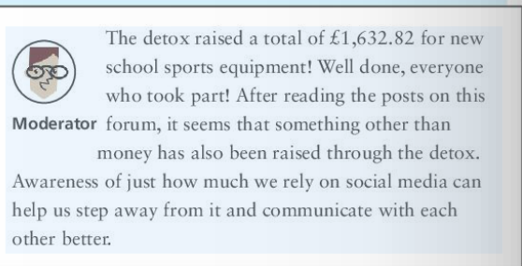
Prediction
Where is the passage taken from?
The passage is taken from a forum.

Slide 16
Read the forum and answer the questions:
1. What is the forum about and why was it started?
2. Were all the participants willng to participate in it?
3. Among the 5 participants, who lasted for the full 7 days?
4. Why do you think the rest give up halfway or even throw in the towel at the very beginning?
5. What positive impact does living without a smartphone for a week have on both Devon and Cindy?

Slide 17
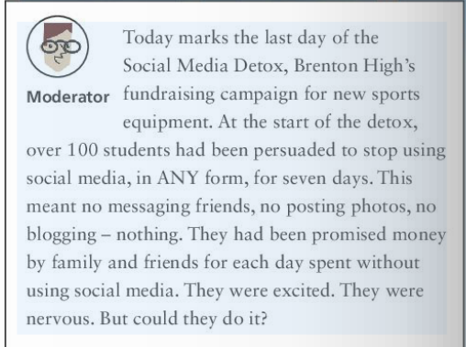
1. What is the forum about and why was it started?
The forum is about a fundraising campaign, in which 5 participants talk about their experiences and reflection.
It was in order to raise funds for new sports equipment that the campaign was started.

Slide 18
2. Were all the participants willng to participate in it?
No, they were unwilling/reluctant because most of them were persuaded to participate in stoping using social media.

Slide 19
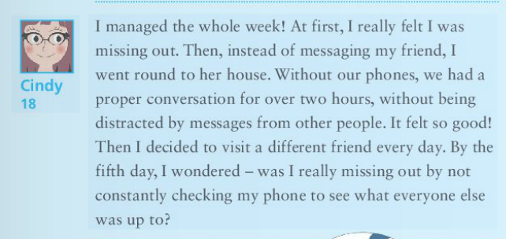
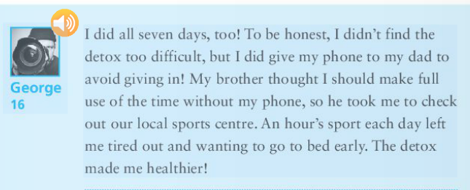
3. Among the 5 participants, who lasted for the full 7 days?

Slide 20
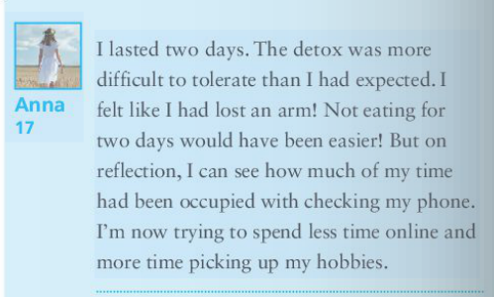
4. Why do you think the rest give up halfway or even throw in the towel at the very beginning?
They couldn’t resist temptation of mobile phone.

Slide 21
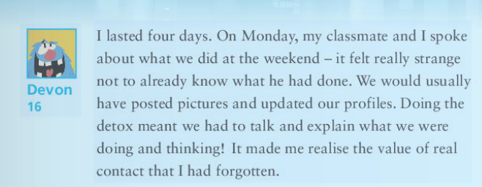
4. Why do you think the rest give up halfway or even throw in the towel at the very beginning?
They couldn’t resist temptation of mobile phone.

Slide 22
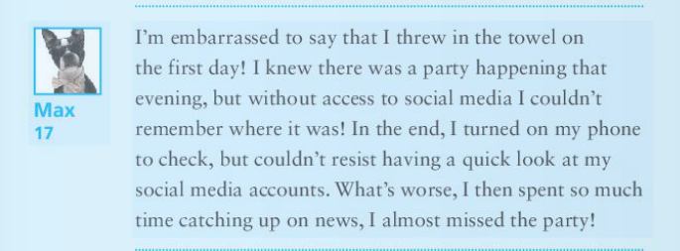
4. Why do you think the rest give up halfway or even throw in the towel at the very beginning?
They couldn’t resist temptation of mobile phone.

Slide 23
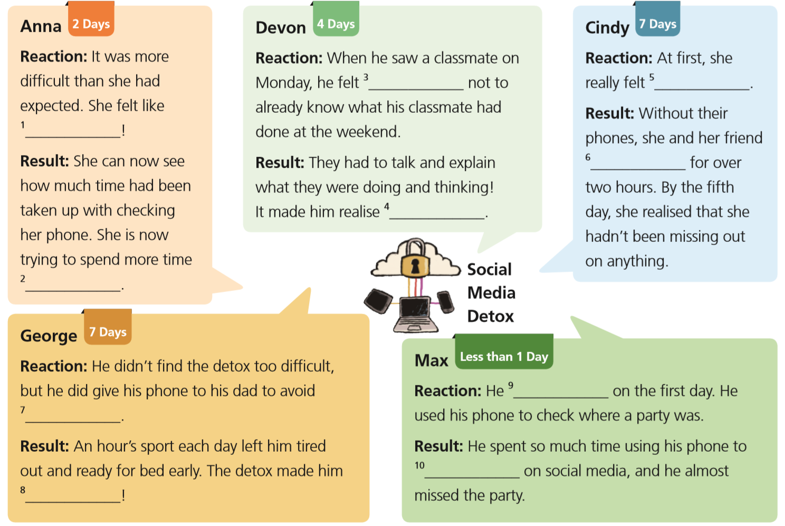
Read Para. 3 to 7 and complete the summaries. (P16)

Slide 24
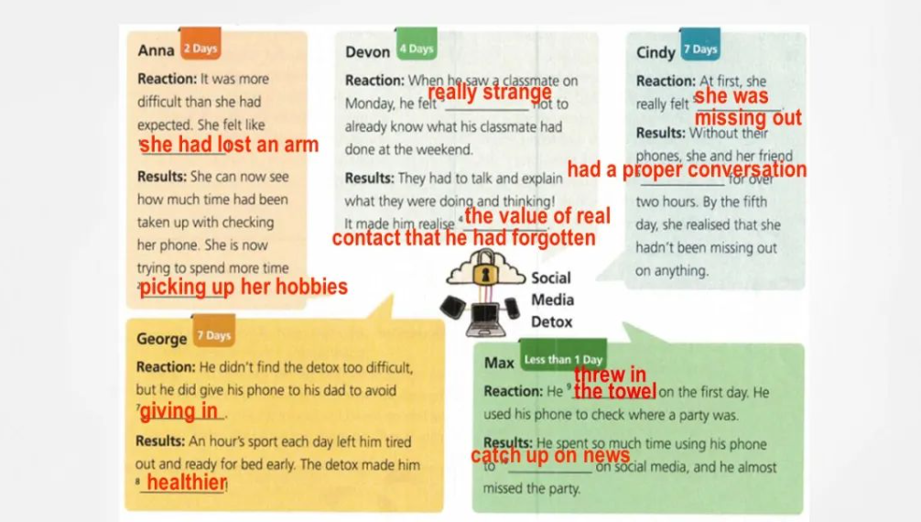
Read Para. 3 to 7 and complete the summaries. (P16)

Slide 25

5. What positive impact does living without a smartphone for a week have?
It helped students learn how to best communicate using social media.
It raised money for school sports equipment.
It made students want to spend even more time on social media.
It made students realize how much time they had been spending on social media.
It encouraged students to find new ways to communicate and try new activities.

Slide 26
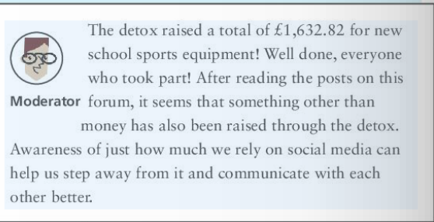
2. It raised money for school sports equipment.

Slide 27
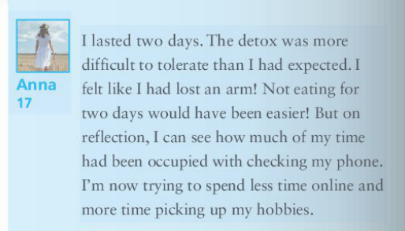
4. It made students realize how much time they had been spending on social media.

Slide 28
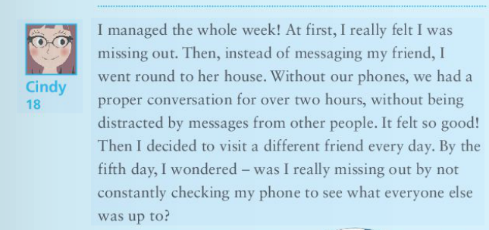
5.It encouraged students to find new ways to communicate and try new activities.

Slide 29
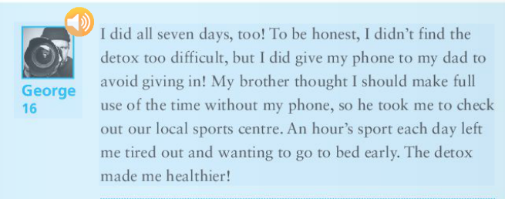
5.It encouraged students to find new ways to communicate and try new activities.

Slide 30
Make these phrases into sentences according to the picture.
surf on the Internet 网上冲浪 v.
drown(v.) to death 溺死；淹死 v.
struggle v. 努力；挣扎 v.
reach for v. 伸手去够 v.
life buoy n. 救生圈 n.
Surfing on the Internet, a teen is trapped,nearly drowning to death. Aware of danger, it is time for him to struggle, reaching for the life buoy.

Slide 31

Let’s explore the reasons for social media addiction

Slide 32
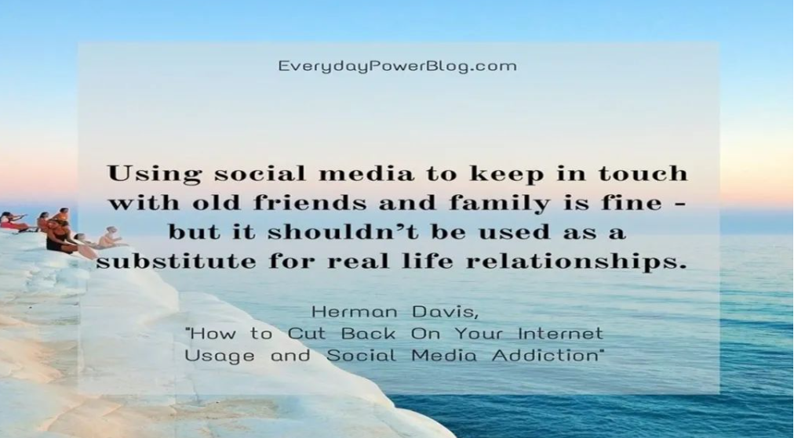

Slide 33
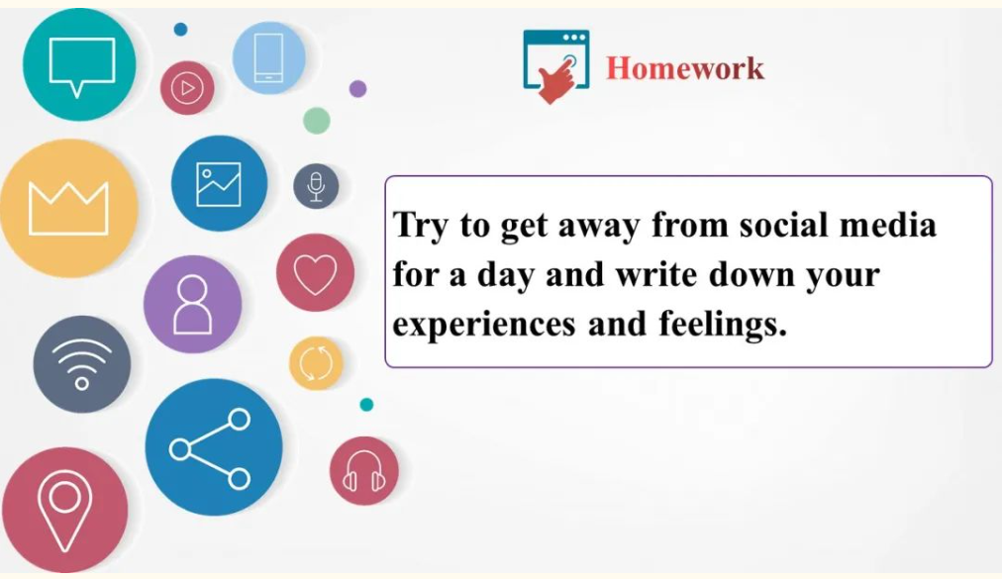

Slide 34
Fill in the blanks and try to retell the passage.
A fundraising campaign — the Social Media Detox has been launched to persuade over 100 students to stop ¹__________ (rely) on social media for seven days. Five of the students shared what they ²__________ (learn) from the experience.
Anna said the campaign was ³______________ (difficult) than she had expected. She can now see how much of her time had been ⁴__________ (occupy) with checking her phone. She’s now trying to spend more time picking ⁵__________ her hobbies. Devon said it felt strange not to already know ⁶__________ his classmate had done at the weekend. They talked and explained what they were doing and thinking, ⁷__________ made him realise the value of real contact.
relying
had learnt
more difficult
occupied
up
what
which

Slide 35
Fill in the blanks and try to retell the passage.
Without phones, Cindy and her friend had a proper conversation for over two hours, without being distracted by ⁸__________ (message). She said it felt good.
George didn’t find ⁹__________ campaign too difficult. An hour’s sport each day left him tired out and wanting to go to bed early. The campaign made him healthier. Max threw in the towel on the first day. He switched ¹⁰__________ his phone to check where a party was. He couldn’t resist having a quick look at his social media accounts.
messages
the
on

