Slide 1
Unit 2 Improving yourself
Past perfect passive

Slide 2
* past perfect tense
过去完成时
（过去的过去）
past perfect
past
future
present

Slide 3
Past perfect passive
定义
过去完成时的被动语态
过去完成时的被动语态表示动作在过去某一时间或某一动作之前已经发生或完成，且主语与谓语动词之间是被动关系，句中常用by, before, until, when等词引导时间状语。
基本结构
肯定：主语 + had been done
否定：主语 + had not been done
疑问句：Had + 主语 + been done ?

Slide 4
Look at the sentences from the reading passage and answer the questions.
a At the start of the detox, over 100 students had been persuaded to stop using social media, in ANY form, for seven days.
bAt the start of the detox, people had persuaded over 100 students to stop using social media, in ANY form, for seven days.
1 Were the students in sentence (a) persuaded before the detox
started, or afterwards?
The students were persuaded before the detox started.

Slide 5
Look at the sentences from the reading passage and answer the questions.
a At the start of the detox, over 100 students had been persuaded to stop using social media, in ANY form, for seven days.
bAt the start of the detox, people had persuaded over 100 students to stop using social media, in ANY form, for seven days.
2 What is the difference between sentences (a) and (b)?
They differ in voice（语态）. The passive voice is used in sentence (a), while the active voice is used in sentence (b).

Slide 6
Now look for more sentences with the past perfect passive in the reading passage.
They had been promised money by family and friends for each day spent without using social media.
But on reflection, I can see how much of my time had been occupied with checking my phone.

Slide 7
At the start of the detox, over 100 students had been persuaded to stop using social media, in ANY form, for seven days.
They had been promised money by family and friends for each day spent without using social media.
The detox was more difficult to tolerate than I had expected.
But on reflection, I can see how much of my time had been occupied with checking my phone.
After reading the posts on the forum, it seems that something other than money has also been raised through the detox
以上句子中，句子①②④都是____________的被动语态；其结构为________________
句子③的时态是__________
句子⑤用的是___________的被动语态
过去完成时
had been done
过去完成时
现在完成时

Slide 8
基本结构
肯定：主语 + had been done
否定：主语 + had not been done
疑问句：Had + 主语 + been done ?
Five new buildings had been built by the end of last year.
The classroom hadn’t been cleaned before the teacher came.
Had many buildings been destroyed before the hurricane ended?

Slide 9
基本用法
在told, said, knew, heard, thought, reminded, reported等动词之后的宾语从句中，若表示过去的某一被动动作时，事态用过去完成时。
They said the production costs had been reduced.
他们说生产成本已经被降低了。
The boy was reminded that his homework had not been handed in.
这个男孩被提醒他的家庭作业还没有交。

Slide 10
基本用法
根据语意可以判断动作先后的被动语态，时态用过去完成时。
As the assignment had been done, he went on to search the Internet.
任务已经完成了，他继续上网查询。
He did what he had been told to.
他按照之前被告知的那样去做。

Slide 11
用被动语态的情况
一是强调动作的承受者，二是不知道谁是动作的执行者，或者没必要指出谁是动作的执行者。例如：
The car had been damaged by the flood water.
The task had been completed before noon yesterday.

Slide 12
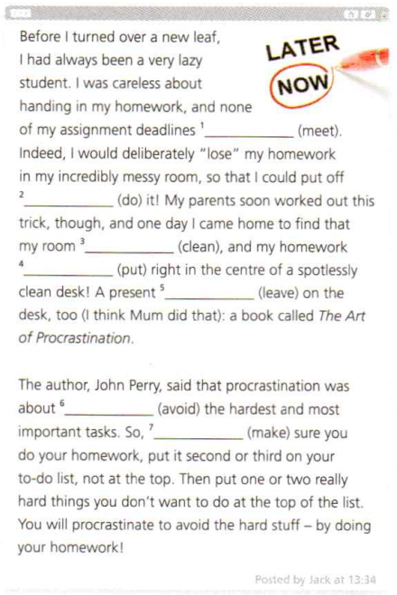
Complete Jack’s blog post with the correct form of the verbs in brackets.
avoiding
to make
had been met
doing
had been cleaned
had been put
had been left

Slide 13
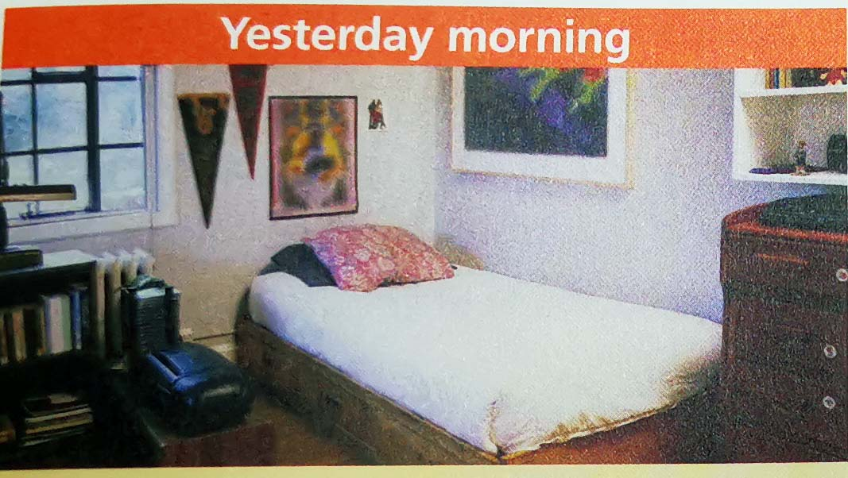
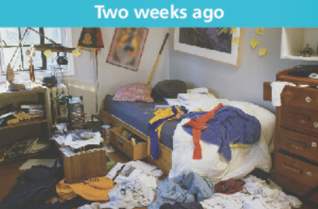
Work in pairs. Describe the pictures using the past perfect passive.
Jack started the habit of cleaning his room last week. This is what his room looked like yesterday morning.
But two weeks ago, Jack’s room was like this …

Slide 14

Work in pairs. Describe the pictures using the past perfect passive.
Jack started the habit of cleaning his room last week.This is what his room looked like yesterday morning.(The floor was clean.The sheet waslaid flat on the bed.All the books and clotheswere placed neatly and tidily.The pictures on thewall were straight.)
But two weeks ago,Jack’s room had been an awful mess.His clothes had been thrown everywhere;the pictures had not been hung straight;and all the drawers had been opened.It had been a very disorderly sort of room,with books and papers lying aroundeverywhere

Slide 15
practice !
（14天津）We won’t start the work until all the preparations __________.
A. are being made B. will be made
C. have been made D. had been made
（2013山东卷）I didn’t think I’d like the movie, but actually it _____ pretty good.
A. has been B. was C. had been D. would be
C
B

