Slide 1

Unit 2 Improving yourself
Using languageⅡP18-19

Slide 2
Learning objectives
You’ll know some expressions and signs that prohibit uncivilized behaviors.
You’ll listen to and complete a newspaper report about civilized behaviors in schools.
You’ll talk about the significance of promoting values education in schools.

Slide 3






Do you know these signs? Guess the meanings.
Do not litter.
Do not talk loudly in public.
Do not smoke.
Do not take photos.
Do not spit in public.
Do not walk on the grass.

Slide 4

5
Match the sentences to the signs. Pay attention to the
words and expressions in bold.
a
1 Do not litter.
2 Do not talk loudly in public.
3 Do not spit in public.
4 Do not walk on the grass.
5 Do not smoke.
6 Do not take photos.
b
e
f
c
d

Slide 5
6
Complete the conversations with the correct form of the words and expressions in Activity 5.
talk loudly in public
1 A: What do you do when people __________________?
B: I put my headphones on. I don’t want to hear other people’s
conversations.
2 A: How can we stop people _______________________?
B: We should tell them it’s dirty and it can spread diseases.
3 A: What would you do if you saw people ________?
B: I would go up to them and ask them to put the litter into a
rubbish bin.
(from) spitting in public
littering

Slide 6
4 A: How can we prevent people from __________________?
B: If we keep the grass looking really neat, maybe people will
realise they shouldn’t walk on it.
5 A: What would you do if you saw someone ________ where it’s
not allowed?
B: I’d politely remind them it’s not permitted, and that they should
be considerate of others.
6 A: What would you do if you saw someone ____________ in a
museum?
B: I’d ask them to stop, because it can damage the exhibits.
walking on the grass
smoking
taking photos

Slide 7
Think of more types of inappropriate behaviour and talk about
what you think is the right thing to do when faced with them.
1. Bicycles are parked randomly.
1. Bicycles are parked randomly.
I’ll suggest that people park the bicycles where they won’t block the way.
2. Small advertisements are posted here and there.
I’ll tell people that small ads will make the city look ugly, and we should make our city more beautiful.
3. People cross the street without obeying traffic rules.
I will warn people that it’s dangerous to do like that and we should obey the traffic rules.

Slide 8

7
Listen to the interview and choose a topic for it.
1 Ways to promote values education.
2 How to inspire students to work hard.
3 How to introduce school programmes.
4 How to fairly distribute books and umbrellas.

Slide 9
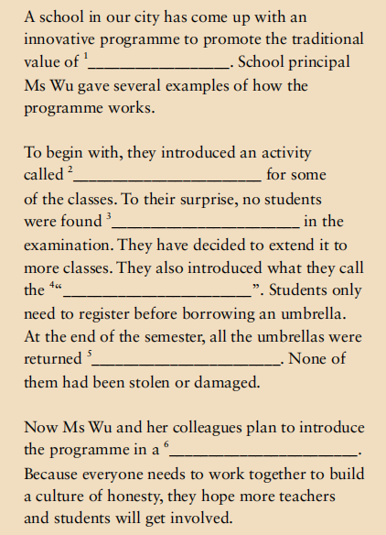
8
Listen again and complete the newspaper report.
1 honesty
2 present to oversee the students
3 sign a letter of commitment
4 trusted
5 the relaxed atmosphere
6 greater self-control
7 honesty umbrella
8 honesty and other values
9 in one piece
10 another branch of the school

Slide 10
听力原文：
Interviewer: Honesty is a traditional value for the Chinese. Recently, one senior
high school in our city developed a programme to promote honesty
among its students. Today we are honoured to have with us the
principal of that high school, Ms Wu Yuxian, who is the initiator of
the Honesty Programme. Ms Wu, how did you go about promoting
honesty at your school?
Wu: I can give a couple of examples. We first started an activity last year called the
“unsupervised examination”. That is, during this examination, there is no
teacher present to oversee the students. Before taking the examination,
students first need to sign a letter of commitment, promising to abide by the
rules.
Interviewer: It’s great that you trust all of your students to sit the unsupervised
examination.
➊

Slide 11
Wu: Well, let me clarify, it’s still only some of them. In the beginning, we chose
only some classes so we could get an idea if an unsupervised examination
would work or not. To our surprise, it was a great success. Students generally
expressed that they like this kind of examination because it’s good to feel
trusted and they quite enjoyed the relaxed atmosphere in the examination. In
turn, they developed greater sef-cntrol. As a result, more classes will do this
examination as of next term.
Interviewer: What fabulous students! Can you give any other examples from the
Honesty Programme?
Wu: Yes, for instance, we have what we call the “honesty umbrella”. At the start of
the term, we put 200 umbrellas in the library, the canteen and the teaching
buildings. Printed on each umbrella was a short statement about honesty and
other values, such as “Honesty is the best policy” or “It’s good to share”. The
result was that at the end of the term, all the umbrellas were returned in one
piece. I mean not one of them had been lost or damaged.
➋

Slide 12
Interviewer: That’s fantastic! What else are you going to do?
Wu: We are planning to expand the programme. Take next year as an illustration.
We aim to introduce the programme to another branch of the school. A culture
of honesty can exist and grow in a group environment. To put it another way,
everyone needs to work together to build a culture of honesty, and we need
more teachers and students to join us.
Interviewer: Thank you, Ms Wu!
Wu: It’s my pleasure.

Slide 13
9
Complete the boxes with the expressions from the
interview.
I can give a couple of examples.
That is…
Let me clarify…
For instance, …
I mean…
Take… as an illustration.
To put it another way, …
2, 3, 5, 7
Clarifying what you mean：_________________________
Giving examples: _________________________________
1, 4, 6

Slide 14
10
Work in groups.
Discuss how to promote values education at your school
using the words and expressions in this section.
Now talk about how well you did in offering effective
advice or ideas and developing effective solutions in the
group discussion.
Reference:
1. start from strengthening patriotic emotion,
2. cultivate the great national spirit with patriotism ;
3. set up and cultivate the right ideal and belief;
4. cultivate good moral character and civilized behavior;
5. start from improving the basic quality

Slide 15

Thank you!

