Slide 1
Times change!
Book 5 Unit 3
[c] 时代
Notes:
How are you doing, today? Great.
Let’s start our class. Class begins. Sit down, please.
Today, we are going into Unit 3 Times change. Let’s start with a video about changes.

Slide 2


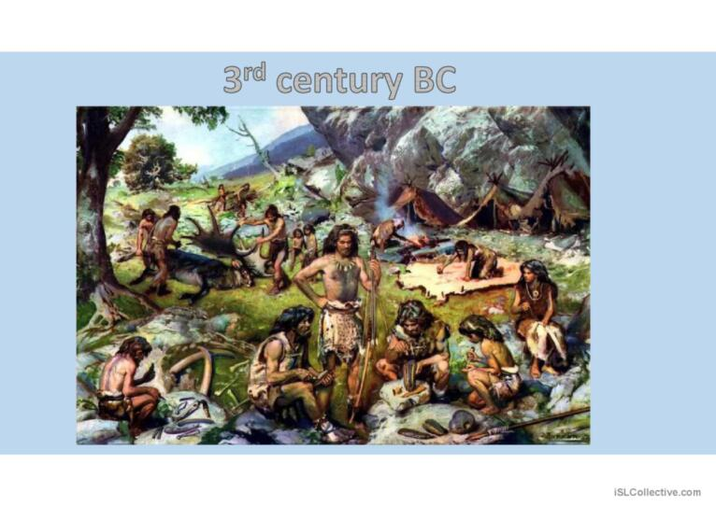
Group A: What has changed over time?
Group B: What hasn’t changed over time?

Slide 3
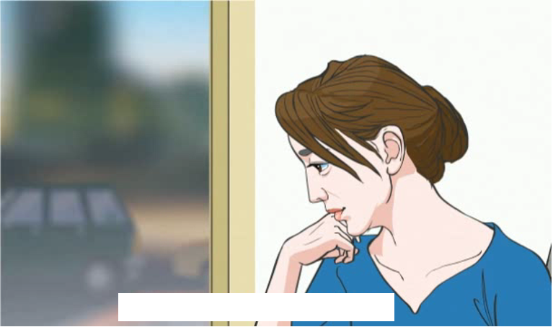
Starting out
Watch the video and answer: What changes are mentioned?
Notes:
watch the video & answer what changes are mentioned

Slide 4
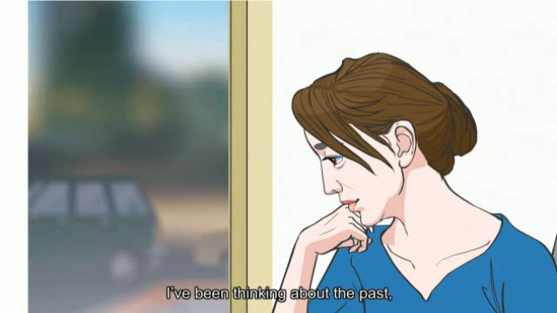

Slide 5
Starting out
Watch the video and answer: What changes are mentioned?
Means of transportation;
Means of communication;
The way we work;
The way we make friends and maintain friendship.
Which do you prefer, a faster pace of life/ a slower pace of life?
Notes:
抽学生：What changes are mentioned?--抽三个学生 (3mins)

