Slide 1
Times change!
Book 5 Unit 3
[c] 时代
Notes:
How are you doing, today? Great.
Let’s start our class. Class begins. Sit down, please. Today, we are going into Unit 3 Times change. Let’s start with a video about changes.

Slide 2
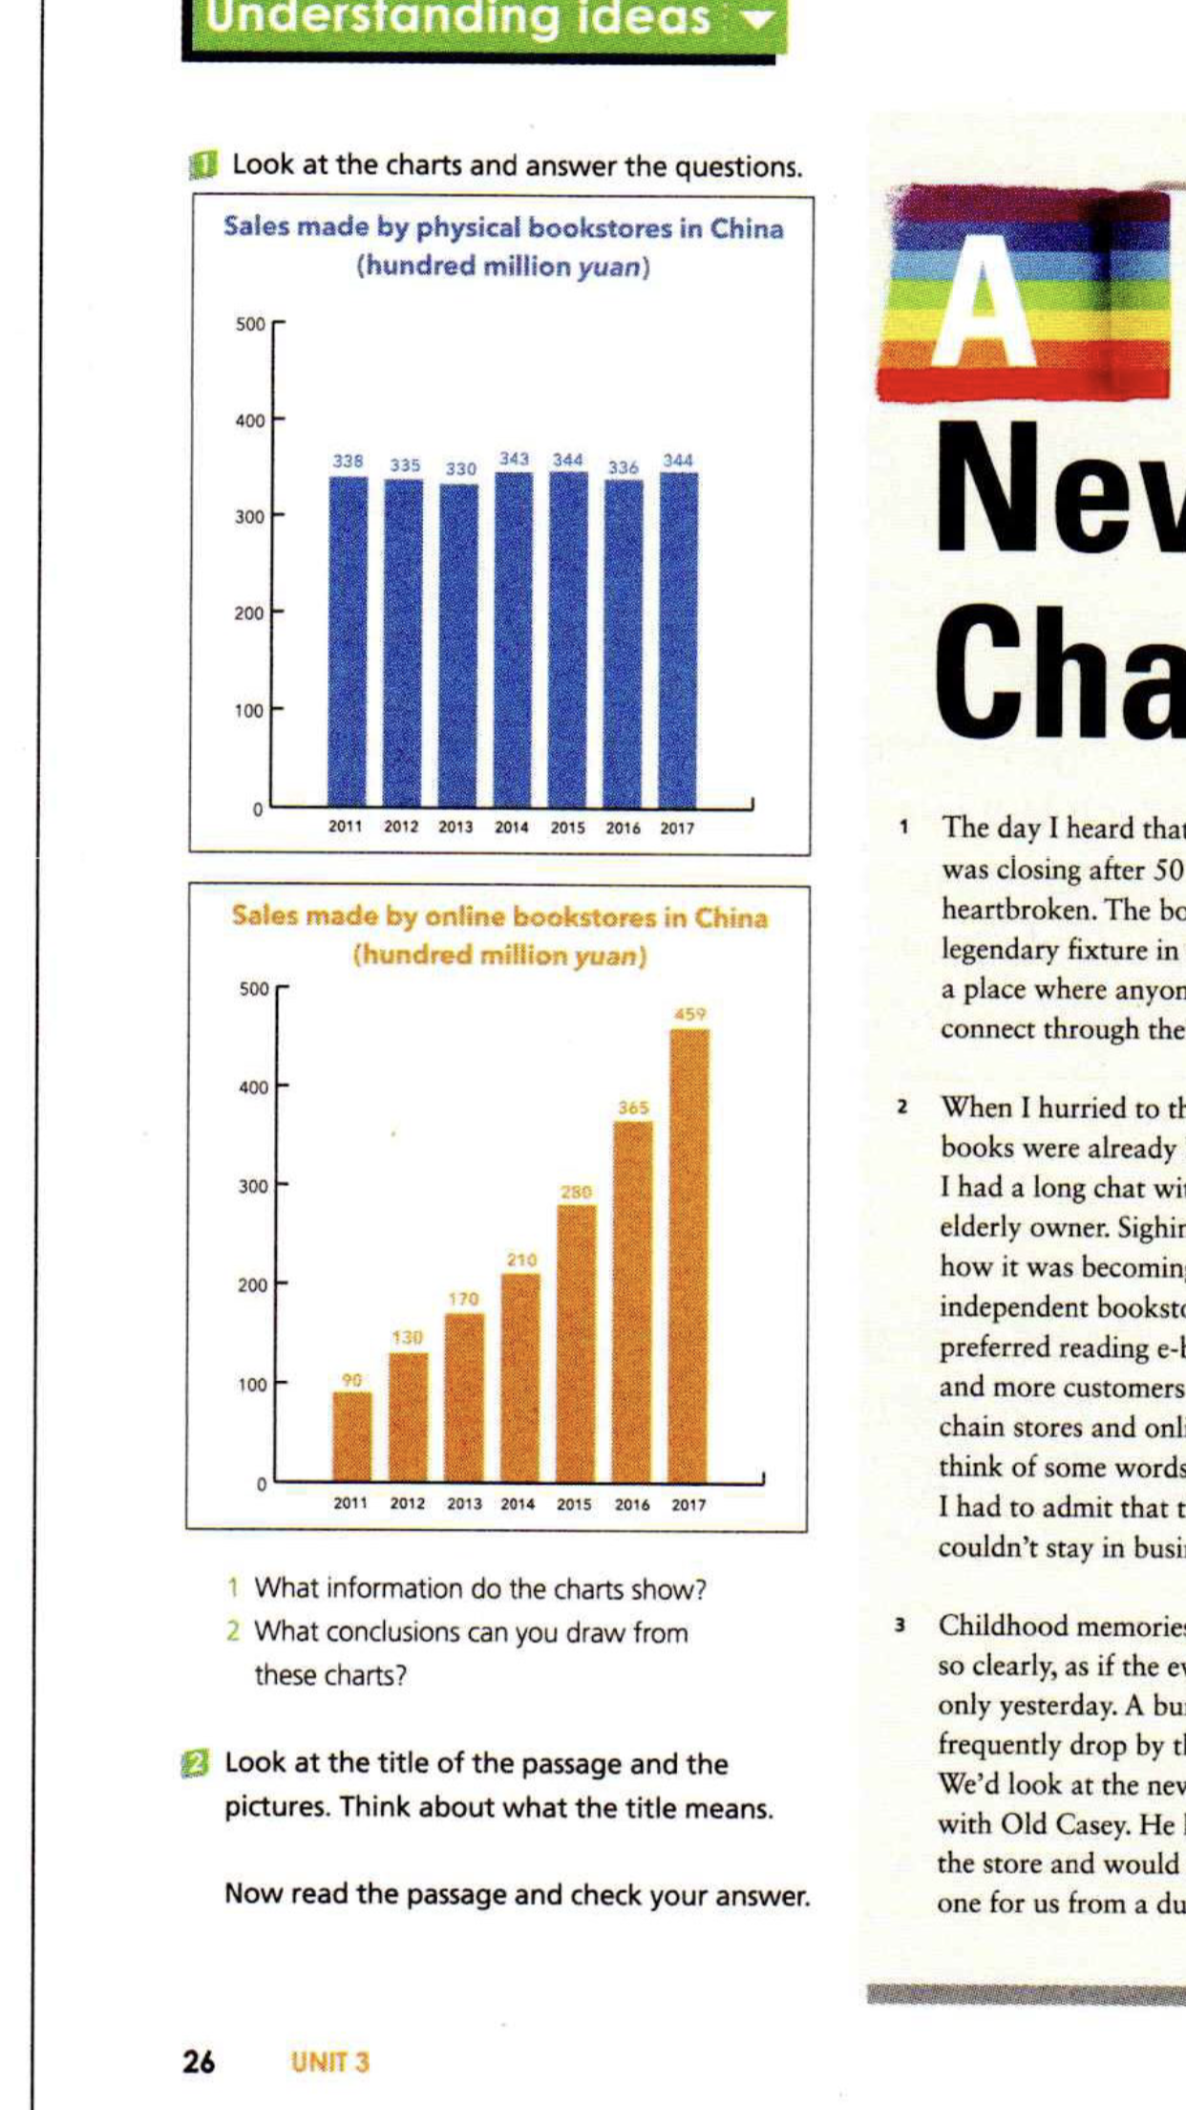
Leading in
Look at the charts and find out the change shown in these charts.
More and more people are choosing to buy books online instead of from physical bookstores.(实体书店)
Notes:
Now, I’m going to show two charts which also show a change.
What information do the charts show?
抽一个学生：the left one？
抽一个学生: the right one?
抽一个学生: What change is shown in the two charts?
And that is, more and more people are choosing to buy books online instead of from physical bookstores. (1min)
Then what may happen to physical bookstores? They may die, maybe. Today, we are going to read about a physical bookstore, the Rainbow Bookstore.

Slide 3
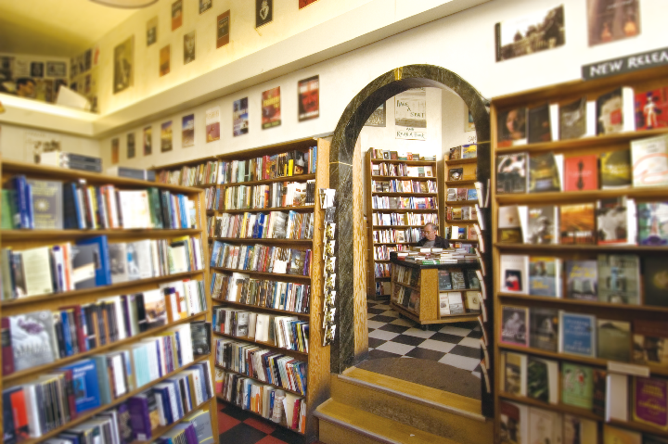
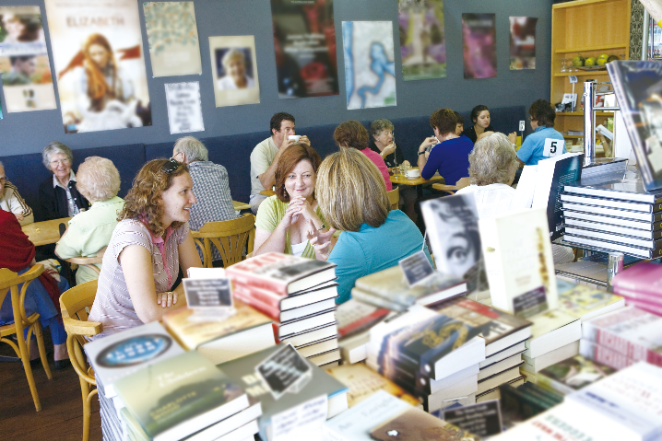

Reading for the main idea
Read the passage on P26-27 and tell what happened to the Rainbow Bookstore. (3 mins)
The Rainbow Bookstore was closing but it revives (复兴) with a new look.
Notes:
Turn to P26 read the passage and tell what happened to the bookstore. You have 3 mins (目前总共花7~8mins)
此处板书The crisis The revival

Slide 4
Reading for structure
What order does the passage follow?
Divide the passage into parts and summarize the main idea in each part. (1.5 mins)
It follows the order of time/chronological order.
Para 5~8
Para 2~4
The revival
The chat and the memories
Para 1
The crisis
Notes:
Quite an interesting story, huh! And the author tells the story in a specific order. What order?
-Time order.
Now follow the time order, divide the passage into parts and summarize the main idea in each part. You have 1 and half a mins.
I do like your second half, para 5~8. But I want to divide your first half into two parts, cuz they are in different scenes.
So if we divide para 1~4 into two parts.
Part 1--para 1 I heard of the bookstore’s crisis.
para 2~4 When I went back to the bookstore to chat with the owner, childhood memories went back.
para 5~8 When I saw the bookstore again, it revived.
So there are three stages in the story. In each stage, there was an “I”. (3mins) (目前10mins)

Slide 5
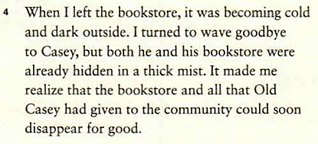

Reading for feelings
How did the author feel in each stage?
surprised
relieved
pleased
sympathetic
nostalgic(怀旧的)
gloomy(忧伤的)
Para 5~8
heartbroken
Para 2~4
The revival
The chat and the memories
Para 1
The crisis
Notes:
How did the author feel in each stage? We can find direct and indirect description from the passage. Circle the direct description & think about the indirect description. You have 1 min.
--请一位同学 When hearing the news, how did I feel?
--heartbroken. (抽同桌)
--Then when hurrying to the store?
When I was chatting with the owner, how did I feel?
--sad. Did I understand and have the same feelings with Casey, the owner?
--sympathetic
Why does the author describe his childhood memories? What feelings does this show?
--miss the good old days, or we say nostalgic
How did I feel when I left the bookstore? Why does the author describe the weather? To reflect his mood, just like the weather, cold, and dark and in a thick mist. Gloomy.
--请第三位同学
surprised, pleased and relieved, right? (抽同桌)
From heartbroken to pleased, we can see the author did love the Rainbow Bookstore. And so did other people in the community. That’s why they worked together to save it. (2mins) (总共13mins)

Slide 6
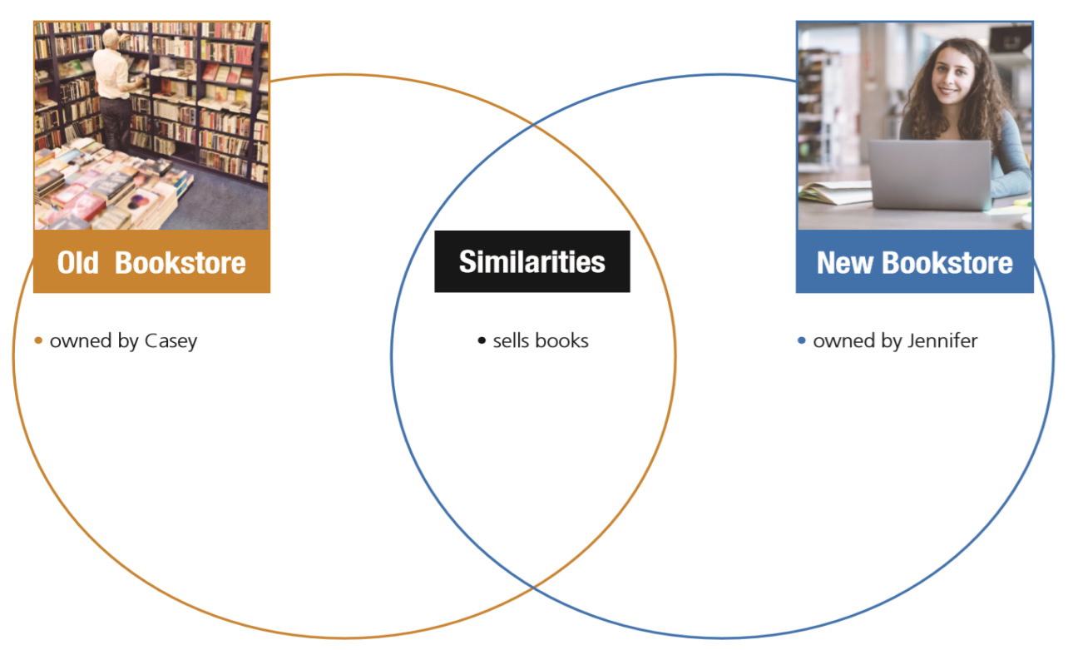
Reading for details
Find the differences and similarities between the old and the new Rainbow Bookstore. (2 mins) P28
Notes:
What did they do? What was changed? Let’s find the differences and similarities between the old and the new Rainbow Bookstore.
Organize information with the Venn diagram on P28.
You have 2mins. 目前总共(18~20mins)

Slide 7
Reading for details
a big screen
a café
stationery, posters, gifts, and organic food
community events like book readings, poetry recitals, jazz concerts and movie nights.
books
an old brick exterior
a place for people to read and connect
dusty shelves, old but comfortable furniture
a board
an experience that couldn’t be downloaded
downloaded
Notes:
Let’s take a look at the similarites first.抽一个同学 books, an old brick exterior, a place for people to read and connect.
What are the differences. What was the old Rainbow Bookstore like?—抽一个同学
What was the new Rainbow Bookstore like?—
抽一个同学—此处处理recital
以及Does the author think these activities meaningful? How do you know that?
From para 7, we can see the author think in these community events, people could gather to share an experience that couldn’t be downloaded.
What does it mean?
学生说：Maybe e-books are cheaper and more convenient, but that doesn’t mean bookstores should be replaced,
for the experience to read and communicate with other people cannot be replaced.
Let’s compare the old and new Rainbow Bookstore. What characteristics does the new Rainbow Bookstore have?
multifunctional(5mins）

Slide 8
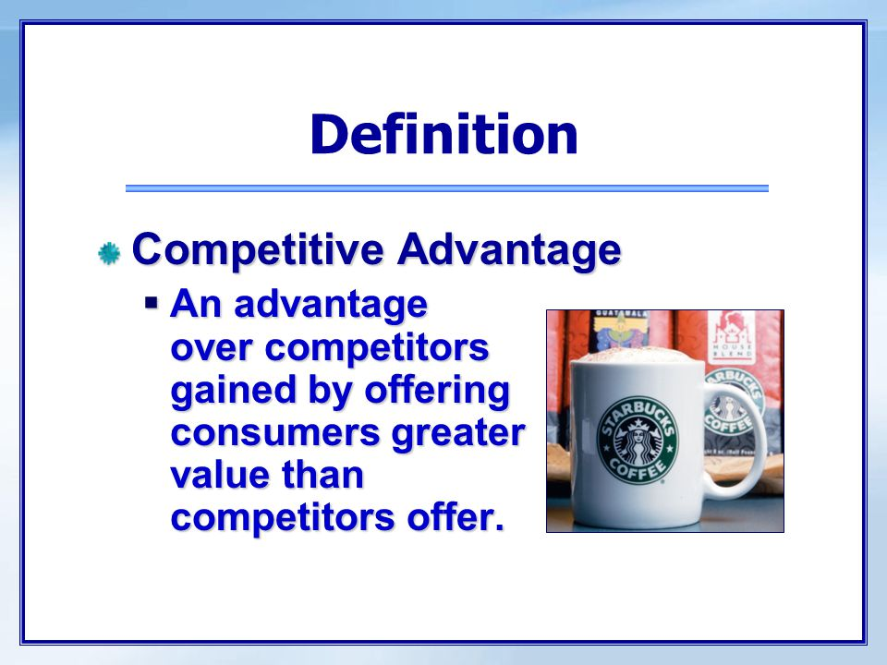
Thinking & Sharing
Why did Jennifer make the Rainbow Bookstore multifunctional?
What is the Rainbow Bookstore’s competitive advantag (竞争优势)?
an experience that couldn’t be downloaded
through constant change
through constant change
Notes:
Why did Jennifer make the Rainbow Bookstore multifunctional?
--increase profit--Why? Drinks and activities are more profitable than books.
But why do people come to the bookstore for drinks and activities?
Here I wanna introduce an economic term.
Competitive advantage. 此处板书 competitive advantage
What’s that? Let’s read the definition together.
Competitive advantage one two three go.
What’s the Rainbow Bookstore’s competitive advantage?
It offers experiences that couldn’t be downloaded.
To survive, to find and keep the competitive advantage is the key.
But how? When I was in college, my economic professor told us “to keep competitive advantage, rule no.1 constant change.”
Why? Let’s take a look at the definition. There are three variables.
competitior, consumer, we---If one factor changes, competitive advantage changes.
In order to keep competitve advantage, we need to change, we need to find and even create our competitive advantage first.
That’s why Jennifer could bring the rainbow bookstore into a new chapter.

Slide 9
Thinking & Sharing
Do you like the changes in the Rainbow Bookstore? Why?
Notes:
This is the author’s story. We don’t have a say.

Slide 10

Thinking & Sharing
What is your understanding of the title?
A New Chapter
A new beginning
of the Rainbow Bookstore
of the industry
of times
Notes:
Speaking of “A New Chapter”What’s your understanding of the title? Discuss with your shoulder partner. You have 1min.
When do you see a new chapter? In a book. This is a story about a bookstore. So the writer chose this word in response to the context of a bookstore.
What does it mean in a book?
A new beginning. From my point of view, it means a new beginning of the Rainbow Bookstore. And it is also a typical example of the bookselling industry. It also means a new beginning of the industry where physical bookstores have been turned into cultural centers in response to the times’change. So it also symbolizes a new beginning of the times. As times change so quickly, a new chapter is opened every day.

Slide 11
Thinking & Sharing
What qualities do we need to always embrace a new chapter?
adaptive/ flexible
insightful
courageous
embrace a new chapter
creative
......
Notes:
In order to always embrace a new chapter, what qualities do we need?
Ss’ answers. (1~2mins) (总共27mins)
With these qualities, we can always embrace a new chapter.

Slide 12


Notes:
It’s fantastic to see that you all have echoed times’ change. Heraclitus once said, there is nothing permanent except change. So we need to keep up with change, then the change will be our chance to always embrace a new chapter. Be insightful, be adaptive.

Slide 13
Language learning

Slide 14
Para 1
The day
_______ (那天) I heard that the Rainbow Bookstore was closing after 50 years of business, I was heartbroken.
注意：The day充当连词，类似的有the moment, the first time等
传奇式的固定存在物
顺便来访
drop out
a legendary fixture
drop in at sp.
drop by (sp)
辍学

Slide 15
Para 2
tablet
chain store
同情 n. adj.v.
对某人同情
继续营业
歇业
平板电脑
连锁店
sympathy; (un)sympathetic;
show sympathy for ... be in sympathy with
sympathize with sb.
stay in business
go out of business

Slide 16
Para 3~4
Childhood memories came back to me so clearly, as if the events _______________ (happen) only yesterday.
一群；一束；一串
布满灰尘的
家具
对……的评价
向……挥手告别
隐藏在浓雾中
永久消失
一劳永逸地
had happened
a bunch of
dusty
furniture [u]
comments on
wave goodbye to sb.
be hidden in a thick mist
disappear for good
once and for all

Slide 17
Para 5~6
砖
n. adj 外部
interior
deliver book readings
to look at or read sth very carefully
[u] school supplies
take over
brick
exterior
内部（的）
进行读书会
pore over
stationery
接管

Slide 18
Para 7~8
under one’s leadership/under the leadership of sb.
literature-loving member
organic food
朗诵会 recite 背诵 recitation背诵；朗诵
join sb. (in doing sth./for sth.)
pop up
快闪店；临时店
humble
在……的领导下
文学爱好者
有机食物
recital
加入（某人）
突然出现
pop-up store
简陋的；谦虚的

