Slide 1
Times change!
Book 5 Unit 3
Notes:
How are you doing, today? Great.
Let’s start our class. Class begins. Sit down, please. Today, we are going into Unit 3 Times change. Let’s start with a video about changes.

Slide 2
Grammar: Past continuous passive
a When I hurried to the store, I saw that the books were already being packed into boxes.
b When I hurried to the store, I saw that the books were already packed into boxes.
1. What is the difference between sentences (a) and (b)?
Past continuous passive (过去进行时被动)is used in sentence (a) and past simple passive (一般过去时被动)is used in sentence (b).
2. Which sentence emphasises process and which emphasises result?
In sentence (a) the action was being done while in sentence (b) the action was already finished.

Slide 3
Grammar: Past continuous passive
1. 过去进行时态的被动语态的基本结构
肯定式： was / were + being + done
否定式： was / were + not + being + done

Slide 4
More examples from the text
When I hurried to the store, I saw that the books __________________ (pack) into boxes.
More and more customers __________________ (attract) by chain stores and online discounts.
In one area, a book reading __________________ (deliver).
The large board in the coner had been replaced by a big screen, where customers’ comments on the month’s best-seller _______________ (display).
Under Jennifer’s leadership, the bookstore ________________ (turn) into a place for literature-loving members of the community to get together.
were being packed
were being attracted
was being delivered
were being displayed
was being turned

Slide 5
Grammar: Past continuous passive
Rewrite the passage using the past continuous passive.
Walking home a few days ago, I saw that people were doing reconstruction work on the old market. It would be turned into a modern shopping mall. Some people were tearing down the old gate. Some were removing the wooden stands.
Some were clearing away rubbish from the floor. While all this was going on, a journalist was taking photos. The resulting story in the local newspaper divided the people of the town: some were in favour of the new shopping mall, and some were against it.

Slide 6
Grammar: Past continuous passive
Rewrite the passage using the past continuous passive.
Walking home a few days ago, I saw that reconstruction work was being done on the old market. It would be turned into a modern shopping mall. The old gate was being torn down. The wooden stands were being removed.
Rubbish was being cleared away from the floor. While all this was going on, photos were being taken by a journalist. The resulting story in the local newspaper divided the people of the town: some were in favour of the new shopping mall, and some were against it.

Slide 7
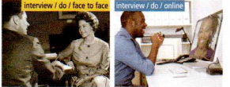
Grammar: Past continuous passive
Look at the two groups of pictures and describe
the changes in the news industry using the past
continuous passive where appropriate.
Yesterday, I watched a documentary about the news industry in the past.
I saw that the an interview _____________________.
But now, interviews _________________________.
was being done face to face
can be done online

Slide 8
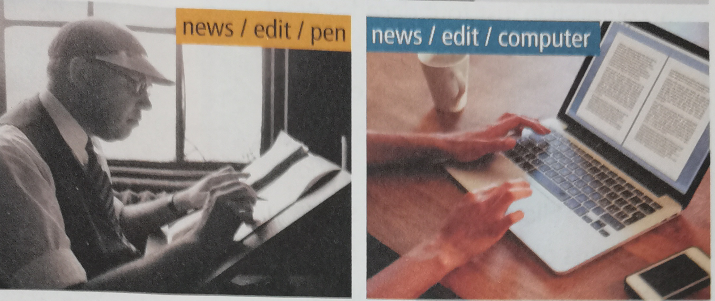
Grammar: Past continuous passive
Look at the two groups of pictures and describe
the changes in the news industry using the past
continuous passive where appropriate.
Yesterday, I watched a documentry about the news industry in the past.
was being edited with a pen
I saw that the news ___________________________.
But now, news _______________________________.
can be edited on the computer

Slide 9
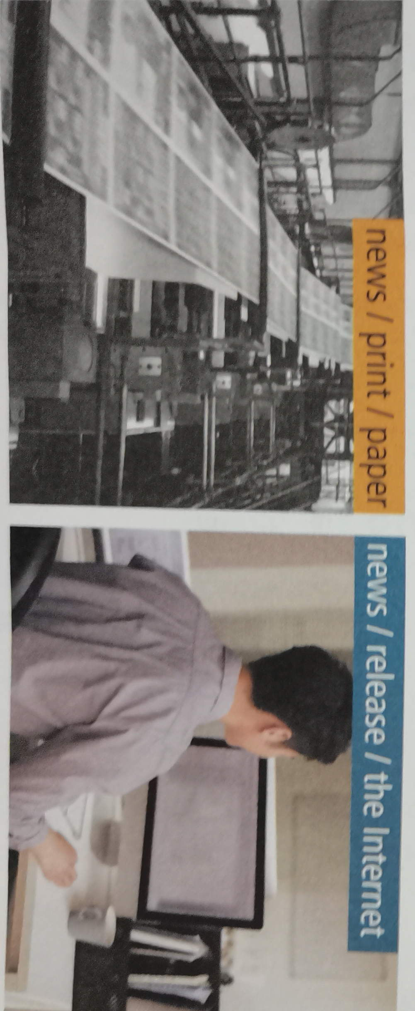
Yesterday, I watched a documentary about the news print in the past.
I saw that the news __________________________.
But now, news ______________________________.
was being printed on paper
can be released on the Internet

Slide 10
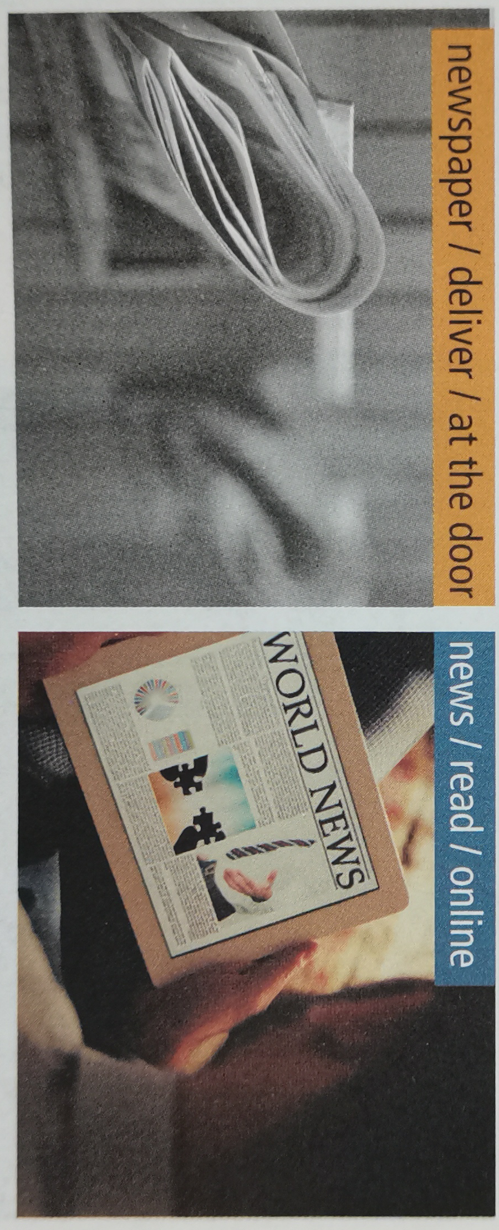
Yesterday, I watched a documentary about the newspaper delivery in the past.
I saw that newspapers ________________________________.
But now, news _________________________.
were being delivered to readers' doors
can be read online

Slide 11
Grammar: Past continuous passive
时间状语的使用问题
注：过去进行时态的被动语态一般不与表示一段时
间的状语或表示次数的状语连用，这时要用完
成时态的被动语态。
a. The campus over there has been built for three years.
(那边的校园已经建了三年了。)
b. The car has been repaired twice.
(这辆车已经被修理过两次了。)

Slide 12
进行重建工作
变成
拆除
木架子
记者
清理地面上的垃圾
使人产生分歧
最后的故事
支持
反对
编辑 v. n. (人)
纪录片
do reconstruction work
be turned into
tear down
wooden stand
journalist
clear away rubbish from the floor
divide people
the resulting story
be in favor of ...
be against ...
edit; edition; editor
documentary

Slide 13
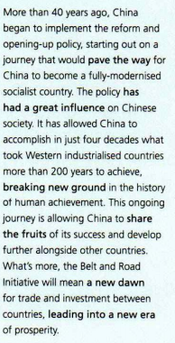
Into a new era/ˈɪərə//ˈerə/
What is the passage about?
China has entered into a new era since the implementation(实施) of the reform and opening-up policy (改革开放政策) and will continue to move forward.

Slide 14
Into a new era
实施改革开放政策
开启了
为……铺平道路
全面现代化的
社会主义国家
开辟新天地
仍在进行的
分享果实
与……一起
“一带一路”倡议
新的黎明
开启一个繁荣发展的新时代
implement the reform and opening-up policy
start out on a journey
pave the way for
fully-modernized
socialist country
break new ground
ongoing
share the fruits
alongside
The Belt and Road Initiative
a new dawn
lead into a new era of prosperity

Slide 15
Vocabulary building
Complete the speech with the correct form of the expressions in Activity 5.
Dear friends,
Thank you for coming together to celebrate the first anniversary of Tech-Hub Business Park. It’s great to see so many of you representing the many different companies that have made the park their professional home. What started as an idea by local entrepreneurs 1________________ for this town to become known as a centre of technology and formed a solid basis for future business development.
paved the way
/ˌɒntrəprəˈnɜː/企业家
形成坚实的基础

Slide 16
Vocabulary building
Like everyone else in this town, we are proud that the Tech-Hub companies continue 2 ______________________ in technology. Such innovation will, without doubt,
3 _____________________ of technological discovery. What’s more, it seems that Tech-Hub 4 ______________________ on local schools, with more students than ever applying to study Computer Science at university. Tech-Hub remains thankful to the community and promises 5___________________ of our success with the town.
Thank you!
breaking new ground
毫无疑问
lead into a new era
has a great influence
to share the fruits

Slide 17
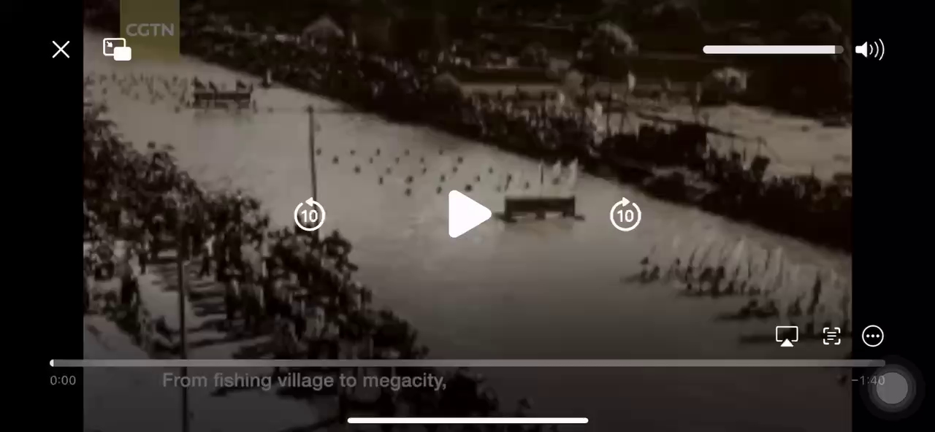
Which city in China can be called a Tech-Hub?
The city of Shenzhen.
What do you know about Shenzen concernning its development?

Slide 18

Listen to the interview and choose its purpose.
undergo v. to experience sth, especially a change or sth unpleasant
1. To find out what changes Shenzhen has undergone after
the introduction of the reform and opening-up policy.
2. To understand how people feel about the way life has
changed in Shenzhen this century.
3. To show what the first special economic zone looks like
now.
4. To figure out how life is different for the older and
younger generations in Shenzhen.

Slide 19
Listen again and complete the interview record.
INTERVIEWEE No.1
Personal information
Has lived in Shenzhen for 1 ____________________
Occupation: 2 _______________________________
Impression of Shenzhen
In the past
Shenzhen was a small town 3 ___________________.
more than 40 years
software engineer
surrounded by fields

Slide 20
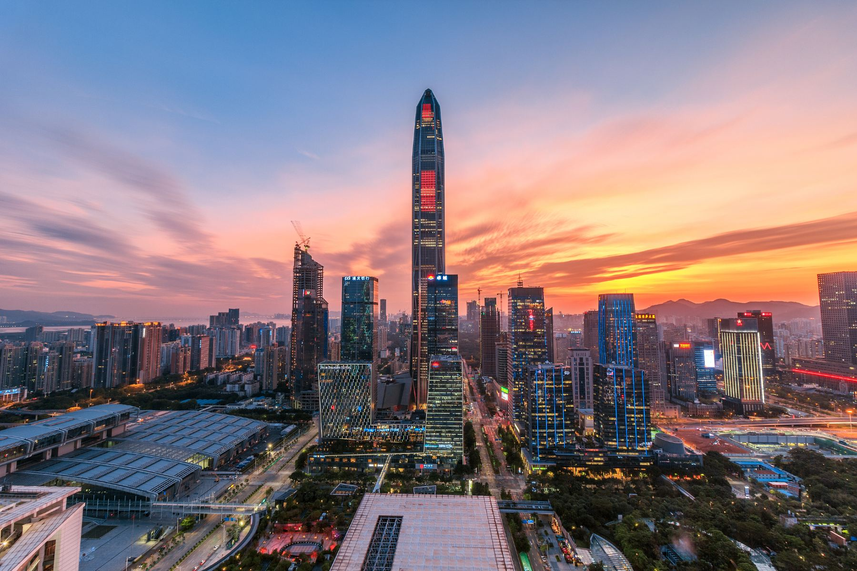
Listen and complete the interview record.
There were not many people living there and there were no 4 _____________________________. People made a living from 5 _______________________.
In the present
It has developed into 6 ___________________ with modern skyscrapers and a population of 7 __________
_________________.
busy streets and no traffic jams
fishing and farming
an international city
over
12 million people

Slide 21
Listen and complete the interview record.
Life in Shenzhen
In the past
People stayed in the same area, and one day
8 _____________________.
In the present
Each day brings something new. 9 _____________
keep coming.
was just like any other
New things

Slide 22
Listen and complete the interview record.
easier
Life is 10 ___________ and it’s certainly interesting!
Comments on Shenzhen today
Shenzhen is a special place full of 11 _____________
______________. It is a place where young people can 12____________________.
opportunities
and challenges
realise their dreams

Slide 23
Complete the boxes with the expressions from the interview.
Describe the changes in your hometown using the expressions below.
Comparing and contrasting | Describing a place
At that time ...
There’s been a huge change!
Compared with the past, ...
In the past, ...
But now ...
... has undergone rapid development ...
... was only a small town ...
It has developed into ... with ...
... is a very special place.
It’s full of ...
... is a place where...

