Slide 1
Times change!
Book 5 Unit 3

Slide 2
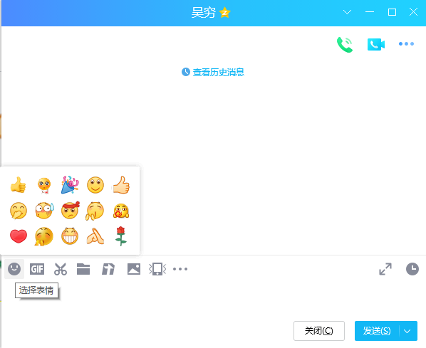
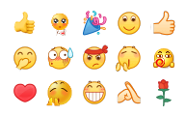
Emoji
facial
category
facilitate
integral component

Slide 3
Developing ideas

Slide 4
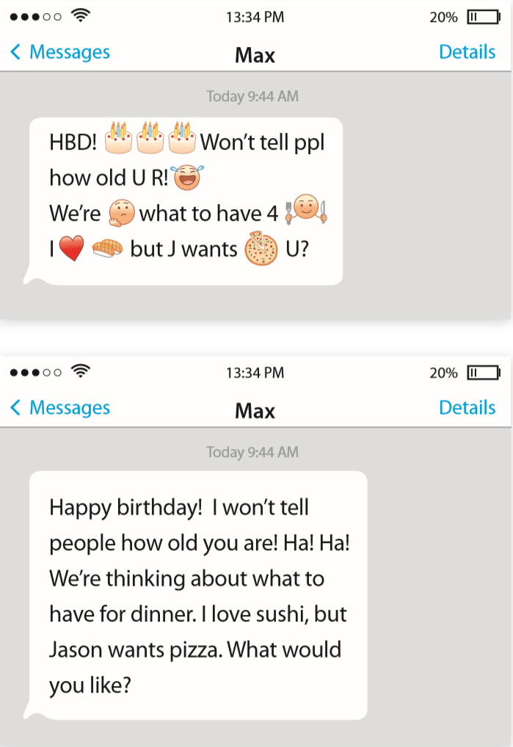

Lead-in
Look at the message and tell the meaning of it.
Which message do you prefer? Why?

Slide 5
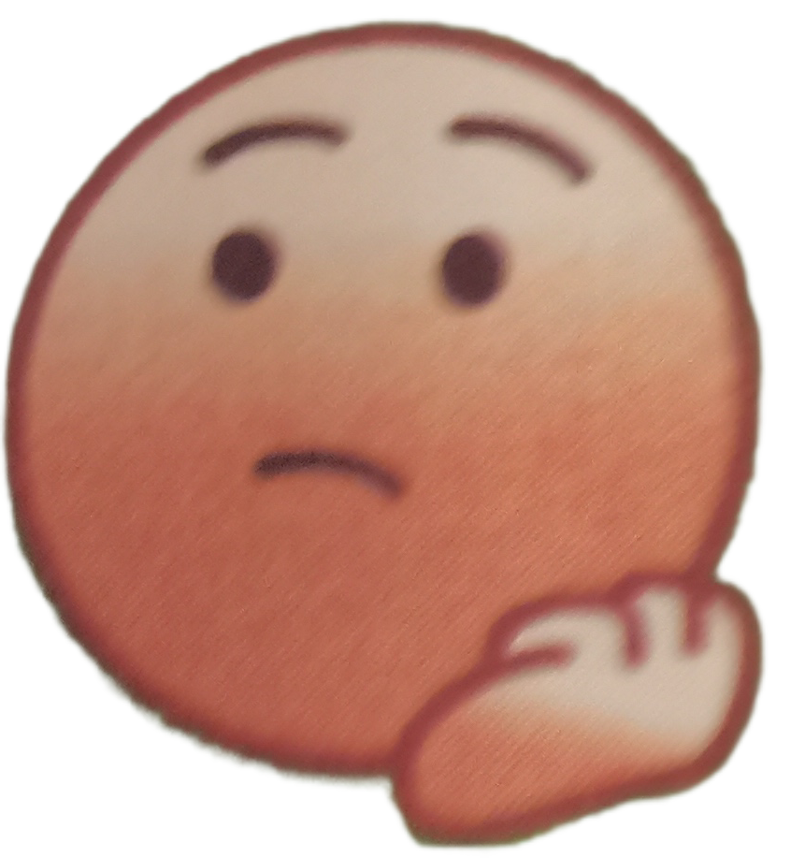
Emojis: a new language?
Prediction
Look at the title and predict the author’s attitude
towards emojis.
The author may be skeptical about emojis as a new language.

Slide 6
The main idea
Read and check your prediction.
Choose the author’s purpose in writing the passage and give your reasons.
1. To guide readers to use emojis properly.
2. To discuss the development and influence of emojis.
3. To criticise the increased use of emojis.
4. To entertain readers with examples of how emojis have
been used.

Slide 7
The structure
Part
Para
General idea
Part 1
Para 1~2
lead in with examples
Part 2
Para 3~5
the origin and influence
Part 3
Para 6~7
its popularity
Part 4
Para 8
different opinions

Slide 8


The details: Para 1~2
What’s the meaning of
He’d be running late and would be there soon.
OK, don’t rush.

Slide 9
The details: Para 3~5
How influential are emojis?
What is the meaning and origin of emojis?
Emojis are used everywhere, from text
messages to emails, blogs and other social media networks.
Emojis are becoming an integral component of the language we use to express ourselves.
There are 3000 emojis now and the Oxford Dictionaries Word of the Year in 2015 was a pictograph.
The word “emoji” comes from Japanese, literally meaning “picture character”. They represent ideas, emotions or feelings.

Slide 10
The details: Para 6~7
What are emoji’s advantages over written language?
Why are some words in some Shakespeare’s plays replaced with textspeak and emojis?
They add emotional meaning, and are quick and easy to use. Also, they help people express their feelings when they cannot find the appropriate words.
The intention of these adaptations is to make the classics more accessible to young readers.

Slide 11
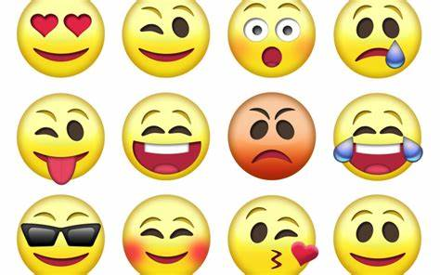
The details: Para 8
The details: Para 8
What are people’s opinion towards the use of emojis?
What’s the author’s opinion?
For
They facilitate the way we communicate and express ourselves.
Against
Because of emojis, people are losing the ability to communicate properly using the written word, or even the spoken word.
It’s best that we just enjoy using them.
Notes:
Using emojis enhances expressiveness, making messages more dynamic and appealing.
Emojis' meanings can be ambiguous due to cultural differences, leading to misunderstandings and communication barriers.
Emojis help convey emotions and feelings effectively, making communication more vivid and engaging.
Emojis convey rich meanings and emotions quickly, enhancing communication efficiency.
Excessive use of emojis can lead to a decline in linguistic norms, affecting the standardization of traditional language.

Slide 12
Think and share
What do you think about the way people use emojis?
Emojis offer numerous advantages in digital communication, such as enhancing emotional expression and facilitating emotional communication. However, overdependence on emojis can lead to drawbacks such as impacting written language skills and norms. It is important to use emojis in moderation, considering cultural differences, to ensure accurate and effective communication.

Slide 13

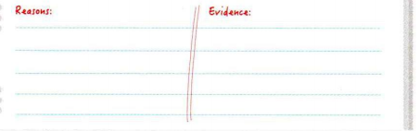
Critical thinking
2. Perhaps people will one day choose to communicate in pictures, and forget how to write properly.
read the sentence and decide whether you agree or disagree with it.
Provide reasons to support your dieas and give evidence.

Slide 14
Think and share
Times change!
2. What lifestyle changes does each reading passage in this unit focus on? What is the common message conveyed in both passages?
The first passage focuses on changes of people’s reading habits, while the second passage focuses on changes of the way we communicate. Both passages convey changes of our lives and society in which we live.

Slide 15
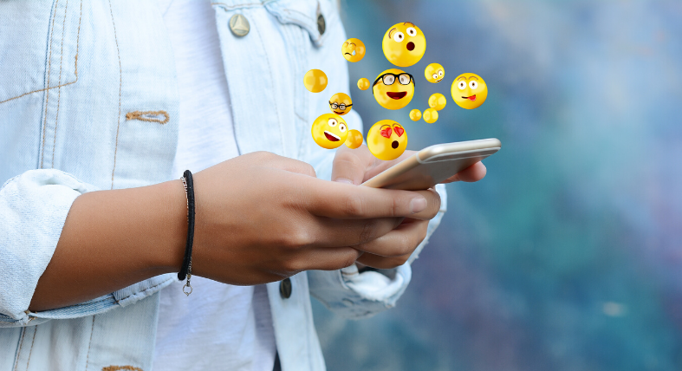


Do emojis make language better?
let people put back some of the human emotion that's missing in written texts and emails.
add feeling and emotion to online messages.
make people more effective communicators in the digital age.
make people that use more emojis tend to be luckier in love, they have more success in terms of dating.
let us show our true personality

Slide 16
language points

Slide 17
Para 2-3
我花了一分钟才理解了这条信息。
要迟到了
This was my _________ to follow the ______ of communicating with emojis.
Two factories were closed _____________ to reduce pollution.(为了)
The small factory ________________ to cut costs.
The prisoners _________ an escape, but failed.
The prisoners _________________, but failed.
4. ...的趋势
5. 一个不可缺少的部分
It took me a minute before I realized what it (this message) meant.
run late
attempt
trend
in an attempt
made an attempt
attempted
attempted to escape
a trend in/towards (doing) sth.
an integral /ˈɪntɪɡrəl/ component/part of sth
=essential

Slide 18
Para 4~6
代表想法、情感和情绪的小图标
他们分为不同的类型
拓宽我们交流的渠道
胜过；优于
一串的哭脸
small symbols representing ideas, emotions, or feelings
They come in different categories.
expand (on/upon) the way (in which/that) we communicate
have (clear) advantages over
a string of crying faces

Slide 19
Para 7~8
对……易得到、易使用、易懂得的
版本
有……的趋势
到处出现
有助于；利于
满是表情符号的短信
be accessible to sb.
version
have a tendency to do sth.
pop up all over the place
facilitate
a message packed with emojis
containing a lot of particular things

