Slide 1
Times change!
Book 5 Unit 3

Slide 2


What do you know about Superman?
Superman is a superhero published by DC Comics since 1938. He was from the destroyed planet Krypton and raised as Clark Kent by human foster parents (养父母), Martha and Jonathan Kent. As an adult, Superman became the protector of Earth.
For much of his life, he doesn’t reveal his true identity and powers to anyone, not even his closest friends. In the earlier films, when Clark Kent wanted to transform into Superman, he would step into a phone box and the switch would be complete.

Slide 3
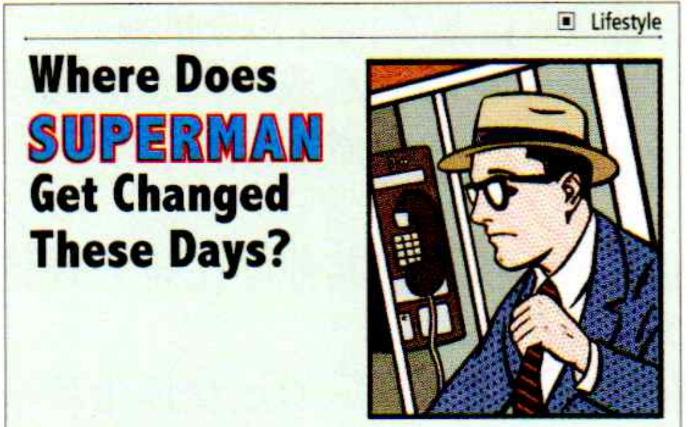

Read the passage and answer the questions.
What is the passage mainly about?
This passage mainly tells us that phone boxes where Superman used to get changed in the films are hard to find now and gives us the reasons.

Slide 4
Read the passage and answer the questions.
Why does the author start the passage by writing about Superman?
The author starts by writing about Superman in order to form an instant connection with readers, as everyone is familiar with Superman. It also sets the tone of the passage by introducing some light-hearted humor.

Slide 5
Read the passage and answer the questions.
2. What will disappear in the future according to the passage? What is the major reason for this phenomenon?
Phone boxes will disappear in the future.
The major reason is that almost everyone has a mobile phone and they don’t need phone boxes any more.

Slide 6
Read the passage and answer the questions.
3. What supporting arguments does the author give to make the point convincing?
1) It is convenient to take out a mobile and make a call at the touch of a button than to press a series of long numbers.
2) Remembering others’ telephone numbers is not easy.
3) It is more convenient to borrow a mobile phone
from someone else than walk around looking for a
phone box.

Slide 7
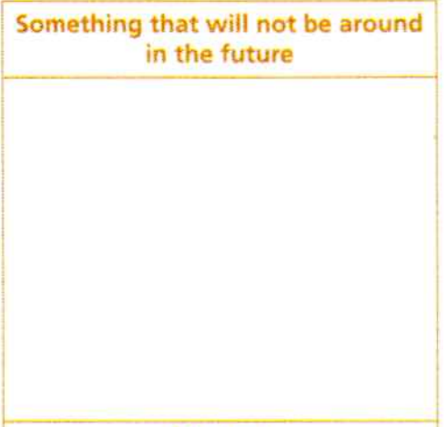
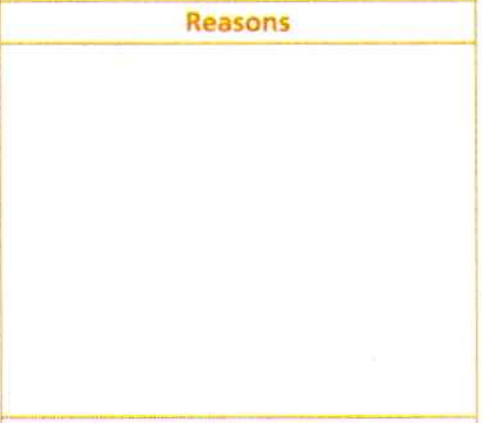
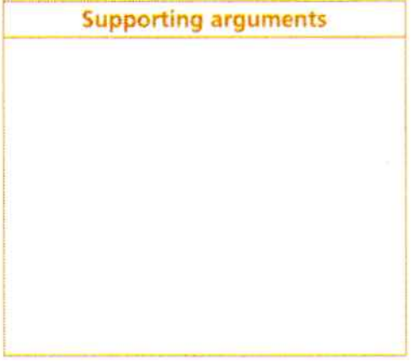
Writing about a change
Think about something that might disappear in the future and complete the table.
cash
paper maps
keys
...
technological advancements,
consumer preferences,
cost considerations,
financial security.

Slide 8
Smart expressions
过去某一天
我突然冒出一个想法
突然想起
急忙走进
按一个按钮就能打电话
过去的事物
the other day
A thought occurred to/hit/struck me.
It occurred to/hit/struck me that ...
pop into (go somewhere suddenly)
make a call at the touch of a button
a thing of the past

