Slide 1

4
Breaking boundaries
U N I T

Slide 2


Slide 3


To look at the pictures and make a list of boundaries in society
To reflect what you’ve learnt and what you need to improve in this unit

Slide 4


Work in groups. Look at the pictures and make a list of boundaries in society.
1
Boundaries in society:
__________________________________________________________________________________________________________________________________________________________________________________________

Slide 5

Many old people find it difficult to communicate with the young by using smart phones or through Internet.
What may cause their problems?
too old to see the words clearly
hard to understand the Internet words
difficult to operate the touch screen
…

Slide 6
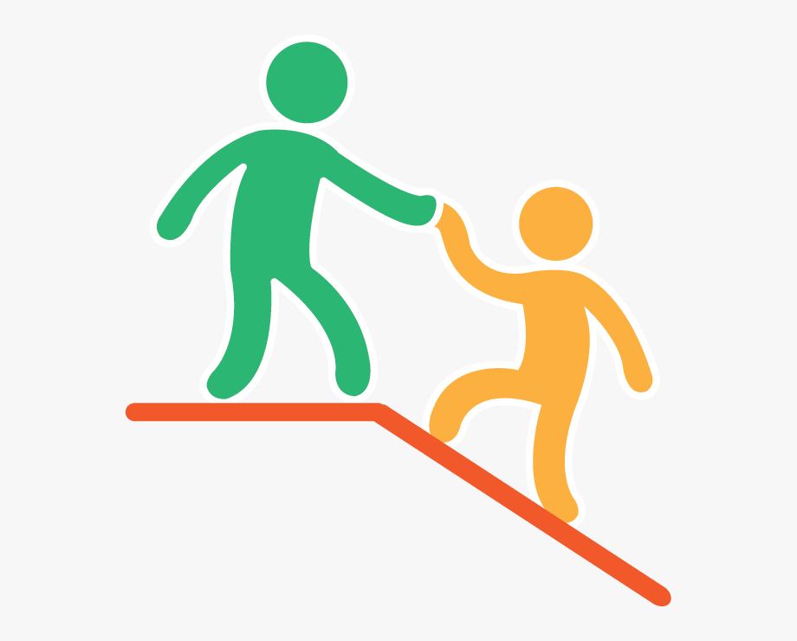
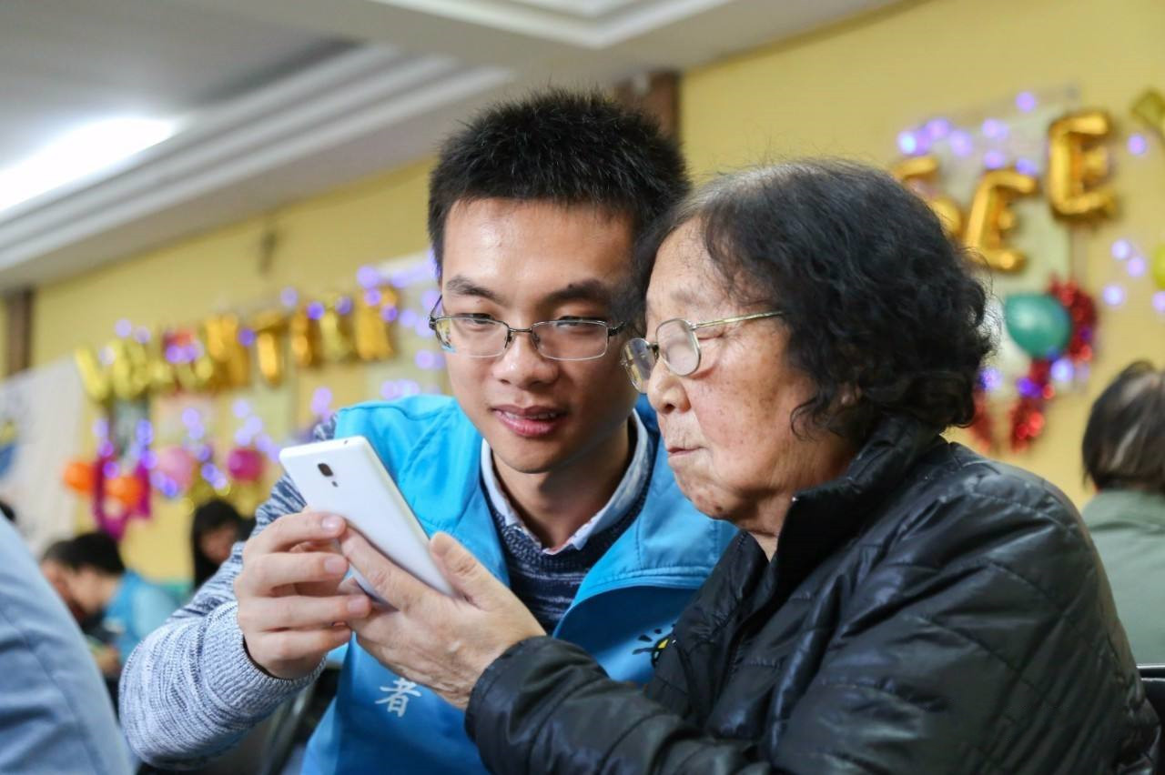
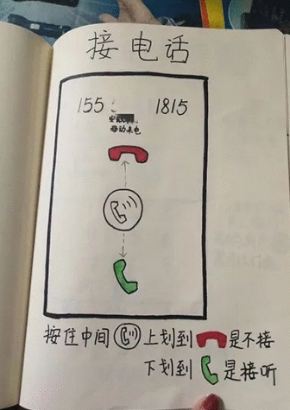
How can we help them?

Slide 7
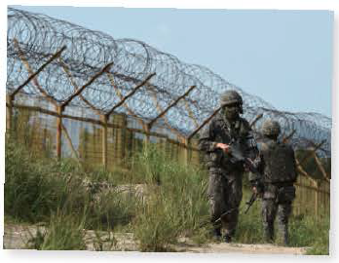
The unfriendly relationship between countries leads to the crisis in their boundaries.
What may cause the boundary?
different political beliefs
economic crisis
different religious beliefs
…
What should people do to keep the boundary peace?

Slide 8
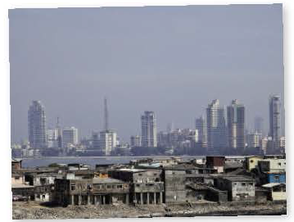
In many countries, the modern buildings and the slums are found in the same area.
What may cause the boundary?
different development in economy
unfair social system
different education level and class
…

Slide 9
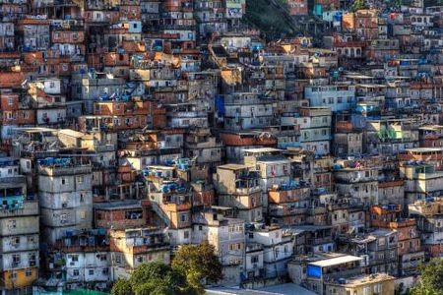
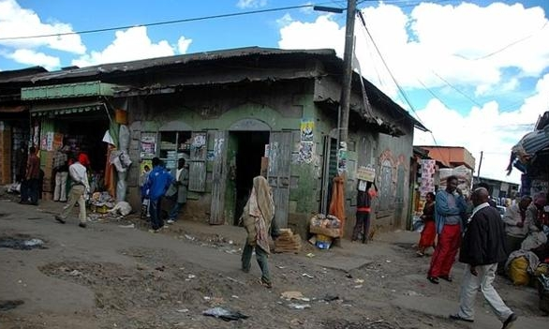
How can we help those who live in the slums?

Slide 10
Choose one of the boundaries you have listed and talk about how to break that boundary by answering the questions.
2
What led to the boundary?
Who is affected by the boundary?
What can be done to remove the boundary?
How would society change if the boundary were removed?

Slide 11
Take the old people's difficulty for example.
What can be done to remove the boundary?
read the news for them
explain the special words that are used on the Internet
communicate with old people as much as possible
create more functions that are more suitable for them
…

Slide 12

How would society change if the boundary were removed?
If the boundary is removed, the communication between generations can be easier. People can understand each other better, which is beneficial to the society.

Slide 13

3
Prepare a short presentation. Consider the following:
1. the structure of your presentation
2. useful words, expressions and structures
4
Give your presentation to the class.

Slide 14

Reflection
Write a reflection after completing this unit. Consider the following:
1. What is your understanding of breaking boundaries?
2. What text types have you learnt about? What are their features?
3. What words, expressions and structures have you learnt?
4. What improvement have you made in understanding different cultures?
5. What improvement have you made in using learning strategies and exploring effective ways of learning?
6. What improvement have you made in analysing and solving problems?

Slide 15


Choose one of the boundaries you have listed and think about how to break that boundary. Write your ideas down in about 100 words.

Slide 16


