Slide 1



外研社版高中英语选择性必修二 Unit4 Breaking Boundaries Using Language

Slide 2
Learning Objectives
Master the structure and usage of “it” to stand for formal subject;
Think about the formation and use of it as a empty subject;
learn how to use “it”to stand for formal subject and use “It” freely and correctly.

Slide 3

Grammar

Slide 4

Underline the sentences below in the reading passage.
But it is vital not to take any chances.
...it was my duty as a doctor to go there and offer my help.
It is important to remember that Ebola doesn't respect national boundaries.
It is so inspiring to have colleagues like Wilton, Maisy and Alfono, not mention all...
... it is absolutely essential for us all to collaborate to create a global community...

Slide 5
What does “it” refer to in sentences (a) and (c)?
a But it is vital not to take any chances.
b But not to take any chances is vital.
c It is important to remember that Ebola doesn't respect national boundaries.
d To remember that Ebola doesn't respect national boundaries is important.
“It” refers to “not to take any chances” in sentence (a) and “to remember that Ebola doesn't respect national boundaries” in sentences (c).

Slide 6
a But it is vital not to take any chances.
b But not to take any chances is vital.
c It is important to remember that Ebola doesn't respect national boundaries.
d To remember that Ebola doesn't respect national boundaries is important.
What is the difference between the sentences in each group? Why does the author choose to use sentences (a) and (c) instead of (b) and (d)?
The first sentences in each group use “it” as an empty subject at the beginning of the sentences. The reason why sentences (a) and (c) are chosen is that the sentences are kept balanced and the key information of the sentences is emphasised.

Slide 7
summary
It as an empty subject
it作形式主语
It作为形式主语，所代替的是句子的逻辑主语，并无实际词义。这可以保持句子的结构平衡，避免主语太长，显得头重脚轻。

Slide 8
1
It做形式主语的基本用法：
（1）不定式。句子的谓语可以是：
① be+形容词；
e.g. It is important ________ (know) your limitations.
知道自己的局限性是很重要的。
② be+名词；
e.g. It is a good idea _____ _(have) a little notebook
handy.
手边有个小笔记本是个好主意。
to know
to have

Slide 9
1
It做形式主语的基本用法：
（1）不定式。句子的谓语可以是：
③ be+介词短语；
e.g. It is against the law to do that.
这样做是违法的。
④ 及物动词+宾语+不定式
e.g. It gives me great pleasure to see the
movie.
观看电影让我很高兴。

Slide 10
1
It做形式主语的基本用法：
（2）动名词
① 用no good,no use,great fun, a new experience等名词
作表语；例：
It is fun working for him.
为他工作很有意思。
② 也可用某些形容词作表语；例：
Do you think it is worth quarrelling with him？
你认为和他吵值得吗？
③ 一些其他的谓语形式。例：
Does it matter wasting a little money?
稍微浪费一点钱行吗？

Slide 11
1
It做形式主语的基本用法：
（3）主语从句
可以是that引导的；例：
It is strange that it hasn‘t been noticed before.
真奇怪，它以前没有引起注意。
It is a wonder that he is still alive.
他居然还活着，真是个奇迹。
It happened that the harvest was bad that year.
碰巧，那年的收成不好。
It is said that there was an earthquake in Japan.
据说日本发生了地震。

Slide 12
1
It做形式主语时的常用句型：
（1）It is clear/ obvious/ true/ possible/ certain/... that ...例：
It is obvious that he's late.
很明显他迟到了。
（2）It is important/ necessary/ right/ strange/ natural/...
that ...(should) do... 例：
It is necessary that you do enough exercises before
the race.
你在比赛前做足够的运动是有必要的。
（3）It is said/ reported/ learnt/... that...例：
It is reported that a seven-year-old girl won the game.
据报道，一个七岁的女孩赢了比赛。

Slide 13
1
It做形式主语时的常用句型：
（4）It is suggested/ ordered/ required/... that ...(should)
do... 例：
It is suggested that the meeting (should) be put off.
人们建议推迟会议。
（5）It is a pity/ shame/ ... that...例：
It is a pity that you didn't see such a good film.
真可惜你没看到这么好的电影。
（6）It happens /seems/ looks/ appears/... that...例：
It happens that I know him.
碰巧我认识他。
（7）It looks/ seems as if... 例：It looks as if he is wrong.
看起来像是他错了。

Slide 14
1
It做形式主语时的常用句型：
（8）It doesn't matter whether/ if... 例：
It doesn't matter if you miss the bus, because there's
another one 15 minutes later.
你错过了这一趟公交车也没关系，15分钟后还有
一趟。
（9）It takes... (some time) to do...例：
It took us three hours to get there.
去那里要花费我们三个小时。
（10）It is + 形容词+ (of sb)+ to do... 例：
It is kind of you to think so much of us.
你为我们考虑那么多，你真是太好了。

Slide 15
1
Proverbs with “It”
随
堂
练
习
① It is never too old to learn.
活到老, 学到老。
② It is easier to fall than to rise.
摔倒容易爬起来难。
③ It is no use crying over spilt milk.
覆水难收。
④ It never rains but it pours.
不鸣则已, 一鸣惊人。
⑤ It is easy to open a shop but hard to keep it always
open.
创业容易守业难。
⑥ It takes three generations to make a gentleman.
十年树木, 百年树人。

Slide 16
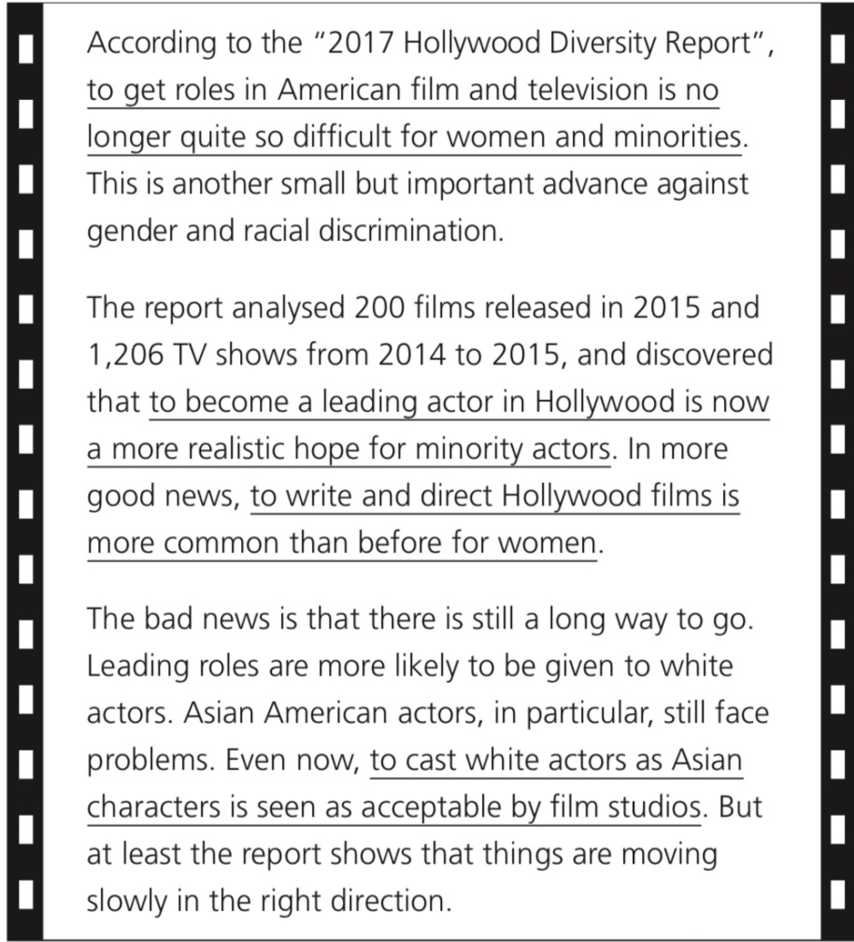
Activity 2
Rewrite the underlined parts using it as an empty subject.
It is no longer quite so difficult for women and minorities to get roles in American film and television.
It is now a more realistic hope for minority actors to become a leading actor in Hollywood.
It is more common than before for women to write and direct Hollywood films.
It is seen as acceptable by film studios to cast white actors as Asian characters.

Slide 17
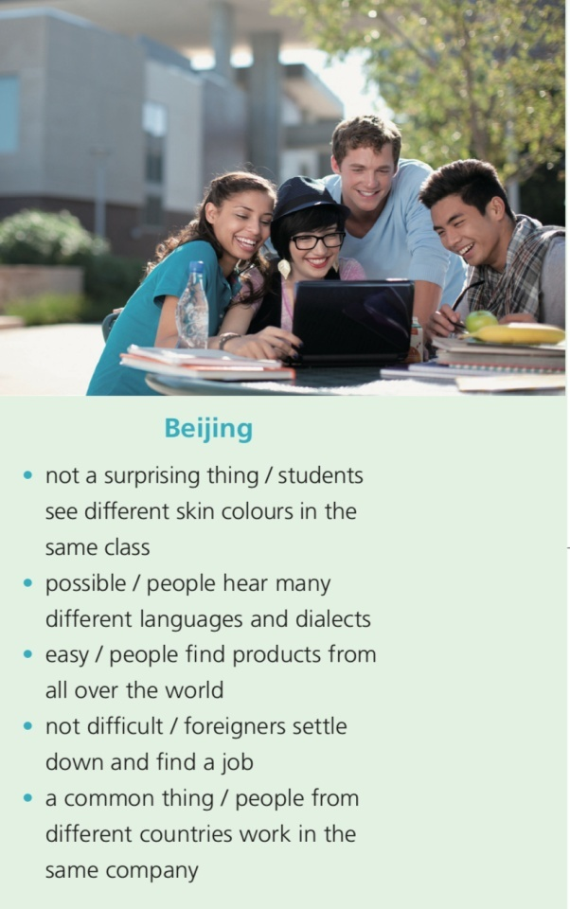
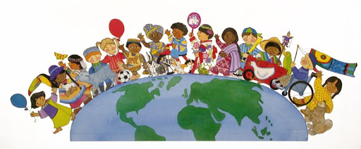
Activity 3
Describe the city using the information provided and it as an empty subject.
Beijing today is multicultural. It is not a surprising thing for students to see different skin colours in the same class. It is possible for people to hear many different languages and dialects. It is easy for people to find products from all over the world. It is not difficult for foreigners to settle down and find a job. It is a common thing for people from different countries to work in the same company.

Slide 18
The global village

Slide 19
Vocabulary building
Read the passage and answer the questions. Pay attention
to the expressions in bold.
Nowadays, people all over the world are becoming more and more connected, as if the world were getting smaller — as if we were living in a “global village”.
Technology is largely responsible for bringing people together.
bring together 使……团结起来；集合

Slide 20
Vocabulary building
Read the passage and answer the questions. Pay attention
to the expressions in bold.
沟通渠道
Channels of communication, such as the mobile phone and the Internet, have made it possible to speak instantly with someone on the other side of the planet, enabling us to form close connections with people of completely different cultures. The television, meanwhile, is a window on the world, giving us quick and easy access to other cultures and lifestyles.
形成密切联系
了解世界的窗口

Slide 21
Vocabulary building
Read the passage and answer the questions. Pay attention
to the expressions in bold.
Cultural exchange helps us to be more inclusive and to overcome culture shock. But inclusiveness doesn’t mean that our cultures will merge into one another. Rather, it’s about countries and people making a joint effort to come together to create a more harmonious and understanding
world, so that we can all enjoy the mutual benefits.
更包容的
文化冲击
共同努力
互惠互利

Slide 22
Vocabulary building
Read the passage and answer the questions. Pay attention
to the expressions in bold.
1. What phenomenon does the passage describe?
2. What effect does technology have on cultural exchange?
It describes the phenomenon of the “global village” as related to the promotion of technological and cultural exchange.
Technology enables us to form close connections with people of completely different cultures and gives us quick and easy access to other cultures and lifestyles.

Slide 23
Vocabulary building
Complete the letter with the correct form of the
expressions in the above activity.
Dear Editor,
Your article about living in a global village really struck a chord with me because I’ve just returned from a teaching project in Cambodia and Thailand. I had been worried about the 1_____________ , but fortunately the other volunteers and local teachers were really welcoming. We were able to
2 __________________________ each other as well as our students.
culture shock
form close connections with

Slide 24
Vocabulary building
Complete the letter with the correct form of the
expressions in the above activity.
Throughout, we made 3____________ to make our classes a success, so that we could all enjoy the 4 ______________ of working well together. It was rewarding to see how our work helped 5 _____________________ from different cultures.
a joint effort
mutual benefits
bring people together

Slide 25
Vocabulary building
Complete the letter with the correct form of the
expressions in the above activity.
Before I went, TV and the Internet were my
6 ____________________, but being there in person was even better. I think the experience has taught me to
7 _________________ and I can’t wait to do it all over again.
Paul
window on the world
be more inclusive

Slide 26
Listening & speaking

Slide 27
Listening & speaking
Listen to the conversation and choose the main idea.
1. More and more foreign words and expressions are entering the English language, especially those about food.
2. Chinese food is popular in the UK, and many Chinese words and expressions are entering English dictionaries as a result.
3. Intercultural communication is increasing, and people all over the world have a better understanding of each other.
4. World sports are bringing people together in the same way that food is.

Slide 28
Listening & speaking
Listen again and complete the table.
Phenomena | Examples
More and more 1 _______________________________ into dictionaries these days. | From Devon: grockle From Chinese: wok, chow mein, 2 _______ and chop suey
regional words are making it
wonton

Slide 29
Listening & speaking
Phenomena | Examples
Besides words, changes also happen to 3 ____ ________________________________________________________ ______________. | In a large Asian supermarket, there are 4 _______________ from Asia. There are 5 _______________________ ______________ in the male speaker’s city, such as 6 ____________________ ________________________________. Many European people can 7 __________________.
all kinds of food
the food we now find in shops and restaurants /
the food we buy and eat
a lot of other restaurants /
a lot of choices
Italian, French and
Japanese restaurants
use chopsticks

Slide 30
Listening & speaking
Phenomena | Examples
Sports also play an important role in 8 __________ ____________ . | It is not a surprise to see 9 _____________ _________________________ while watching the UEFA Champions League live and not unusual to find people enjoying 10 ________________________ __________ on the other side of the world.
people in Britain eating Chinese food
connecting
people
pizza while watching the
same game

Slide 31
Listening & speaking: Summary
Complete the boxes with the expressions from the conversation.
Really?
That’s interesting.
Is it really?
It is really amazing ...
I also find it interesting to see ...
No wonder it isn’t a surprise to see ...
It is not unusual to find ...
Showing interest
Describing a common phenomenon

Slide 32
Listening & speaking: Summary
Complete the boxes with the expressions from the conversation.
Showing interest
Describing a common phenomenon
Really?
That’s interesting.
Is it really?
It is really amazing ...
I also find it interesting to see ...
No wonder it isn’t a surprise to see ...
It is not unusual to find ...

Slide 33

Listening & speaking: Pair work
Work in pairs. Talk about another phenomenon of the global village using the expressions in this section.

Slide 34
Homework
1.Review the usage of it .
2.Work in pairs. Talk about another phenomenon of the global village using the expressions in this section.

