Slide 1


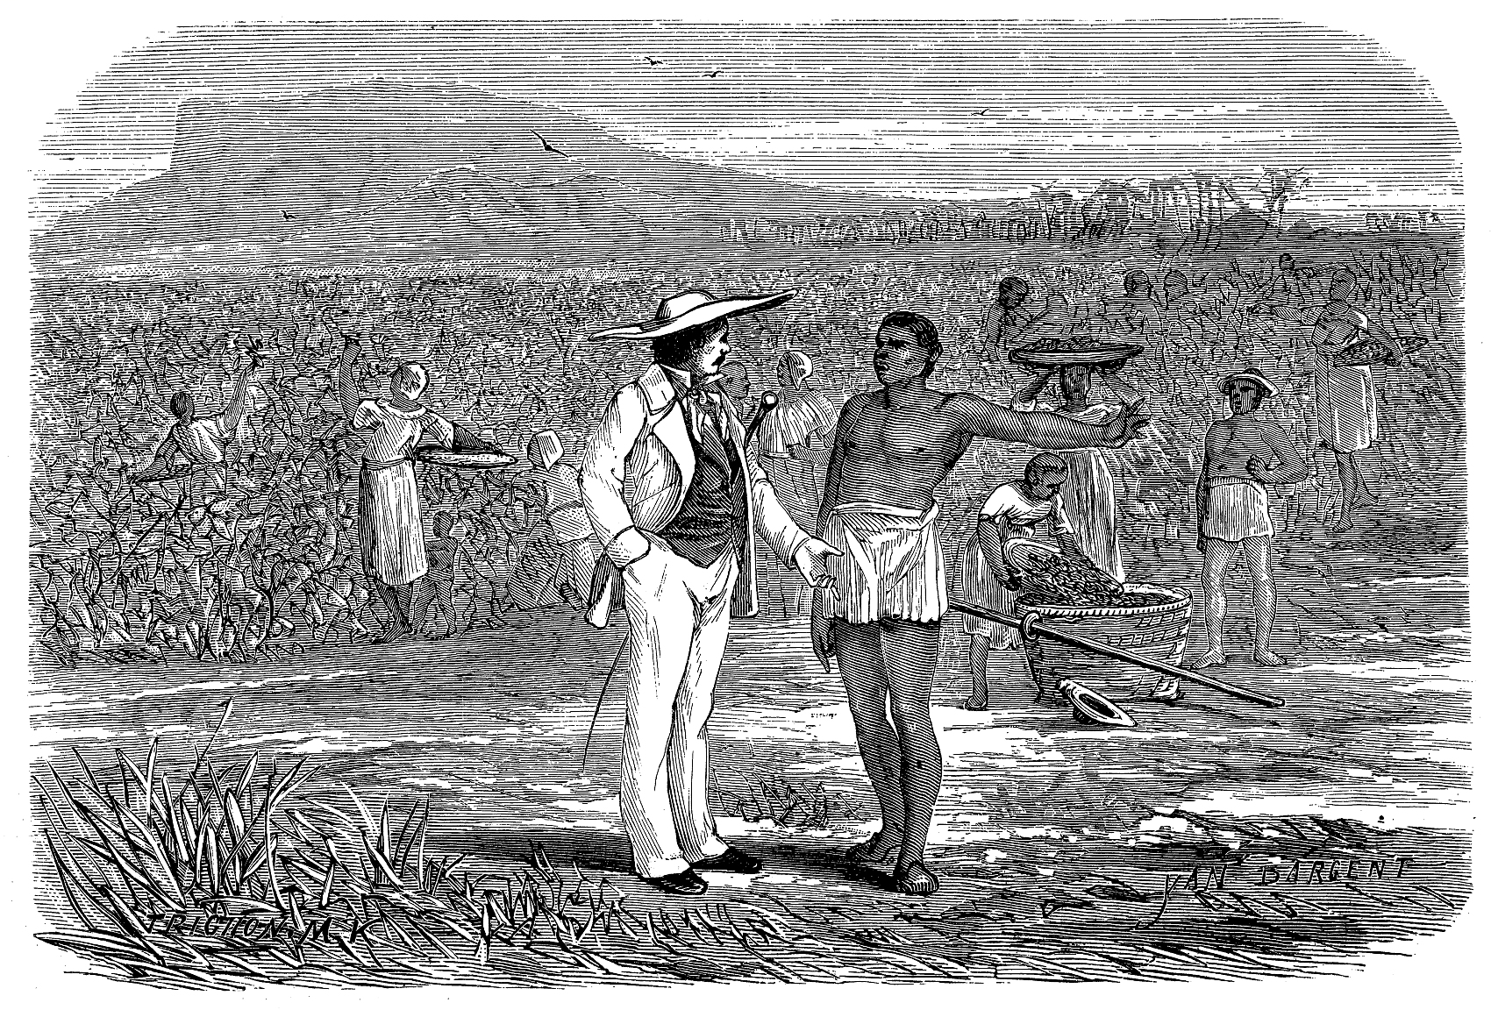
外研社版高中英语选择性必修二
Unit4 Breaking Boundaries
Developing Ideas

Slide 2
Learning Objectives
Get the historical background and meaning of the Gettysburg speech, and make your own speech;
Read for main ideas of paragraphs and give a talk about the significance of abolishing slavery in the US ;
Learn the features and structures of argumentative essays and give opinions about the movie adaptations.

Slide 3
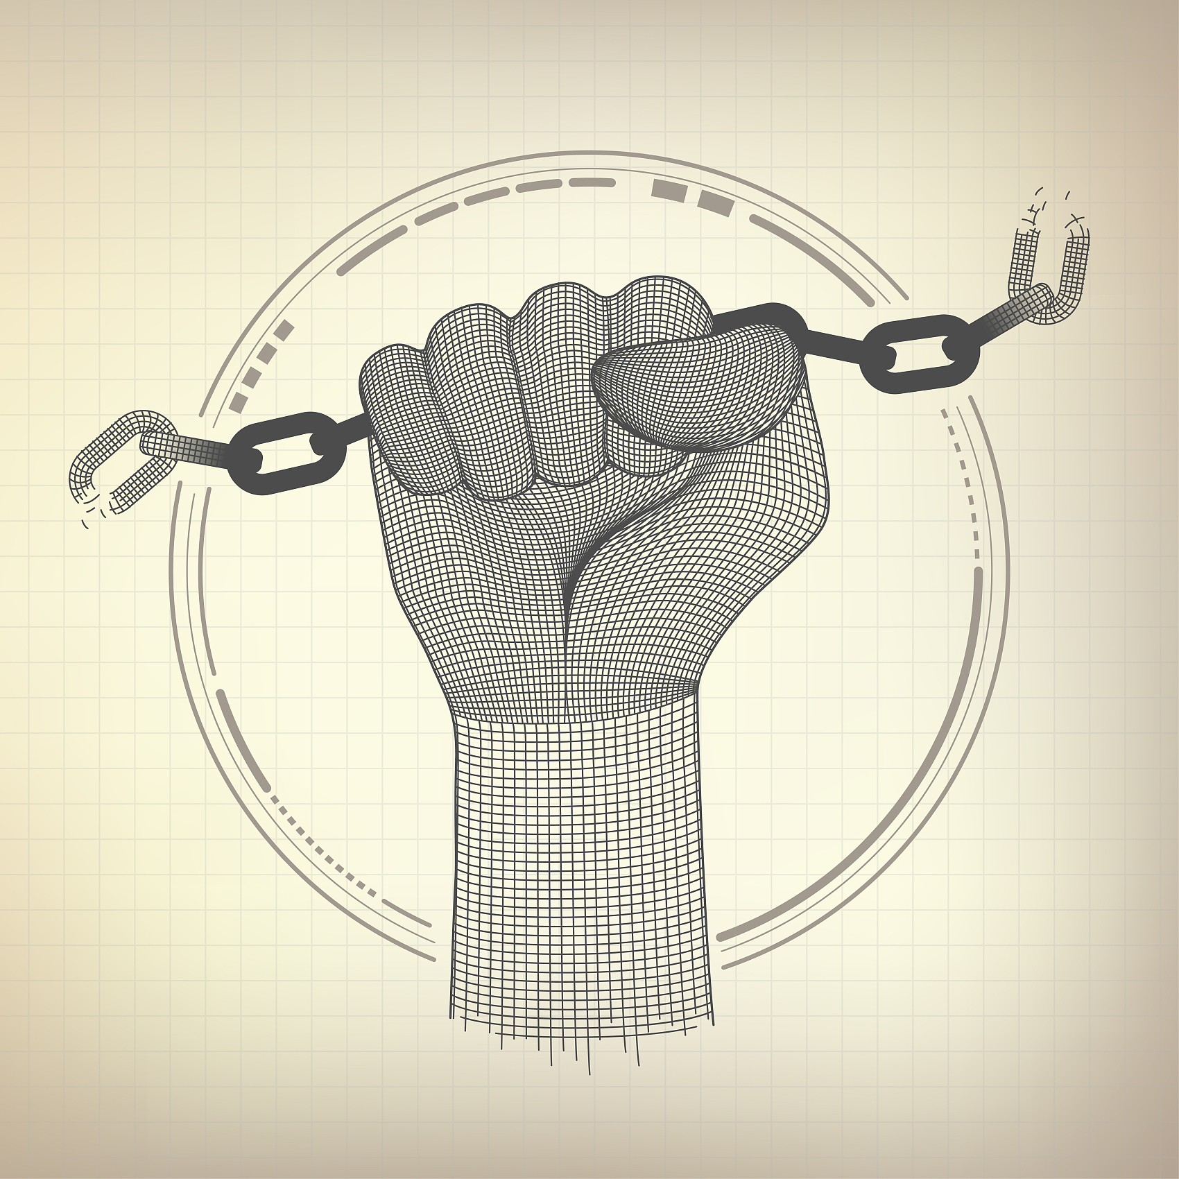
Reading

Slide 4

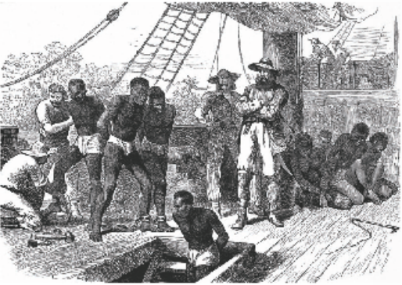
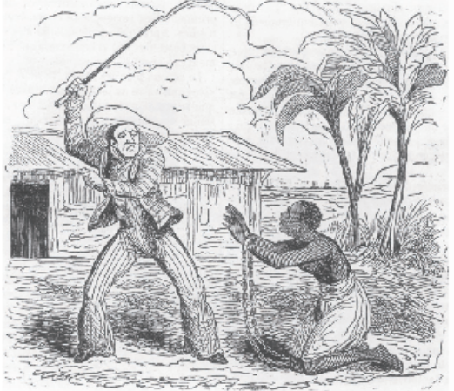
Do you know what these pictures are about?
Slavery

Slide 5
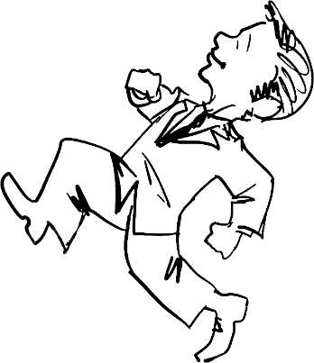
When it comes to slavery, what pops into your mind? Is it …?
black and white
cotton fields
the Civil War
Slavery
cruelty
Lincoln
Uncle Tom’s Cabin
Let’s watch a video and learn more about slavery!

Slide 6
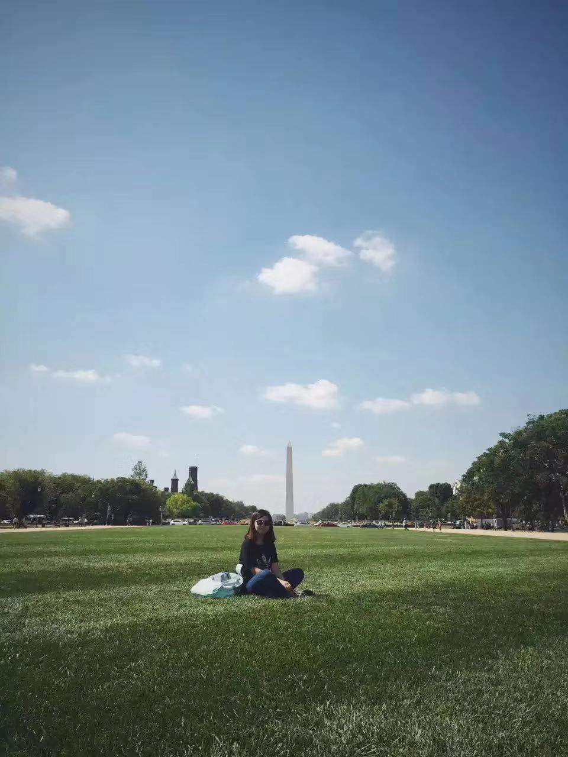
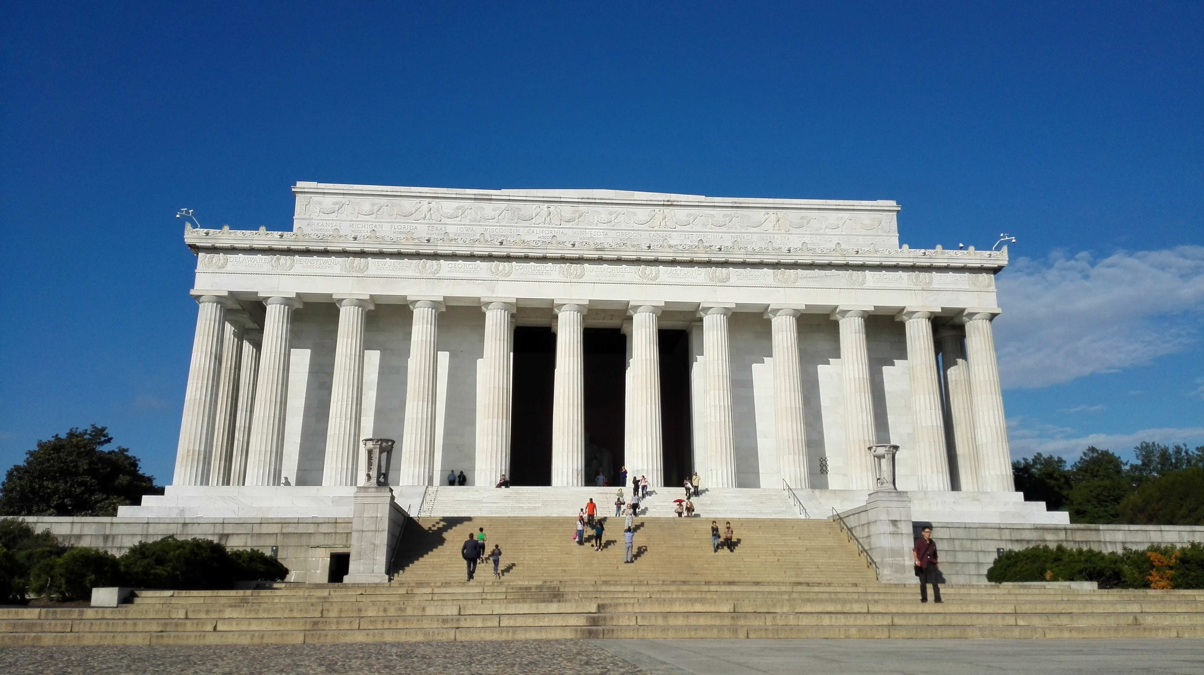
Washington Monument
Lincoln Memorial

Slide 7
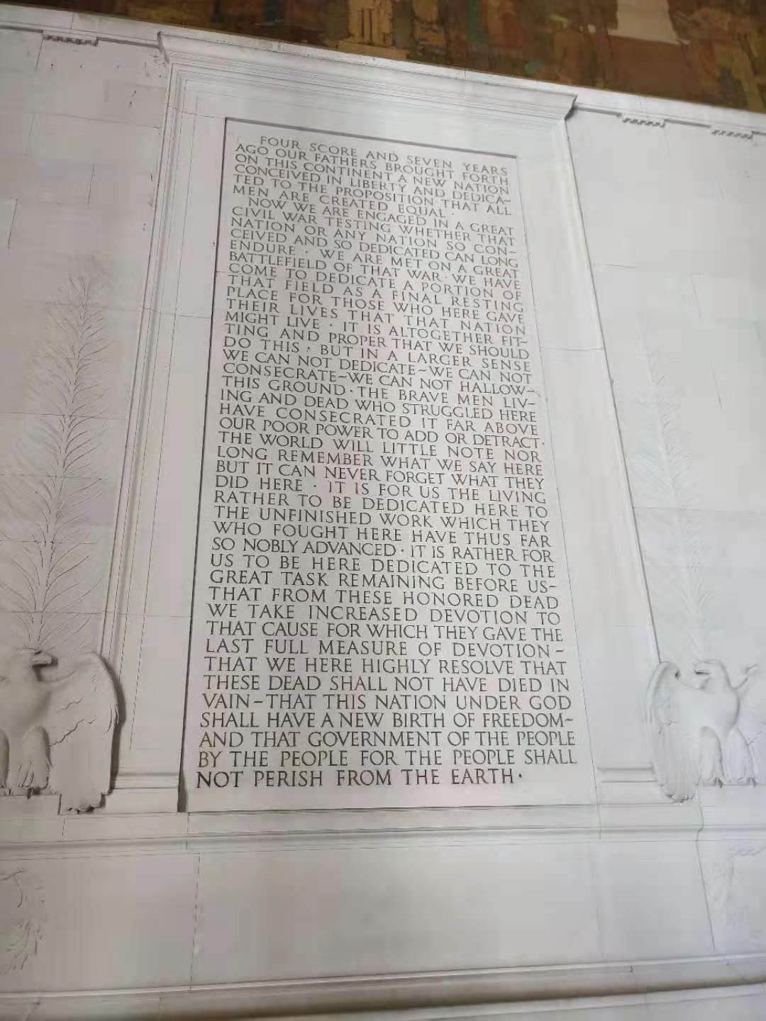
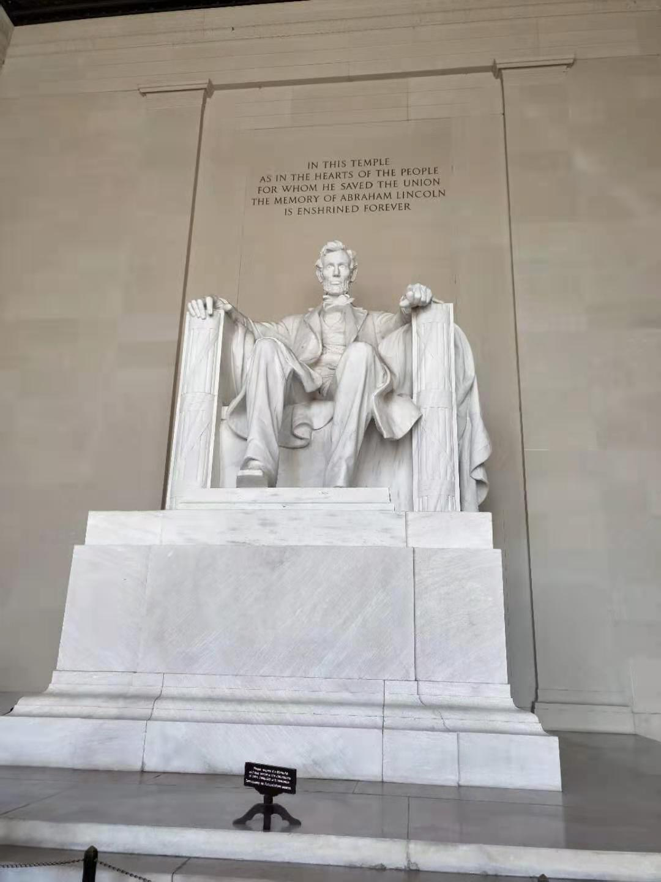
In this temple as in the hearts of the people for whom he saved the union, the memory of Abraham Lincoln is enshrined forever.

Slide 8
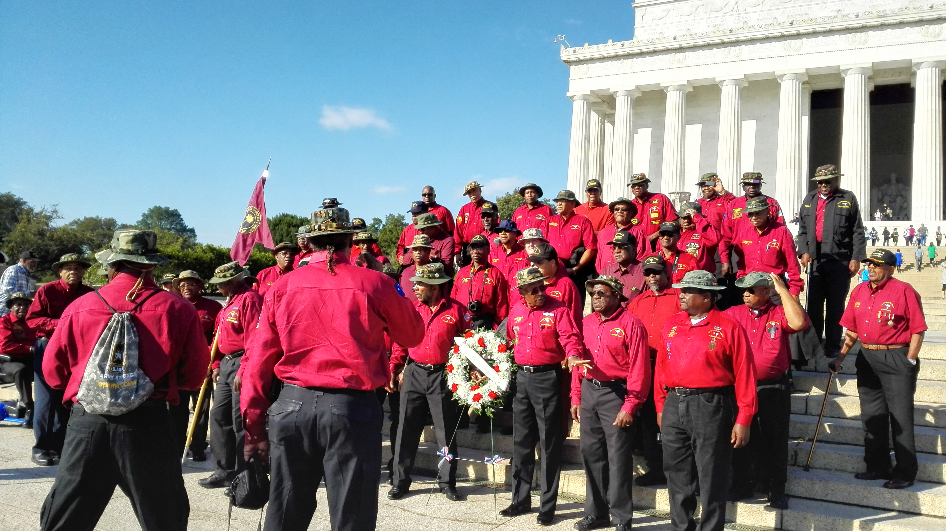

Slide 9
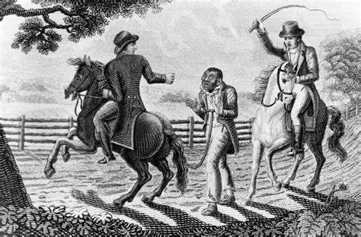
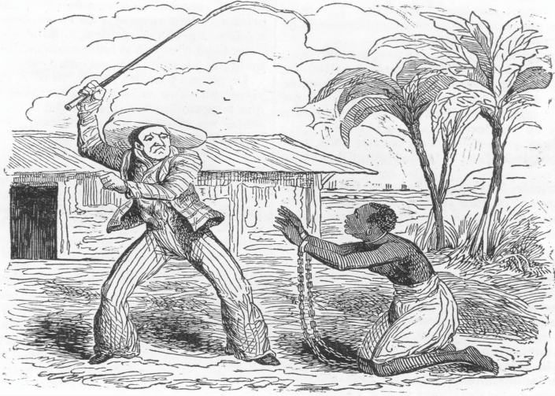

What can you see from the pictures?
It was common to see the phenomenon in southern states of the United States at that time. But it was one man who played a key part in abolishing the slavery in the United States. Do you know his name?
2. Daily life for a slave involved back-breaking( 使人疲劳至极的) labour. Slaves had to work all day long without enough rest. They were often physically abused by their owners and had no legal rights.
slave/black people
slave owner
abuse
whip
…
Watch the video and answer the questions.
1. How did slave owners regard their slaves?
2. What was a slave's life like?
1. They didn't regard them as human but as animals, without respecting them.

Slide 10
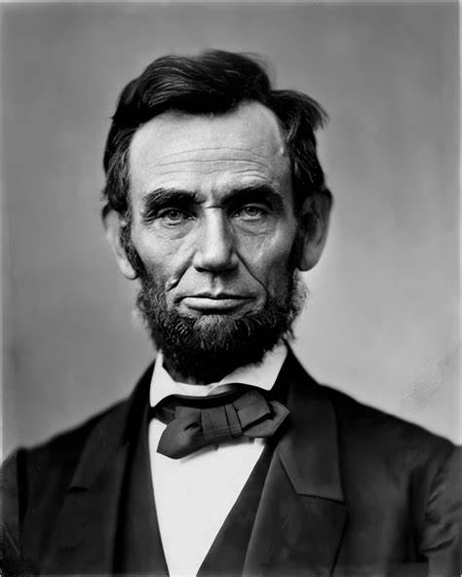
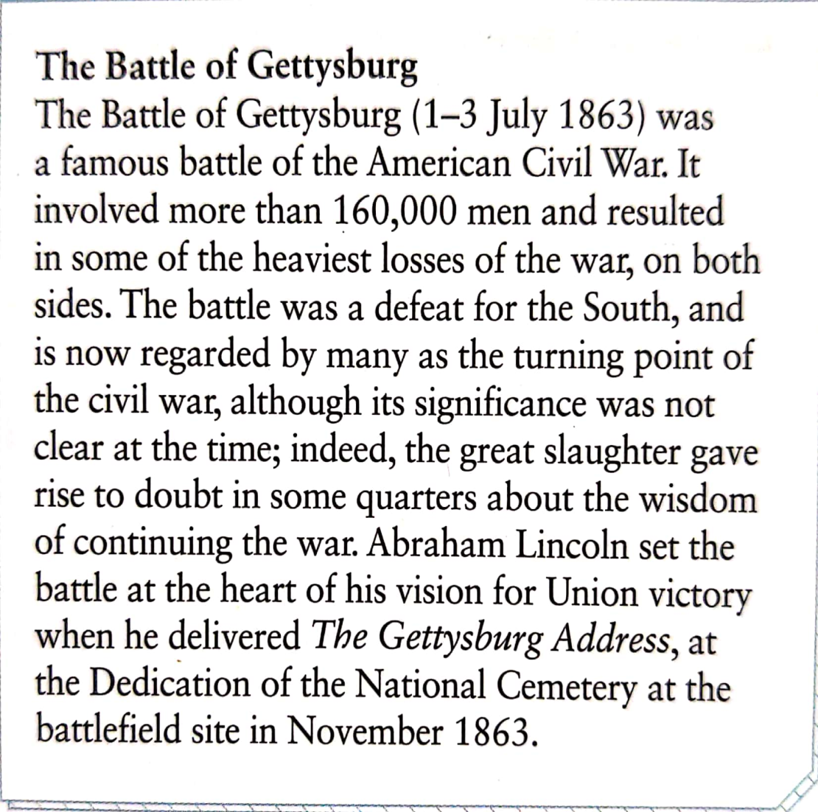
Abraham Lincoln
Abraham Lincoln was the 16th president of the United States of America, the leader who successfully prosecuted(发动) the Civil War to preserve the nation. He played a key role in passage of the Thirteenth Amendment(修正案), which ended slavery in America.
On November 19, 1863, President Abraham Lincoln gave the speech, which later became known as the Gettysburg Address, at the dedication(落成仪式) of a cemetery(公墓) for the soldiers who had died during the Battle of Gettysburg.
Now let's read the passage to learn more about the famous speech.

Slide 11
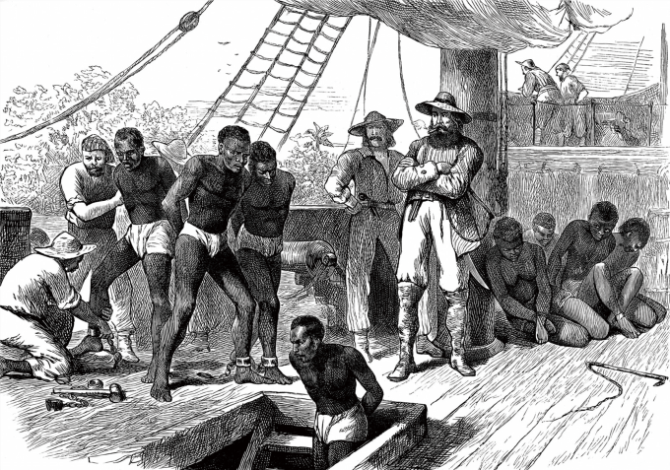
Pre-reading Acticity 1
Watch the video and answer the questions.
1. How did slave owners regard their slaves?
They didn’t regard them as humans but as animals, without respecting them.
2. What was a slave’s life like?
Daily life for a slave involved back-breaking labour. Slaves had to work all day long without enough rest. They were often physically abused by their owners and had no legal rights.

Slide 12

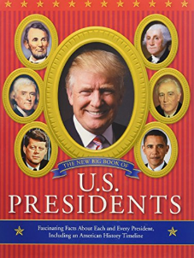
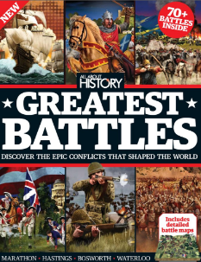
Fast reading
Look at the title and skim the passage. Choose the book in which you would most likely find the passage.
The Power of Speech
Famous US Presidents
Great Battles in History

Slide 13

Careful reading
Reading comprehension
1 What was Lincoln’s purpose in giving the speech?
A To declare a civil war.
B In memory of the soldiers who died in the war.
C To celebrate a victory.
2 How long did the worst battle last?
A One day. B Two days . C Three days. D Four days.

Slide 14
3 What did Lincoln think the nation should altogether do in a fitting and proper way?
A They should be engaged in the civil war.
B They should devote to their nation for the dead soldiers.
C They should meet there on a great battlefield of that war.
D They should fight for freedom and equality.
4 How did Lincoln describe the men who fought in the war?
A Brave and dedicated. B Selfless.
C Generous. D Hard-working.

Slide 15
5 What was the “great task” that Lincoln described?
A Winning the war against South.
B Achieving human equality.
C Building a stronger America.
D Making people live a better life.

Slide 16
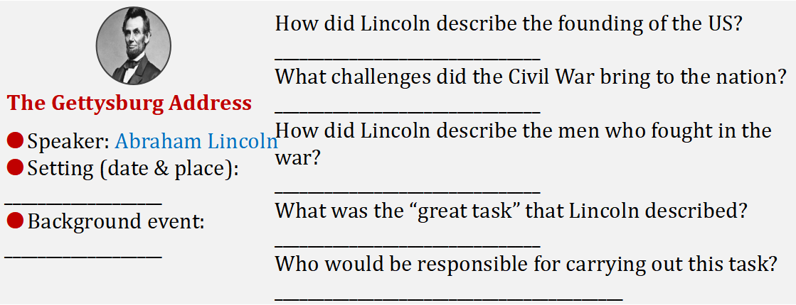
Intensive reading
Organise information from the passage and complete the notes.

Slide 17
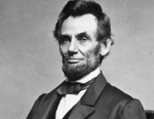
Intensive reading
Organise information from the passage and complete the notes.
How did Lincoln describe the founding of the US?
________________________________
What challenges did the Civil War bring to the nation?
________________________________
How did Lincoln describe the men who fought in the war?
________________________________
What was the “great task” that Lincoln described?
________________________________
Who would be responsible for carrying out this task?
__________________________________________
The Gettysburg Address
●Speaker: Abraham Lincoln
●Setting (date & place):
___________________
●Background event:
___________________

Slide 18
Intensive reading
● Speaker: Abraham Lincoln
● Setting (date & place):
____________________________
____________________________
● Background event:
____________________________
____________________________
____________________________
On 19 November 1863, in a field in Gettysburg, Pennsylvania
The Gettysburg Address
The Battle of Gettysburg in 1863, which resulted in over 50,000
casualties.

Slide 19

Intensive reading
How did Lincoln describe the founding of the US?
____________________________________________________________________________________________________________
____________________________________
____________________________________
It was a new nation conceived in Liberty and dedicated to the proposition that all men are created equal. / It aimed at bringing freedom to the people and was based on the principle that all men are created equal.
The Gettysburg Address

Slide 20
Intensive reading
What challenges did the Civil War bring to the nation?
____________________________________________________________________________________________________________
____________________________________
It would test whether a nation conceived in
Liberty and dedicated to the proposition that all men are created equal can long endure.
The Gettysburg Address

Slide 21
Intensive reading
How did Lincoln describe the men who fought in the war?
____________________________________________________________________________________________________________
They gave their lives so that their nation might live. They were brave men whose struggles had consecrated the ground.
The Gettysburg Address

Slide 22
Intensive reading
What was the “great task” that Lincoln described?
____________________________________________________________________________________________________________
____________________________________
That this nation shall have a new birth of
freedom; and that this government of the
people, by the people, for the people, shall not perish from the earth.
The Gettysburg Address

Slide 23
Intensive reading
Who would be responsible for carrying out this task?
____________________________________
The Gettysburg Address
The living should be dedicated to the task.

Slide 24
Summary
Abraham Lincoln, President of the United States of America, made a speech on 19 November, 1863 in Gettysburg, Pennsylvania in memory of the soldiers who 1________(die). At that time, America was 2_________(bitter) divided. For two years, its people had been deep in a civil war between South and North. The Union side won but 3_________ a great cost. People lost hope and purpose. Lincoln understood the feelings of the 4____________(civil) people. His speech gave them hope, 5__________(believe) and a reason to look to the future. He gave them a new vision of 6_________ the United States of America should be, 7__________(base) on the ideals set down by its Founding Fathers 87 years before. 8_________ was what the soldiers had died for. Now it was up to the living 9______________(remove) not only the divisions between North and South, 10____________ the boundaries between black and white, and work step by step towards the equality of humankind.
had died
bitterly
at
civilian
belief
what
based
It
to remove
but

Slide 25
Think and share
Discuss and answer the following questions.
1. What was Lincoln’s purpose in giving the speech?
He wanted to give the people hope, belief and a reason to look to the future.
2. Lincoln talked about government “of the people, by the people, for the people”. What does this mean?
“Of the people” means that government should be made up of or drawn from the people; “by the people” means that government should be run by ordinary people; “for the people” means that government should use its power for the people’s benefit.

Slide 26
3. What other speeches can you think of that stress the importance of breaking boundaries?
Example: I Have a Dream
I have a dream that one day on the red hills of Georgia, the sons of former slaves and the sons of former slave owners will be able to sit down together at the table of brotherhood.
4. What efforts to break boundaries are described in the two reading passages in this unit?
In the first passage, doctors or other people of different backgrounds worked together to save people in danger.
In the second passage, Lincoln called on the people of the United States to strive for a free nation where all men are equal.

Slide 27
Post reading
Work in groups. Give a talk about the significance of abolishing slavery in the US.
1. Organise your ideas by answering the questions.
• What was the US like before slavery was abolished?
• How was it different afterwards?
• In what ways did the abolition of slavery help to break boundaries?

Slide 28

1. The US was divided into states in the North that prohibited slavery, and states in the South which allowed slavery and depended upon slavery economically. Slavery was a very cruel institution, and caused great human suffering in the states that permitted it. Reliance on slavery also made the South less technologically advanced than the North.
2. Slaves were freed and were regarded as equal under the law, at least in theory. In practice, black Americans continued to suffer great discrimination in the South for the next hundred years, until the birth of the modern civil rights movement in the 1960s. The legacy of slavery continues to affect race relations in the US today.
3. The abolition of slavery made former slaves and their former masters equal before the law. This was the first step towards true equality.

Slide 29
Writing

Slide 30
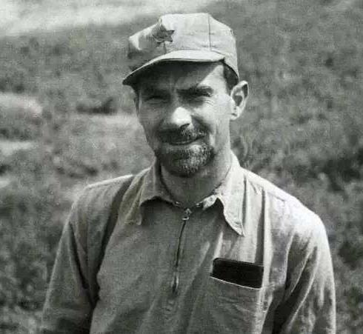
Pre-writing
Read the speech on Edgar Snow and answer the questions.
Hello, everyone. Today, I’m going to
introduce Edgar Snow. Edgar Snow was
an American journalist who wrote influential
books and articles about China in the 1930s.
At a time when relatively little was known
about our country in the Western world, his 1937 book Red Star over China broke ideological boundaries by telling the stories of the Chinese communist movement from the inside.
influential adj 有影响力的

Slide 31
Pre-writing
Read the speech on Edgar Snow and answer the questions.
Although Snow was not the only
international journalist to set foot in China
during the early decades of the 20th century,
what set him apart from the others was that
he actually spent time with the Chinese Red
Army. He listened to their stories and
observed their day-to-day lives, as well as conducting interviews with Mao Zedong and other leaders.

Slide 32
Pre-writing
Read the speech on Edgar Snow and answer the questions.
His biographical accounts and depictions of
historical events, such as the Long March,
therefore captured the spirit of the period
and the people living through it with
unprecedented authenticity. Snow is considered “our American friend”.
depiction n 描述
authenticity n 真实性；确实性
unprecedented adj 史无前例的

Slide 33
Pre-writing
Read the speech on Edgar Snow and answer the questions.
I admire Snow’s special insight and bravery,
risking his life during the war to get to the
heart of the story and correct prejudice. For
me, Snow’s writing, and in particular Red
Star over China, is a must-read for anyone with an interest in that period.
insight n 洞察力

Slide 34
Pre-writing
Read the speech on Edgar Snow and answer the questions.
1. Who was Edgar Snow?
He was an American journalist who wrote influential books and articles about China in the 1930s.

Slide 35
Pre-writing
Read the speech on Edgar Snow and answer the questions.
2. What did he do and what boundaries did he break?
He actually spent time with the Chinese Red Army and listened to their stories and observed their day-to-day lives. He also conducted interviews with Mao Zedong and other leaders. His book Red Star over China broke ideological boundaries by telling the stories of the Chinese communist movement from the inside.

Slide 36
Pre-writing
What does a speech usually include?
Who the person is.
Opening
What boundary he / she has broken.
a speech
Body
How he / she achieved this.
Summary
Comments on him / her.

Slide 37
While-writing: Think and write
Complete the table to organise your own speech about another person who has helped to increase understanding between two countries.
Opening
Who the person is: What boundary he / she has broken:
Body
How he / she achieved this:
Summary
Comments on him / her:

Slide 38
While-writing: Think and write
Useful expressions:
Today, I’m going to introduce ...
He / She was born in ..., in ...
Opening
He / She is / was a doctor / social worker ..., who is / was hard-working / diligent / intelligent / ...
He / She would break national boundaries by doing ...

Slide 39
While-writing: Think and write
Useful expressions:
He / She made every effort to do ...
He / She is / was devoted / dedicated to doing ...
Body
His / Her social conscience developed ...
He / She worked ceaselessly to help ... / make a difference in the world ...

Slide 40
While-writing: Think and write
Useful expressions:
I admire ... (for ...)
What he / she has done is worth ...
Summary
His / Her contribution to ... is not only ... but also ...
... call on ... to learn from his / her example ...

Slide 41
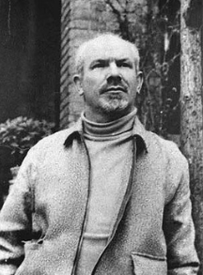
While-writing: Think and write
Henry Norman Bethune
A Canadian
A famous doctor
In January 1938, Bethune joined the Chinese to struggle against the Japanese invaders.

Slide 42

While-writing: Think and write
Now write your speech.
Please keep in mind the three parts to be included in a speech: opening, body and summary.
Try to use some words and expressions you have learned.
Do further research if necessary.

Slide 43

Post-writing: Presentation
Work in pairs. Make improvements to each other’s speeches and share them with the class.

Slide 44
Post-writing: Evaluation
Questions | Your evaluation | Evaluator
Does the speech include the key points? | 4 2 0
Is the speech organized properly and smoothly? | 3 2 1
How is the language? | 12 8 4 2
How is the handwriting? | 3 1 -1
Paper design | 3 1 -1
TOTAL MARK

Slide 45
Post-writing: Reference Text
Good morning, everyone. Today I’m going to introduce a great man who devoted his life to practising medicine for the people of China — Dr Norman Bethune. He was born in 1890, in Canada. He was a complicated person who was both very creative and very stubborn. He was also very hard-working, and wanted to make a difference in the world. In fact, he invented or improved numerous surgical procedures and surgical instruments.
adj 复杂的

Slide 46
Post-writing: Reference Text
However, it was in China that he would break national boundaries by becoming one of the few Western doctors to help the Chinese in their wartime struggle. His contribution to the welfare of the Chinese people was not only unusual, but immense.
Having married a wealthy woman, Bethune had once enjoyed a luxurious lifestyle in Canada. However, his social conscience developed during the 1930s, with a visit to the Soviet Union and time as a surgeon during the Spanish Civil War.
adj 巨大的
社会责任感

Slide 47
Post-writing: Reference Text
In January 1938, he left Canada again, this time to help the soldiers in China’s Eighth Route Army. It was no easy journey. Travelling thousands of kilometres, he did not reach Yan’an until the end of March. By June, he was working at the front. He soon saw that the medical situation for the troops and local people was bad. There were not enough medicines or surgical instruments, and the medical staff were not well trained.
n 军队

Slide 48
Post-writing: Reference Text
Bethune worked hard to help the wounded and train his staff, even inventing medical equipment that was suitable for guerilla warfare in China. The pace at which Bethune worked can be seen in a battle during April 1939, when he performed 115 operations in only 69 hours. The Chinese, though they sometimes found Bethune difficult because of his stubbornness, admired him greatly because of his ceaseless hard work and his dedication to helping the Chinese people.
游击战
adj 不断的

Slide 49
Post-writing: Reference Text
But tragedy struck when Bethune cut himself while conducting an operation. He soon contracted blood poisoning and died on 12 November 1939.
Dr Norman Bethune had worked tirelessly as a surgeon, teacher and hospital administrator for the Chinese people. Their struggle became his own. Although he was not Chinese, he sacrificed his life for them.
v 感染 （疾病）
v 牺牲；献出

Slide 50
Post-writing: Reference Text
In December 1939, Chairman Mao Zedong wrote an article “In Memory of Norman Bethune”, as a tribute to Bethune, and called on the Chinese people to learn from his example. Dr Norman Bethune remains the greatest inspiration for anyone who believes that we must fight alongside others for justice — even if they are from a different nation to our own.
n 致敬

Slide 51

Find another speech that changed a nation and then write a passage about it, including its background information.

