Slide 1

Unit5 A Delicate World Developing Ideas

Slide 2
Learning Objectives
Find out why Shennongjia has been chosen as a UNESCO World Heritage and analyze the stucture and characteristics of a lecture ;
Draft a lecture about Fanjing Mountain and increase the awareness of environmental protection ;
Raise the students’ cooperative awareness and individual thinking capability in their study and life and develop their creativity and encourage them to protect our local environment.

Slide 3

Reading

Slide 4


Lead in
World Heritage Site (世界遗产地)
How much do you know about UNESCO World Heritage Site?
A World Heritage Site may signify a remarkable accomplishment of humanity, and serve as evidence of our intellectual history on the planet, or it might be a place of great natural beauty. It is administered by the United Nations Educational, Scientific and Cultural Organization (UNESCO).

Slide 5
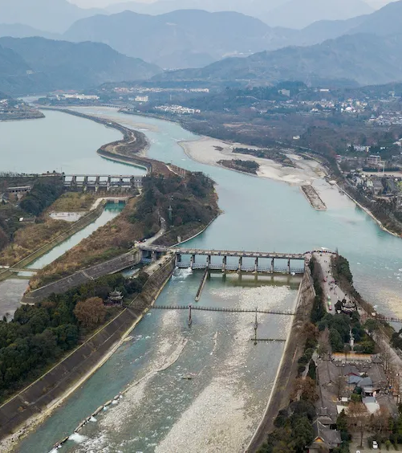
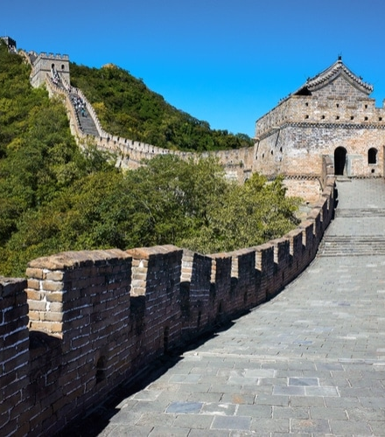
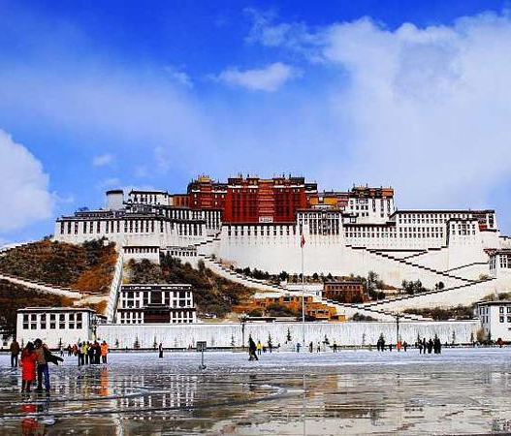
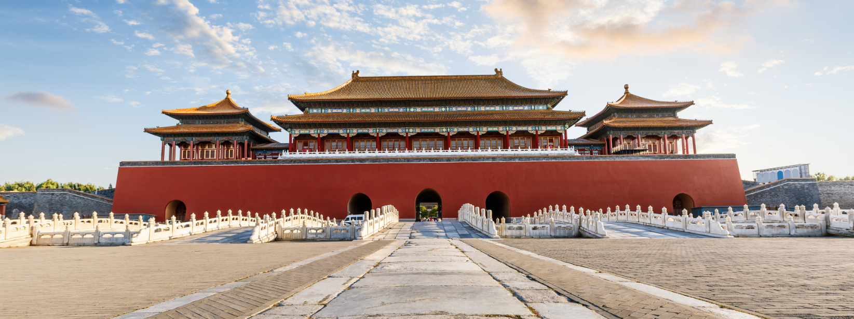
Lead in
The Great Wall
长城
The Potala Palace
布达拉宫
The Dujiangyan Irrigation System
都江堰水利系统
Imperial Palaces of the Ming and Qing Dynasties
皇宫
Some of Cultural World Heritage sites in China

Slide 6
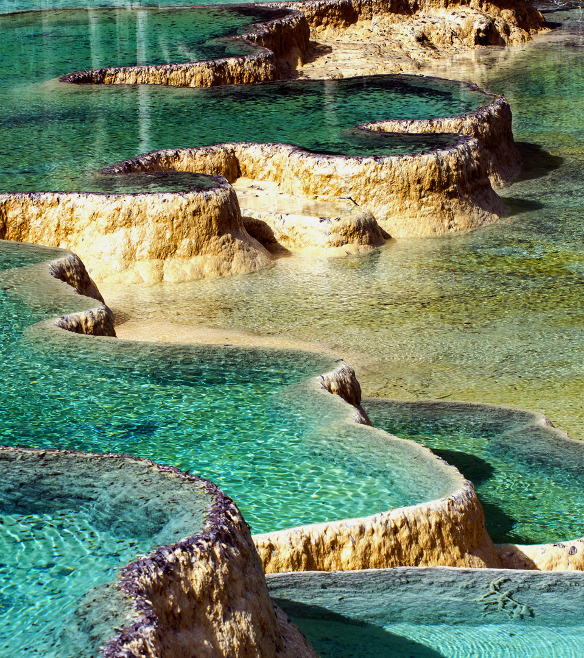
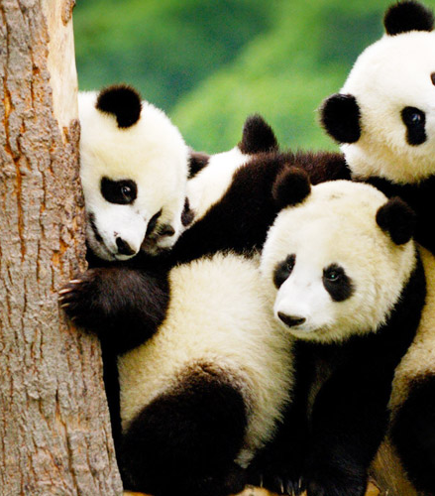
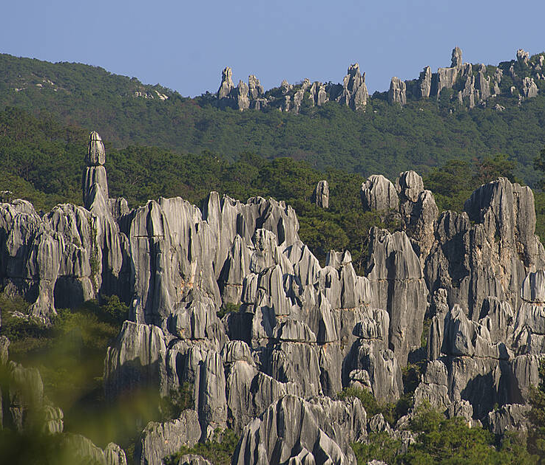
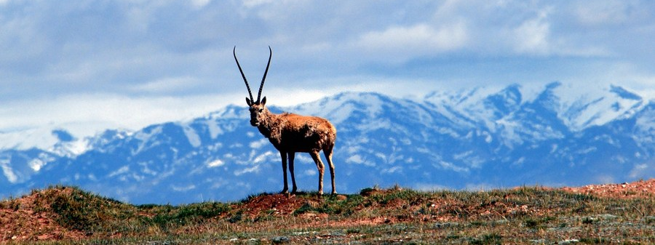
Lead in
Huanglong Scenic and Historic Interest Area
黄龙风景名胜区
Sichuan Giant Panda Sanctuaries
四川大熊猫基地
South China Karst
喀斯特地貌
Qinghai Hoh Xil
青海 可可西里
Some of Natural World Heritage sites in China

Slide 7
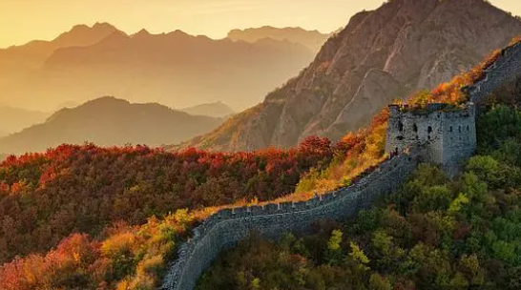
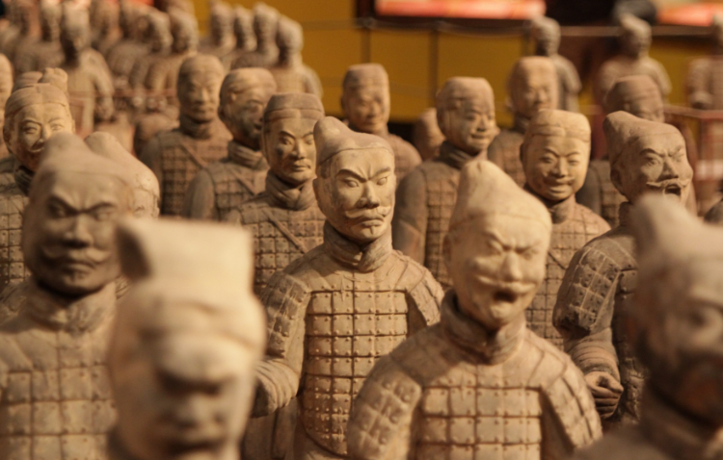
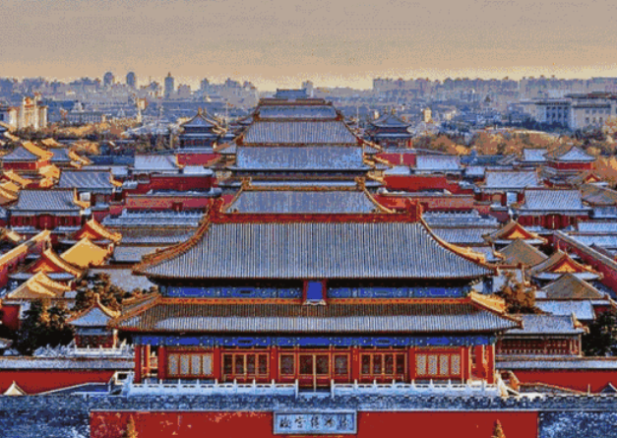
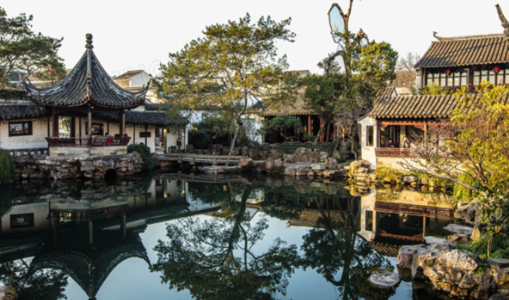
Lead in
the Terracotta Army
秦始皇兵马俑
the Great Wall
长城
the Imperial Palace
故宫
Suzhou garden
苏州园林

Slide 8
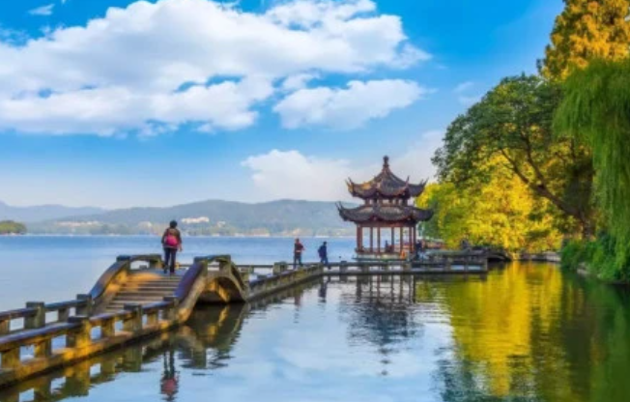
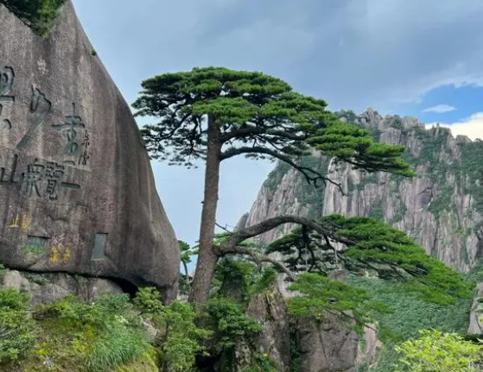
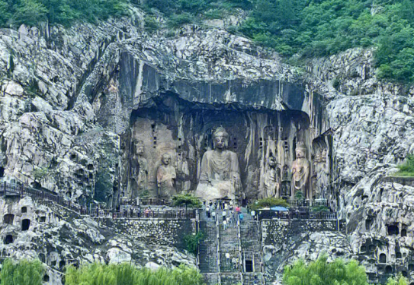
Lead in
Mount Huang
黄山
The West Lake
西湖
the Longmen Grottoes
龙门石窟

Slide 9
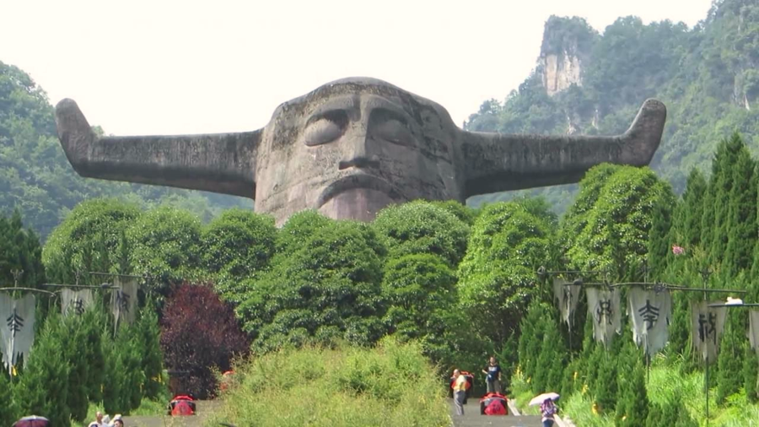
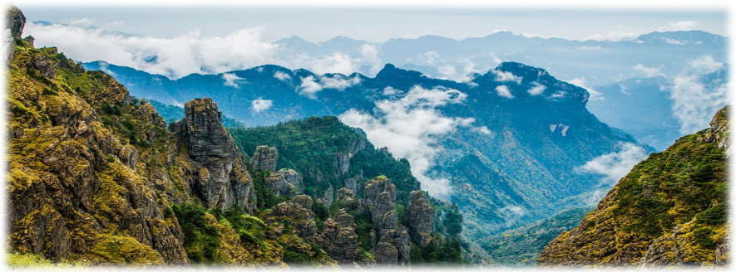
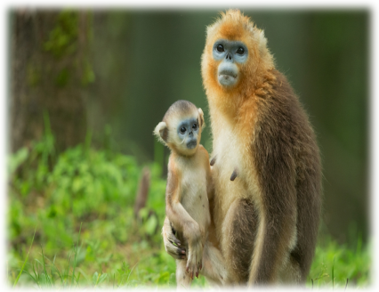


Lead in
WHAT
World Heritage Site is it?
Shennongjia(神农架)
Let’s watch a video and learn more about it!

Slide 10

Lead in
Watch the video and answer the questions.
Who is Shennong?
Where is Shennongjia and what is it famous for?

Slide 11
Who is Shennong?
Where is Shennongjia and what is it famous for?
A mythical figure in ancient China who brought agriculture and the use of tools to China and who invented agricultural tools and techniques, and the Chinese calendar with its 24 solar terms.
Shennongjia lies in the north-west of Hubei Province and is famous for its beauty and diversity.

Slide 12

Pre-reading
Look at the title of the passage and think about what it means.
Why did Shennongjia make it onto the UNESCO World Heritage List?

Slide 13
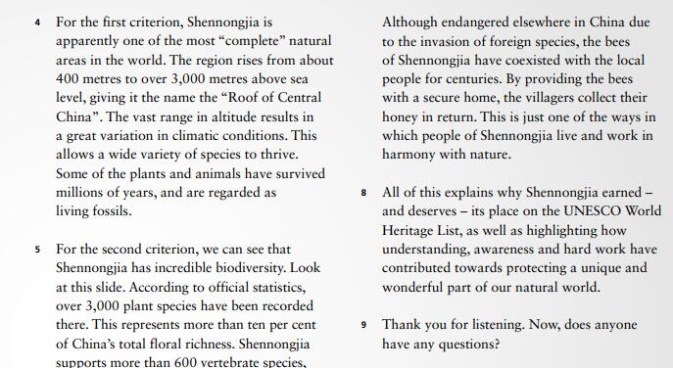
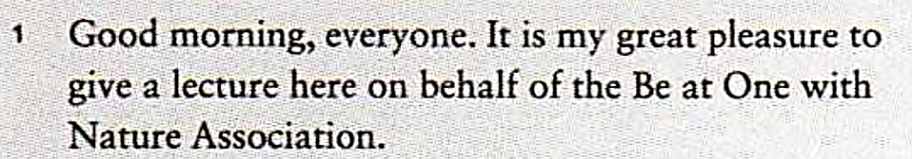
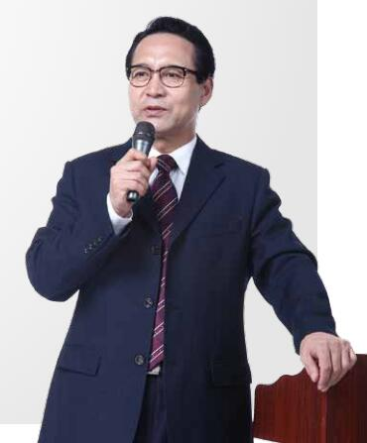
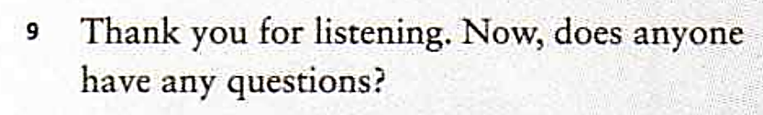
Pre-reading
What is the genre (体裁) of the passage?
The genre of the passage is lecture.

Slide 14
Pre-reading
Learning to learn
The lecture is one of the oldest teaching methods, and is still widely used today. A typical lecture often starts with addressing the topic directly. Data, examples and comparisons are then used to support the main ideas. Both verbal（口头的） and visual information is used in order to maintain the audience’s interest. The end of a lecture is often followed by a short question-and-answer session（问答环节）.

Slide 15
Learning to learn
演讲时常用说明方法：
列数据 (give data)、举例子 (examples)、作比较 (make comparisons).
列数据 (give data): 用具体的数据对事物的特征或事理加以说明，使说明更准确、更有说服力。
举例子 (examples): 通过具体的实例对事物的特征或事理加以说明，使说明更加生动形象、易于理解。
作比较 (make comparisons): 将两个事物放在一起进行比较，呈现事物的相同点和不同点。

Slide 16
While-reading
Read for structure
Part 1
Para. 1-2
Greeting + introduction
WHY SHENNONGJIA?
Part 2
Para. 3-5
Criteria for selection
Part 3
Para. 6-7
Protective measures
Part 4
Para. 8
Conclusion
Part 5
Para. 9
Q & A

Slide 17
While-reading
Read details
Para. 1-2 Greeting + introduction
What roles do the questions in Paragraph 2 play?
Para. 1: Good morning, everyone. It is my great pleasure to give a lecture here on behalf of the Be at One with Nature Association.
Para. 2: As we know, in 2016, Shennongjia made it onto the UNESCO World Heritage List. But there are so many important places not yet on this list. So you might ask: why Shennongjia? Is it its forests that stretch on and on like great green seas? Is it the legendary father of Chinese herbal medicine, Shennong, after whom the park is named? Or is it the mysterious creature called “Yeren” (wild man) that has captured the imagination of the world?
They serve to introduce the topic and attract the audience.

Slide 18
While-reading
Para. 3 Criteria for selection
What are the criteria required by the UNESCO World Heritage List?
Para. 3: UNESCO awarded Shennongjia this status because it meets two criteria required by the list. It contains a naturally-balanced environment that allows the many and various species to live and prosper. It is also one of the rare locations in the world where scientists can observe in real time the ecological and biological processes that occur as the plants and animals develop and evolve.
Containing a naturally-balanced environment and being one of the rare locations in the world where scientists can observe in real time the ecological and biological processes.

Slide 19
While-reading
Para. 4 Criteria for selection
What makes Shennongjia the most “complete” natural areas in the world?
Para. 4: For the first criterion, Shennongjia is apparently one of the most “complete” natural areas in the world. The region rises from about 400 metres to over 3,000 metres above sea level, giving it the name the “Roof of Central China”. The vast range in altitude results in a great variation in climatic conditions. This allows a wide variety of species to thrive. Some of the plants and animals have survived millions of years, and are regarded as living fossils.
Shennongjia rises from about 400 metres to over 3,000 metres above sea level, which results in a great variation in climatic conditions, allowing a wide variety of species to thrive.

Slide 20
While-reading
Para. 5 Criteria for selection
Read carefully and fill in the blanks.
plant
more than ten per cent of China’s
total ______________
Over 3,000 _____ species
floral richness
incredible biodiversity
600
more than ____ vertebrate species
the Golden Snub-nosed Monkey and ____________________
the Clouded Leopard
around 4,300 ______ species
insect

Slide 21
While-reading
Para. 6 Protective measures
How does the scientist protect the species?
Para. 6: It is a challenge to look after so many species. In winter, scientists brave heavy snow and freezing temperatures to supply food to the Golden Snub-nosed Monkey. Thanks to their efforts, the monkey’s population has doubled since the 1980s. Their number reached over 1,300 in 2015 and continues to grow.
They brave heavy snow and freezing temperatures to look after the species.

Slide 22
While-reading
Para. 7 Protective measures
Read carefully and fill in the blanks.
The local people
with a secure home
providing them ________________
Bees
with honey
providing them ________________
People of Shennongjia live and work
______________________________ nature.
in harmony with

Slide 23
Post-reading
Think & Share
According to the passage, what has been done to protect the ecology of Shennongjia?
To protect the ecology of Shennongjia, scientists make every effort to look after the species.
In winter, scientists brave heavy snow and freezing temperatures to supply food to the Golden Snub-nosed Monkey. More importantly, the local people live in harmony with nature. They take things from nature without damaging it.

Slide 24
Post-reading
Think & Share
Which part of Shennongjia interests you most? Why?
What interests me most is that Shennongjia has so many species and has a long history.
It is said that Emperor Yan, Shennong taught the first people living here how to build houses, find herbs, and farm the land, so the area is called Shennongjia.

Slide 25
Homework
1. Give a talk comparing Macquarie Island and Shennongjia.
2. Design a poster to call on people to protect our environment.

