Slide 1

Unit 5 A delicate world
Using language
Vocabulary+Listening+Speaking

Slide 2
Learning objectives
To learn something about ecosystems
To listen to the conversation and get the detailed information about what makes bee habitats dangerous
To think how animals and human beings rely on each other to live on the earth

Slide 3
Ecosystems

Slide 4
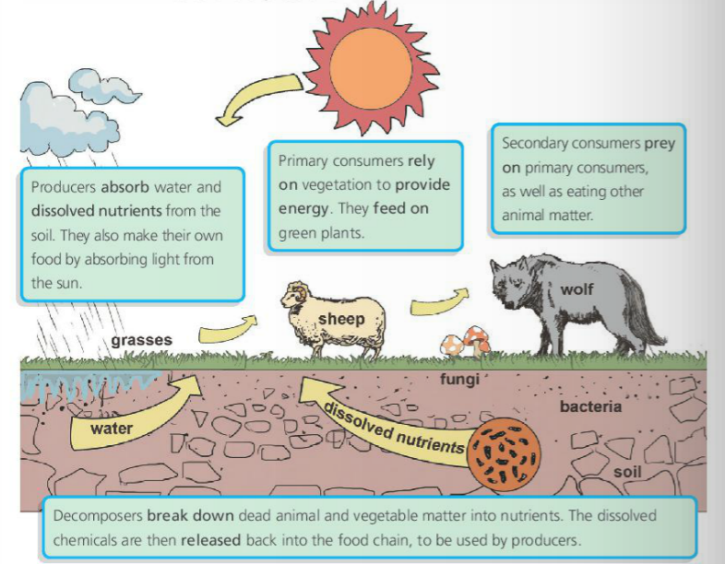
Look at the diagram and answer the questions. Pay attention to the words and expressions in bold(黑体).
1.What does the diagram show?
The diagram shows a food chain(食物链) – the connection between the living things.

Slide 5
Look at the diagram and answer the questions. Pay attention to the words and expressions in bold(黑体).
2. Who are the Producers, Primary consumers, Secondary consumers and Decomposers?
Producers=grasses
Primary consumers=sheep
Seconary consumers=wolf
Decomposers=water; dissolved nutrients; fungi; bacteria, soil

Slide 6
Look at the diagram and answer the questions. Pay attention to the words and expressions in bold(黑体).
3. What are the relationships
between the living things?
The living things are closely connected with each other by the food they eat.

Slide 7
Ecosystem
Pay attention to the words and expressions in bold.
1. absorb __________________
2. dissolved nutrients __________________
3. rely on __________________
4. provide energy __________________
吸收，摄入
溶解的营养物质
依靠，依赖
提供能量

Slide 8
Ecosystem
Pay attention to the words and expressions in bold.
5. feed on ______________
6. prey on _______________
7. break down _______________
8. release _______________
以……为食
捕食，掠夺
分解
释放

Slide 9
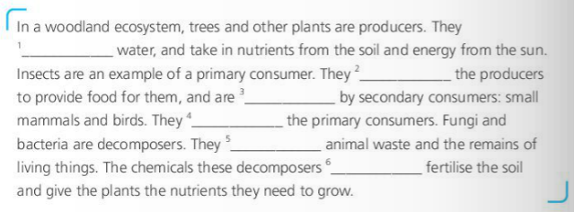
Ecosystem
Complete the passage with the correct form of the words and expressions in Activity 5.
absorb
rely on
fed on
prey on
break down
release

Slide 10
Listening & speaking

Slide 11
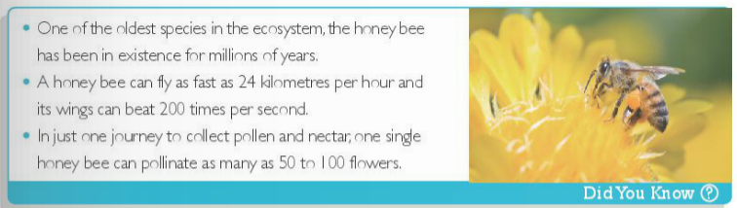
Before-listening---Background information
bee/honey bee
as busy as a bee
one of the oldest species in the ecosystem; millions of years
Existing time
Flying
Function
fly as fast as 24 kmph(kilometers per hour); wing beats 200 times per second
collect pollen(花粉) and nectar(花蜜); pollinate(授粉) as many as 50 to 100 flowers

Slide 12
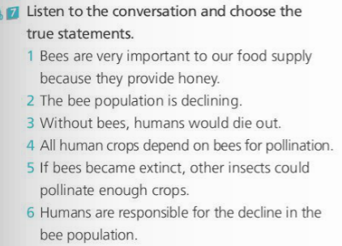

While-listening---Main idea

Slide 13
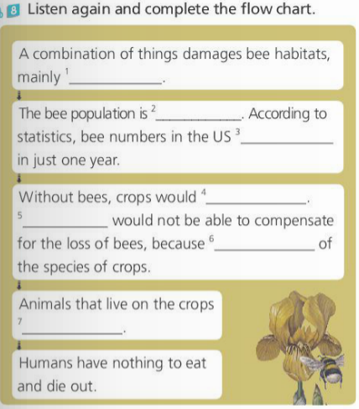
While-listening---Details
pesticides and climate change
declining very quickly
have fallen by 17%
be unable to reproduce
Other insects
bees are responsible for pollinating about 70%
would die out

Slide 14
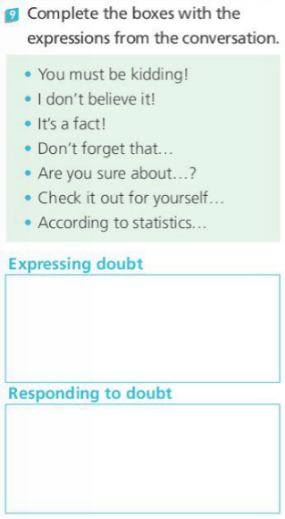
• It’s a fact!
• Don’t forget that…
• Check it out for yourself...
• According to statistics...
• You must be kidding!
• I don’t believe it!
• Are you sure about ... ?

Slide 15
听力文本填空
Meg: Hey Ollie, have you heard that the bee population is ___________?
Ollie: No, I haven't. But, thinking about it, I _________ ever see bees these days. When I was little, they _________ to be everywhere!
Meg: If bees die out, _________ will die out too.
Ollie: What?! You must be _________! I don't believe it!
Meg: It's a fact!! I _________ a nature documentary all about it the other evening. Bees are very important to our food ________.
Ollie: How can that be ________? Humans won't die out just because there's no honey!
Meg: Bees don't just make honey. Don't forget that bees are also __________ for pollinating plants.Without them, crops would be unable to ___________.
declining
hardly
seemed
humans
kidding
watched
supply
possible
responsible
reproduce

Slide 16
听力文本填空
Ollie: But surely there are other ways of getting these _______ to reproduce. Does it have to be bees?
Meg: Well, there are other _______ that pollinate plants, but it's _______ that they would be able to fully compensate for the loss of bees. Bees are responsible for pollinating about _______ of the species of crops.
Ollie: Are you sure about that data? It ________ rather exaggerated.
Meg: Watch the documentary and check it out for yourself if you don't ________ me. Without bees, numerous plant species would die out. Animals that _________ the crops would die out, and we wouldn't have enough to eat.
Ollie: Seriously? That's ________! But looking on the bright side, there are millions and millions of bees. They're not going to die out any time soon.
crops
insects
unlikely
70%
sounds
believe
live on
scary

Slide 17
听力文本填空
Meg: I'm afraid you're wrong. The bee population is declining very quickly. ___________ statistics, bee numbers in the US have ________ by 17% in just one year.
Ollie: Gosh! What _______ that?
Meg: A combination of things, really, but it's mainly ________ damage to their habitats caused by pesticides and _______________.
Ollie: So human ________ is the main cause?
Meg: That's right.
Ollie: Well, ___________, we'd better do something before it's too late.
According to
fallen
caused
due to
climate change
activity
in that case

Slide 18

Pair work
Work in pairs. Talk about what would happen to the ecosystem if another species died out. Use the words and expressions in this section.

Slide 19

Homework
Write a passage about how a place you know has changed using the words and expressions in this section.

