Slide 1
Unit 5 A delicate world
Using language

Slide 2

Using language
Activity 1. Look at the sentences and answer the questions. Sentences (a) and (c) are from the reading passage.
a No visitor would think it surprising that the island is a UNESCO World Heritage Site.
b No visitor would think that the island being a UNESCO World Heritage Site is surprising.
------------------------------------------------------------------------------------------------------------------
c Experts felt it necessary to come up with a plan to remove all the rabbits from the island.
d Experts felt to come up with a plan to remove all the rabbits from the island was necessary.
1. What does “it” refer to in sentences (a) and (c)?
In sentence (a), “it” refers to “that the island is a UNESCO World Heritage Site”.
In sentence (c), “it” refers to “to come up with a plan to remove all the rabbits from the island”.

Slide 3
Using language
Activity 1. Look at the sentences and answer the questions. Sentences (a) and (c) are from the reading passage.
a No visitor would think it surprising that the island is a UNESCO World Heritage Site.
b No visitor would think that the island being a UNESCO World Heritage Site is surprising.
------------------------------------------------------------------------------------------------------------------
c Experts felt it necessary to come up with a plan to remove all the rabbits from the island.
d Experts felt to come up with a plan to remove all the rabbits from the island was necessary.
2. What is the difference between the sentences in each group?
The sentences with “it” as an empty object are well balanced in structure.

Slide 4
No visitor would think it surprising that the island
is a UNESCO World Heritage Site
d. Experts felt it necessary to come up with a plan to remove all the rabbits from the island.
宾语从句
83%
58%
不定式
Analyze the structure of the sentences .
主语+动词+it+宾语补足语+真正的宾语

Slide 5
it 作形式宾语
用法：当不定式、动名词或从句在某个句子中作宾语时，为了保持句子的结构平衡，常用it作为形式宾语，而将真正的宾语放到句子后部去。
（it 没有具体的意义，仅用于维持句子结构平衡。)
构成结构为：
动词+it+宾语补足语+真正的宾语

Slide 6
It作形式宾语条件：
※it 作形式宾语时， 需具备两个条件：
①真正的宾主是不定式、动名词或从句。
②有宾语补足语
具备了这两个条件， 形式宾语it一定要用。
不定式
真正的宾语是
动名词
从句
条件
有宾语补足语
具备了这两个条件， 形式宾语it一定要用。

Slide 7
1.it作形式宾语代替动词不定式。
常用动词不定式作真正宾语的句型：动词＋it＋形容词/名词＋（for sb） to do sth
I find it pleasant to work with him.
我觉得和他一起工作很愉快。
He makes it a rule never to borrow money from others.
他的规矩是从不向别人借钱。
He likes to stay up late， so he often feels sleepy， which makes it difficult for him to concentrate on what he is doing.
他喜欢熬夜，所以他经常感到困倦，这使他很难集中精力在他正在做的事情上。

Slide 8
2.it作形式宾语代替动词－ing形式。
常用动词－ing形式作真正宾语的句型：
动词＋it＋no good/no use/no value/a waste of time/hard work/worthwhile＋doing sth
I think it no good spending too much time watching TV.
我认为花太多时间看电视是没有好处的。
He thought it no use trying to multiply their number.
他认为企图增加它们的数量没有用。

Slide 9
3.it作形式宾语代替从句。
（1）当从句在复合宾语结构中作某些动词（如think,make, find等）的宾语时，it作形式宾语代替从句。
We all thought it a pity that the conference should have been cancelled.
会议取消了，我们都感到很遗憾。
I find it strange that she doesn’t want to go.
她竟然不想去，我觉得奇怪。
名师点津
上述句中it后面需要有名词或形容词作宾语补足语。

Slide 10
3 it 代替宾语从句
2）某些表示“喜，怒，哀，乐”的动词， 如like, enjoy, love, hate, appreciate等，往往不能直接接宾语从句，而是先用it作形式宾语， 再把真正的宾语从句放在后面。
I don`t like it that he`s so lazy.
I hate it when my mother asks me to eat eggs.
We really appreciated it when she offered to help .
3) 在一些“动词＋介词”构成的短语，如：depend on，rely on，see to（照料；处理），stick to，take ...for granted，owe ...to sb, answer for（因...而受罚；对...负责）等常先接it，再接that 引导的从句。
You may depend on it that we shall always help you.
Would you see to it that she gets home early?
She insisted on it that she was innocent.

Slide 11
3) 动词+it+过去分词+从句
He made it known to everyone that he was right.

Slide 12
活学活用
语法填空：
I would appreciate ______ if you could let me know in advance whether or not you will come.
it
Susan made _____ clear to me that she wished to make a new life for herself.
it
We feel it our duty ________(make) our country a better place.
to make
I find it hard ______ me to get on well with my classmates.
for

Slide 13
活学活用
语法填空：
I think it no use _____ (talk) about it with them.
talking
We find it essential ______ we should learn to spend money wisely.
that
The right level of background noise may interrupt our normal patterns of thinking just enough to allow our imaginations to wander, withough making it impossible ________(focus).
to focus

Slide 14
活学活用
Translate the following sentences.
我认为保护环境非常重要。
I think it very important to protect the environment.
以前我们总是理所当然地认为自然资源取之不尽，这对大自然造成了巨大的伤害。
We took it for granted that the natural resources were endless, which caused great harm to nature.
我们一定要确保采取有效措施阻止污染。
We should see to it that effective measures should be taken to prevent pollution.

Slide 15
Using language
Activity 1. Rewrite the underlined parts using it as an empty object.
The red-eared slider, a species of freshwater turtle, is native to the Southern United States and Northern Mexico. Due to its cute appearance, many people think keeping this turtle as a pet is a good idea. Recent years have seen more and more pet sliders escaping or being released from homes, and some owners believe to release them into the wild is no big issue.
These days, people have found to release these turtles into the wild is a threat to other species. Experts consider owners keeping their pets in an enclosed area important, and anyone unable to keep their pets should take them to an appropriate animal shelter.

Slide 16
Using language
Activity 1. Rewrite the underlined parts using it as an empty object.
1 many people think keeping this turtle as a pet is a good idea
改：
many people think it a good idea to keep this turtle as a pet
2 believe to release them into the wild is no big issue
改：
believe it no big issue to release them into the wild
3 people have found to release these turtles into the wild is a threat to other species
改：
people have found it a threat to other species to release these turtles into the wild
4 Experts consider owners keeping their pets in an enclosed area important
改：
Experts consider it important that owners should keep their pets in an enclosed area

Slide 17
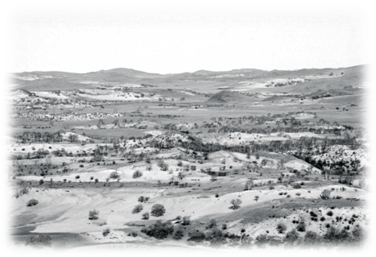
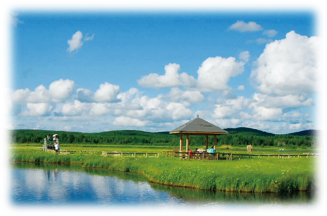
Look at the pictures of the Saihanba National Forest Park and describe its changes using it as an empty object where appropriate.
I think it a breakthrough to transform a desert into a forest…
1960s
nouns/adjectives
breakthrough
impossible
likely
unrealistic
…
to do /that
grow
investigate
plant trees
transform
…
present day

Slide 18



Review it as an empty object.
Describe how our school has changed using it as an empty object where appropriate.
·
·
.

