Slide 1


Learning Objectives
By the end of this class, we will be able to:
1. retrieve and summarize what happened to Macquarie Island by predicting and skimming ;
2. analyze the lessons we can learn from people’s action by deep understanding;
3. evaluate people’s action by critical thinking;
4. apply the sense of protecting our ecosysterm to our daily life and live in harmony with our ecosysterm .
Notes:
请注意：
1.正文标题为：黑体，30号字；
2.正文内容为：华文楷体，尽量不小于24号，特殊辅助性文字不低于18；根据文字量可适当调整。内容文字一行一般不能超过28个字，单页文字一般不能超过8行。
3.拍摄版本呈现内容务必与上传版本呈现的内容完全一致。
英文
1.正文标题为：以Times New Roman为主,可搭配使用Arial。字号为32—36号，特别强调可以用40号。
2.正文内容为：以Times New Roman为主,可搭配使用Arial。字号为24—28号，特别强调可用32号。
3.英文每行一般不能超过15个单词；单页文字一般不能超过8行。

Slide 2
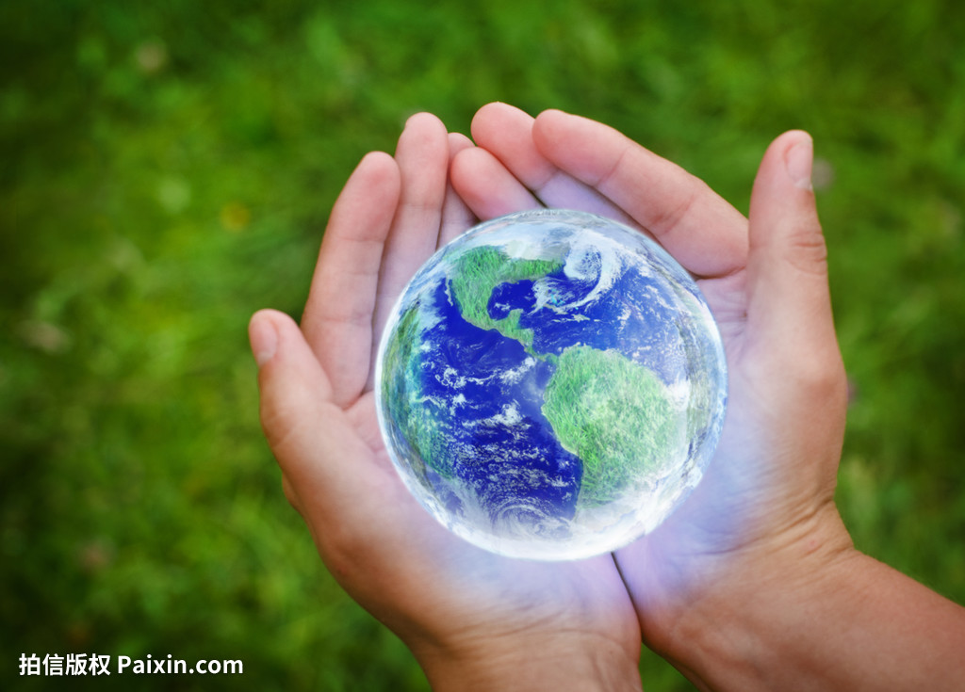
Unit 5 A delicate world
Understanding ideas

Slide 3
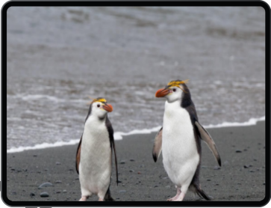
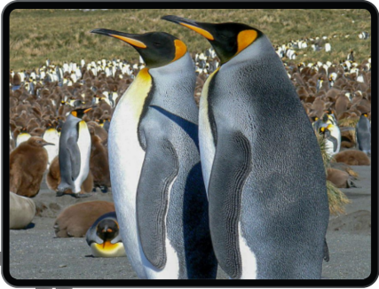
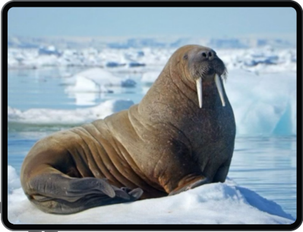
What animals are they?
Where do they live?
They all live in Macquarie Island.
royal penguins 皇家企鹅
king penguins 帝企鹅
elephant seals 海象
Notes:
请注意：
1.正文标题为：黑体，30号字；
2.正文内容为：华文楷体，尽量不小于24号，特殊辅助性文字不低于18；根据文字量可适当调整。内容文字一行一般不能超过28个字，单页文字一般不能超过8行。
3.拍摄版本呈现内容务必与上传版本呈现的内容完全一致。
英文
1.正文标题为：以Times New Roman为主,可搭配使用Arial。字号为32—36号，特别强调可以用40号。
2.正文内容为：以Times New Roman为主,可搭配使用Arial。字号为24—28号，特别强调可用32号。
3.英文每行一般不能超过15个单词；单页文字一般不能超过8行。

Slide 4
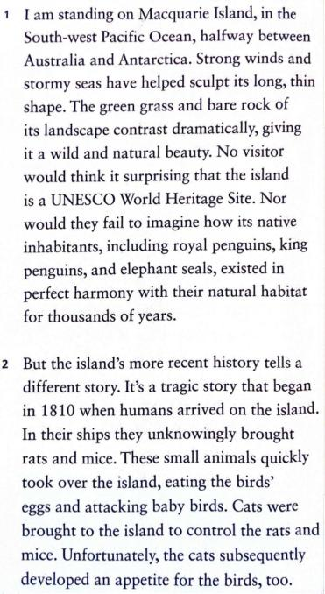
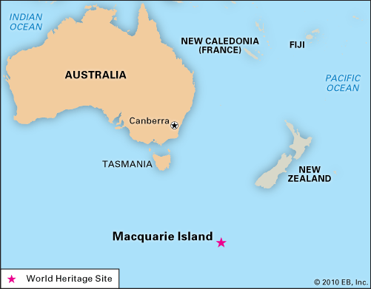
Read para.1 and find out from what aspects the author introduces Macquarie Island.
Macquarie Island
Notes:
请注意：
1.正文标题为：黑体，30号字；
2.正文内容为：华文楷体，尽量不小于24号，特殊辅助性文字不低于18；根据文字量可适当调整。内容文字一行一般不能超过28个字，单页文字一般不能超过8行。
3.拍摄版本呈现内容务必与上传版本呈现的内容完全一致。
英文
1.正文标题为：以Times New Roman为主,可搭配使用Arial。字号为32—36号，特别强调可以用40号。
2.正文内容为：以Times New Roman为主,可搭配使用Arial。字号为24—28号，特别强调可用32号。
3.英文每行一般不能超过15个单词；单页文字一般不能超过8行。

Slide 5
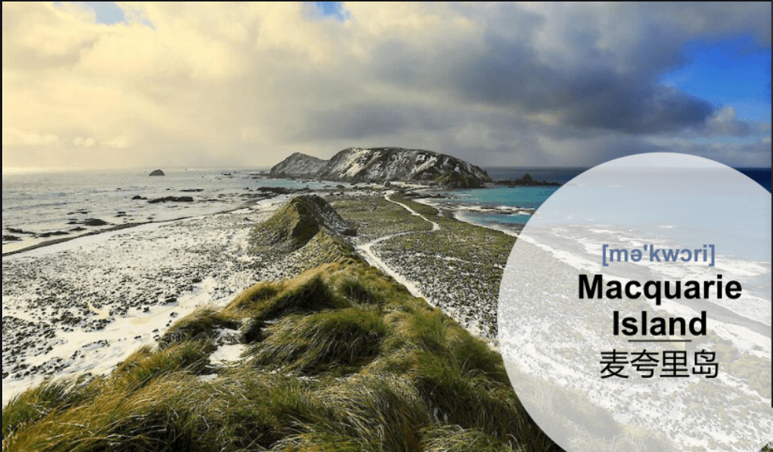
Read para.1 and find out from what aspects the author introduces Macquarie Island.
location
shape
Macquarie Island
Notes:
请注意：
1.正文标题为：黑体，30号字；
2.正文内容为：华文楷体，尽量不小于24号，特殊辅助性文字不低于18；根据文字量可适当调整。内容文字一行一般不能超过28个字，单页文字一般不能超过8行。
3.拍摄版本呈现内容务必与上传版本呈现的内容完全一致。
英文
1.正文标题为：以Times New Roman为主,可搭配使用Arial。字号为32—36号，特别强调可以用40号。
2.正文内容为：以Times New Roman为主,可搭配使用Arial。字号为24—28号，特别强调可用32号。
3.英文每行一般不能超过15个单词；单页文字一般不能超过8行。

Slide 6
Read para.1 and find out from what aspects the author introduces Macquarie Island.
location
shape
Macquarie Island
landscape
title
native
inhabitants
Notes:
请注意：
1.正文标题为：黑体，30号字；
2.正文内容为：华文楷体，尽量不小于24号，特殊辅助性文字不低于18；根据文字量可适当调整。内容文字一行一般不能超过28个字，单页文字一般不能超过8行。
3.拍摄版本呈现内容务必与上传版本呈现的内容完全一致。
英文
1.正文标题为：以Times New Roman为主,可搭配使用Arial。字号为32—36号，特别强调可以用40号。
2.正文内容为：以Times New Roman为主,可搭配使用Arial。字号为24—28号，特别强调可用32号。
3.英文每行一般不能超过15个单词；单页文字一般不能超过8行。

Slide 7
Read para.1 and underline the answer to the question.
Is Macquaria in good conservation?
Macquarie Island:
from Chaos to
Conservation
Notes:
请注意：
1.正文标题为：黑体，30号字；
2.正文内容为：华文楷体，尽量不小于24号，特殊辅助性文字不低于18；根据文字量可适当调整。内容文字一行一般不能超过28个字，单页文字一般不能超过8行。
3.拍摄版本呈现内容务必与上传版本呈现的内容完全一致。
英文
1.正文标题为：以Times New Roman为主,可搭配使用Arial。字号为32—36号，特别强调可以用40号。
2.正文内容为：以Times New Roman为主,可搭配使用Arial。字号为24—28号，特别强调可用32号。
3.英文每行一般不能超过15个单词；单页文字一般不能超过8行。

Slide 8
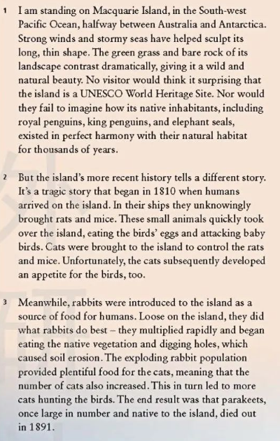
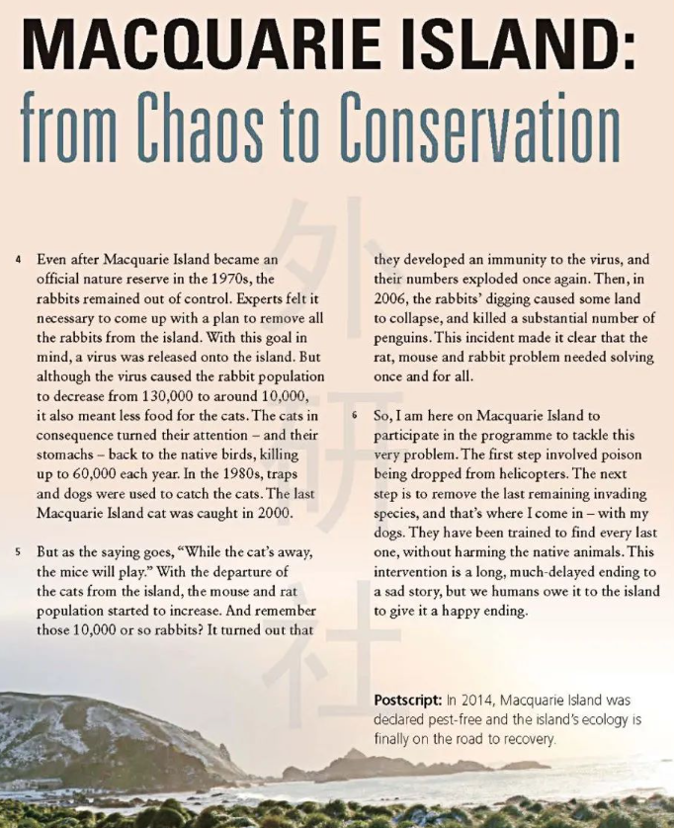
Look at the title and skim the passage to get the main idea and the strucure of the text.
The passage mainly talks about how Macquarie Island was saved from chaos.
Conservation(Paras 4-6)
Chaos
(Paras 2-3)

Slide 9
Group Work：
1.Read paragraph 2-6 according to your own role and draw an action-purpose-result flow chart to show the story of Macquarie Island basedd on the order of time.
2. Present the group work.

Slide 10
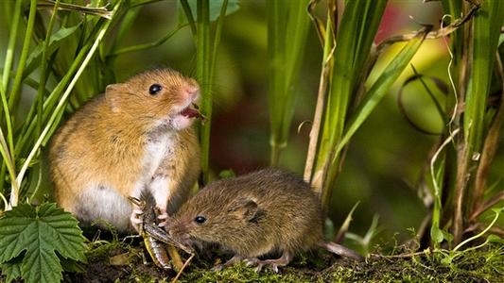
What happened to Macquarie Island in 1810？
_________________________________
Actions
Humans arrived on Macquarie Island
in 1810
Purposes
live there
To ____________________
1. ___________________ were brought there by accident.
2.These small animals quickly___________ the island,
eating the birds’ eggs and attacking baby birds.
Rats and mice
took over
Results

Slide 11
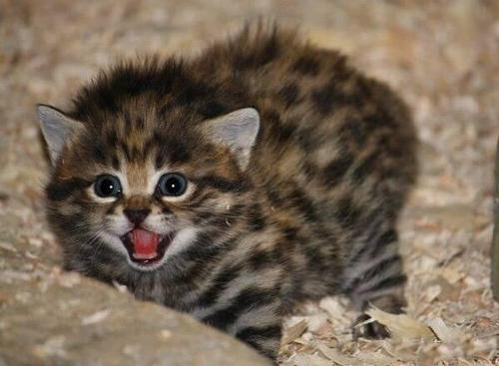
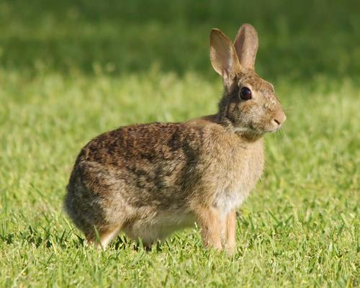
What happened to Macquarie Island from 1810 to 1891？
Cats were brought to the island.
1._________________________________
2._________________________________
Actions
Rabbits were introduced to the island .
control the rats and mice
from 1810 to 1891
1.To _______________________
2.To_________________________________ ___________________________________
Purposes
serve as a source of food for humans.
1.____________________________________________
2.Rabbits began eating the vegatation and digging holes, which_____________________
3. The rabbit provided plentiful food for the cats.
4.The number of cat also increased, leading____________
5. Parakeets died out in 1891.
The cats developed an appetite for the birds, too.
caused soil erosion.
Results
more cats hunting
the birds.
Lesson 1: People’s unknowing action may do severe damage to the ecosystem.

Slide 12
What happened to Macquarie Island in the 1970s？
Actions
A virus was released onto the island.
In the 1970s
Purposes
To___________________________________
remove all the rabbits from the the island.
1. The rabbit population decreased to 10,000, but it meant less food for the cats.
2. The cats ________________________________
Results
killed up to 60,000 native birds each year.

Slide 13
What happened to Macquarie Island in the 1980s?
Traps and dogs were used.
Actions
___________________________
In the 1980s
Purposes
catch the cats.
To___________________________________
1. The last Macquaire Island cat was caught in 2000.
2. With the departure of the cats, ________________________________
3.The rabbits population ____________________
Results
the mouse and rat started to increase.
exploded once again.

Slide 14
What happened to Macquarie Island in 2006?
1.____________________________________________
2.____________________________________________
The mouse and rat started to increase
Problems
The rabbits’ digging caused some land to collapse, and killed a substantial number of penguins.
In 2006
Purposes
the rats, mouse and rabbit problem once and for all.
To solve____________________________
Actions
......
Lesson 2: People’s action with good purpose may turn out the opposite.

Slide 15
What happened to Macquarie Island before 2014？
Actions
1. The first step is poison dropped from helicopters.
2. The next step is to ____________________
3.Dogs have been
trained to _________________
remove the last remaining invading species.
find every last species without harming the native animals.
before 2014
Purposes
To _______________________
tackle this very problem.
This intervention is a long, much-delayed ending to a sad story, but we humans _______________________
Results
owe it to the island to give it a happy ending.

Slide 16

What is your understanding of the sentence?
“This intervention is a long, much-delayed ending to a sad story, but we humans owe it to the island to give it a happy ending”.
???
???
It’s our responsibility to keep the balance of the ecosystem and save it from chaos.

Slide 17
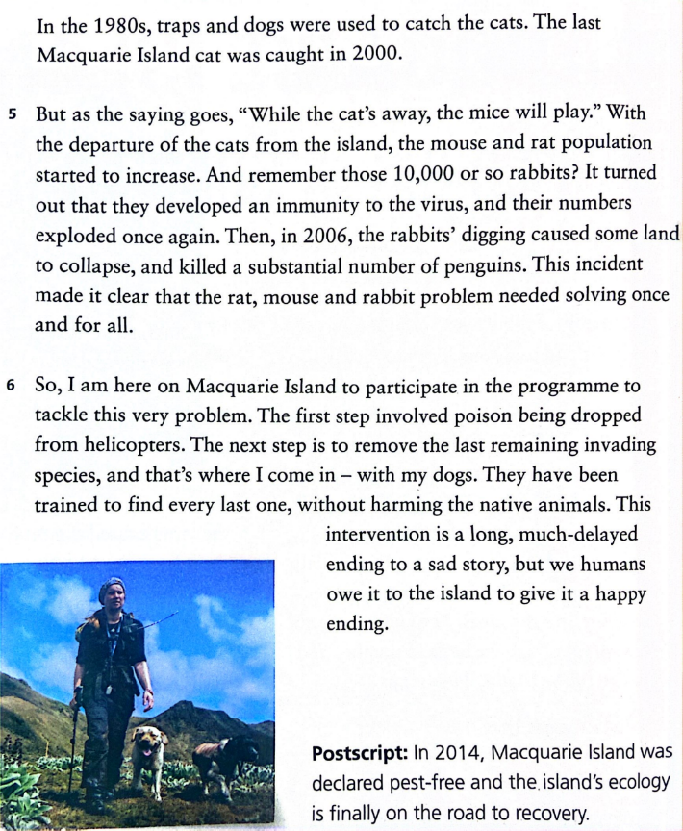
What happened to Macquarie Island in 2014?
Lesson 3: People’s action after thinking twice may help restore the ecosystem.

Slide 18
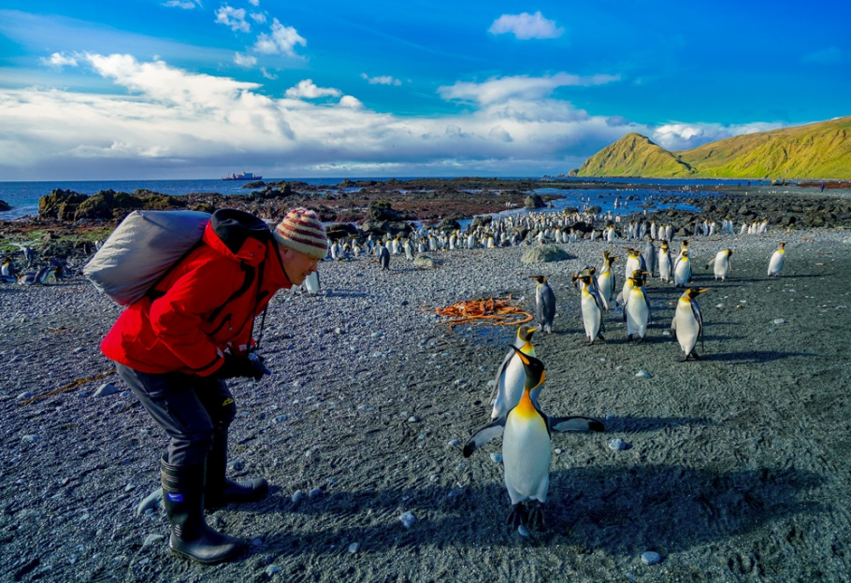
The relationship between human and ecosystem
Lesson 1: People’s unknowing action may do severe damage to the ecosystem.
Be aware.
Lesson 2: People’s action with good purpose may turn out the opposite.
Think twice before we do.
Lesson 3: People’s action after thinking twice may help restore the ecosystem.
Be brave to make up.

Slide 19
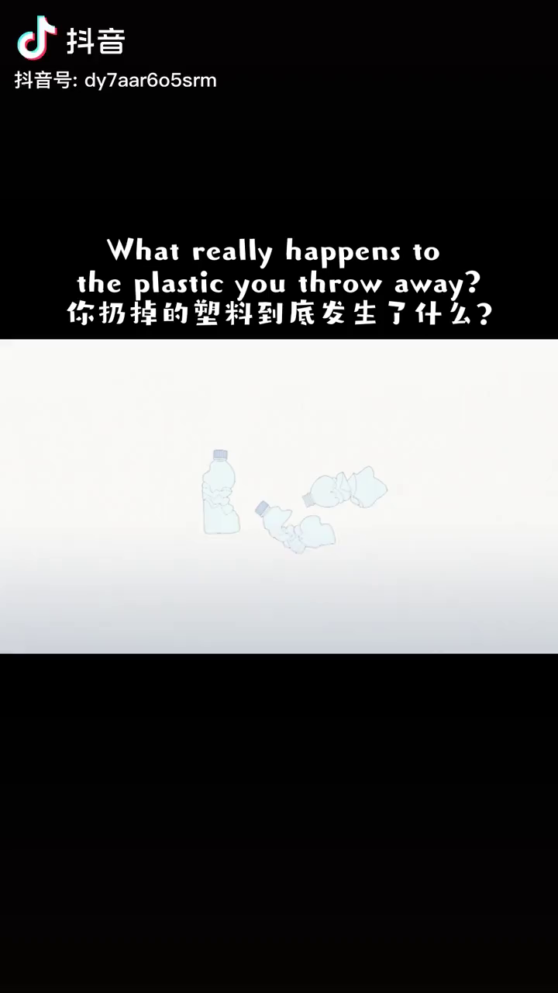

Slide 20

Group work: Should we say no to plastic objects in our daily life? Why?
Cooperation-list
Member 2: recorder
record the views and time
Member 3: creator
provide creative ideas
Member 4: coordinator
resolve conflicts or misunderstanding
Member 1: organizer
arrange the discussion
Member 5: presenter
share the ideas in the class

Slide 21

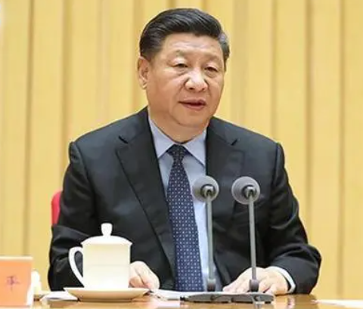

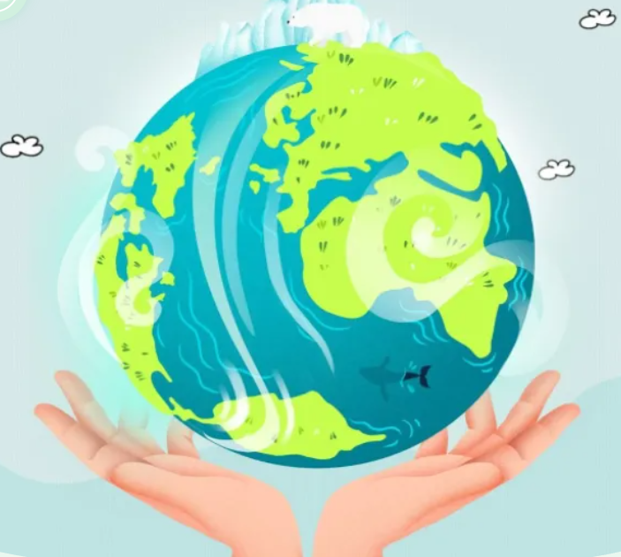

“Green Mountains Are Gold Mountains”.
National Ecology Day
The World Earth Day

Slide 22
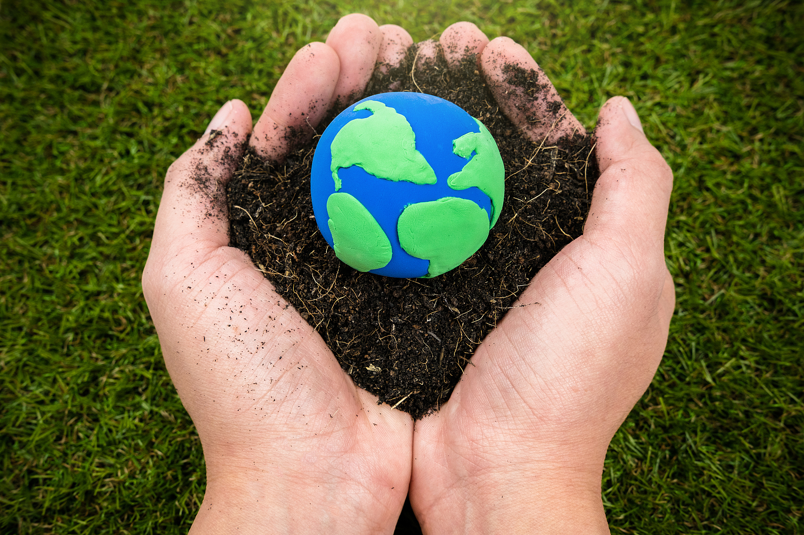
Protecting the ecosystem, we are taking action.

Slide 23
We can change a delicate world into a delicate world!

Slide 24
Make a self-evaluation on the performance on this lesson.
Check-list
Items | Content | Scores (1, 2, 3)
1. Actions | I can talk about what happened in the Macquaria Island.
2. Results | I can summarize how people’ actions affect the ecosystem.
3. Purposes | I can analyze the reasons for the change of people’s action.
4. Feeling | I can respect the ecosystem and live in harmony with the ecosystem.
Reflection | What I have learned:___________________________________________________ What I want to learn more about:________________________________________

Slide 25

Homework
Find out more news about the destruction and the conservation of the ecosystem online.
Basic
Expanding
Design a poster on the theme of “Ecosystem-our home” and write your opinions on how to protect it in your daily life.

