Slide 1
B5U6
Developing ideas

Slide 2
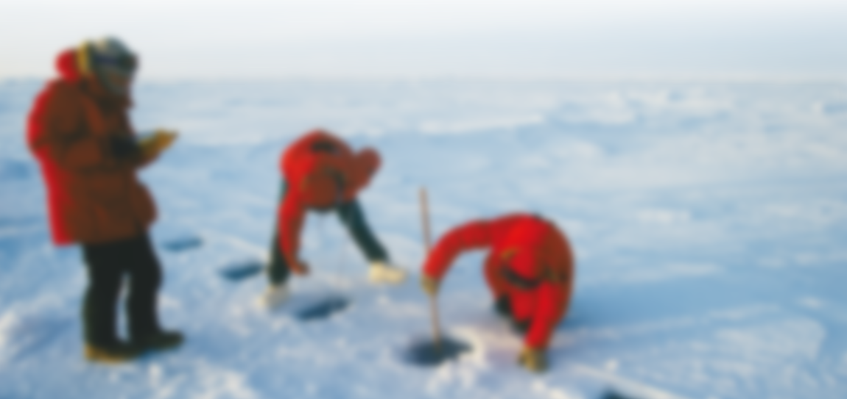
Pre-reading (P61)
Watch the video and answer the questions.
1 Where do people in the video live?
2 What difficulties do they face?
Activity 2

Slide 3


Slide 4
Pre-reading (P61)
Watch the video and answer the questions.
1 Where do people in the video live?
The people in the video live in the Antarctica.
2 What difficulties do they face?
They have to endure extreme weather including freezing temperatures, fierce winds and strong blizzards. When they go outside the stations, they wear special clothes for protection. As weather can change from calm to white-out in minutes, people have to take a special survival bag in case they are trapped outside overnight.
Activity 2

Slide 5
Pre-reading (P61)
Activity 2
2 What difficulties do they face?
One of the most difficult things is the long days and nights. They may cause issues with the scientists’ body clocks. The darkness also makes outdoor research impossible.
It is almost impossible to grow fresh produce there because of the extreme conditions, and most food is imported. It is difficult for scientists to have a varied diet, and they can’t get enough fresh fruit and vegetables.
They have to face psychological problems. To keep the scientists psychologically healthy, research stations offer activities and entertainment including live music and lectures.

Slide 6
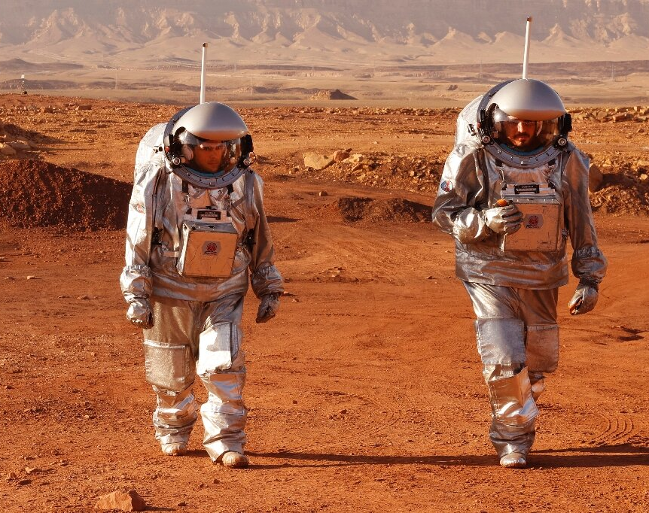
Pre-reading
If people were to live on Mars, what difficulties might they face?

Slide 7
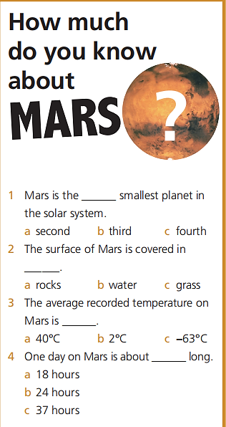
Pre-reading
Do you really know about Mars?
Activity 1

Slide 8
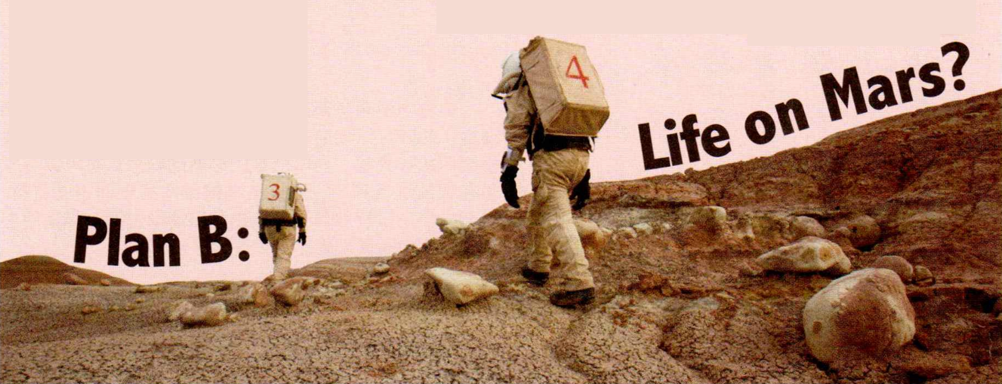
Pre-reading
1 What is Plan A? Why is Plan B needed?
2 Why Mars?

Slide 9
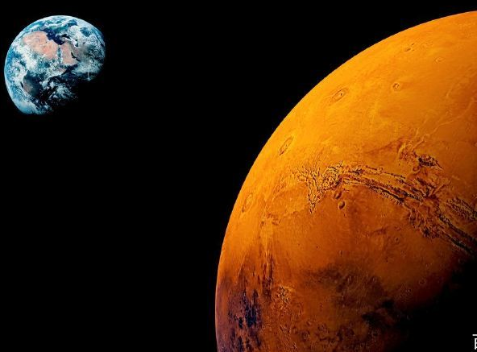

While-reading
Read and check your prediction.
Risks
Para. 1 _______ to life on Earth
In the 1960s and 1970s, the greatest fear was that… could be wiped out by nuclear missiles.
Today, however, environmental problems have taken over as the greatest risk to life on Earth.
Plan A
Plan B
Why Mars
Para. 2 _____________?
less hostile
/ˈhɒstaɪl/
Mars is relatively close to Earth and has a ____________ environment than that of other planets.

Slide 10
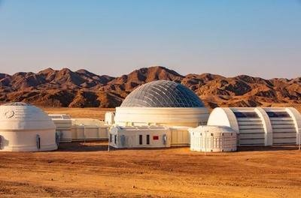
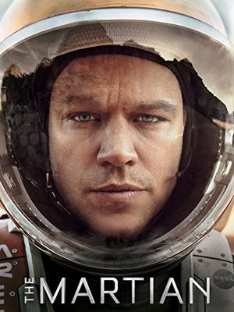
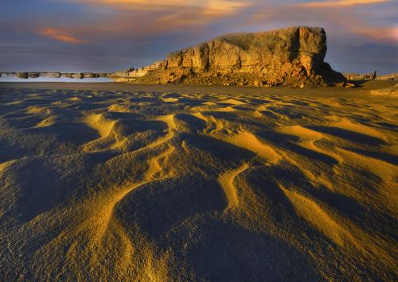
While-reading
Plan B: Life on Mars?
Para. 1 Risks to life on Earth
nuclear missiles → environmental problems
Para. 2 Why Mars?
less hostile
How far have we gone in exploring Mars?
They are mentioned to ___________________________________
_________________________________.
show that our interest in Martian exploration is greater than ever before
Mars Desert Research Station
Mars Village in North-west China’s Qinghai Province

Slide 11
While-reading
Plan B: Life on Mars?
Para. 1 Risks to life on Earth
nuclear missiles → environmental problems
Para. 2 Why Mars?
less hostile
greater interest in Martian exploration
Efforts
Para. 3-4 _______ in exploring Mars
Para. 3:
Since the 1960s, we have been sending unmanned spacecraft to Mars.
… space agencies of various countries are planning manned missions to Mars…
Para. 4:
Staying alive… will not be impossible.
Scientists have succeeded in growing plants in an environment similar to that on Mars.

Slide 12
While-reading
Plan B: Life on Mars?
Para. 1 Risks to life on Earth
nuclear missiles → environmental problems
Para. 2 Why Mars?
less hostile
greater interest in Martian exploration
Para. 3-4 Efforts in exploring Mars
spacecraft & missions
possibilities
Does it mean we give up Plan A?
Para. 5 “We need to take much better care of our own planet.”

Slide 13
While-reading
In which magazine would you most likely find the passage?
1 The Traveller
2 All About Space
3 Environmental Concerns
4 Biology for Fun
Activity 3

Slide 14
While-reading
to form opinions and draw conclusions based on given information
Choose the statements that can be inferred from the passage.
1 Humans have yet not visited Mars.
2 People want to go to Mars on holiday.
3 There are plants growing on Mars.
4 The greatest to life on Earth used to be nuclear missiles.
5 One day, humans will have to go and live on another planet.
6 Our Plan A includes developing renewable energy resources.
7 The Biosphere 2 experiment ended in failure.
Activity 4
inferred from para. 3
inferred from para. 1
inferred from para. 1
inferred from para. 4

Slide 15
Reading techniques
How do we identify an inference question?
“According to the passage, we can reasonably infer…”
“Based on the passage, it could be suggested that…”
“Which of the following statements is best supported by the passage?”
“The passage suggests that this primary problem…”
“The author seems to imply that…”
“With which of the following statements would the author most likely agree?”
infer, imply, suggest, support, agree...

Slide 16
Language points – Para. 1
that
In the 1960s and 1970s, the greatest fear was _______ the human race, and possibly all advanced life forms on the planet, could be wiped out by nuclear missiles, just at the push of a button.
表语从句，在句子中充当表语，表语从句常用的引导词是 that, what, which, who, how, whether, if 等。
麻烦的是我把信给弄丢了。
The trouble is that I have lost the letter.
这就是我能为你做的。
This is what I can do for you.
当表语从句不缺成分时，可选用引导词 that；
当表语从句缺少主语、宾语或表语时，用what 引导表语从句。

Slide 17
表语从句练习
The reason is _______ she got up late this morning.
This is _______ she has always done for this school.
Next month is _______ the project will be launched.
The point is _______ can be done to stop this accident from happening again.
This is exactly _______ she is absent from school these days.
that
what
when
what
why

Slide 18
Language points – Para. 1-2
彻底摧毁；消灭
按下按钮
接任成为对生命最大的威胁
地球上；世界上
降低风险
用可再生能源取代煤炭和石油
做最坏的打算
可怕的场景
努力去做某事
在全世界范围内受欢迎
在某事上对某人予以教育
wipe out
at the push of a button
take over as the greatest risk to life
on Earth
lower the risk
replace coal and oil with forms of renewable energy
prepare for the worst
terrifying scenes
enjoy worldwide popularity
make efforts to do sth.
educate sb. on sth.
on earth 究竟；到底

Slide 19
Language points – Para. 3
一直在向……发射无人飞船
环绕星球运行
有价值的数据
令人惊叹的照片
stun vt.
他在这件事上的观点让我很震惊。
His view on this matter stunned me greatly.
stunned adj.
在峰顶看到的景色使他们惊叹不已。
They were stunned by the view from the summit.
have been sending unmanned (adj.) spacecraft to
orbit the planet
valuable data
stunning (adj.) images
使震惊（或惊愕）；给（某人）以深刻印象
震惊的；惊讶的；惊叹的

Slide 20
Language points – Para. 3
一直在向……发射无人飞船
环绕星球运行
有价值的数据
令人惊叹的照片
stun vt.
他在这件事上的观点让我很震惊。
His view on this matter stunned me greatly.
stunned adj.
在峰顶看到的景色使他们惊叹不已。
They were stunned by the view from the summit.
have been sending unmanned (adj.) spacecraft to
orbit the planet
valuable data
stunning (adj.) images
使震惊（或惊愕）；给（某人）以深刻印象
震惊的；惊讶的；惊叹的

Slide 21
Language points – Para. 4
Staying alive will be a daily challenge, but as proved by the Biosphere 2 experiment, not impossible.
生存将是每天的挑战，但正如“生物圈2号”实验所证明的，并非不可能。
包含
被设计用……运行
为我们提供了更好的理解
成功做成
各种各样的
consist of
be designed to function with
provide us with a better understanding of
succeed in doing
a variety of

Slide 22
Language points – Para. 5
For now, human settlement of Mars is decades away.
就目前而言，人类在火星定居还需要几十年的时间。
与此同时
对……有可怕的影响
照顾好
in the meantime
have a terrible effect on
take good care of

Slide 23
Writing a survival story
Read the story and answer the questions.
1 Where is the person in the story?
The person in the story is on Mars.
2 What difficulties is he facing?
He has to keep himself safe from the deadly radiation outside. And he is facing the lack of water, oxygen and food.
3 What has he already done to stay alive?
He has resumed communication with the base. He has discovered an underground ice deposit to get water, and produce oxygen with the water.
4 What will he do next?
He will work out how to farm on Mars and grow plants with seeds.
Activity 6

Slide 24
Language points – P71
left
It’s been a week since the other astronauts ______ (leave) Mars and ______ (go) back to Earth, accidentally leaving me here alone.
撇下……一个人；不管；别碰
与……失去联系
与基地恢复联系
It will be eight months _______ a rescue mission arrives from Earth.
保护我免受致命的辐射
由……驱动
一个核电站
使……安全，免受
暴露在，接触
依次，逐一，每次
leave… alone
lose contact with
resume communication with the base
protect me from the deadly radiation
is powered by
a nuclear plant
keep sb. safe from sth.
exposure to
at a time
went
before

Slide 25
Language points – P71
地下冰沉积物
deposit n.
a layer of a substance that has formed naturally underground
（地下自然形成的）沉积物，沉积层
勘测工具
某人存货不足
某物快用完
缺乏……；离……不远
如果电能供应能够稳住
an underground ice deposit
survey tools
sb. run low
sth. run low
be short of
if the electricity supply holds, …

