Slide 1
Survival
Book 5 Unit 6

Slide 2
B5U6
Understanding ideas
The Wild Within

Slide 3
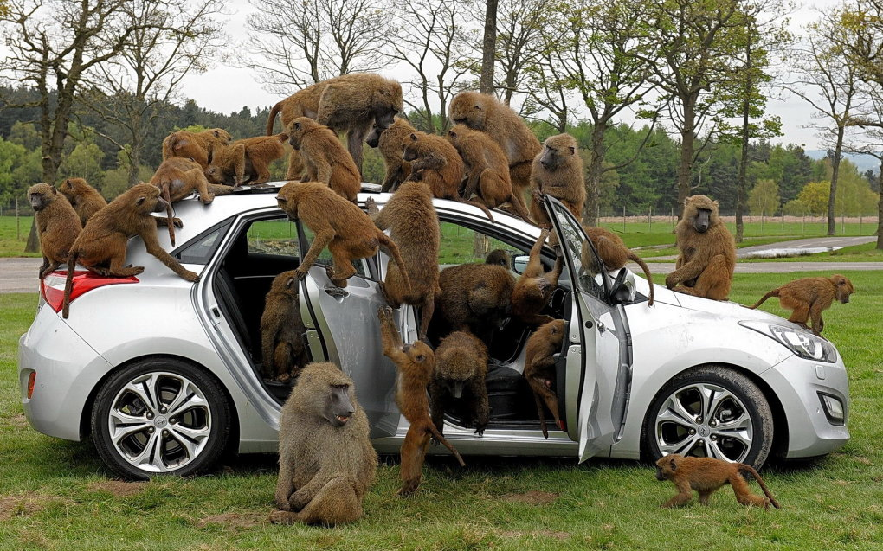
This was no ordinary criminal: it was a chacma baboon (豚尾狒狒).
The crime took place in a seaside suburb of Cape Town. Spotting the car with its window left open, the greedy thief didn’t hesitate. Within seconds, he had reached inside and run away with a bag of shopping. No matter how many crimes he committed, the police were powerless to arrest him…

Slide 4
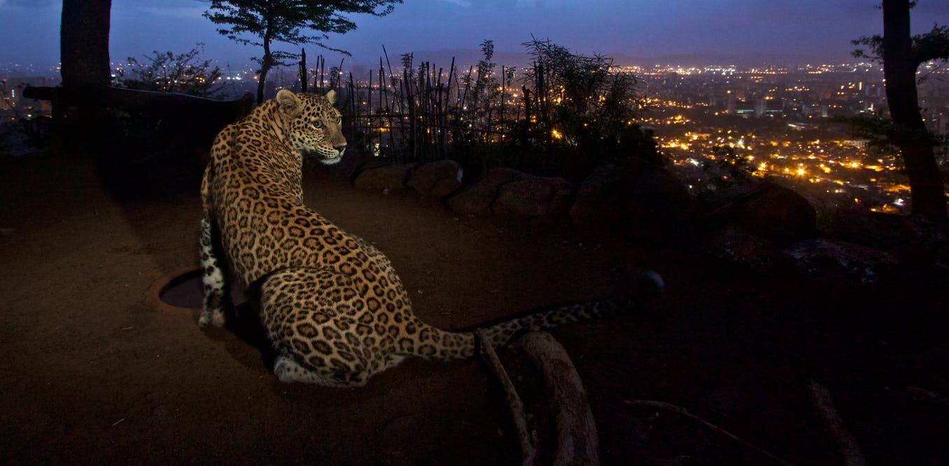
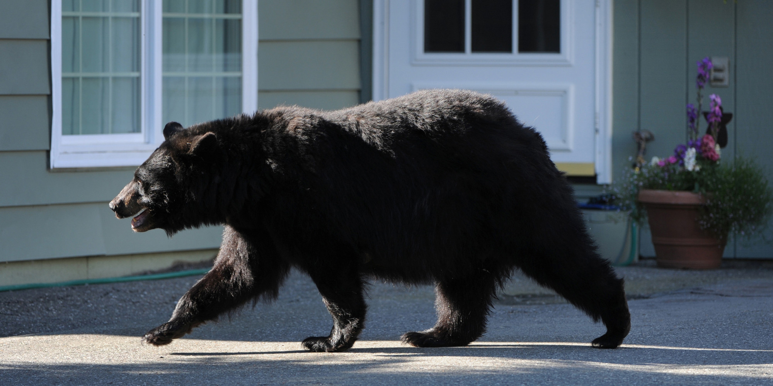
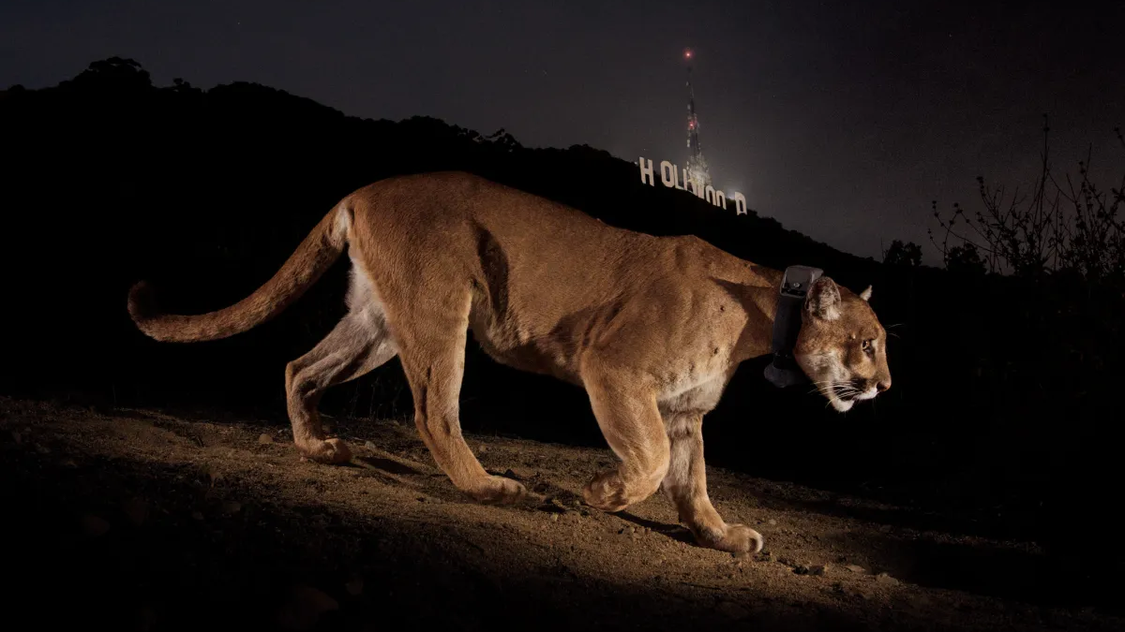
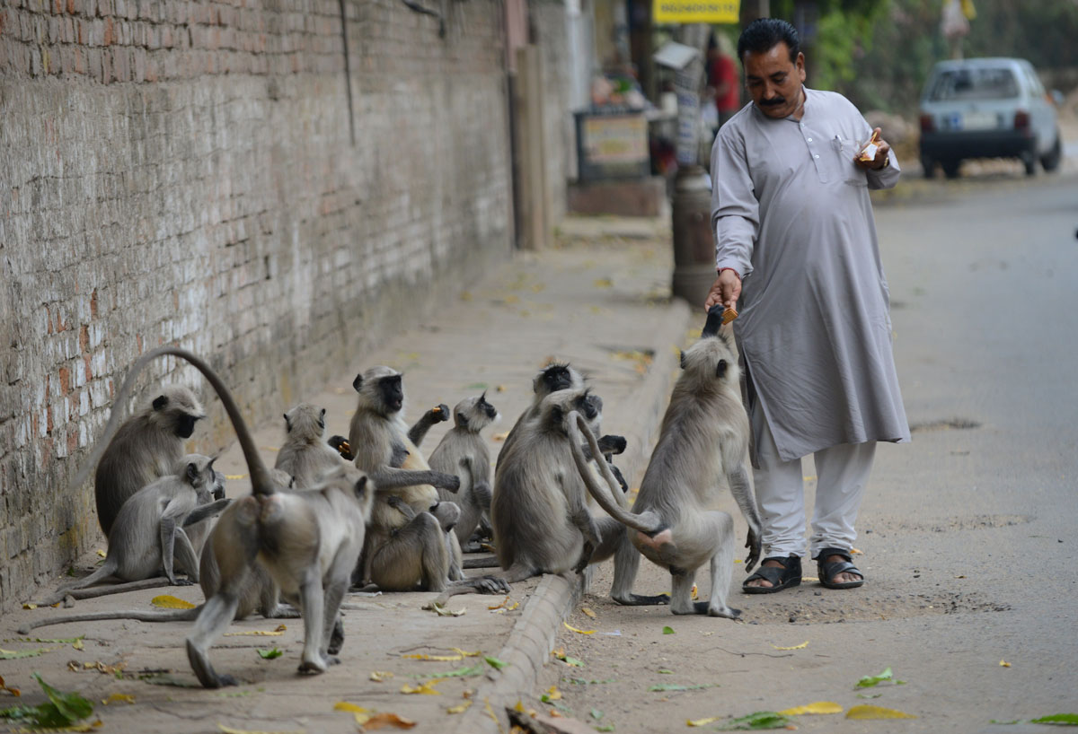
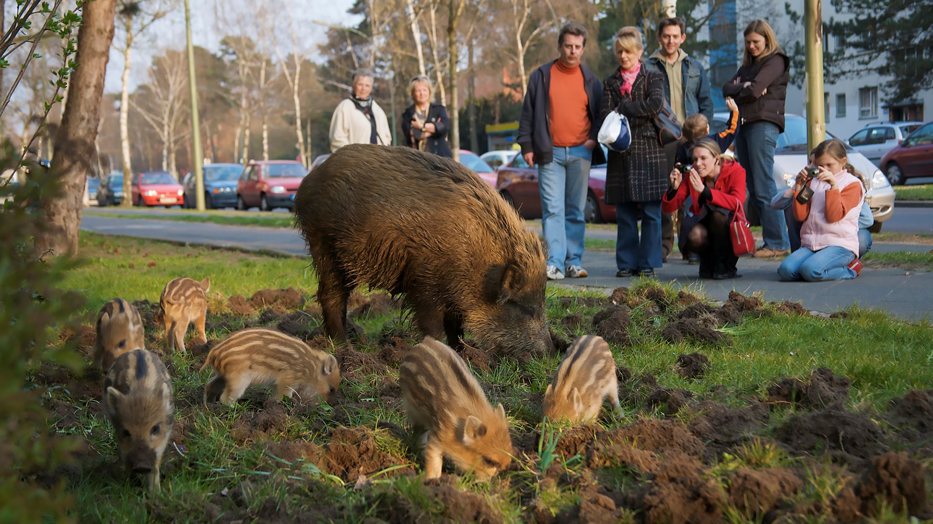
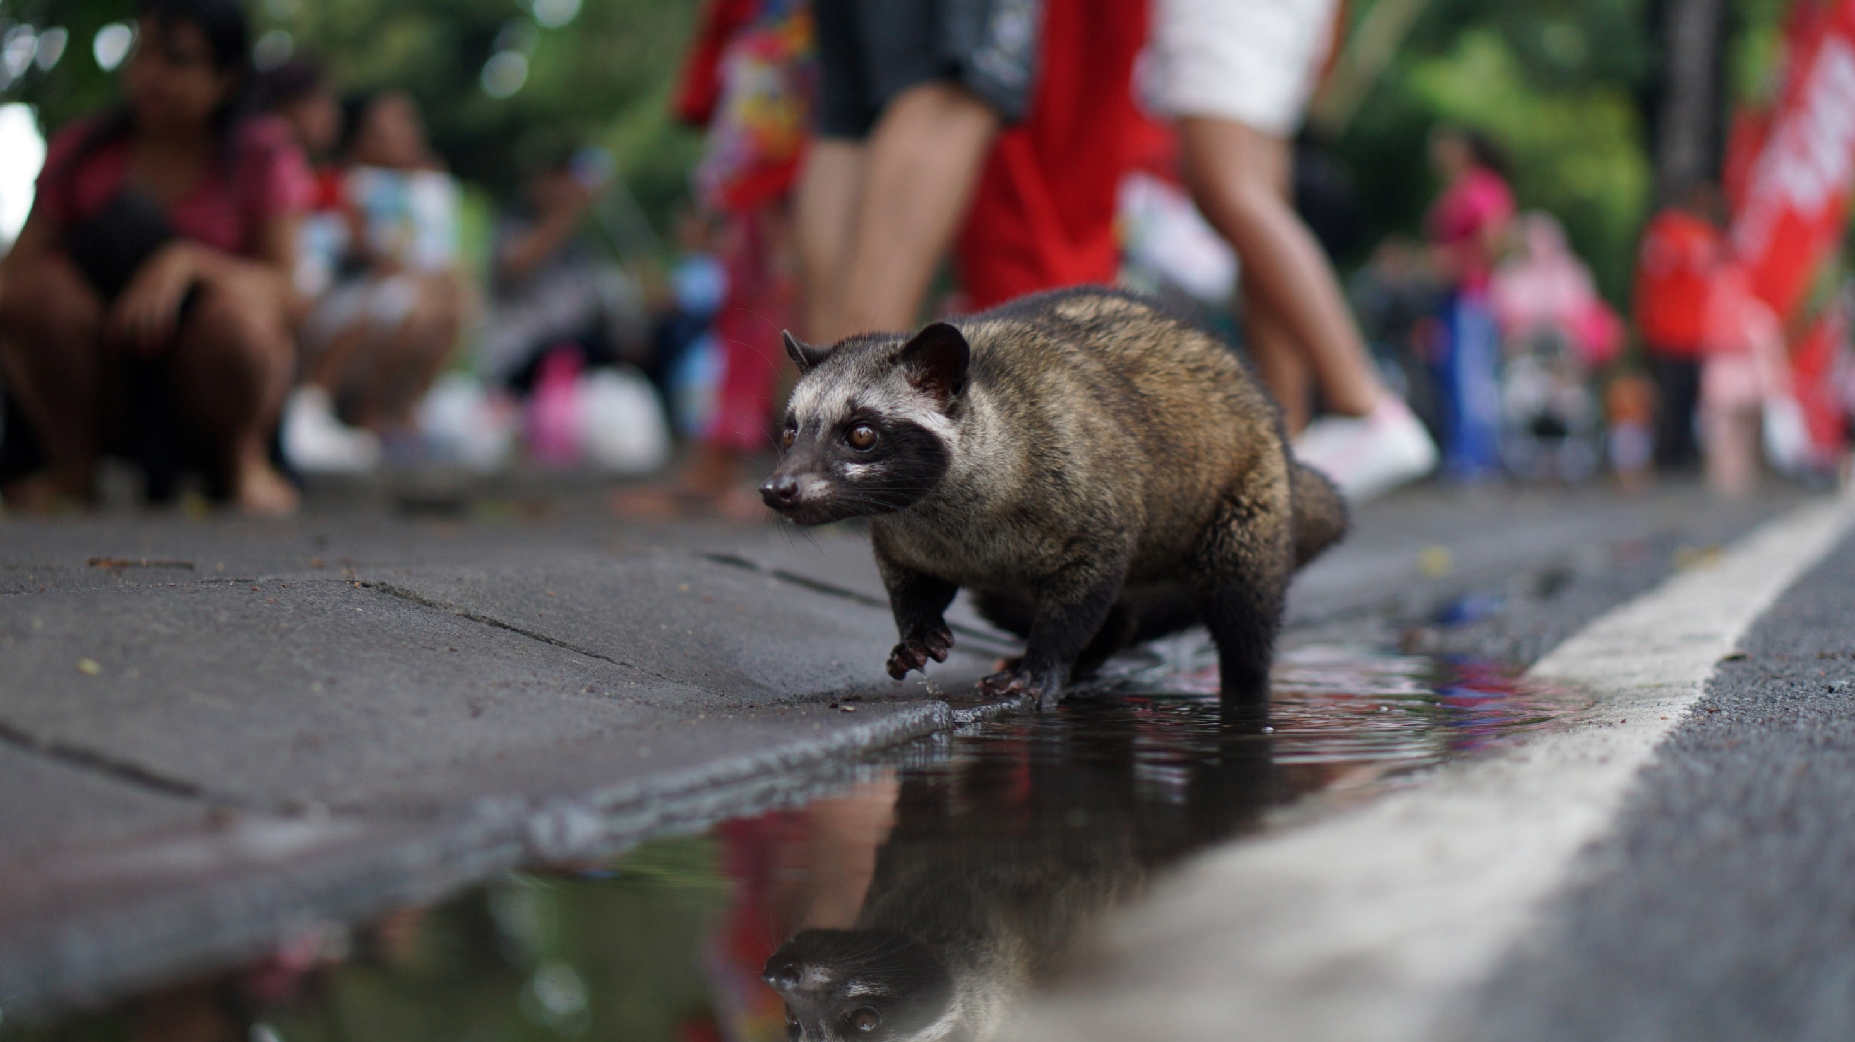

Slide 5
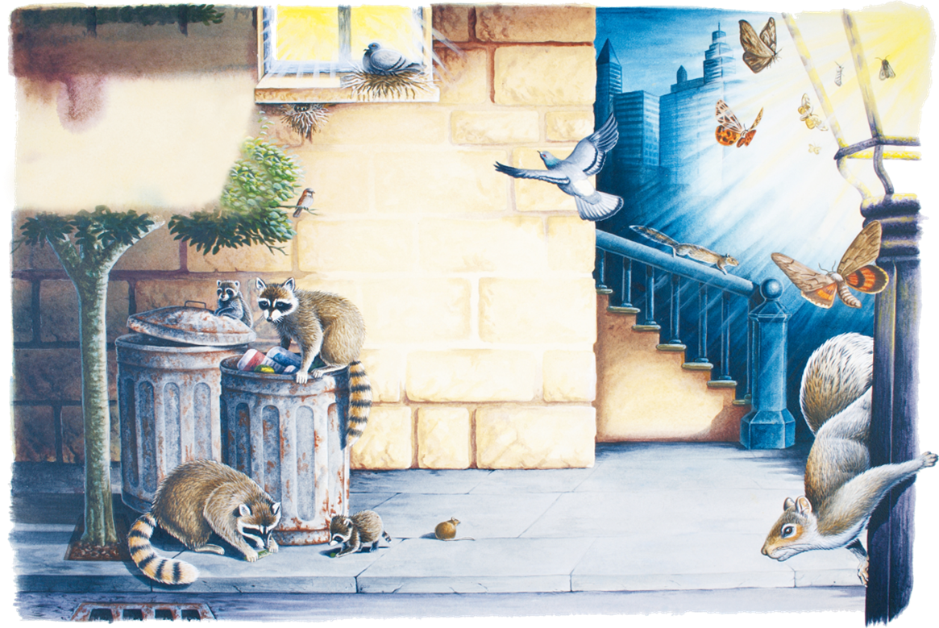
Predicting
From what aspects might the author talk about wild animals in cities?
The
Wild
Within

Slide 6
Fast reading
Read the passage and check your predictions (3 min).
The
Wild
Within

Slide 7
Fast reading
Match the topic sentences to the paragraphs (1 min).
Paragraph 2
One thing crucial to the increasing number of “urban animals” is their ability to adapt.
People often wonder about the reasons behind this mass urban migration.
For those animals that don’t adapt, the city can be a dangerous or even deadly place.
Yet, for its newest and wildest inhabitants, a city can offer many benefits.
Paragraph 3
Paragraph 4
Paragraph 5

Slide 8
Detailed reading
Underline the supporting details and summarise them with key words (3 min).
wildlife taking over cities
reasons for entering cities
The
Wild
Within
benefits of living in cities
animals’ adaption to cities
problems for some animals
attitudes towards urban animals

Slide 9
Detailed reading
Underline the supporting details and summarise them with key words (3 min).
wildlife taking over cities
“Out of reach from many of their natural predators, these newcomers often flourish in their new city lives.”
urban development
climate change
habitat loss
reasons
appealing spaces
absence of predators
sufficient food
The
Wild
Within
benefits
adaption
becoming more intelligent
changing living habits
problems
window impacts
attitudes
understanding/appreciating/sharing

Slide 10
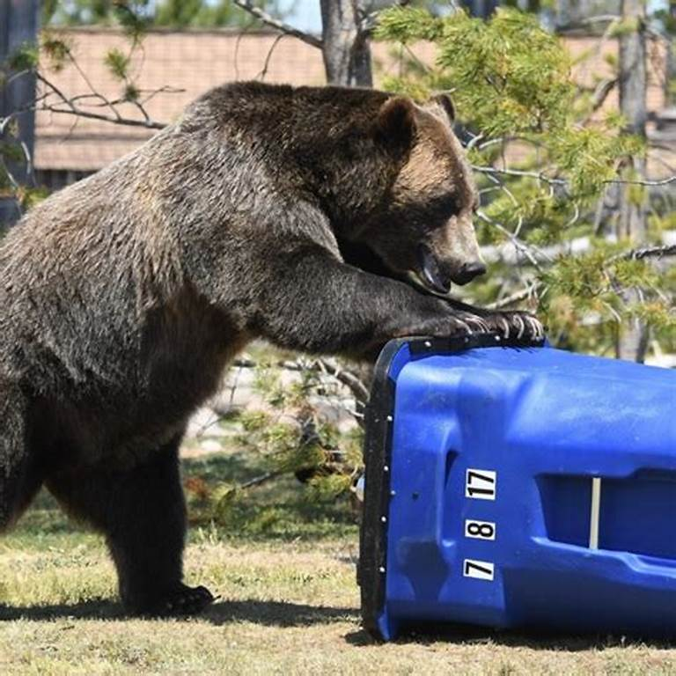
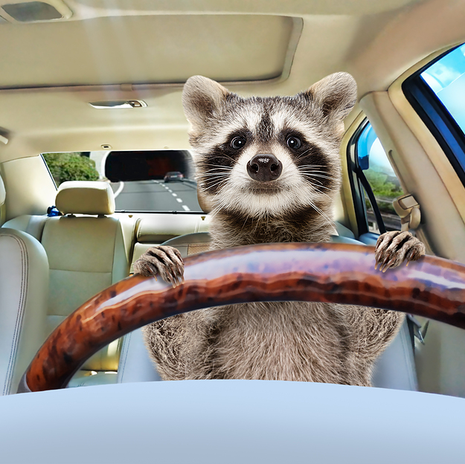
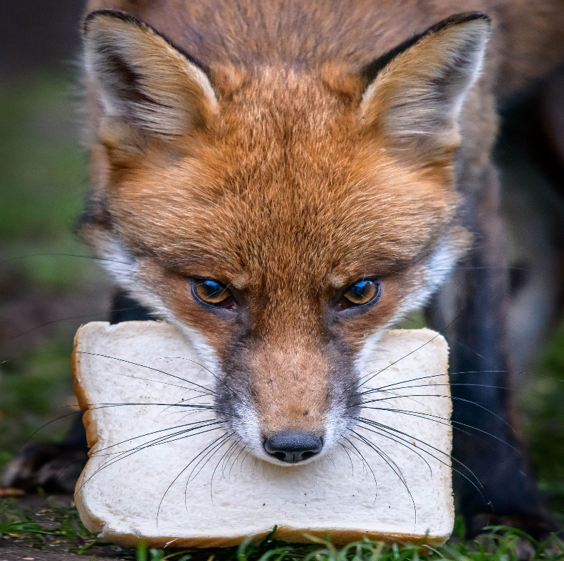
Critical thinking
What are the qualities of successful urban wildlife survivors?
Resourceful
Intelligent
Adaptable

Slide 11
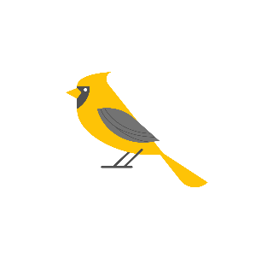
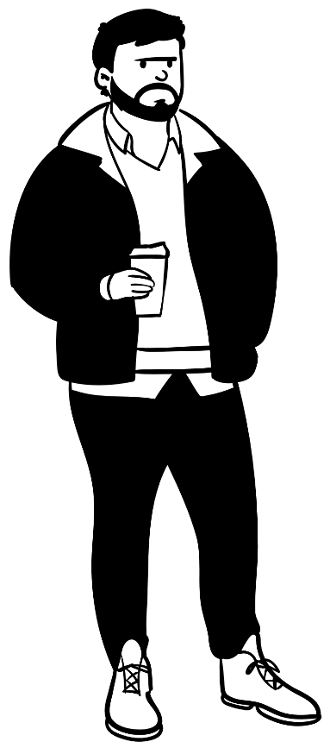
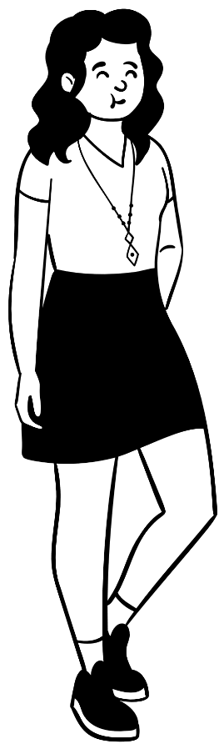
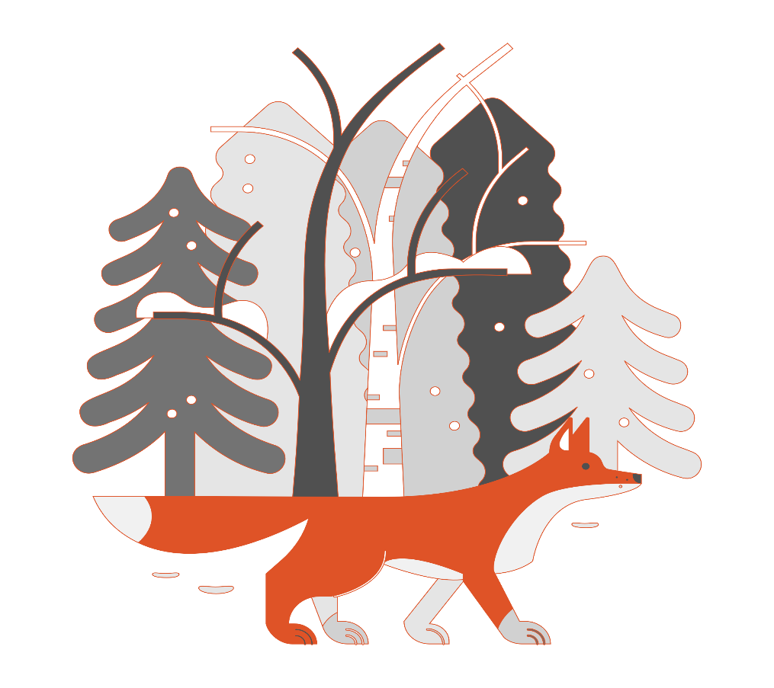
Critical thinking
Should we restrict urban development to protect wildlife in cities?
sharing
balance
adapting

Slide 12
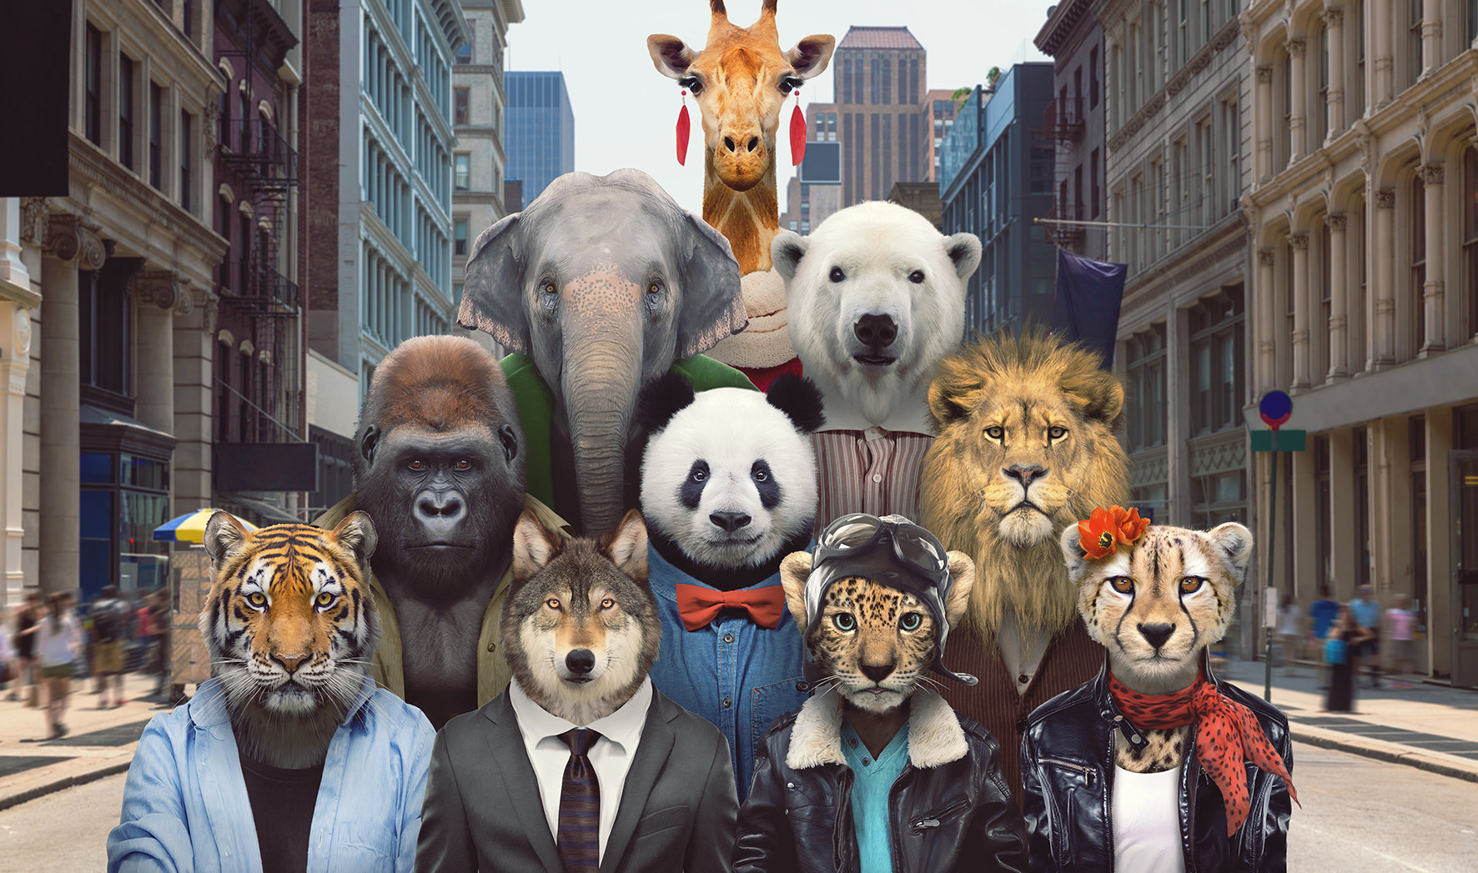
“Each and every animal on earth has as much right to be here as you and me.”
– Anthony Douglas Williams
Survive and thrive!

Slide 13
Language points – Para. 1
遇到问题
__________ (spot) the car with its window left open, the ________ (greed) thief didn’t hesitate.
= When he spotted the car…
立刻；马上
逃离；逃避
犯罪
无力做某事
Once almost _________ (hear) of, scenes like this one in Cape Town are now common all over the world.
= Once they were unheard of, …
控制；接管
encounter a problem
within seconds
run away
commit a crime
be powerless to do sth.
take over
Spotting
greedy
unheard

Slide 14
Language points – Para. 2
assume
Most of us would ________ (假定；认为) that urban development and climate change are responsible for _______ the animals ______ (把……赶出) their habitats.
无论这有多么真实可信，……
____ we humans _________ have moved into their _______ (领地).
无论它们走到哪里，……
挡住去路
别无选择，只能……
pushing
out of
However true this is, …
Wherever they go, …
in one’s way
have no choice but to do
It’s
who/that
territory

Slide 15
Language points – Para. 3
为动物提供越来越有吸引力的空间
翻译：这些新来者远离天敌，在新的城市生活中茁壮成长。
Out of reach from many of their natural predators, these newcomers often flourish in their new city lives.
= Because they are out of reach…
在建设中
扔掉剩饭剩菜
offer increasingly appealing spaces to animals
under construction
throw away leftovers

Slide 16
Language points – Para. 4
对……至关重要
There is evidence ______ urban raccoons are more intelligent than their wild cousins, …
解决；算出；理解
打开垃圾箱
在野外
改变某人的生活习惯
适应
Although naturally active at night, urban foxes come out in daylight…
= Although they are naturally active at night,…
从垃圾中品尝多元文化的美食
提供的；供出售的
be crucial to
figure out
open rubbish bins
in the wild
change sb.’s living habits
fit in with
get a taste for the multicultural cuisine on offer from the garbage
that

Slide 17
Language points – Para. 4-5
lamb kebabs /kɪ'bæb/
garlic bread
区分……
撞到……上
以……的速度
死于撞击窗户
impact n.
Translate: __________ (shock), these deaths __________ (总计，共计；相当于) around ten percent of the total US bird population.
令人震惊的是，这些死亡的数量相当于占了美国鸟类总数的10%左右。
羊肉串
蒜蓉面包
distinguish between…and
crash into
at speeds of/at a speech of
die from window impacts
the act of one object hitting another
Shockingly
amount to

Slide 18
Language points – Para. 5-6
翻译：这些鸟还没有改变它们的迁徙路线，它们要穿过高楼林立的城市。
These birds have yet to change their migratory routes that take them through cities with high-rise buildings.
____________________ (无论它们如何适应) our ways of urban living, it’s important that we __________________________ (更好的了解……) and even learn to appreciate our wild neighbours.
为……做准备；趋向于；期望
不管这些物种进入我们城市的原因是什么，……
Whatever the reasons behind these species entering our cities, …
一种方式
However they adapt to
get a better understanding of
look towards sth./doing sth.
a means of

Slide 19
Language points – Para. 6
Only then can we look towards harmoniously sharing our urban habitats.
只有这样，我们才能和谐地共享我们的城市栖息地。
only放在句首修饰状语时，主句采用部分倒装的形式。具体形式是：only + 状语 + 助动词 + 主语 + 谓语动词 + ……
只有到那个时候你才知道后果。
Only then will you know the outcome.
只有用这种方式，你才能实现你的梦想。
Only in this way can you realise your dreams.
只有当你专心做事的时候，才能实现高效率。
Only when you are focused on the things can you achieve a high level of efficiency.
副词
介词短语
状语从句

