Slide 1
B5U6
Using language

Slide 2
Adverbial clauses with -ever and no matter
Activity 1
a Wherever they go, animals find towns and cities in their way.
b Animals always find towns and cities in their way as they go.
c No matter how many crimes he committed, the police were powerless to arrest him.
d Even though he committed many crimes, the police were powerless to arrest him.
1 What is the difference between the sentences in each group?
2 What is the meaning of -ever and no matter? Why does the author choose to use sentences (a) and (c)?
3 What other words can be combined with -ever and no matter to form adverbial clauses?

Slide 3
Adverbial clauses with -ever and no matter
Activity 1
a Wherever they go, animals find towns and cities in their way.
b Animals always find towns and cities in their way as they go.
c No matter how many crimes he committed, the police were powerless to arrest him.
d Even though he committed many crimes, the police were powerless to arrest him.
1 What is the difference between the sentences in each group?
Sentences (a) and (c) are more emphatic. Sentences (b) and (d) state facts without any particular emphasis.

Slide 4
Adverbial clauses with -ever and no matter
Activity 1
a Wherever they go, animals find towns and cities in their way.
b Animals always find towns and cities in their way as they go.
c No matter how many crimes he committed, the police were powerless to arrest him.
d Even though he committed many crimes, the police were powerless to arrest him.
2 What is the meaning of -ever and no matter? Why does the author choose to use sentences (a) and (c)?
-ever and no matter mean that something is true or happens in all circumstances. Sentences (a) and (c) are used to stress that animals cannot avoid towns and cities encroaching upon their habitats, and that the police had no power to arrest the thief, regardless of his crimes.

Slide 5
Adverbial clauses with -ever and no matter
Activity 1
a Wherever they go, animals find towns and cities in their way.
b Animals always find towns and cities in their way as they go.
c No matter how many crimes he committed, the police were powerless to arrest him.
d Even though he committed many crimes, the police were powerless to arrest him.
3 What other words can be combined with -ever and no matter to form adverbial clauses?
-ever: whoever, whomever, whatever, whichever, whenever, however
no matter: no matter who/whom/what/which/when/where/ whether/if/how, etc.

Slide 6
Adverbial clauses with -ever and no matter
Activity 2
Now look for more examples in the reading passage and summarise their uses in your own words.
However they adapt to our ways of urban living, it’s important that we get a better understanding of…
However true this is, we also need to consider that some of these so-called “urban animals” have never moved at all – it’s we humans who have moved into their territory.
Whatever the reasons behind these species entering our cities, one thing is…
疑问词 + ever 和 no matter + 疑问词引导的状语从句
二者的语义相同，都意为“无论……, 不管……”，均可引导让步状语从句，在句子中起强调、加强语气的作用。
“疑问词 + ever”=“no matter + 疑问词”么？

Slide 7
疑问词 + ever 和 no matter + 疑问词引导的状语从句
1 “疑问词 + -ever”和“no matter + 疑问词”引导让步状语从句时，从句可以位于主句之前或之后，且从句要用一般时来表将来。
No matter how hard you try, loss is something you have to accept.
= However hard you try, loss is something you have to accept.
Whatever happens, I’ll help you.
= No matter what (happens), I’ll help you.
无论什么代价，我们都必须救她。
We must save her, whatever the cost (is).
注意：二者一般不与why连用。
Whatever the reason, you should apologise.
从句的动词有时候可以省略。

Slide 8
疑问词 + ever 和 no matter + 疑问词引导的状语从句
2 “疑问词 + ever”还可用来引导主语从句、宾语从句或表语从句等名词性从句，从句用陈述句语序。
我将会承受生活给我的任何东西。
I will take whatever life gives me.
无论谁违法都会受到惩罚。
Whoever breaks the law will be punished.
Summary
“no matter + 疑问词”只能用来引导让步状语从句，此时相当于“疑问词 + ever”。
“疑问词 + ever” 还可引导名词性从句（主语从句，宾语从句、表语从句），此时不能用 “no matter + 疑问词”替换。

Slide 9
辨析
下面三个句子中，均有从句，请说明是什么从句，且引导词是什么，哪个从句的引导词可被替换。
No matter when you have the problems, I will do everything that I can to help you.
Whatever problems you may face, you have to be brave enough.
Whoever comes late should explain the reason to the head teacher.
让步状语从句，可替换成whenever you have the problems
让步状语从句，可替换成 no matter what problems you may face
主语从句，不能替换成 no matter who

Slide 10
Practice
1 无论有多累，我都会坚持到底。
I will hold on to the last no matter how tired I am.
I will hold on to the last however tired I am.
2 你现在所学的任何东西可能都对将来有所帮助。
Whatever you learn at the moment will be likely to help you later.
whatever you learn 引导的主语从句

Slide 11
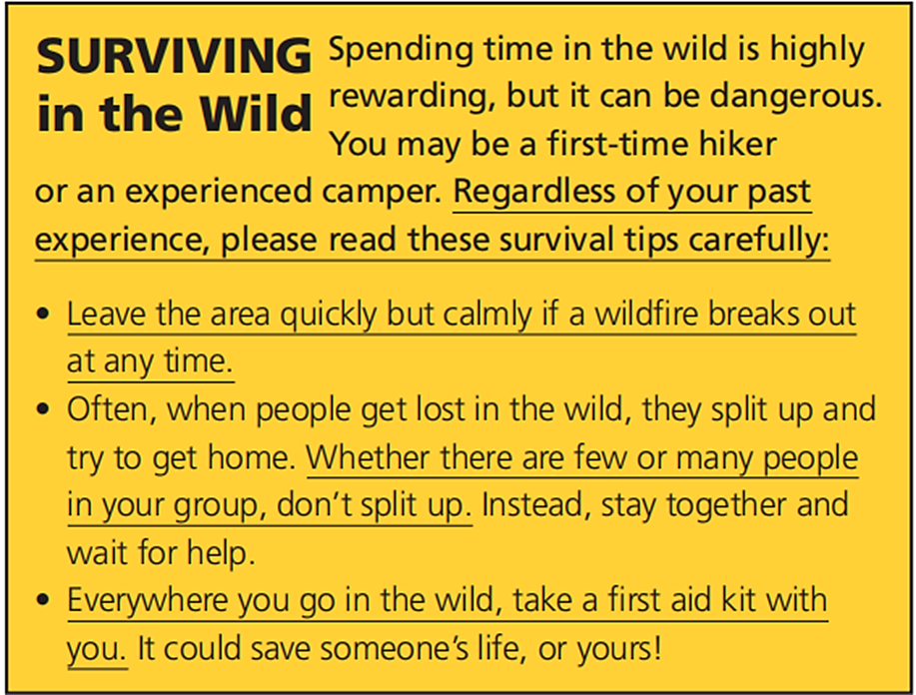
Consolidation
Activity 2
Rewrite the underlined parts using adverbial clauses with -ever and no matter.
Whatever/No matter what past experience you have had, …
Whenever/No matter when a wildfire breaks out, …
However/No matter how many people there are in your group, …
Wherever/No matter where you go in the wild, …

Slide 12

Consolidation
Activity 3
Read and complete the sentences using adverbial clauses with -ever and no matter.
1 _________________________________________
________________ (how), Jane never gave up hope.
2 _________________________________ (where), Jane would invite to donate tissue samples for research purposes.
3 Jane is determined to live a fulfilling life _________
____________________________ (what).
4 _________________________________________
____ (what), Jane is determined to help patients recover from this cancer.
However/No matter how many times she was rushed to the ICU
Wherever/No matter where she went
whatever/ no matter what the future holds
Whatever/No matter what difficulties she might face

Slide 13
Language points – P65
非常有意义
不管，不顾
突然发生；爆发
分开；分裂
急救箱
被诊断出患有……
被告知
被送到重症监护室
在医学实验室参加实习
尽管；不管
过着充实的生活
未来会发生什么
be highly rewarding
regardless of
break out
split up
a first aid kit
be diagnosed with
be informed of/about + n.; that + 从句
be rushed to the ICU
take an internship at a medical lab
in spite of/despite
live/lead a fulfilling life
what the future holds
– split – split; splitting

Slide 14

Facing crisis
What’s the theme of the book The Adventures of Robinson Crusoe? Have you read it before? Can you think of some plots in this book?
SURVIVAL

Slide 15

Facing crisis
Listen to the conversation and choose the ideas NOT conveyed by the speakers.
1 The story of Robinson Crusoe is a very sad survival story.
2 It takes great patience for Robinson Crusoe to survive on the island.
3 Robinson Crusoe is a clever and optimistic man.
4 Robinson Crusoe’s words are good suggestions when we are faced with a crisis.
5 The most important reason for Robinson Crusoe’s survival is his calmness.
Activity 5

Slide 16
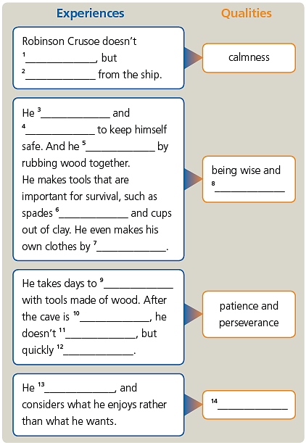
Facing crisis
Activity 6
Listen again and complete the diagram.

Slide 17
Facing crisis
Activity 6
lose his head
Listen again and complete the diagram.
gets necessary things
lives in a cave
builds a fence
makes a fire
knowledgeable
out of wood
sewing animal skins together

Slide 18
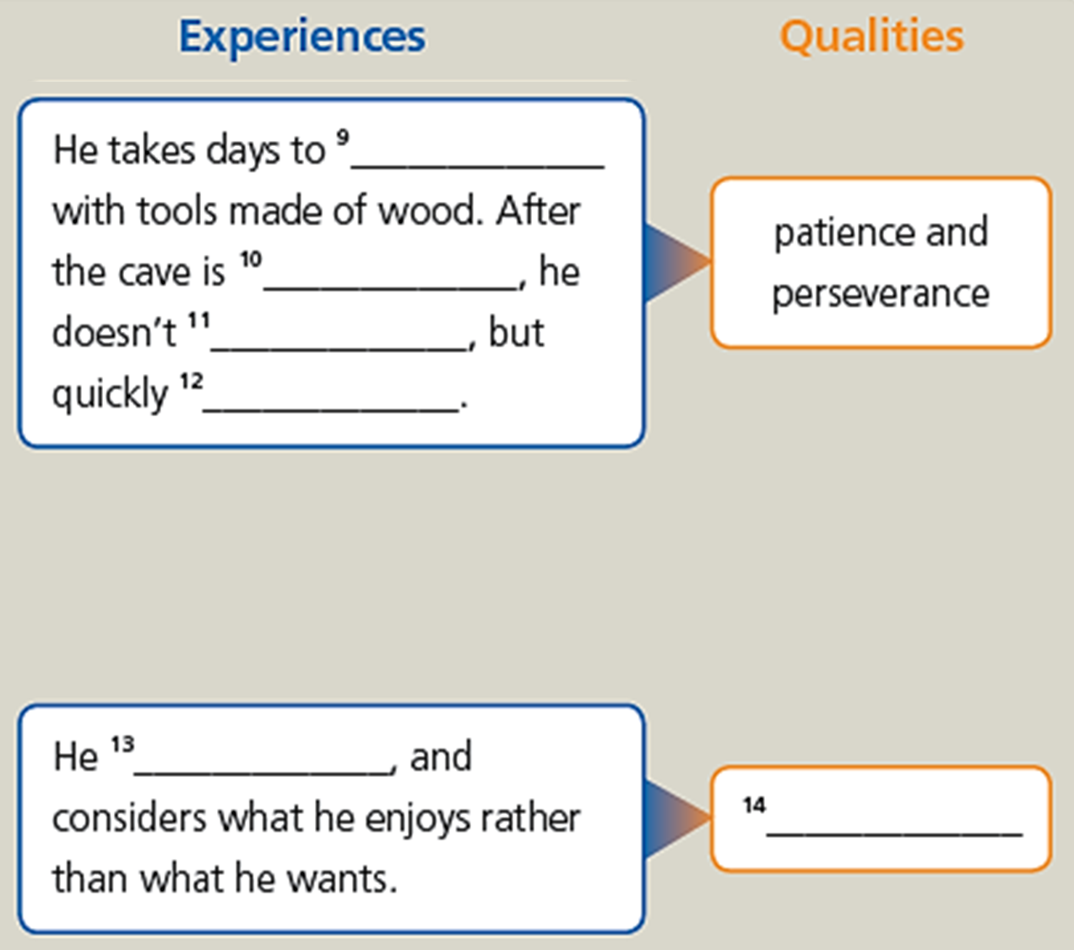
Facing crisis
Activity 6
widen and deepen his cave
Listen again and complete the diagram.
ruined by a landslide/a fall of earth
feel depressed
redoes the work, using wooden posts to make the cave stronger than before
looks more upon the bright side of his condition, and less upon the dark side
positive attitude

Slide 19
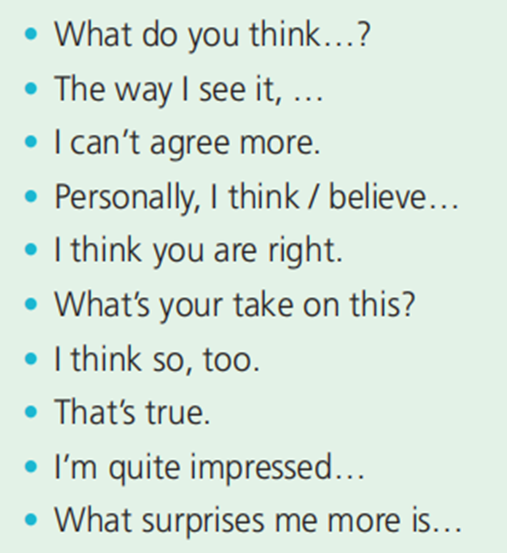
Facing crisis
Activity 7
Asking for opinions
Giving opinions
Agreeing
Complete the boxes with the expressions from the conversation.
What do you think…?
What’s your take on this?
The way I see it, …
Personally, I think/believe…
I’m quite impressed…
What surprises me more is…
I can’t agree more.
I think you are right.
I think so, too.
That’s true.

Slide 20
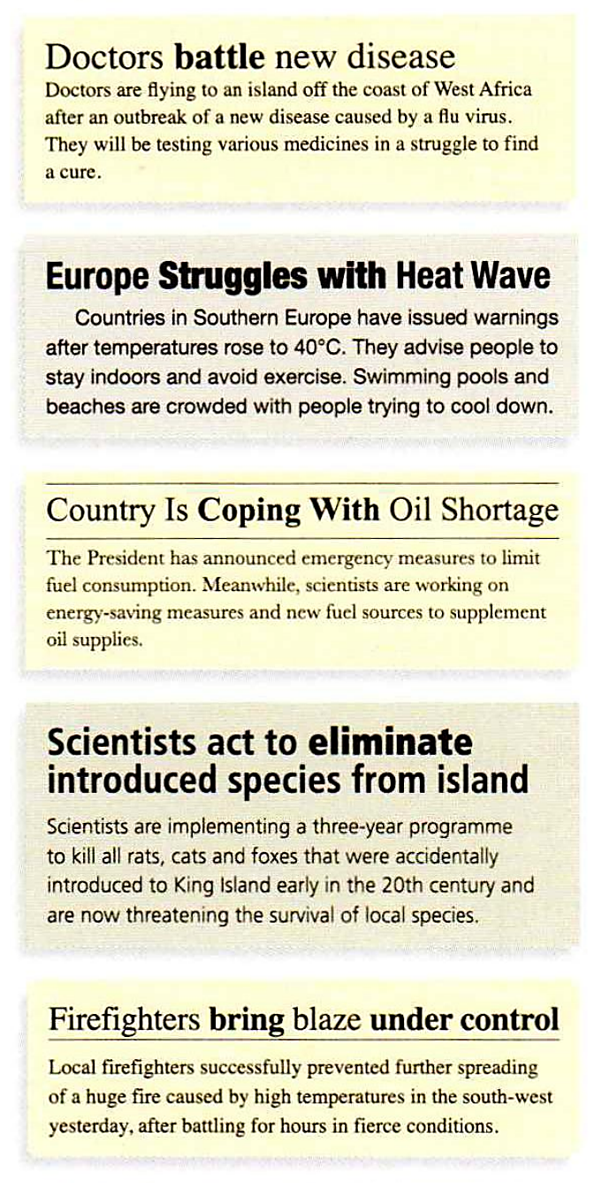
Facing crisis
Activity 9
1 What situations are mentioned in the headlines?
The 1st one tells of an outbreak of a new disease.
The 2nd one reports a heat wave.
The 3rd one tells of an oil shortage.
The 4th one reports the invasion of foreign species on an island.
The 5th one tells of the spreading of a huge fire.

Slide 21

Facing crisis
2 How do people and organisations react to these crises?
1) Doctors are flying there and will be testing various medicines to find a cure.
2) Countries which are hit by a heat wave advise people to stay indoors and avoid exercise. Some people go to swimming pools and beaches to cool themselves down.
3) The president has announced measures to limit fuel consumption and scientists are finding new measures and fuel sources.
4) Scientists are carrying out a three-year programme to eliminate the introduced species.
5) Firefighters brought the huge fire under control after battling for hours.
Activity 9

Slide 22
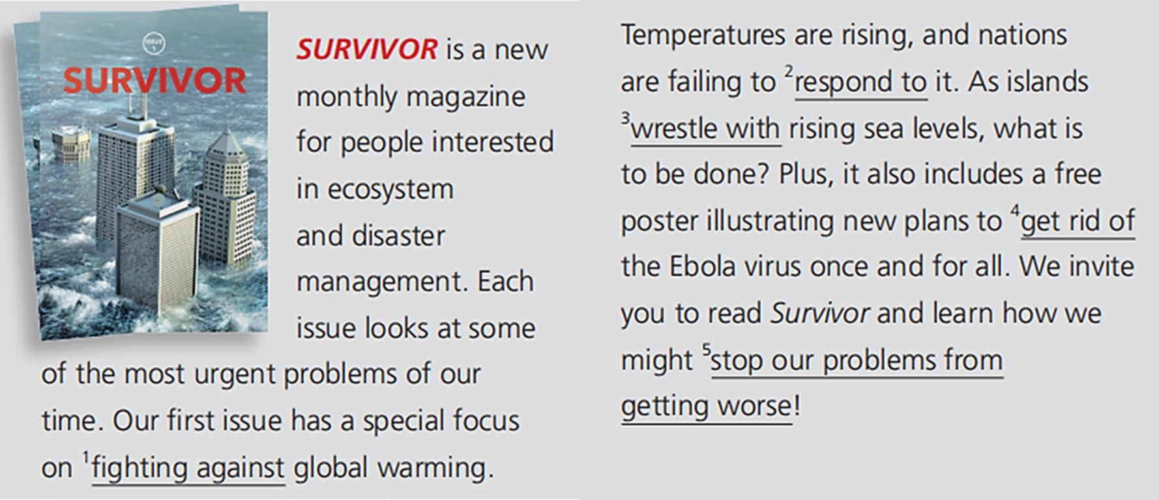
Facing crisis
Read the advertisement and rewrite the underlined expressions with the correct form of words and expressions in Activity 9.
Activity 10
cope with
struggle with
eliminate
bring our problems under control
battling

Slide 23
Language points – P66
对某人来说做某事需要很大的耐心
面临危机
慌张失措；冲动；失去理智
生火
把……相互摩擦
把……缝起来
花了很多天做……
用木头制成的工具
be made of
be made from
It remains one of the most famous tales of survival ever told.
它仍然是有史以来最著名的生存故事之一。
it takes great patience for sb. to do sth.
be faced with a crisis
lose one’s head
make a fire
rub… together
sew… together
take days to do
with tools made of wood
能直接看出原材料
不能直接看出原材料
rubbed; rubbing

Slide 24
Language points – P66-67
Countless readers have been encouraged by Robinson Crusoe’s qualities, which go beyond his survival on a desert island.
无数读者都被鲁滨逊·克鲁索的品质所鼓舞，这超越了他在荒岛上的生存。
在……的海岸线外
一种新型疾病的爆发
热浪
发出警告
建议某人做某事
宣布紧急措施来限制燃料消耗
从事于
off the coast of
an outbreak of a new disease
heat (n.) wave
issue (v.) warnings
advise sb. to do
announce emergency measures to limit fuel consumption
work on

